Slide 1

County of San Diego Probation Department Overview
Citizen Law Enforcement Review Board
December 2023

Slide 2

Probation Department
Mission Statement
Highly skilled professionals promoting safer communities through engagement and connecting individuals to the highest quality of services, while balancing opportunity with accountability.
Vision Statement
Enhancing the safety of our communities through restoration and rehabilitation.

Slide 3
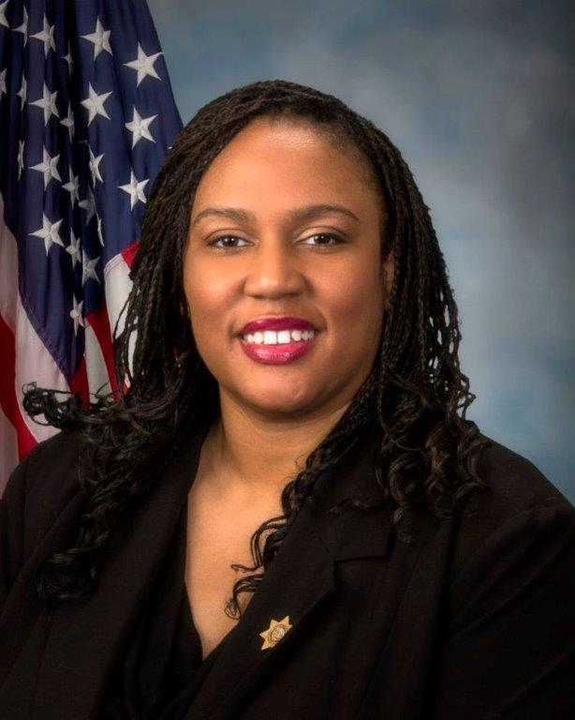
Chief probation officer Tamika Nelson

Slide 4

Who We are as Probation
We are a highly skilled team committed to protecting public safety by coaching clients to restore their lives, families, and communities they live in. We are more than one thousand San Diegans serving our neighbors: Providing services to clients while balancing support and accountability.

Slide 5
PC 830.5
Per PC830.5, Probation’s peace officer power extends to:
Enforcing conditions of probation, mandatory supervision (MS), or Post Release Community Supervision (PRCS)
Preventing the escape of a person detained in Probation’s custody
Transporting clients on formal probation, MS, or PRCS
Violations of any penal provisions of law which are discovered while performing usual authorized duties
Rendering mutual aid to any law enforcement agency

Slide 6





Top Priorities
Balance
Maintaining our uniqueness as Probation and maintaining balance in support and accountability
Engagement
Increasing quality engagement with clients and our community
Services
Delivering quality services to our clients, supported by data and principles of evidence-based approaches
Training
Continuous education for all staff to be innovative, pass on knowledge, and challenge us to grow in our perspectives and our approaches
Stability
Stabilizing our workforce through succession planning and evaluation of efficiencies to maximize our capabilities and capacity
6

Slide 7
Adult Reintegration and Community Supervision Services (ARCSS)
  Pretrial Services
  Investigations
  Reentry Services
  Community Transition Center
  Work Furlough/Residential Reentry Center
  Formal Supervision
  Mandatory Supervision
  Post Release Community Supervision
  Collaborative Courts

Slide 8
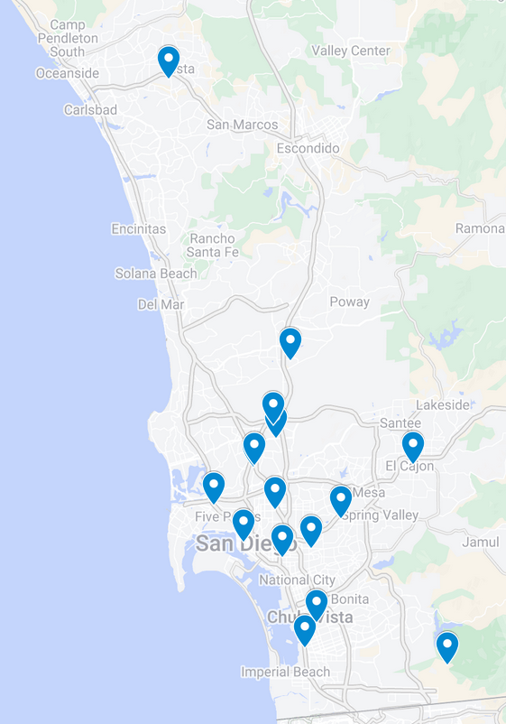
Locations
The Probation Department operates in multiple locations throughout San Diego County:
  8 Community Supervision/Support Offices
  2 Reentry Centers
  1 Training Center
  1 Administrative office
Notes:
SBAY, CV, Vista, El Cajon, Community Support Office, HOJ, SELWC, LGFRC
CTC & WF/RRC

Slide 9
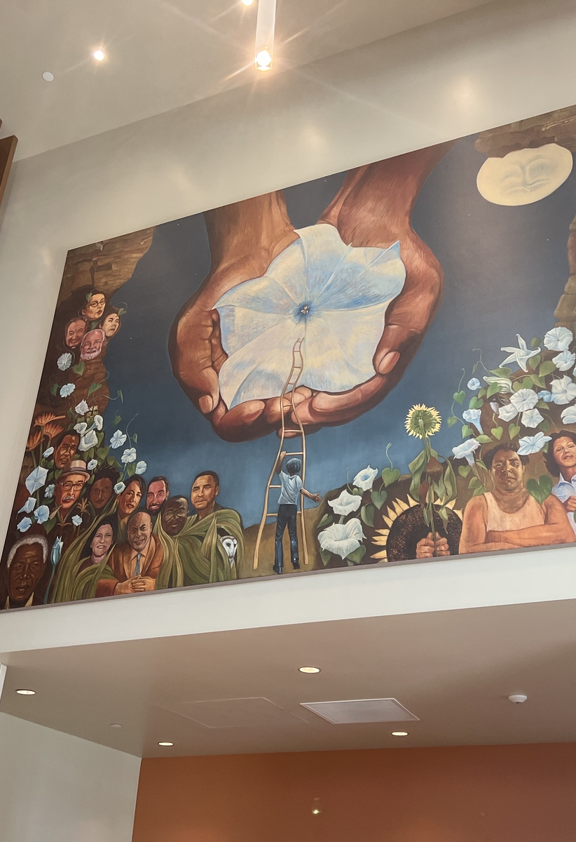
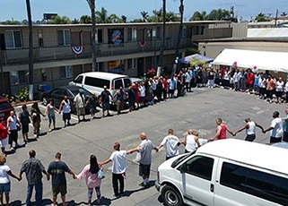
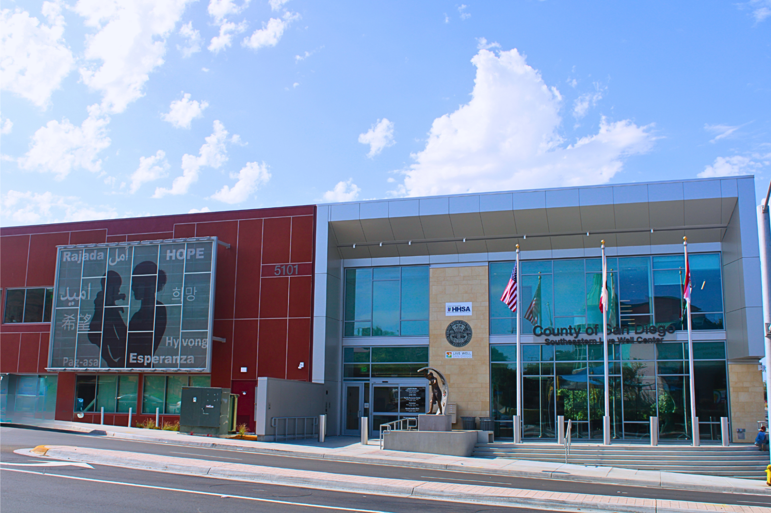
Sites & Programs
Community Supervision
  Co-located with Superior Court: North County, South Bay, East County, and Central (Hall of Justice)
  Community Support Office (North Park)
  Pretrial Services (County Operations Center)
  Lemon Grove Family Resource Center
  Southeastern Live Well Center
  Reentry & Work Furlough
  Community Transition Center
  Work Furlough and Residential Reentry Center
  Programs
  Adult: Cognitive Behavioral Therapy, Transitional Housing, Workforce Development

Slide 10
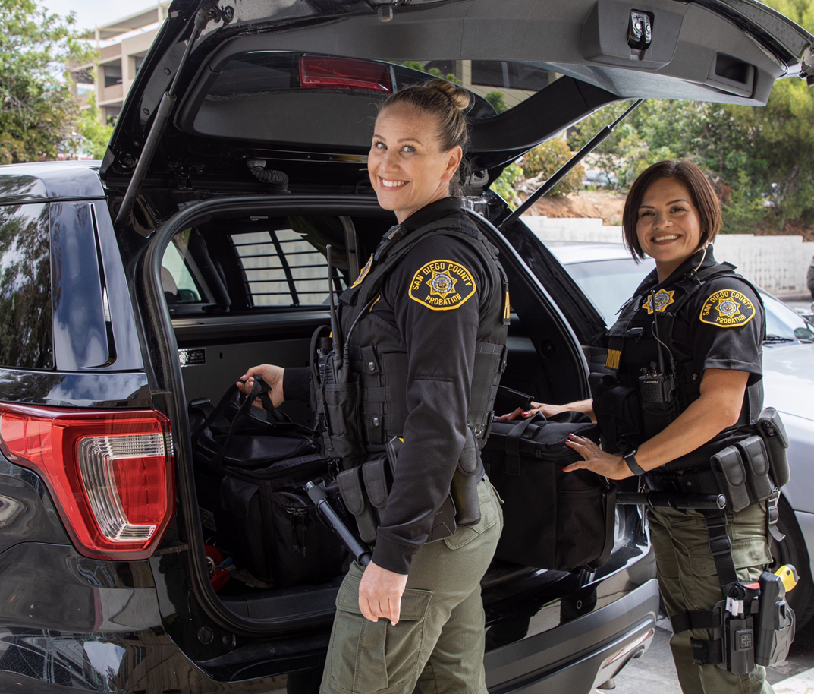
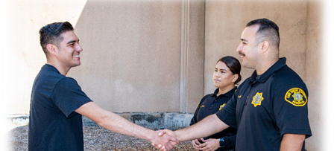
How we serve
Provide judges with vital background information to help identify appropriate sentences and interventions
Utilize Evidence-Based Practices in supervision of clients and making recommendations to the Court
Supervise and engage with clients in custody and in the community
Assist victims through restorative efforts
Connect and collaborate

Slide 11
Who we serve (April 2024):
9202 clients supervised by Probation:
Of the 8538 adult clients on Probation:
  8538 adults
  1656 supervised as part of AB 109, Adult Realignment

Slide 12
Probation Officer’s Role & Responsibility
Conduct
Conduct social history/pre-sentencing investigations to be used in determining sentencing for adults.
Embrace
Embrace evidence-based best practices and restorative justice practices when supervising clients in the community.
Partner
Partner with clients’ case planning teams, providers, and community partners to build upon strengths, address risk, and support needs.
Provide
Provide ongoing case management and linkage utilizing evidence-based interventions and programs.
Serve
Serve as officers of the Court.
Collaborate
Collaborate with community & law enforcement agencies, as well as other stakeholders.
Promote
Promote community safety and assist victims.

Slide 13
Pretrial Monitoring Unit
Maximizing Court Appearances:
A key element of pretrial monitoring is attendance at all mandated appearances. Probation focuses on communication and reminders of all court appearances.
Maximizing Public Safety:
After the Court approves pretrial release based in part on the Sheriff Department’s recommendation, Probation’s role is to remain in regular communication with clients while offering opportunities to address factors contributing to their arrest. Probation does not supervise Pretrial clients.
Maximizing Liberty:
Increase individuals’ opportunities for pretrial release while respecting boundaries and recognizing these individuals have not been convicted of the crime(s) alleged in the pending matter.

Slide 14
Investigations
Pre-Sentencing Investigation and other reports
Initial Risk and Needs Assessments to determine supervision level and appropriate interventions
Recommendations to the Court

Slide 15
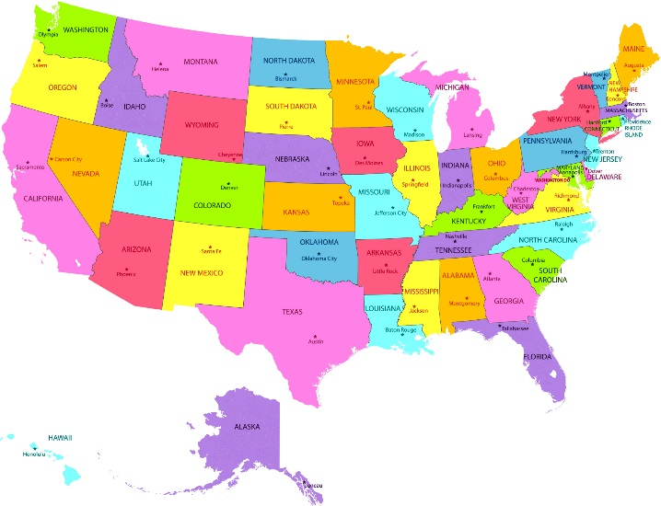
Low Risk Supervision, Jurisdictional Transfer (JT), and Interstate Compact
Low Risk Supervision:
  Clients assessed as low risk or those from a higher supervision level who have been successful and completed all court ordered conditions
  Low Risk Mandated clients seen as needed and may be allowed to report by phone or email
Jurisdictional Transfer Incoming/Outgoing Supervision:
  Review requests for case transfer to San Diego from another California county
  Monitor clients awaiting transfer/acceptance to/by another county in California
Interstate Compact:
  Process transfer requests for clients residing in CA who wish to return to another state
  Review transfer requests on behalf of clients from other states who wish to move to California
  Review requests for consideration of county-to-county Interstate Compact transfers.
Notes:
IC—return w/court approval

Slide 16
Medium Risk Supervision
Clients who have been assessed as being at medium risk and/or who have been successful on a higher level of supervision and completed all court ordered conditions
Clients are seen in the office as needed with visits and/or interventions being more or less frequent depending on a client’s success

Slide 17
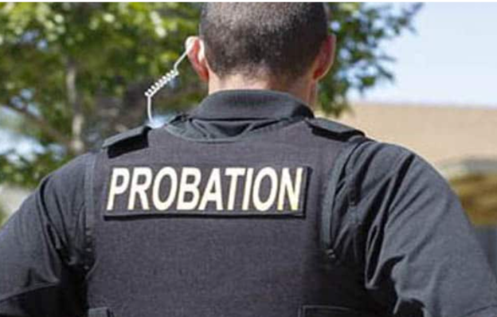
High Risk Supervision
Clients who have been assessed as high risk and/or those whose crime or court ordered conditions warrant closer monitoring by Probation for any period of time.
Intensive supervision w/clients being seen as needed/warranted in the office or field (home, treatment program, etc.)
Specialized Services (SO, DUI, BHSU)

Slide 18

Collaborative Courts
“Team” Approach:
Multidisciplinary team led by a Superior Court Judge and including multiple stakeholders: Probation, members of the District Attorney’s and Public Defender’s or City Attorney’s offices, law enforcement and other partner agencies, and community providers.
“Phased treatment” and routine court appearances balance support and accountability to encourage recovery and stabilization and reduce recidivism.
7 Courts
  Regional Drug Courts (4)
  Behavioral Health Court
  Veterans Treatment Court
  Reentry Court

Slide 19

Reentry Support Unit
The Reentry Support Unit
POs work with clients currently detained in local jails to identify client needs and initiate linkage to services prior to their release, enhancing opportunity for clients’ successful transition upon return to the community.
Interim Housing Contract
Housing Resource Navigation Contract
Adult Drug Program Specialists
Clinicians
Liaisons for the PATH/C3RES program and the Public Defender Holistic Services Unit
Notes:
Case Managing Probation Officer
Leads MDT and completes COMPAS risk and needs assessment
Case plans in tandem with the team and client
Alcohol and Drug Program Specialist
A credentialed specialist will assess, consult, and advocate for the best treatment referral based on current risk and need(s)
Client
Case plan must be client centered such that the client is driven to succeed
Behavioral Health Services Team
Licensed clinician that links mental health and wellness services based on level of care risk and needs assessment

Slide 20
Community Transition Center
Post Release Community Supervision (PRCS) clients are transported from CDCR to the CTC on the day of their release.
Multi-disciplinary team (MDT) comprised of Probation, mental health clinicians (BHST), a nurse case manager, a Medi-Cal application assistor, and treatment staff.
Co-located with the Lighthouse Residential Treatment Program, CTC provides brief transitional housing and early interventions for clients awaiting community services
Since implementation in 2012, over 20,000 clients have been screened and assessed at the facility.
Notes:
Early intervention services
Mental and physical health treatment
SUD treatment and relapse prevention
Cognitive behavioral interventions
Alternative housing or SUD program placement

Slide 21
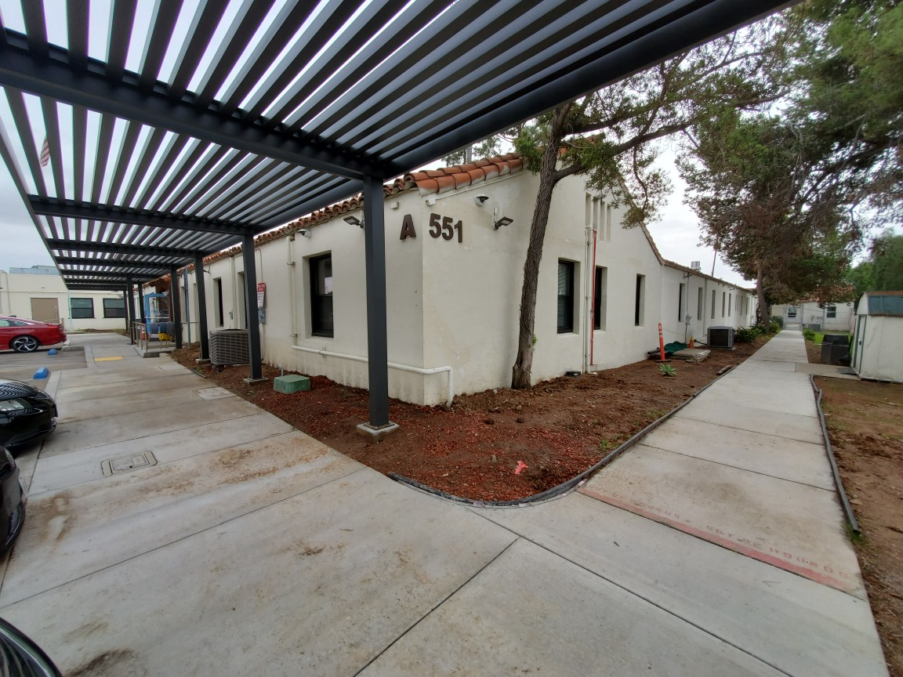
Work Furlough and Residential Re-Entry Center (RRC)
Sentencing alternatives that allow male and female residents to maintain or search for employment while serving a custodial commitment.
Designed to assist clients in their transition into the community by providing employment development, intervention and other self-improvement services.
Housing is community-based and contracted through a private entity.

Slide 22
AB 109
Mandatory Supervision
Local prison sentences in the county jail or “split” sentence
3 “nons” non-violent, non-serious, non-high risk sex offense
Post Release Community Supervision (PRCS)
3 “nons”
Previously supervised by state parole, now under probation supervision
Upon release from prison, PRCS clients are transported to CTC for assessment and linkage

Slide 23
Current Initiatives
Mobile Probation Service Centers
2023: The state awarded Probation a grant of $1.2 million for two MPSCs to improve service delivery to homeless and harder to reach, more vulnerable Probation clients
2025: Completion and implementation of custom built MPSCs
Countywide initiative to safely reduce incarceration and/or prevent justice system involvement
* Behavioral health focused response in lieu of jail for people in behavioral health crisis
* Booking alternatives for low-level misdemeanor drug and public conduct charges.
* Community-based rehabilitative options that support pretrial release.
* Community-based sentencing options for those who pose no threat to public safety.
* Reentry planning and linkage prior to release from custody.
* Evidence-based, person-centered services to reduce recidivism, assist with basic
and immediate needs and improve health, self-sufficiency, and relationships.
Alternatives to Incarceration

Slide 24
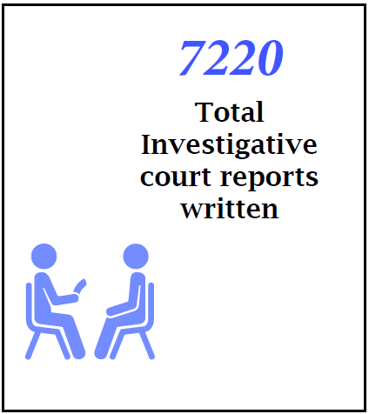
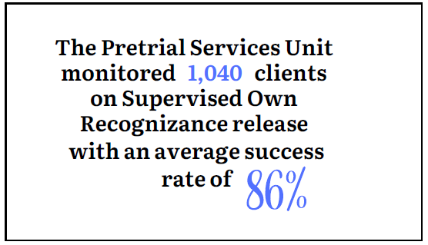
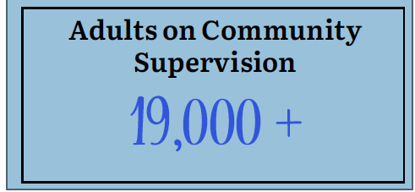
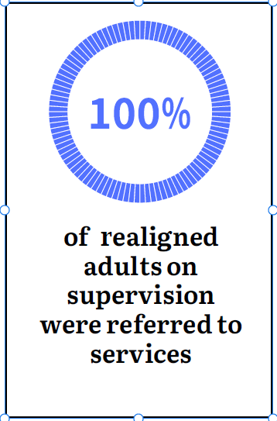
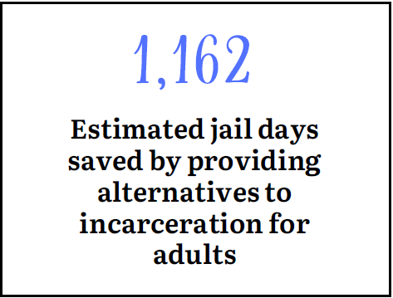
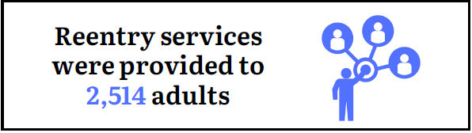

2023 Accomplishments

Slide 25
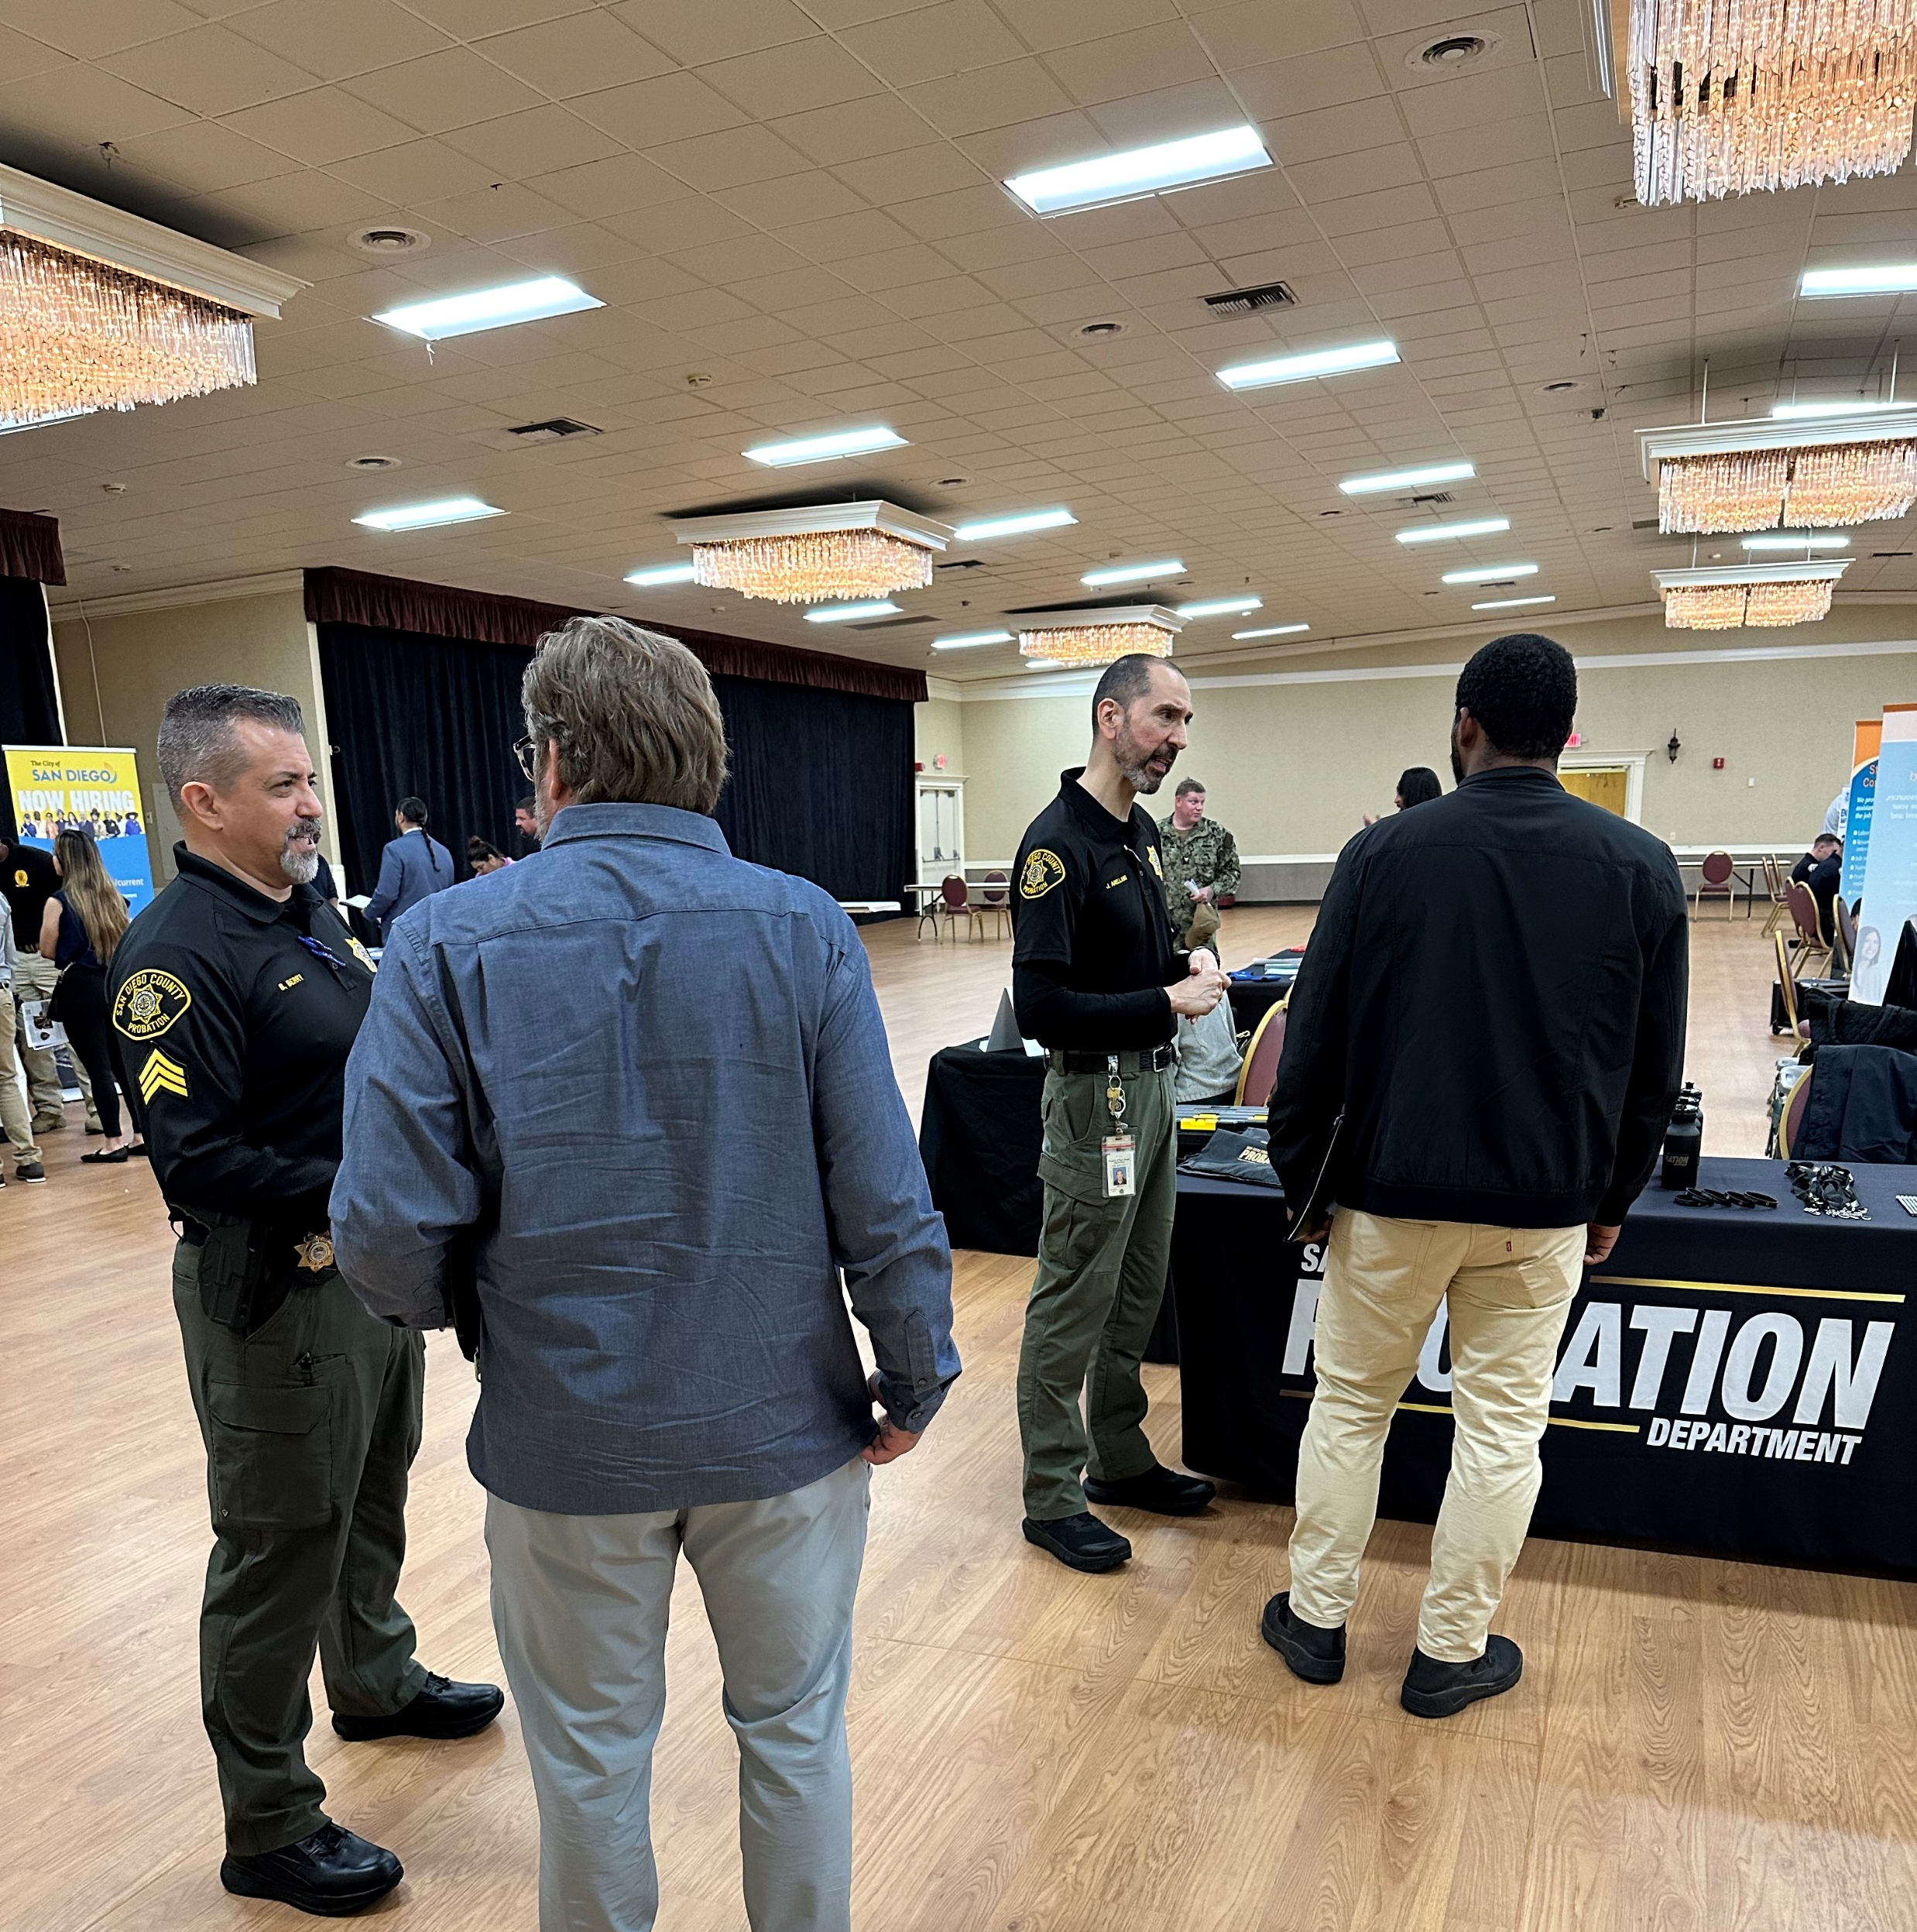

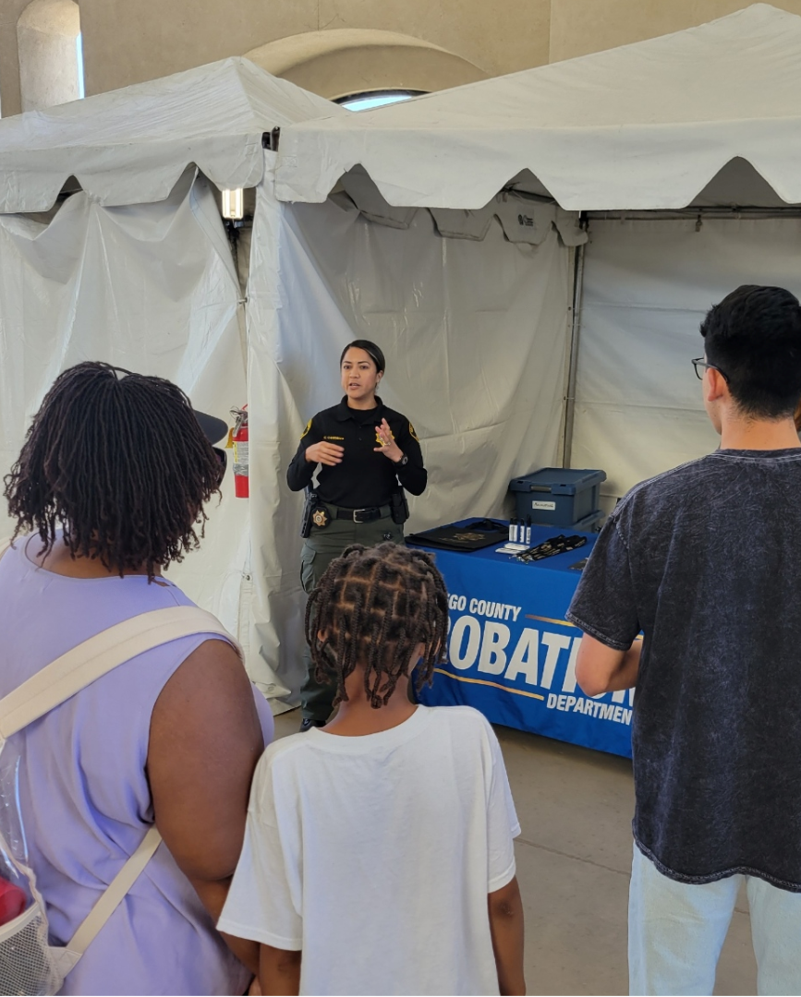

Connecting with our Community

