Slide 1

County of San Diego Probation Department Update
Citizens Law Enforcement Review Board
February 2026

Slide 2
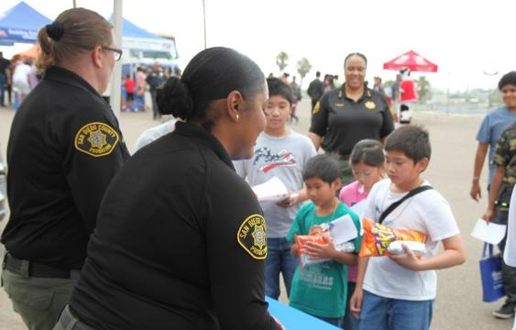
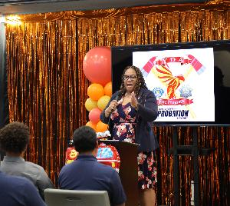
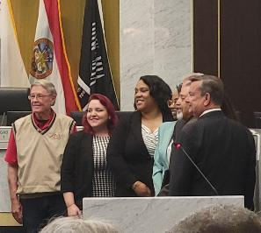
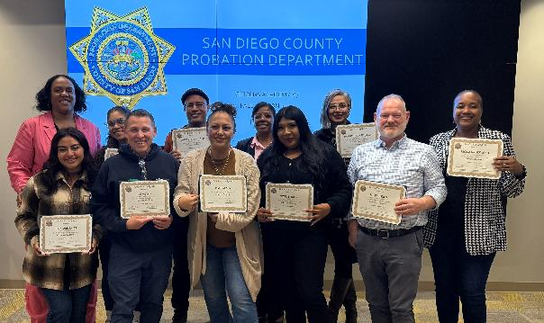
Tamika Nelson Chief Probation Officer
2

Slide 3
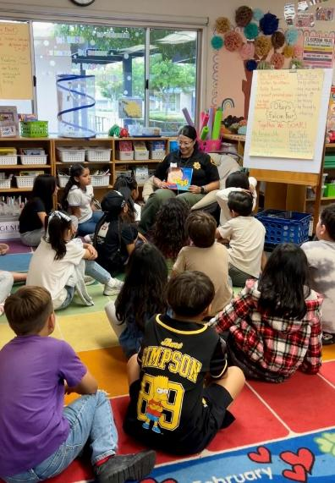
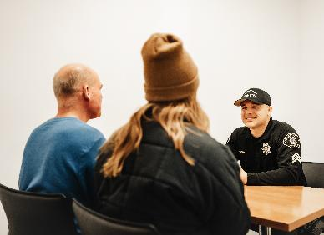
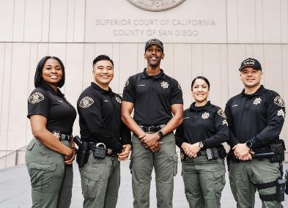
Who We Are
We are a highly skilled team committed to protecting public safety by coaching clients to restore their lives, families, and communities they live in. We are more than one thousand San Diegans serving our neighbors: Providing services to clients while balancing support and accountability.

Slide 4
Top Priorities - BESTS
Balance
Engagement
Services
Training
Safety

Slide 5
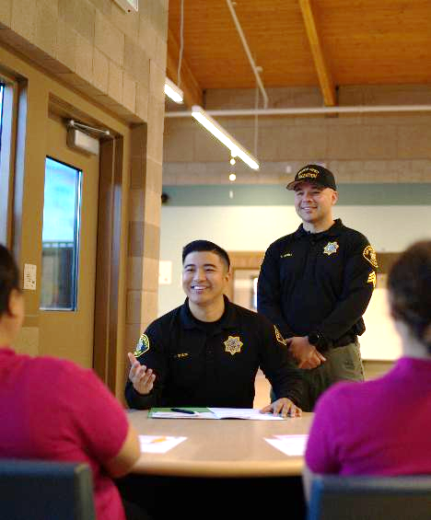
How We Serve
Monitor clients on pretrial as they go through the court process
Provide judges with vital background information to help identify appropriate sentences and interventions
Supervise and engage with clients in custody and in the community
Utilize Evidence-Based Practices
Assist victims through restorative efforts
Connect and collaborate

Slide 6
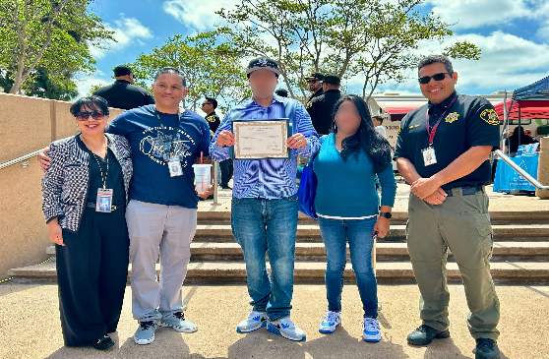
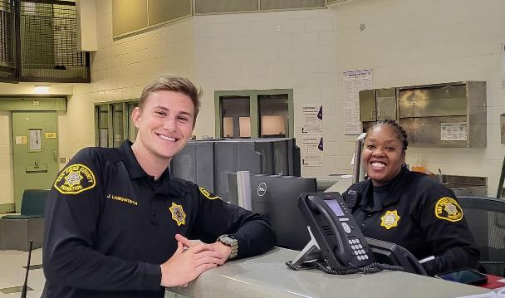
Service Areas
Adult Reintegration and Community Supervision Services
Youth Development and Community Support Services
Professional Standards and Training
Administrative Services
Operational Services

Slide 7
Who We Serve (As of 1/5/26)
Total Client
Population
Realigned
Population
Of the 224 youths in custody: 77 youths are in the Youth Development Academy, as part of SB 823, Juvenile Justice Realignment
Of the 8,092 adult clients on Probation: 1,568 are supervised as part of AB 109, Adult Realignment
1,107 adults on Supervised Own Recognizance
8,772 clients supervised by Probation
224 youths in custody
8,092 adults
680 youths

Slide 8
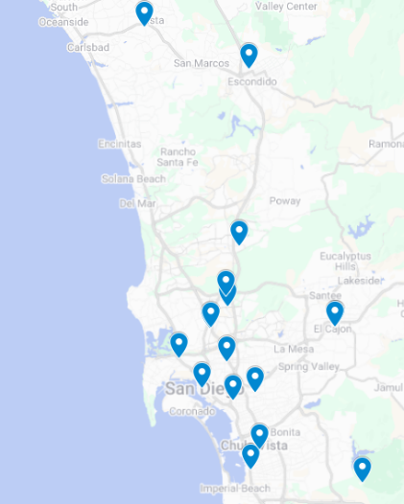
17 locations across San Diego County
9 Community Supervision Offices, 1 office co-located with the Health & Human Services Agency
2 Youth Facilities
2 Reentry Centers
1 Probation Training Center
1 Probation Administration Center
2 Offices co-located with Law Enforcement Agencies

Slide 9
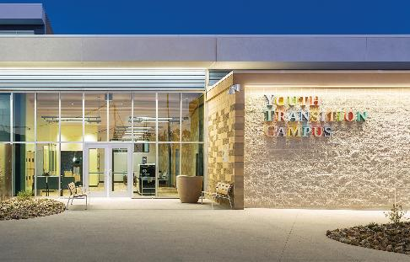
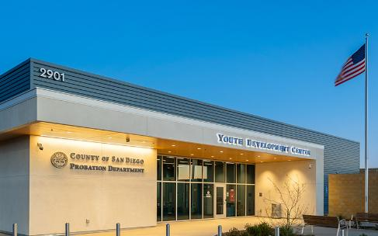
Probation Facilities
Youth Facilities
Youth Transition Campus - Kearny Mesa
East Mesa Juvenile Detention Facility - Otay Mesa
Community Supervision Offices
Co-located with Superior Court: North County, East County, and Central (Hall of Justice)
Community Support Office (North Park)
Youth Development Center (Kearny Mesa)
Pretrial Services (County Operations Center)
Southeastern Live Well Center
Reentry & Work Furlough
Community Transition Center
Work Furlough and Residential Reentry Center

Slide 10
Rehabilitative Services
Cognitive Behavioral Therapy
Housing Assistance
Substance Use Treatment
Canine Assisted Therapy
Mental Health care
CalAIM Benefits
Family Therapy
Job Skills Training
Mentoring
Housing and Resource Navigation
Career Technical Education
Integrated Healthcare

Slide 11
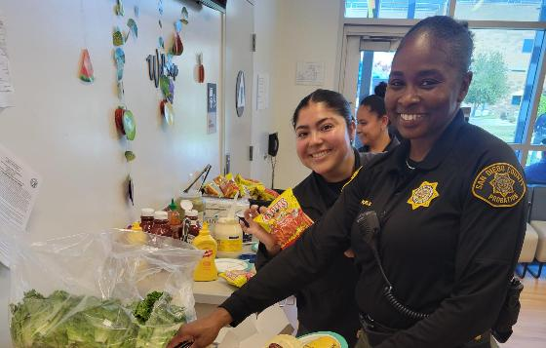
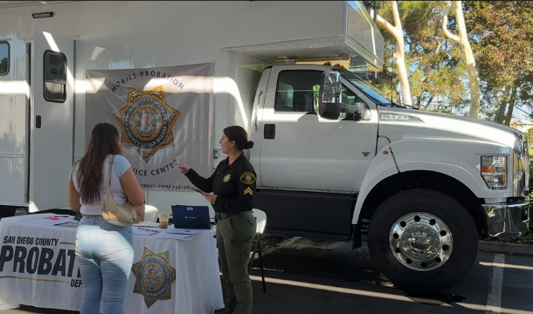
Current Initiatives
Employee Wellness
Mobile Probation Service Centers
Improving Youth Safety in Juvenile Detention Facilities
Less Restrictive Programs
CalAIM Justice-Involved Reentry Initiative

Slide 12
Successful Outcomes
FY 2025-26 Q1

Slide 13
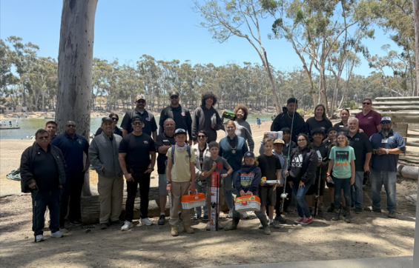
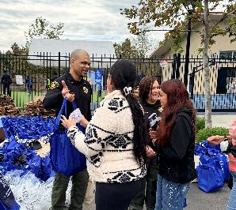
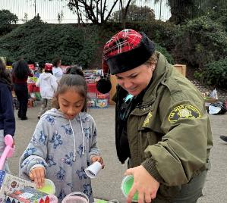
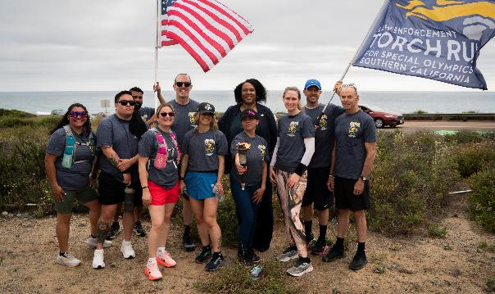
Connecting with Our Community

Slide 14
Notes of Gratitude
Thank you for all the help you have given my family over the last few months! Your job is truly crucial in this process for these youngsters and their support team.
– Parent of a youth client
I was going through a hard time in my life and you helped me stay motivated and moving forward. You had my back and I can’t thank you enough.
– Adult client
My mom would be so proud of me for doing this.
– Youth client in the facilities
The Executive Board Q&A was much appreciated. It showed the Department's commitment to transparency.
– Citizens Academy participant
This kind of human contact that changes people’s views of a profession or group is so very important and would not have been possible without the Probation Department’s participation yesterday.
– Local school
I'm grateful that instead of sending me to jail, you gave me chance after chance in rehab, until it finally stuck.
– Adult client
14

Slide 15
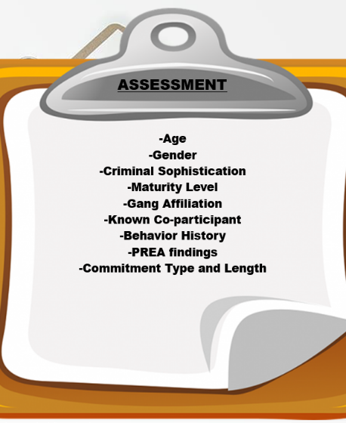
Population Management
Housing assignments are reviewed regularly and adjusted as needed through ongoing monitoring, multidisciplinary and incident reviews, as well as staff observations.

Slide 16
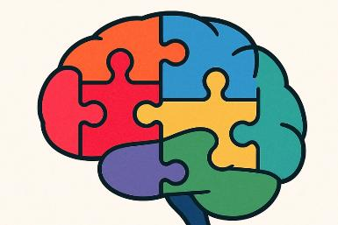
NEURODIVERGENT TRAININGS
Trauma Informed Care
Adolescent Brain Development
Special Education
Mandt: Juvenile Justice Relational/Conceptual
Autism: A Guide for Law Enforcement
Stigma and Bias
Interventions and Resources
Effective Communication

Slide 17
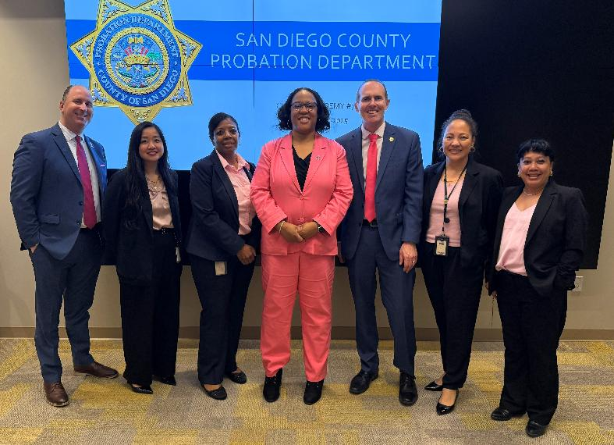
Thank you!
858-514-3148
Tamika.Nelson@sdcounty.ca.gov

