Slide 1

Citizens’ Law Enforcement Review Board ​(CLERB)
Investigations & Investigator Training

Slide 2
Investigation Lifecycle
From Complaint to Final Notice
Intake & Lodging
Review Jurisdiction & Priority
Obtaining Records
Investigation
Report & Recommended Findings
Board Review
Final Notice

Slide 3
Intake Process
Complaints can come by mail, phone, online, or in person
Logged in a case management system
Jurisdiction is confirmed
Referrals
Lodged vs. Filed
Procedurally Closed Cases
Department notifications for specified incidents

Slide 4
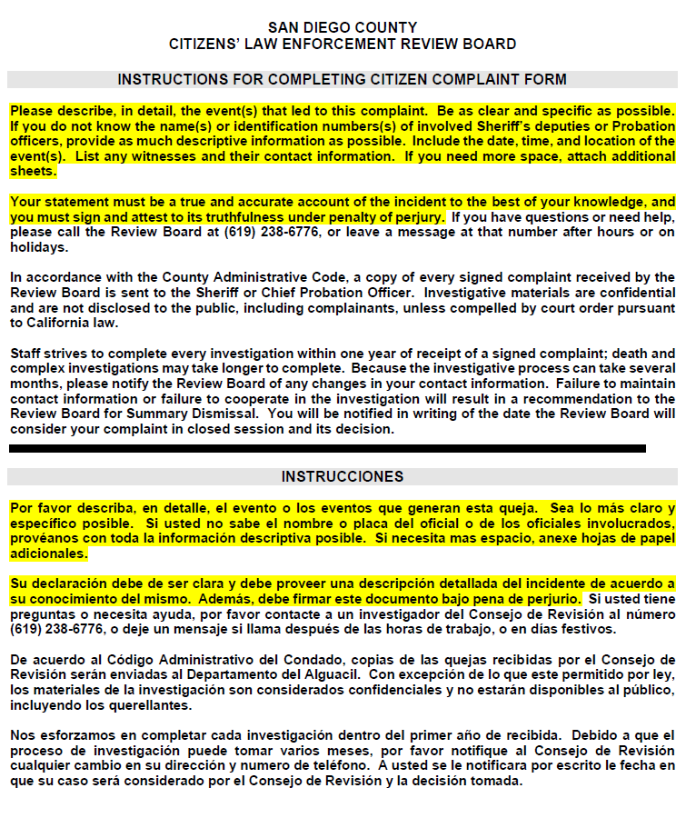
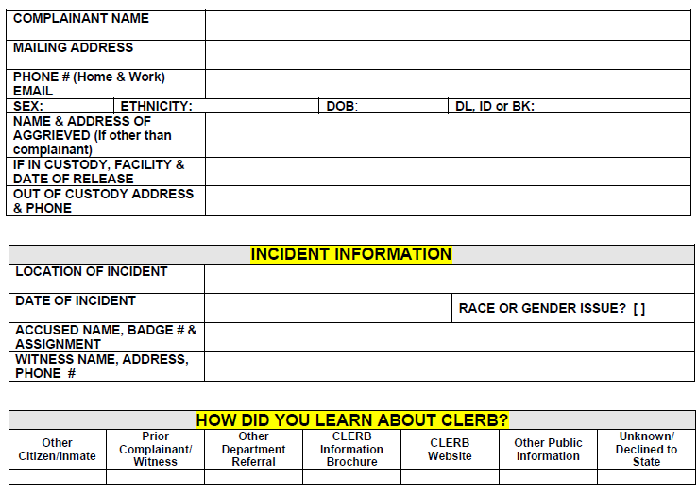
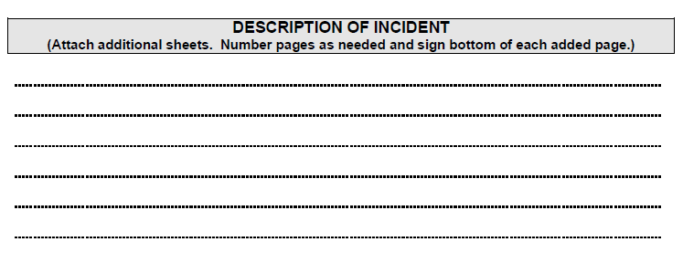

Slide 5
Obtaining Case Records
Requests for Documents
Document Request & Subpoenas
Tracking and Storage
CLERB Rules and Regulations
Section 6: Cooperation and Coordination
Section 7: Subpoenas and Oaths

Slide 6
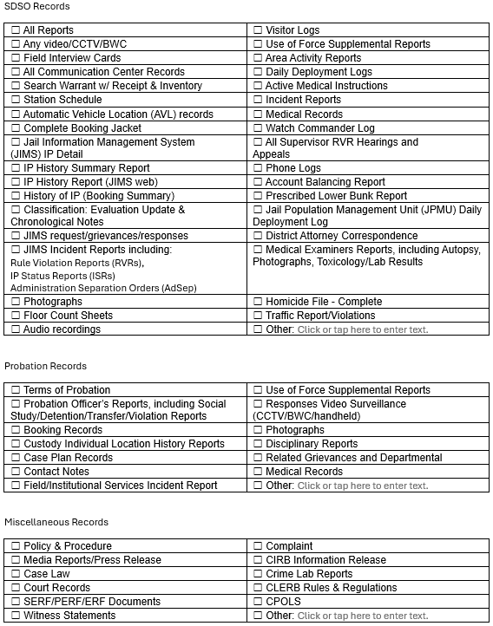
Case Records
Types of Records Received
Complaint Form/Attachments
SDSO/Probation Reports
Dispatch Records
BWC/CCTV Footage
Audio Recorded Interviews
Medical Records
Legal Records

Slide 7

Investigation
Notifications
Review of Evidence
Interviews
Credibility Assessment
Policy and Law Review
Case Discussions
Preparation of Investigative Reports
Redacted Forms
Policy Recommendations

Slide 8
Closed Session Review
Post Board Meeting
Closed Session Review
Board reviews investigative reports and recommended findings
Deliberation, Motions, and Vote
Final Report and Final Notices
Final Notice vs. Adverse Action Notice
Civil Service

Slide 9
Investigator Training
Minimum Qualifications
Five Years of Professional-Level Investigative Experience
Knowledge Areas – Constitutional, Criminal, Civil
Desirable Skills for Investigations
Extensive Expertise in Investigations

Slide 10
Investigator Training
Training Topics
CLERB authority & mission. Ride-alongs & detention facility tours.
Intake process & Case Management System training. P&P review. Shadowing CLERB investigators.
Guided casework under CDI/SSI supervision. Case discussions & feedback.
Collaboration
Conflict of Interest Guidelines

Slide 11
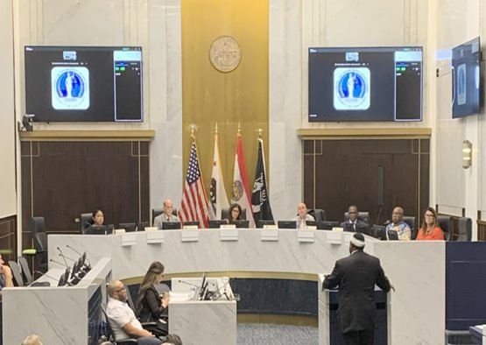
THANK YOU
Please visit the San Diego County Citizens Law Enforcement Review Board Website, www.sandiegocounty.gov/clerb, for additional resources.

