Slide 1



Detention Investigations Unit
Contraband and Narcotics Interdiction Team
Lieutenant Aaron Meleen

Slide 2


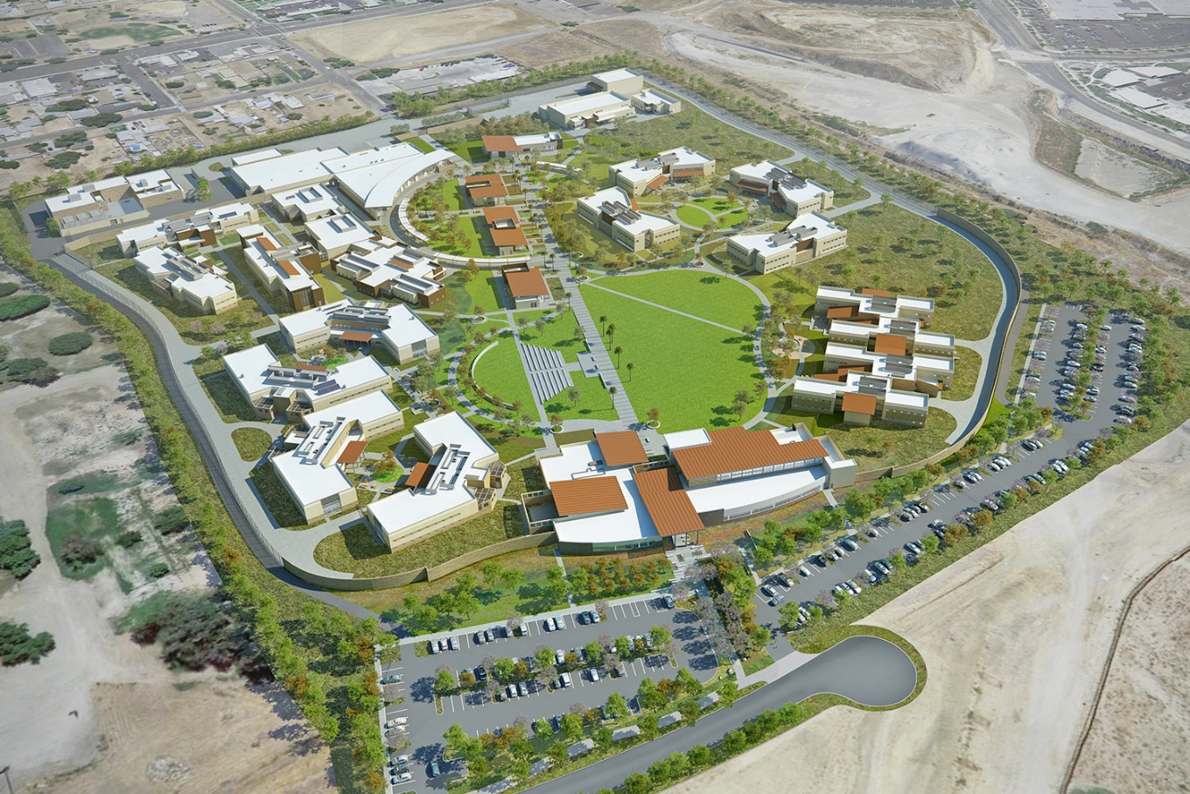
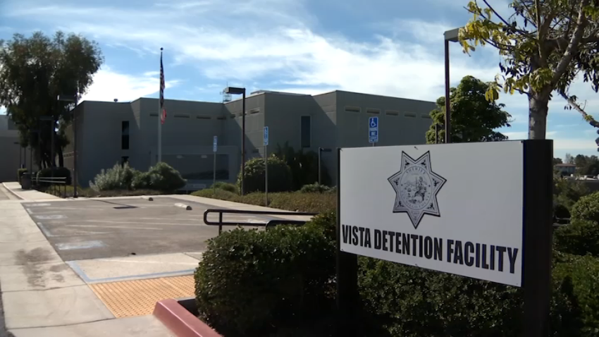
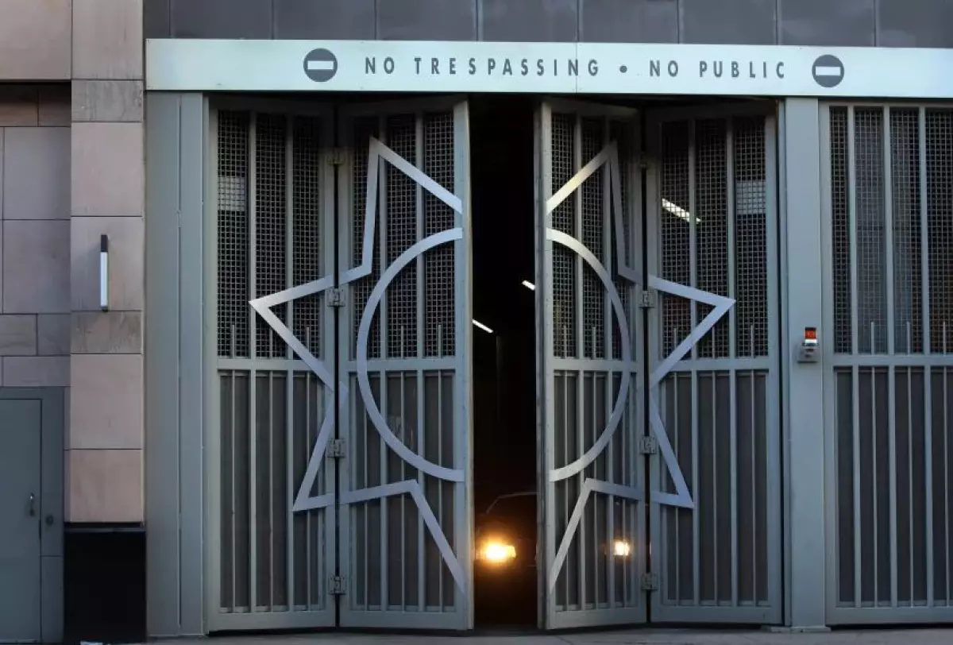
CNIT Facilities
Las Colinas Detention
and Reentry Facility
Sgt. Nadine Boatright
Vista Detention Facility
Sgt. Ryan Lovelace
San Diego Central Jail
Sgt. Jessica Applebaum

Slide 3
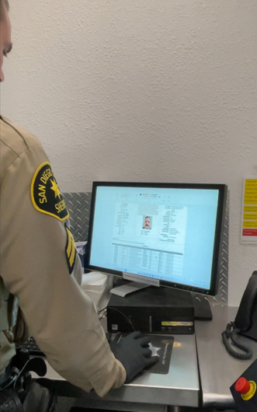
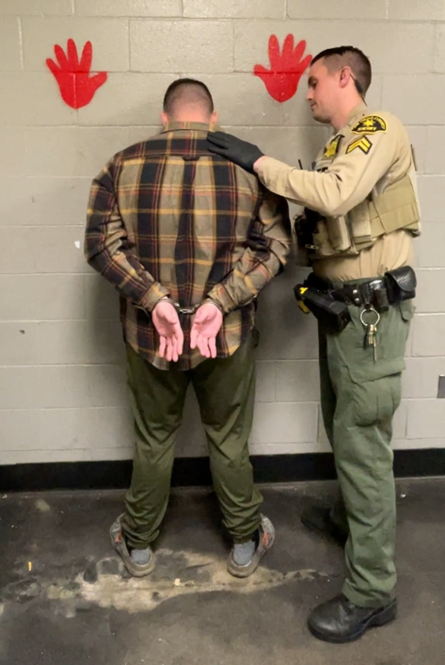
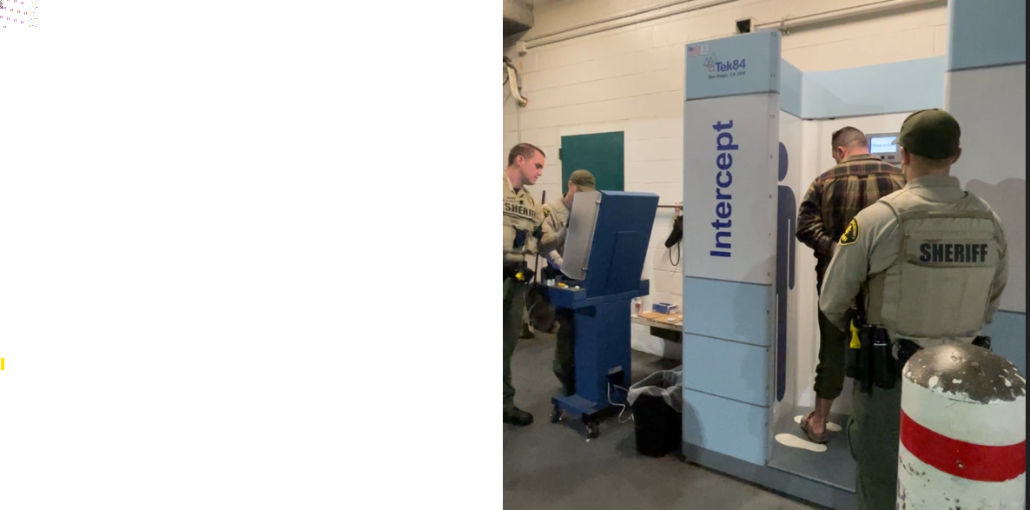
CNIT | Process
Research History
Pat down
Body Scan

Slide 4
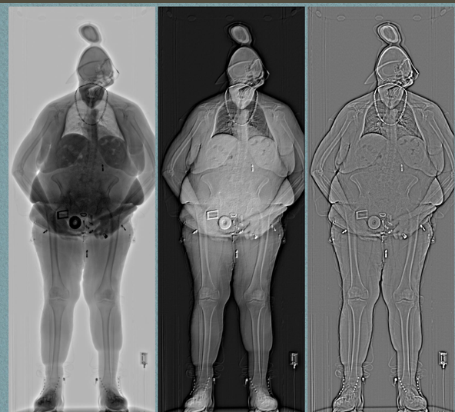
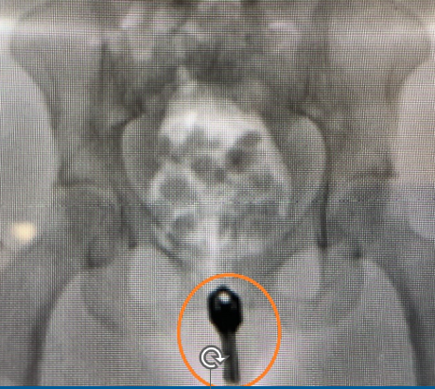
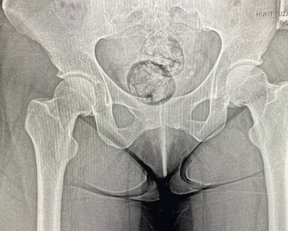
CNIT | Process
X-Ray
Body Scan

Slide 5

CNIT
CNIT Total Number of Bookings | Per Facility
2024 & 2025
CNIT Overall IP’s Sent to Secondary | Per Facility
2024 & 2025
Facility
2024
2025
Total
Facility
2024
2025
Total
SDCJ
28,489
30,271
58,760
SDCJ
4,267
5,267
9,534
LCDRF
8,319
9,123
17,442
LCDRF
1,623
2,378
4,001
VDF
13,660
13,279
26,939
VDF
1,004
1,617
2,621
Grand Total
50,468
52,673
103,141
Grand Total
6,894
9,262
16,156
Rejected
190
309

Slide 6
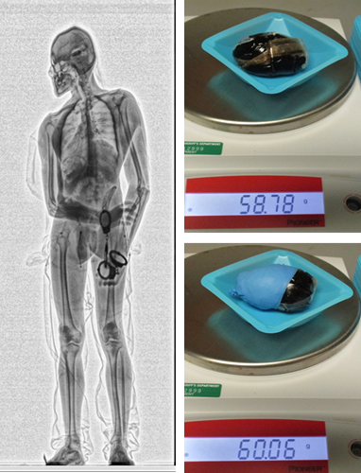
CNIT | Enhanced Screening Process
Total Secondary Screenings: 2024: 6,894 2025: 9,262
2024
2025
Contraband Seized
(at any point during the process)
756
736
Contraband Identified
2024
2025
Pat-down
479
464
Scanner
111
99
Strip Search
100
98
X-Ray
31
14

Slide 7
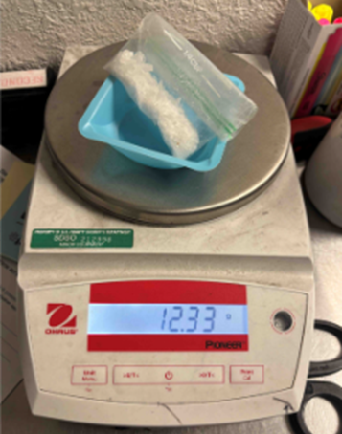
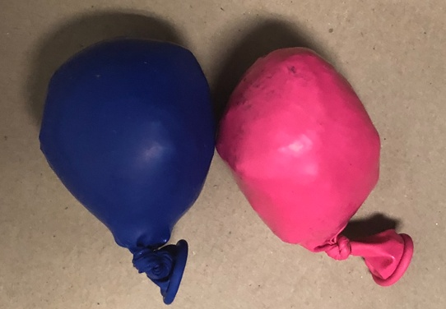
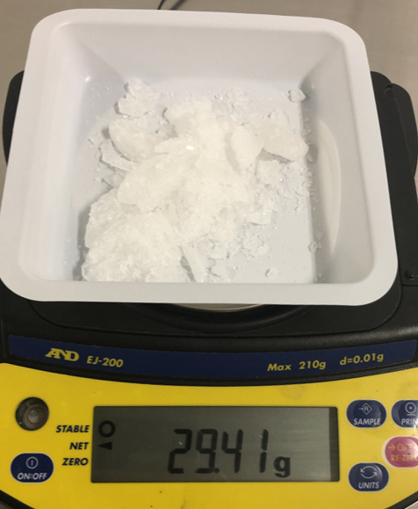
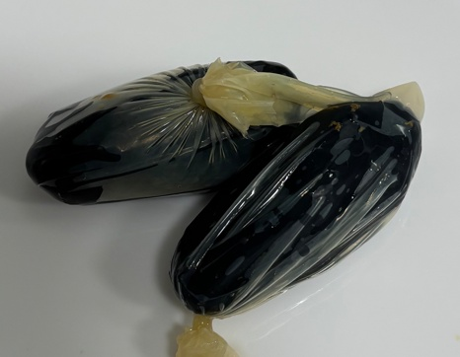
CNIT | Seized Contraband
Overall Secondary Screenings with Contraband Seizures
2024 & 2025

Slide 8
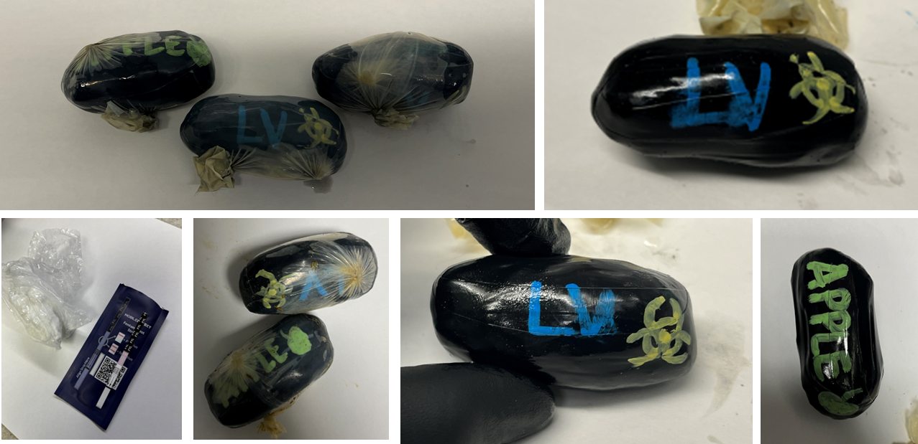
CNIT – SEIZURE HIGHLIGHTS
CNIT Deputy identified anomalies during a Body Scan.
Seven packages were seized containing a total of 188.06 grams of Fentanyl

Slide 9
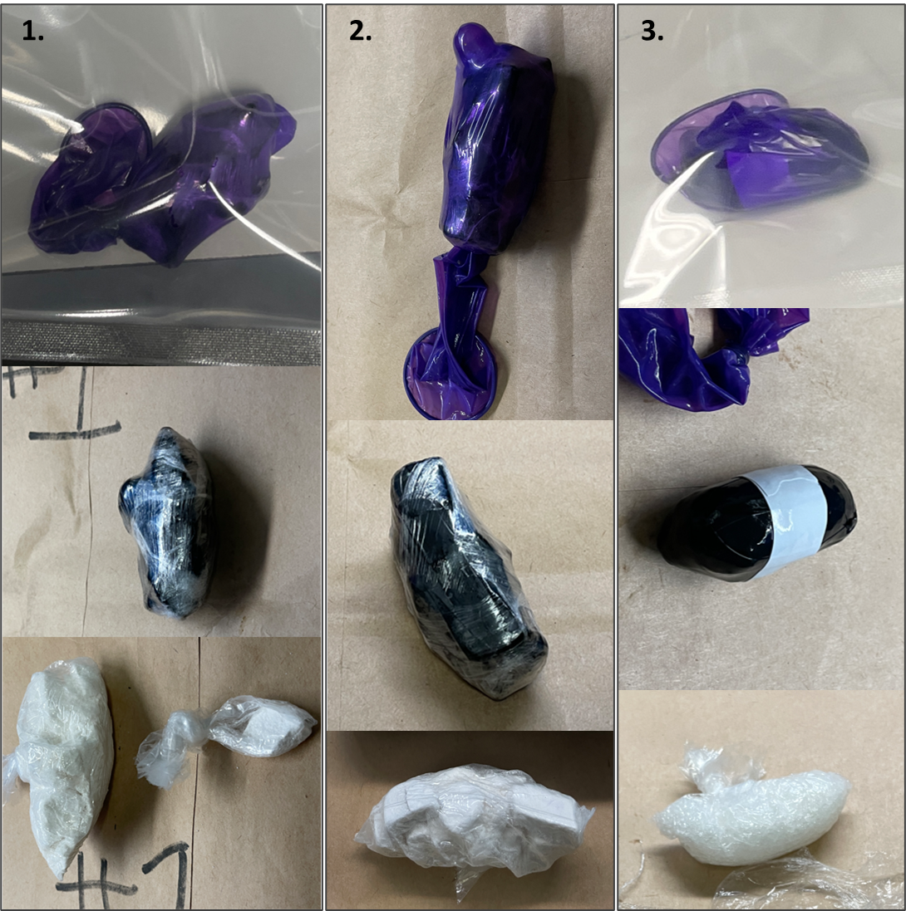
CNIT – SEIZURE HIGHLIGHTS
CNIT Deputy identified anomalies during an X-ray.
Three packages were seized containing a total of 54.15 grams of Fentanyl and 15.05 grams of Methamphetamine

Slide 10
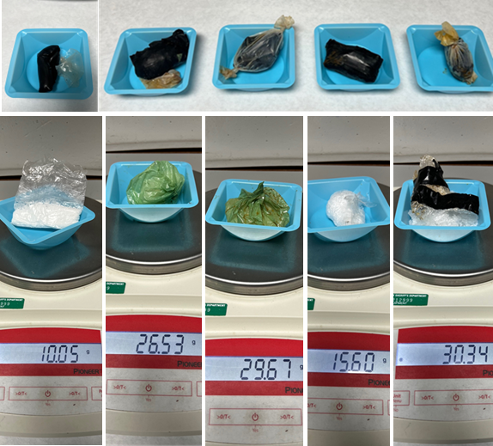
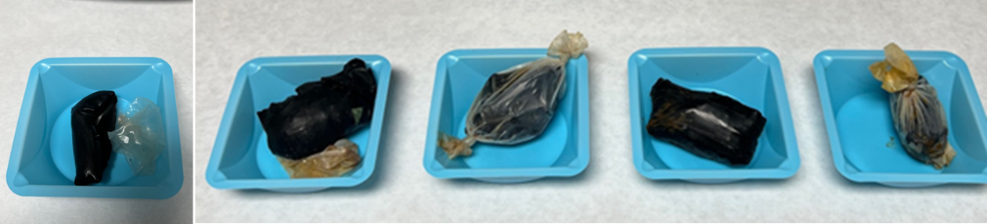
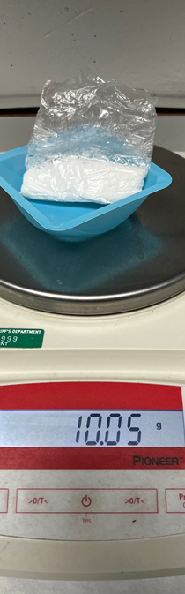
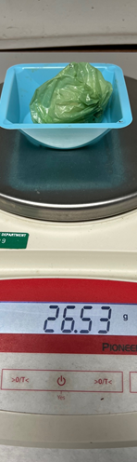
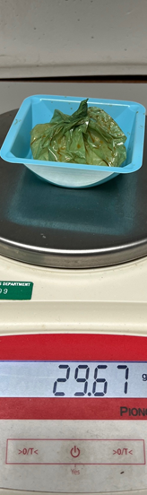
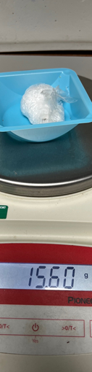
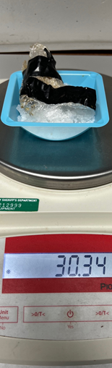
CNIT – SEIZURE HIGHLIGHTS
CNIT Deputy conducted a body scan on a subject and discovered an anomaly in the lower pelvic region. Deputies seized four bindles containing a total of 102.14 grams of Methamphetamine and a bundle containing 10.05 grams of Fentanyl

Slide 11
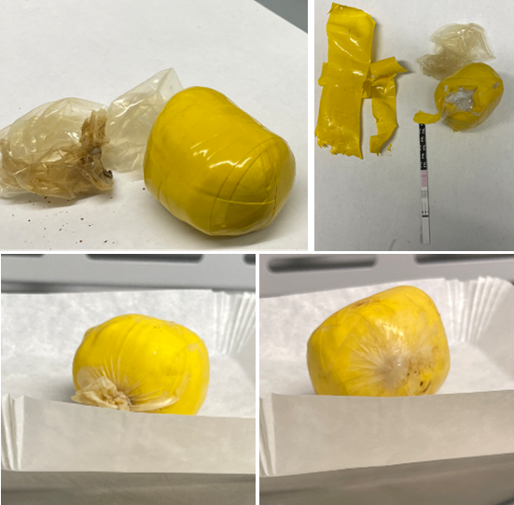
CNIT – SEIZURE HIGHLIGHTS
CNIT Deputy identified anomalies during an X-ray. The subject was found in possession of two packages. The packages seized contained a total of 72.18 grams of Fentanyl

Slide 12
Any Questions?

