Slide 1

Independent Study of In-Custody Deaths
in San Diego County Jails
Prepared for CLERB
by
The Mountain-Whisper-Light: Statistics & Data Science

Slide 2

Who did this study?
Nayak L. Polissar, PhD, President & Senior Statistician
Cheryl Brown Hill, J.D., Attorney
Nirnaya Miljacic, MS, PhD, Statistician
Patricia A. Way, Ph.D., Justice Educator
Michele Deitch, J.D., M.Sc, Director of the Prison and Jail Innovation Lab
The opinions and findings in this presentation are those of the TMWL team
and do not necessarily reflect the opinion of CLERB or SDSO

Slide 3

Public concern, some history
2013: Investigative series in the San Diego CityBeat by Davis & Maas, public concern raised
2017: National Commission on Correctional Health Care Technical Assistance report for SDSO
2018: Report on jail suicides and suicide prevention policies, by Disability Rights California
2018: Report on Suicide Prevention Practices within the San Diego County Jail System, by L. Hayes
2019: 6 months of investigative reporting by the San Diego Union-Tribune
2022: California State Audit Report:
There may be systematic issues related to policies and procedures
2024: San Diego Union-Tribune article:
more then $75 million in jury awards/settlements since 2019

Slide 4
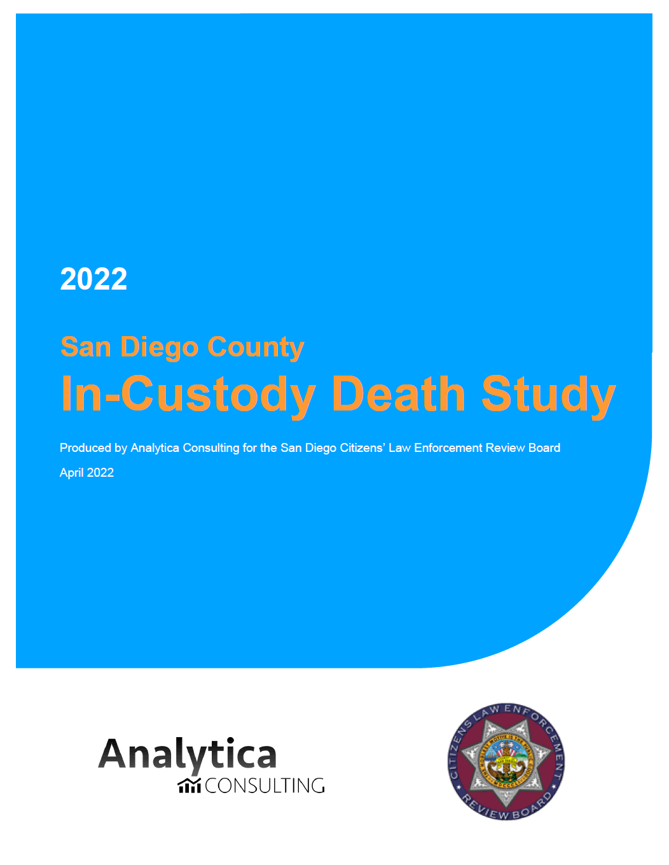
The previous study (2022)
“San Diego County In-Custody Death Study”, by Analytica Consulting
San Diego County vs other CA counties
In-custody deaths vs deaths among all residents
In-custody racial makeup extrapolated from arrest data
Some Findings:
The discord between in-custody deaths and all-residents deaths is highest in San Diego County
In San Diego, incarcerated White population dies more often than its expected share
In nearly all CA counties, suicides are more likely in-custody than among all-residents
These are good exploratory findings

Slide 5
Why this study?
To detect risk factors for dying in the San Diego County detention facilities
For those who died in custody, we sought to understand who they were and how and when they died
Whether any institutional factors may have played a role in the risks/prevention of in-custody deaths
No comparison to other counties and jails
Use of actual numbers only, no approximations

Slide 6
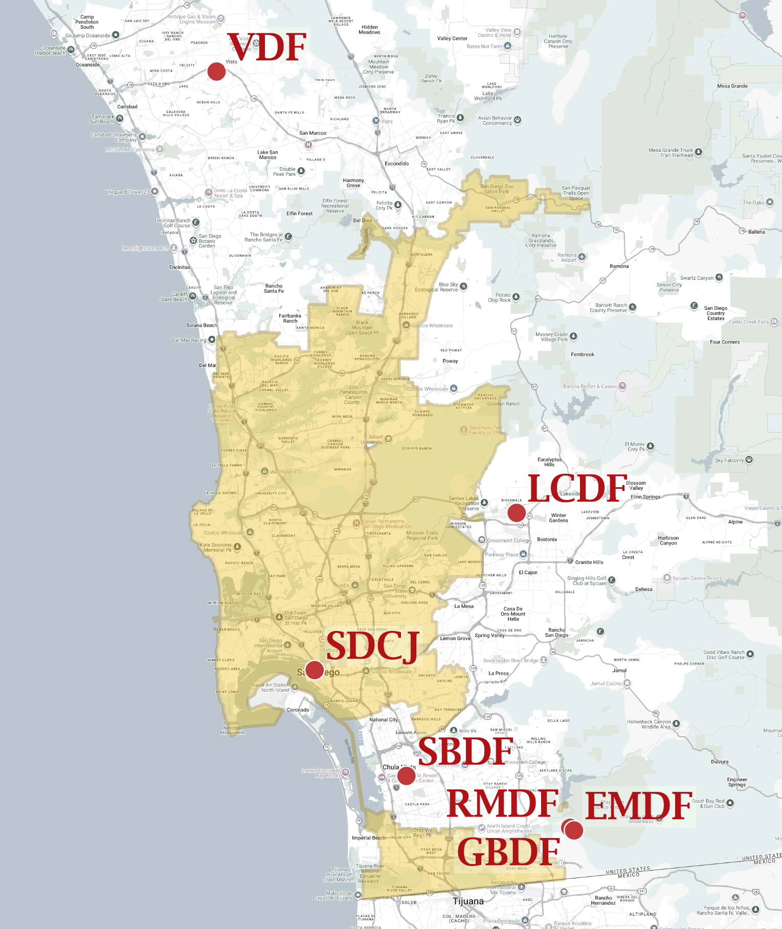
Why this study?
To detect risk factors for dying in the San Diego County detention facilities
For those who died in custody, we sought to understand who they were and how and when they died
Whether any institutional factors may have played a role in the risks/prevention of in-custody deaths
No comparison to other counties and jails
Use of actual numbers only, no approximations
What can be contrasted?
Differences between San Diego detention facilities
Differences over time
Differences between those who died and those who did not die in jail

Slide 7
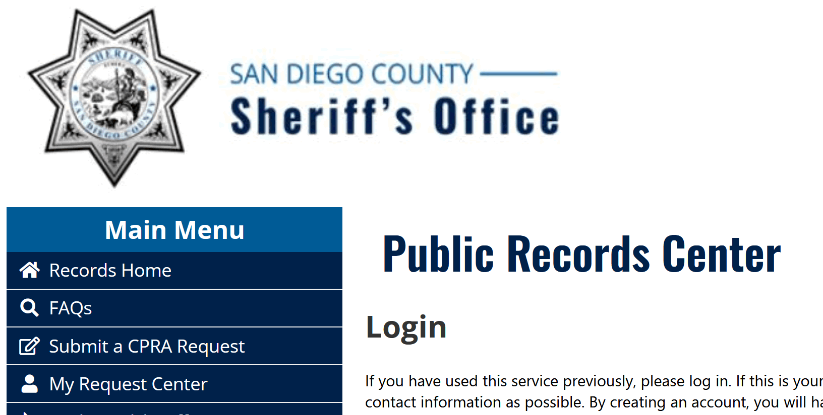
Methodology – Obtaining the Data
California Public Records Act (CPRA)
SDSO’s Public Records Center: initial CRPA requests then multiple
follow-up question and requests
Follow-up questions via CLERB’s liaison to the Sheriff’s Office
CPRA requests via NextRequest countywide portal
Board of State and Community Corrections/Corrections Standard Authority database
A direct letter to Sheriff Kelly Martinez, asking for cooperation
Virtual meeting with SDSO’s data team, CLERB’s Contracting Officer Representative (COR), and TMWL
Special CPRA counsel drafted a rebuttal letter and helped fine-tune additional CPRA requests
to optimize SDSO cooperation

Slide 8
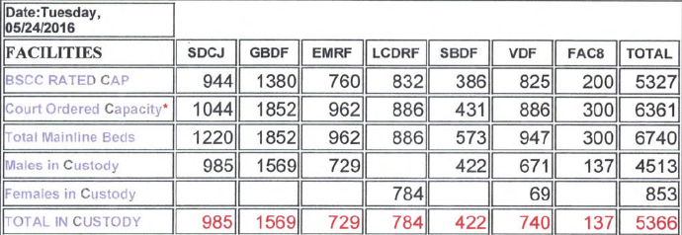
Methodology – Obtaining the Data
In the end, only limited data was obtained
SDSO provided no necessary individual level information for all incarcerated people
On individuals who did not die, we know hardly more than:
  their total daily counts, per facility
  the dates of their social visits, per facility

Slide 9
Methodology – Obtaining the Data
In the end, only limited data was obtained
SDSO provided no necessary individual level information for all incarcerated people
On individuals who did not die, we know hardly more than:
  their total daily counts, per facility
  the dates of their social visits, per facility
Methodology – Statistical Analysis
Descriptives: comparing death counts and percentages
Where possible: rates (counts per person)
Statistical methods for testing association between institutional factors

Slide 10
Findings: Basic Facts
Study period: December 27, 2011 – April 2, 2024
179 reported deaths in total

Slide 11
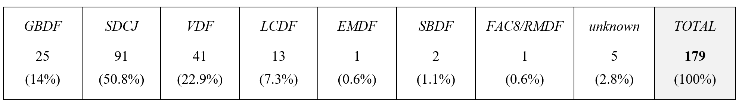
Findings: Basic Facts
Study period: December 27, 2011 – April 2, 2024
179 reported deaths in total
Deaths per facility:
MALE
BOOKING
MALE
BOOKING
FEMALE
BOOKING

Slide 12
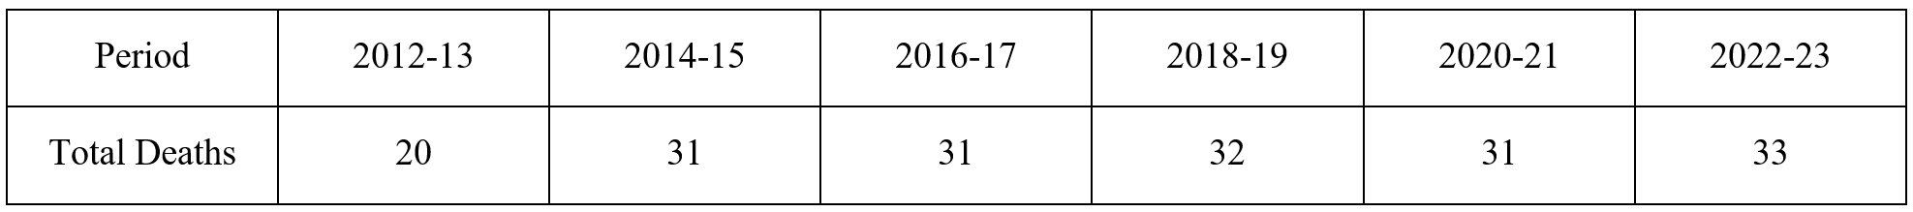
Findings: Basic Facts
Study period: December 27, 2011 – April 2, 2024
179 reported deaths in total
Deaths per facility:
Remarkably constant:
MALE
BOOKING
MALE
BOOKING
FEMALE
BOOKING

Slide 13
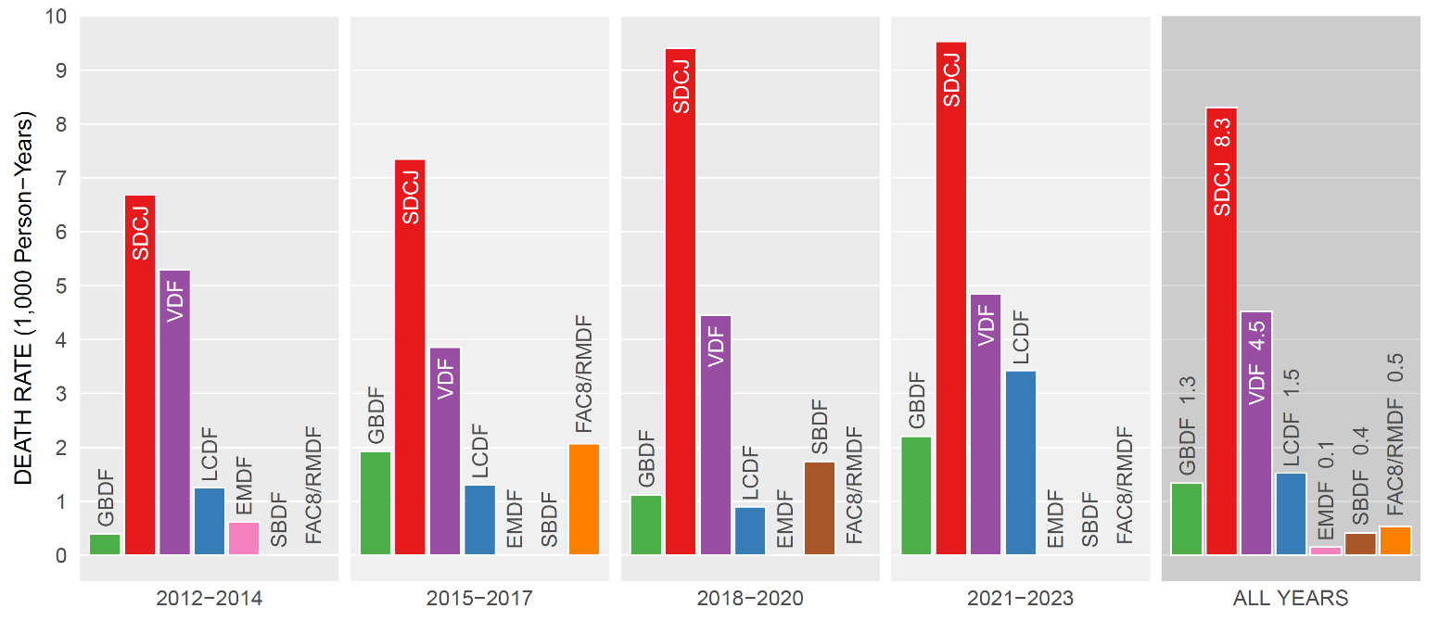
Findings: Facility
When it comes to in-custody deaths, SDCJ is a universe of its own

Slide 14
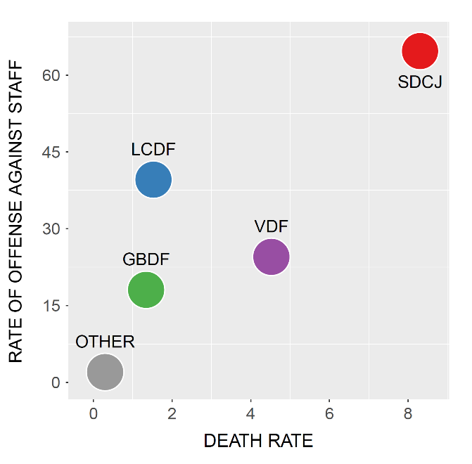
Findings: Facility
When it comes to violence against staff and homicides, SDCJ is also a universe of its own
12 out of 15 homicides occurred in SDCJ

Slide 15
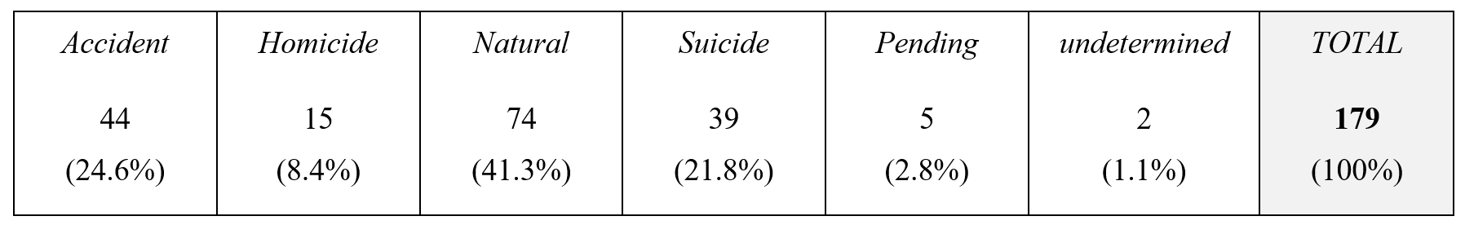
Findings: Descriptive – Manner of Death
55% of all deaths were not “Natural” (Accidents + Homicides + Suicides)
84% of Accidents were Alcohol/Drug Overdoses

Slide 16
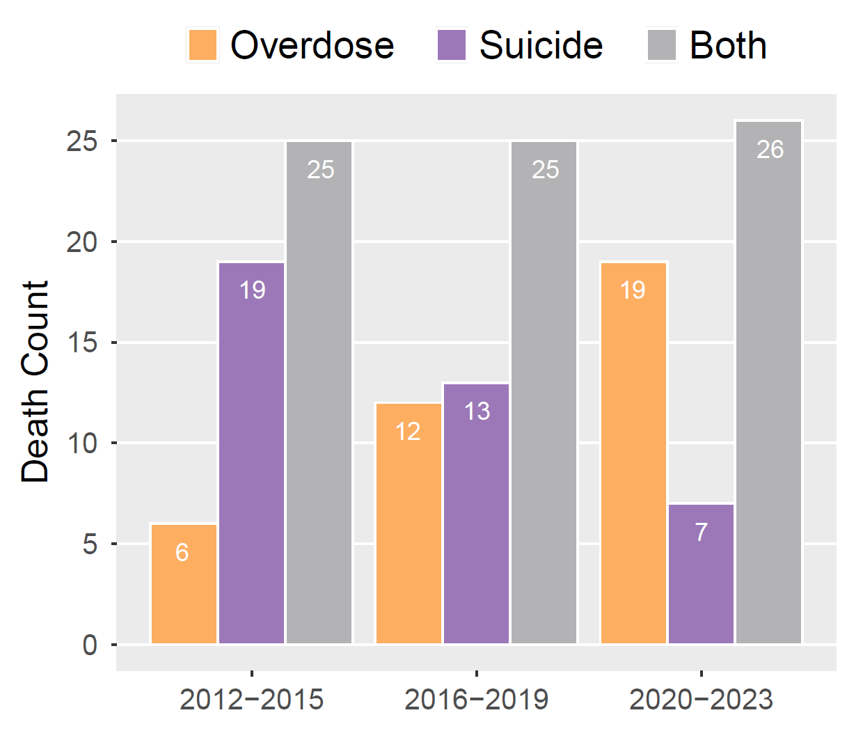
Findings: Descriptive – Manner of Death
55% of all deaths were not “Natural” (Accidents + Homicides + Suicides)
84% of Accidents were Alcohol/Drug Overdoses
Over the years:
Overdose counts increased
Suicide counts decreased

Slide 17
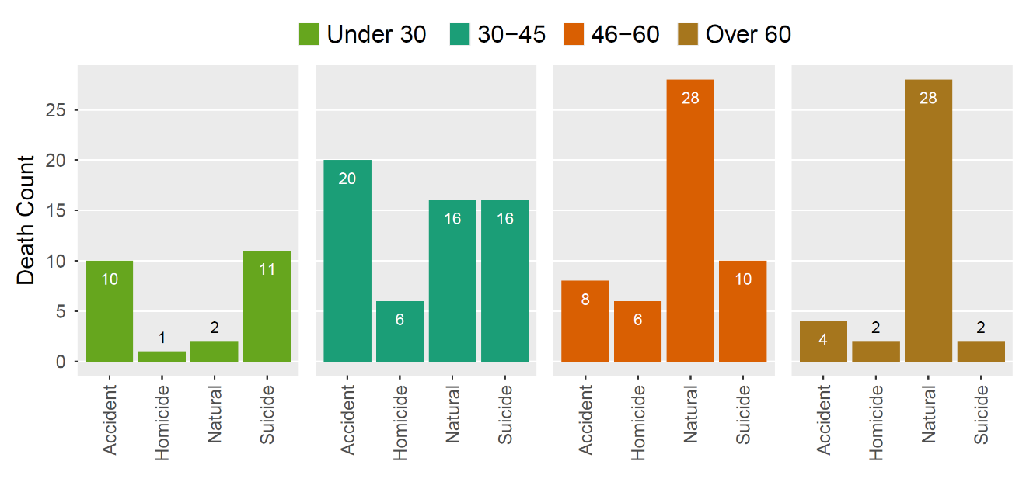
Findings: Descriptive – Age & Race
Under 30: Accidents/Suicides
Over 60: Natural
Homicides: in middle-age

Slide 18
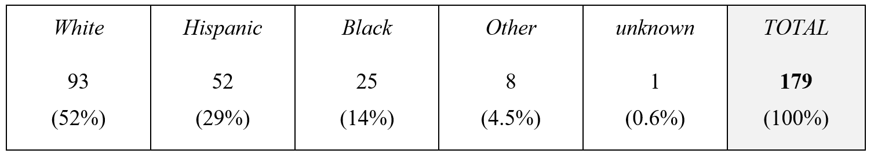
Findings: Descriptive – Age & Race
Under 30: Accidents/Suicides
Over 60: Natural
Homicides: in middle-age
White: 1/2 of all deaths
Hispanic: 1/4 of all deaths
Black: 1/8 of all deaths

Slide 19
Findings: Descriptive – Age & Race
Under 30: Accidents/Suicides
Over 60: Natural
Homicides: in middle-age
White: 1/2 of all deaths
Hispanic: 1/4 of all deaths
Black: 1/8 of all deaths
MEDIAN AGE
50.5
39
51
Hispanics who died were notably younger

Slide 20
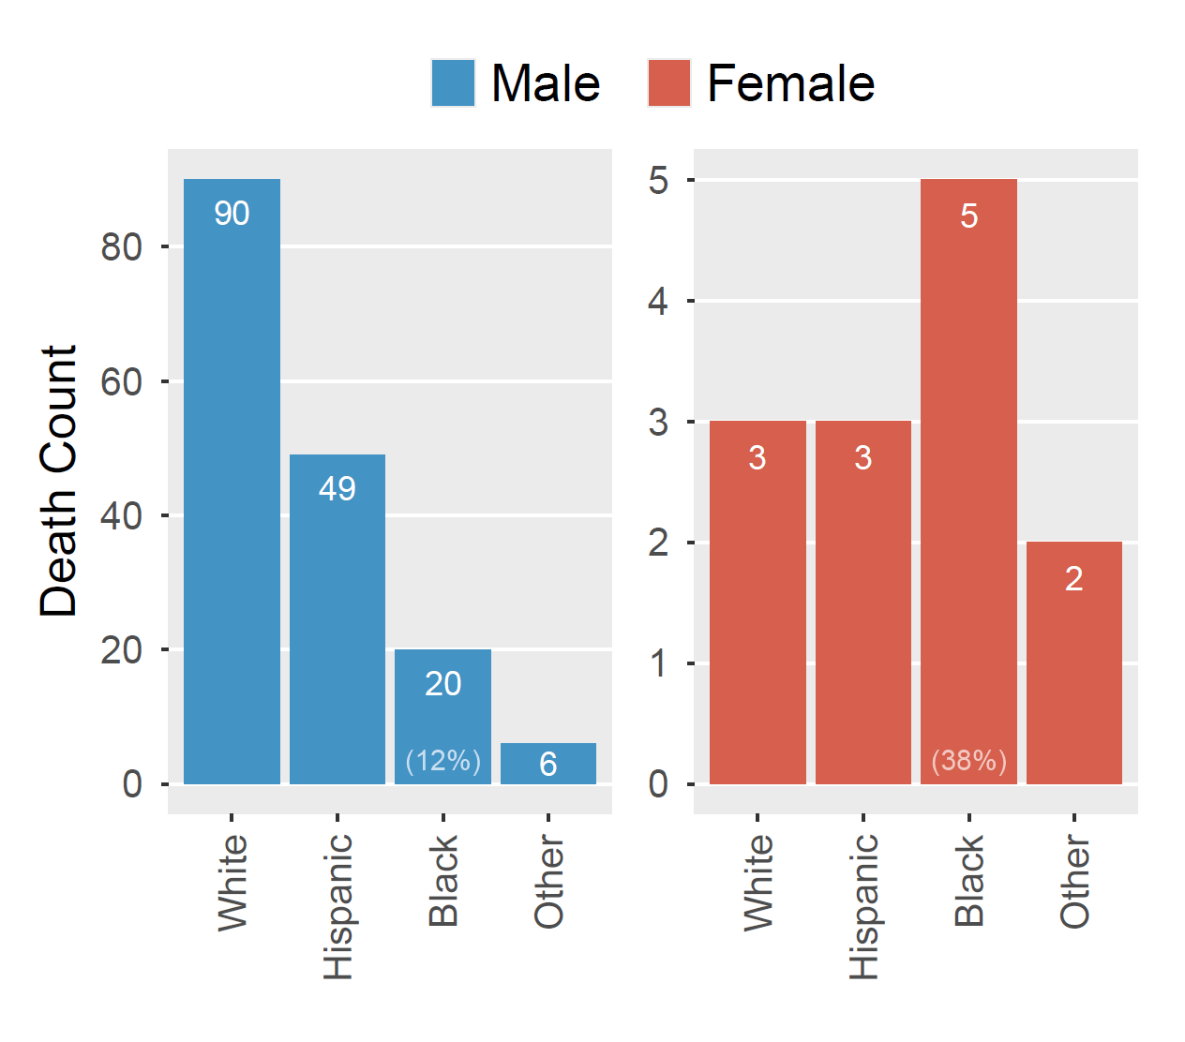
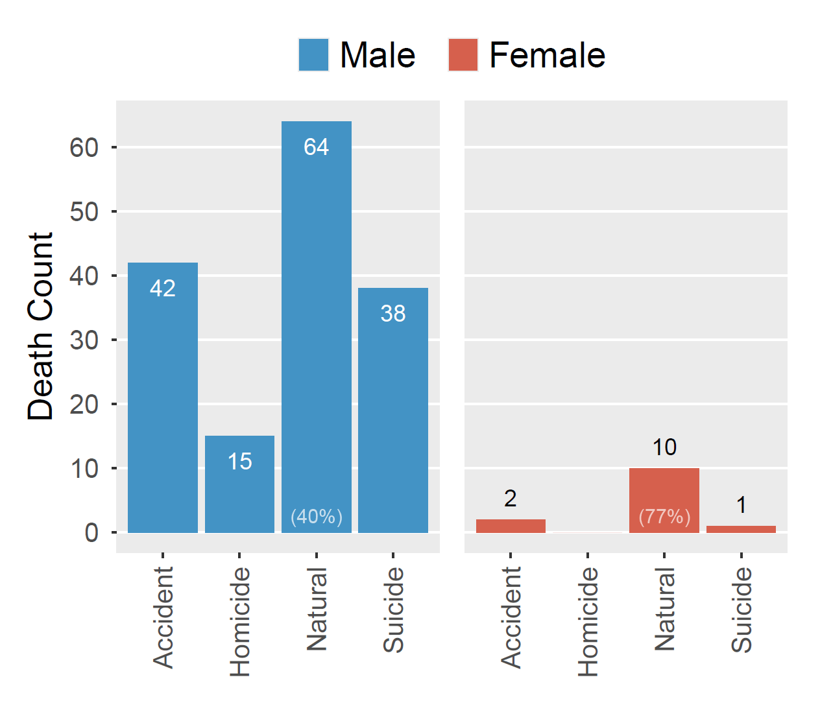
Findings: Descriptive – Gender
Females who died were more often Black:
38% vs 12% (male)
Females died more often from Natural causes:
77% vs 40% (male)

Slide 21
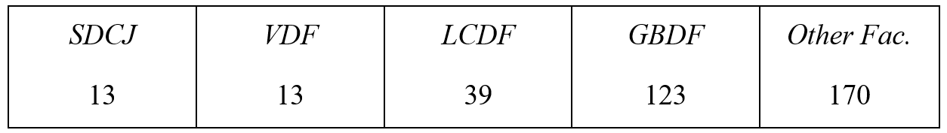
Findings: Descriptive – Length of incarceration prior to death
MALE
BOOKING
MALE
BOOKING
FEMALE
BOOKING
MEDIAN DAYS

Slide 22
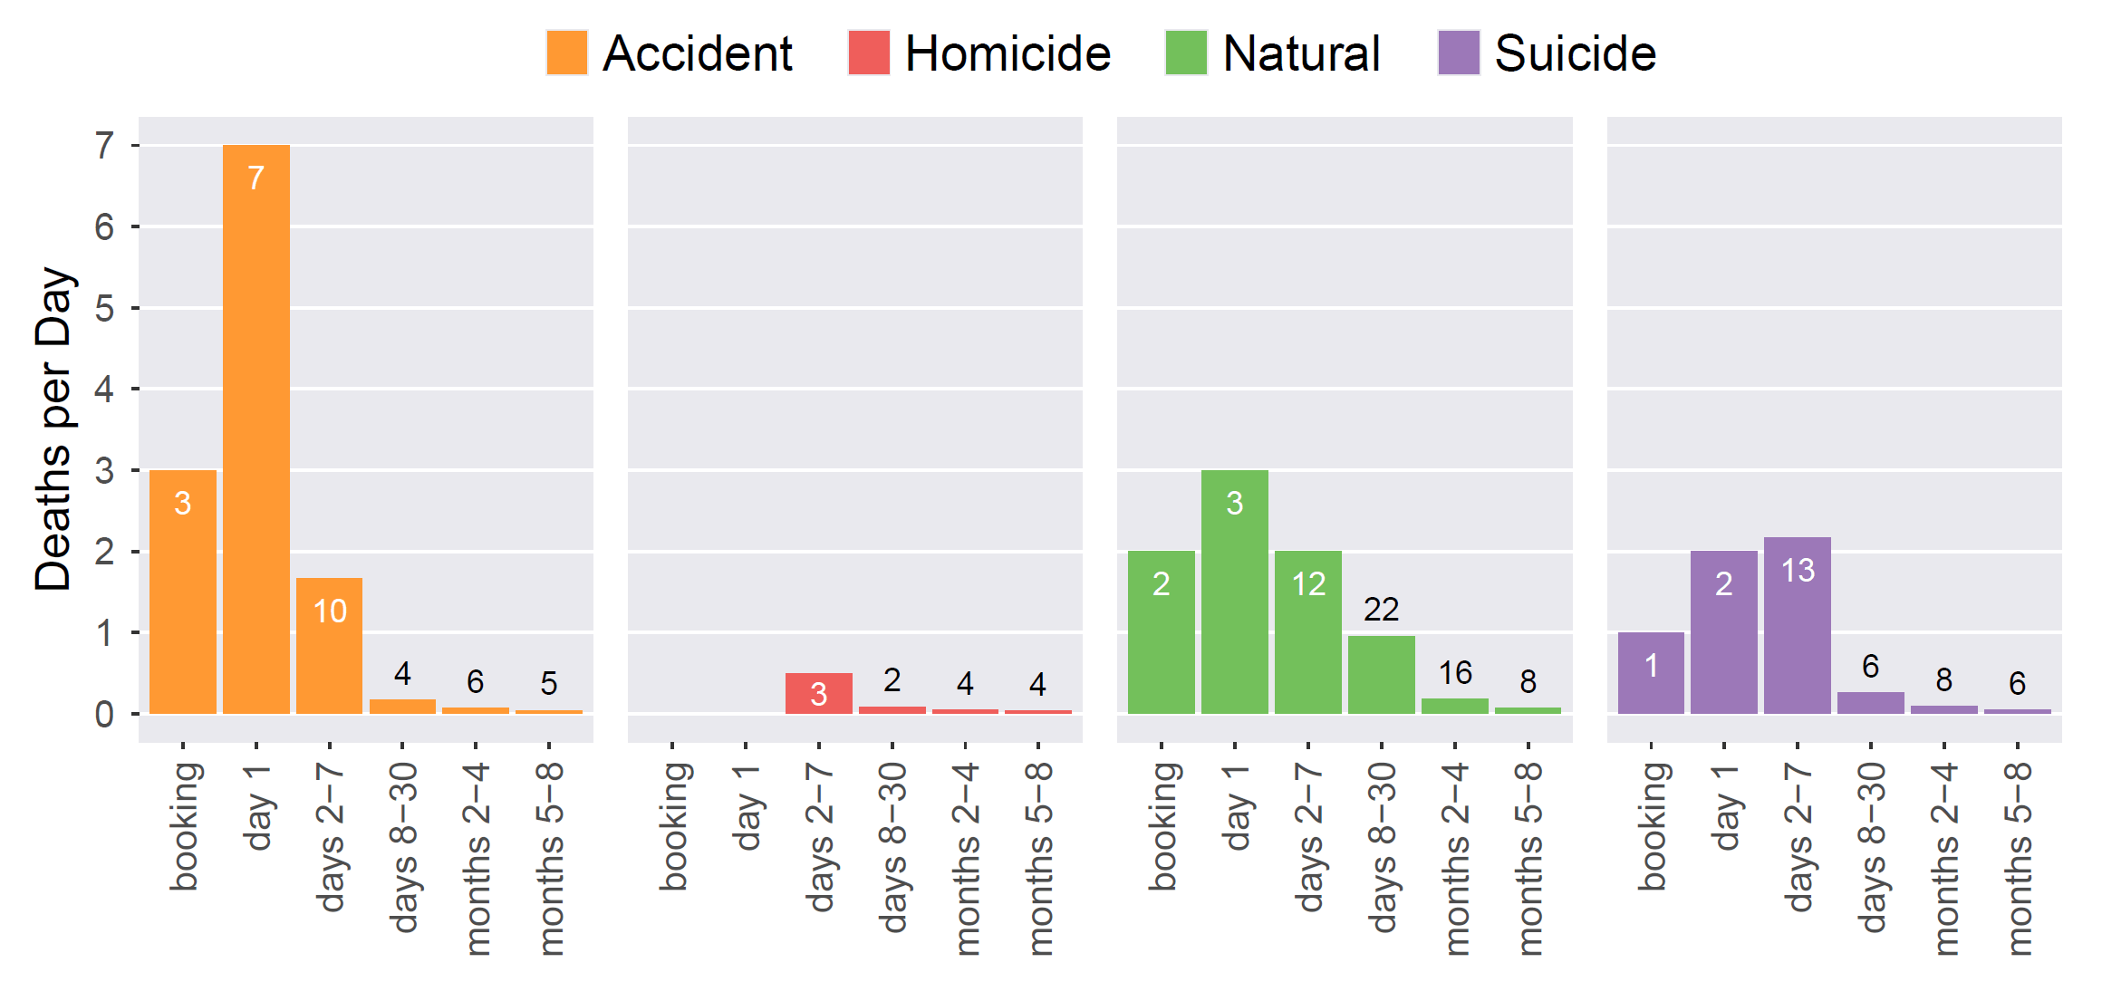
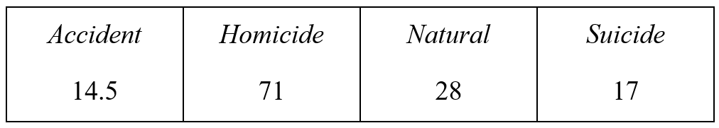
Findings: Descriptive – Length of incarceration prior to death
MALE
BOOKING
MALE
BOOKING
FEMALE
BOOKING
MEDIAN DAYS
MEDIAN DAYS
1/4 of Accidents occur on booking day or day 1
nearly 1/2 of Accidents & Suicides occur within 1st week

Slide 23
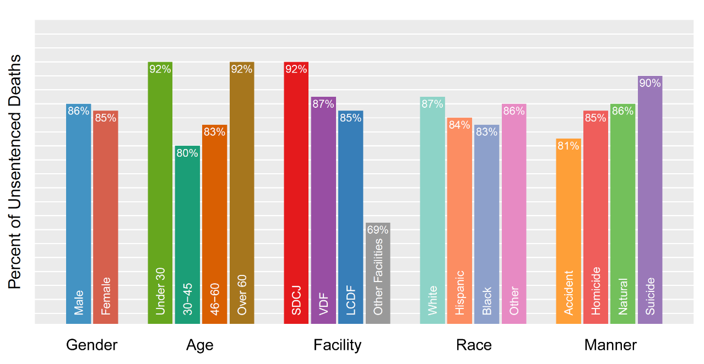
Findings: Descriptive – Custody Status
85% of all people who died had not been sentenced
Deaths among the unsentenced population involved mostly:
Youngest and oldest (under 30, over 60)
SDCJ
Suicides

Slide 24
Findings: Institutional factors
Some situations allowed for more in-depth analysis, as they involved data
on some institutional factors and on people who did not die in jail
These are examinations of:
Occupancy levels
Security enforcement staff levels
Mental health services budget and staff
Social visits

Slide 25
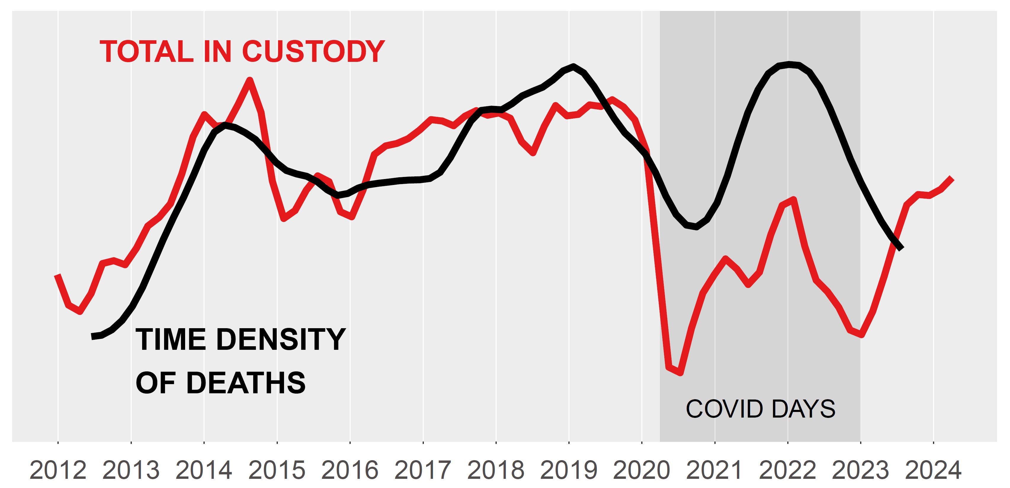
Findings: Institutional – Occupancy levels
The occupancy level of the SDCJ was directly related to the death rate, putting everyone
at a greater risk of dying
The probability of death of each incarcerated individual increased by 34% (p-value 0.037, 95%CI: 3%-79%)
each time the occupancy increased by 100 individuals
COVID period excluded from calculation; similar relation not found in VDF

Slide 26
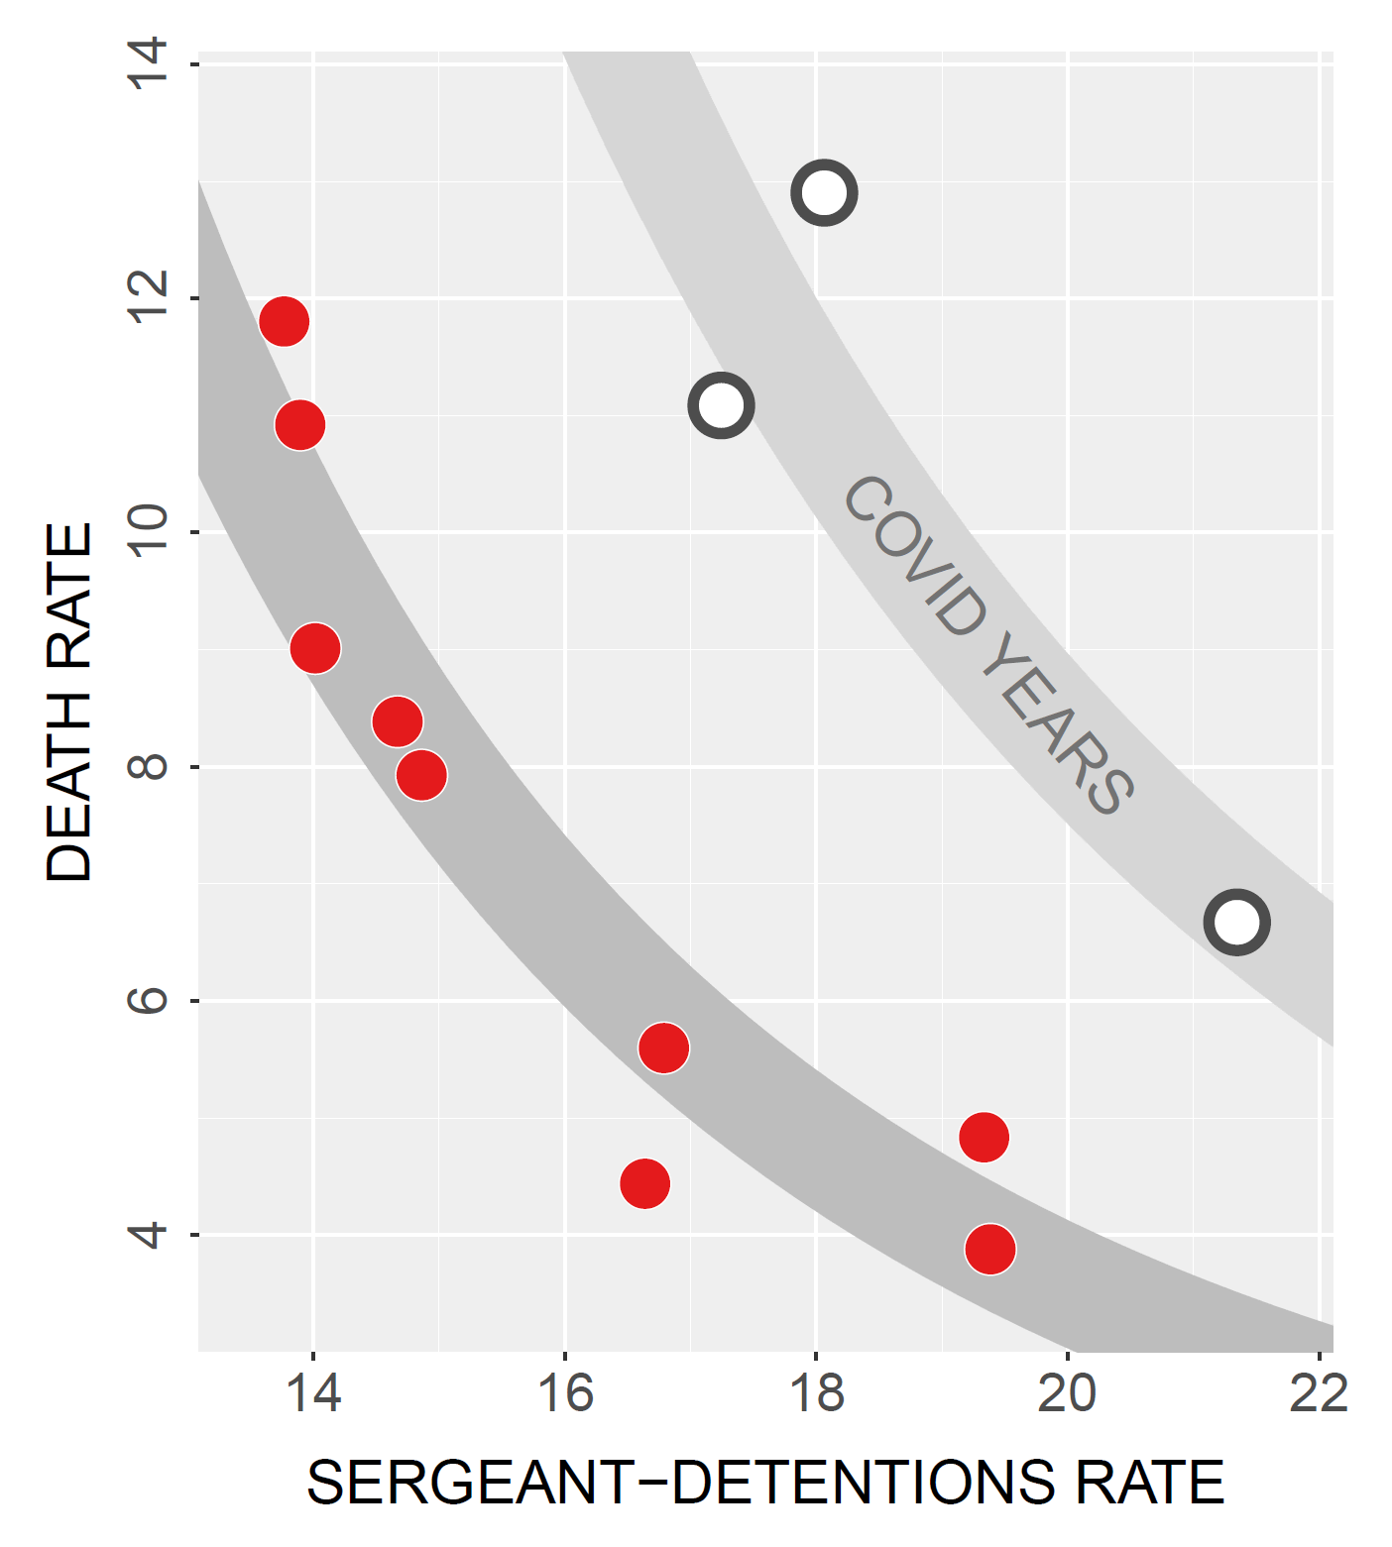
Findings: Institutional – Security enforcement staff levels
The levels of Sergeant-Detentions and Deputy Sheriffs for Detentions/Court Services staff
directly correlated with the death rate at the SDCJ
For every 10% increase in the Sergeant-Detentions rate,
there was 24% decrease of the Death Rate
Similar relation is possible, but not statistically founded in VDF

Slide 27
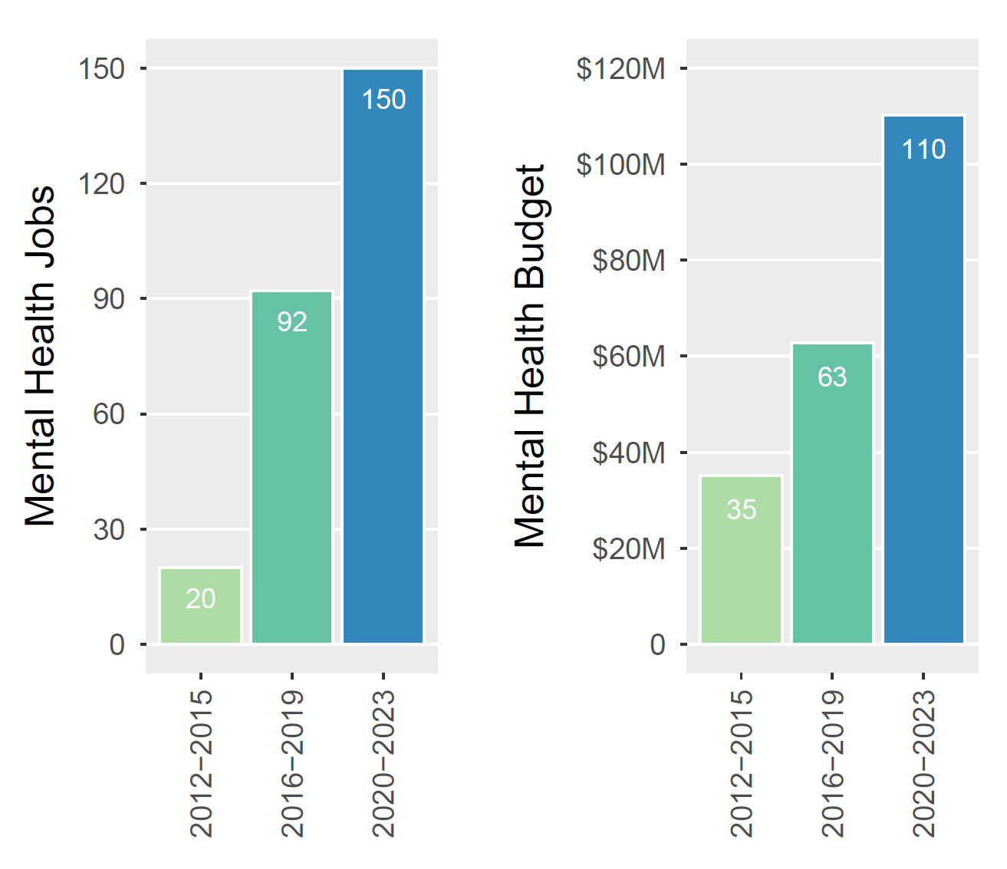
Findings: Institutional – Mental health budget/staff levels
Over time, the number of MH job positions and the MH budget levels sharply increased
The combined deaths from suicides & overdoses remained constant:
suicides decreased, overdoses increased

Slide 28
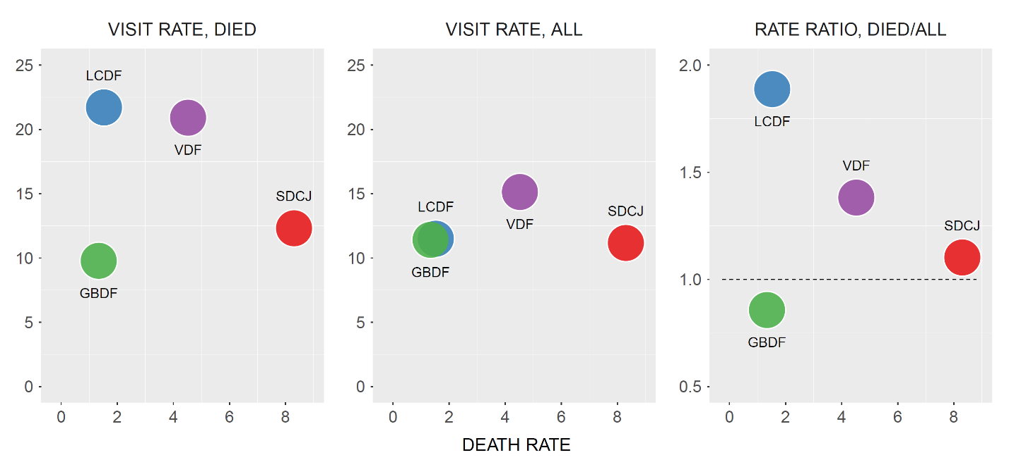
Findings: Institutional – Social visits
In the three booking facilities, social visits had a protective effect for people at high-risk of dying
SOCIAL VISITS RATE RATIO
People who DIED IN JAIL
are best proxies for people
at high-risk of DYING IN JAIL
BASELINE VISITS

Slide 29

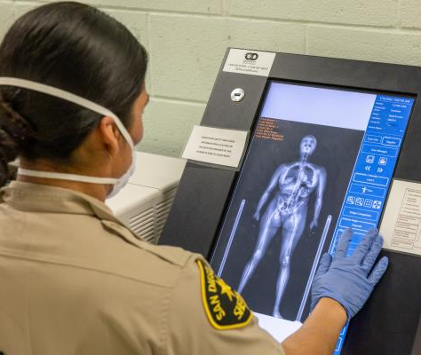
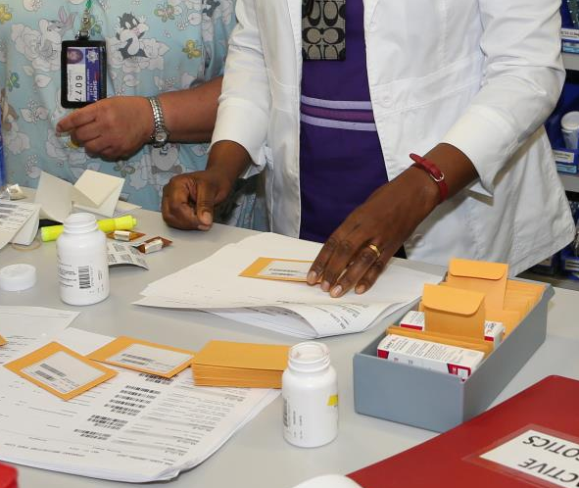
Numerous measures, but no data to assess their effectiveness.
Actions taken by SDSO to prevent jail deaths
Numerous measures, but no data to assess their effectiveness
Deployment of drug-sniffing dogs
Implementation of a new drug-screening process
Hiring more medical staff
Contracting with medical services providers
24/7 medical health staffing
Opening Rocky Mountain Detention Facility
Adding a Certified Nurse Assistant position
Providing access to StatCare telemedic provider when a provider is not onsite and a medical consultation is needed
Implementation of Medication-Assisted Treatment Program - medication-based detoxification program for opioid and alcohol withdrawal
Implementation of voluntary urine screenings during the booking process and counseling
Implementation of in-depth mental health screening for every individual during the booking process
Centralization of the mail delivery process
Placement of Naloxone inside all detention facilities and on individual staff members
Deployment of body cameras… and other actions

Slide 30

Recommendations
Access to Data
CLERB needs the authority to access the SDSO data
  SDSO possesses rich, individual level, historical data
  on the entire jail population
  CPRA method is not the way to obtain this data
  No future study should begin before this data is provided in advance
Facilities
SDSO should prioritize and concentrate its efforts to prevent death and violence in SDCJ and VDF
Occupancy levels
SDSO, in collaboration with other county stakeholders, should make efforts to decrease SDCJ population

Slide 31
Security enforcement staffing
SDSO should consider increasing the number of supervisory staff in SDCJ, as their increased presence seems to have a preventive effect on deaths
Mental Health staffing and budget
A further study should examine why increases in MH staffing and funding are not followed by a reduction of deaths, especially by overdose; the study should assess whether the drop in suicides is attributable to MH services
Social visits
We encourage SDSO to offer social visits as early and frequently as possible, including during the first few days in jail
Actions taken by SDSO
SDSO should provide complete historic data concerning all of the measures it has implemented to prevent deaths, so a follow-up study can assess which were effective and which were not

Slide 32
Suggestions from the descriptive analysis
Due to limited nature of descriptive results, TMWL can only offer suggestions on what needs to be
investigated further
Exploration of the identified Cause of Death for “Natural” deaths; the analysis of sick calls, time between sick calls and treatment, time between diagnosis and treatment, and types of treatment rendered
Study of the specific measures implemented to prevent Suicides, including the timing of implementation
SDSO should consider developing a screening measure during the booking process to identify people with altered mental states and who are potentially at “high risk”; these individuals should be denied clearance to enter the jail, and be brought to a medical/detox facility instead until cleared for admission
In addition, we suggest concentrating efforts on the MH and substance use needs, at booking and shortly thereafter
If additional data reveals that deaths occurred due to access to controlled substance while in the jail, SDSO should re-assess its security measures for preventing contraband in jail
We suggest a comparative study of data related to demographic features of people who died versus those who did not die, to assess the relevance of age, race, and gender

Slide 33
Questions?
The Mountain-Whisper-Light:
Statistics & Data Science
WEBSITE: mwlight.com
EMAIL: nayak@mwlight.com
PHONE: (206) 329-9325

