Slide 1
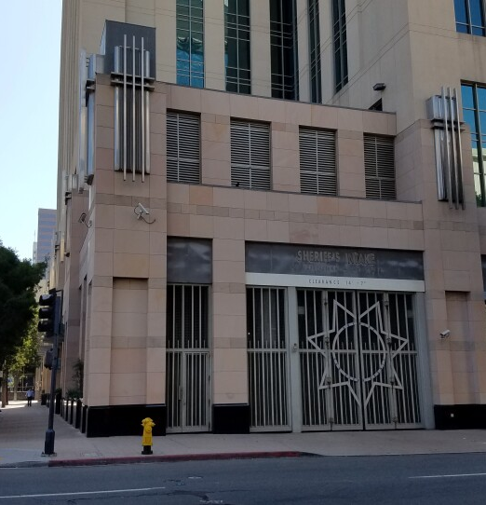
Intercoms in SDSO Facilities
Special Investigator Adam Knowland

Slide 2
AGENDA
CLERB identified issues and concerns
SDSO Policy
Policy Research
Policy Recommendations
Questions

Slide 3
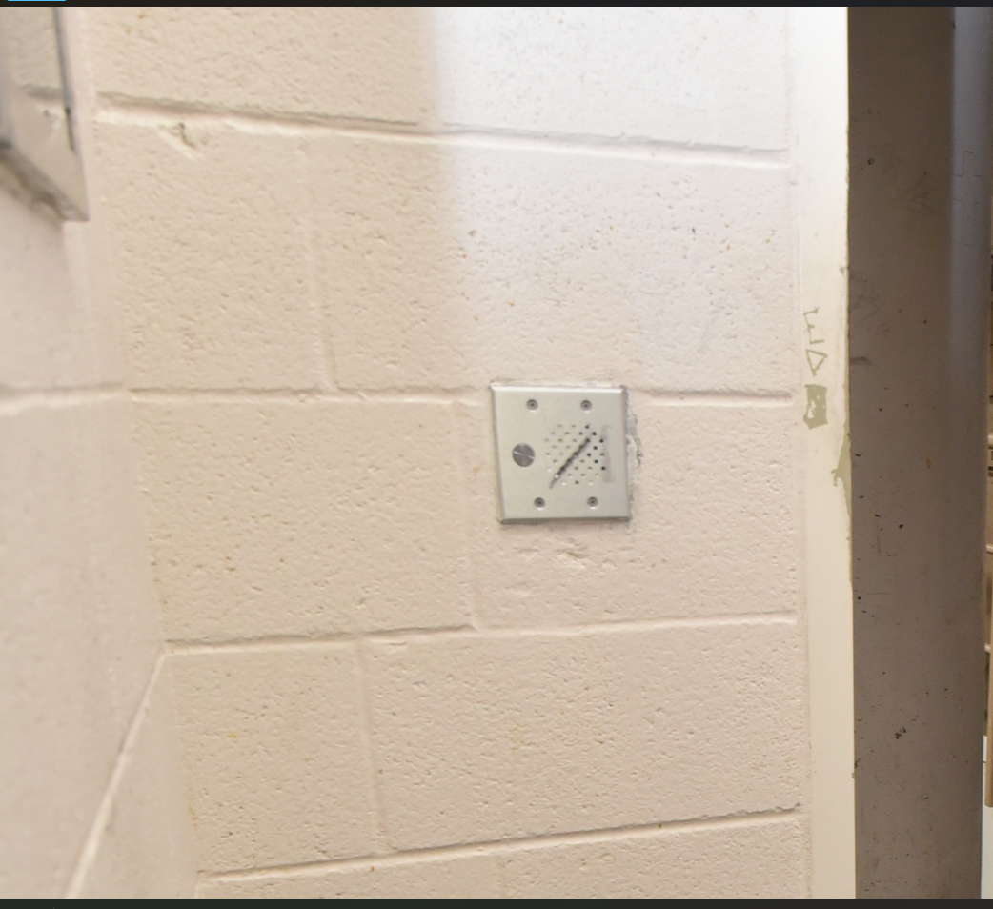
ISSUES & CONCERNS
-Repeated allegations of deputies failing to respond to intercom activations​
-Repeated allegations of deputies silencing or muting intercoms
-Lack of independent verification
-Frequent misuse by Incarcerated Person(s)

Slide 4
INTERCOMS
Locations:
-Day Rooms
-Individual Housing Cells
Function
-Two-way communication between IP’s and Control Deputy
-Simple to operate
Purpose
-Emergency communications
-Medical
-Safety

Slide 5
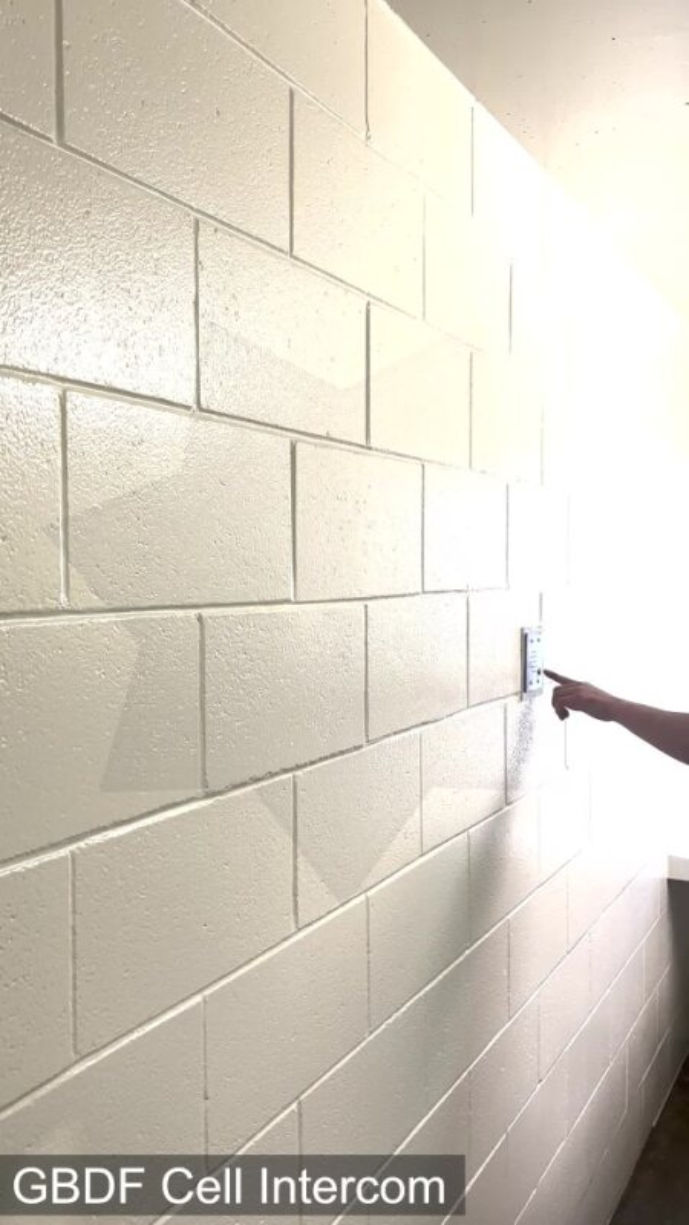

Slide 6
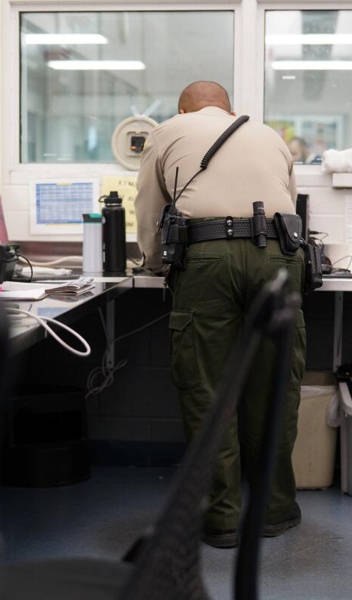

SDSO POLICY
Detention Services Bureau I.2
-Primary use is for summoning emergency assistance
-Prohibits routine muting/Must be documented
-Requires sworn staff to ensure intercom is not muted at beginning of shift
-Sworn staff required to answer all intercom calls in an expeditious manner and follow-up
-Sworn staff required to ensure intercoms are kept clear of obstructions during checks/inspections
-Sworn staff required to make notification if intercom is inoperable

Slide 7
RESEARCH
58 California Counties
10 have systems capable of direct communication between sworn staff and IP’s
SDSO has one of the most comprehensive policies
San Bernadino County requires sworn staff to look up IP’s medical information and notify medical staff upon intercom activation
Sutter County considers non-emergency use of the intercom by IPs as misuse and a rules violation. “It is important staff react to intercom misuse by implementing facility discipline rather than just ignoring the intercom”

Slide 8


RECOMMENDATIONS
CLERB Staff Recommendations
-INTERCOM MISUSE
Adopt policy that prohibits misuse of the intercom system
SWORN STAFF RESPONSIBILITIES
Adopt policy clearly identifying staff’s responsibilities when intercom is activated
DOCUMENT INTERCOM ACTIVATIONS
Adopt a policy and procedure for documenting intercom activations when using systems without the capability
INTERCOM LOGS
Adopt a policy requiring the retrieval of all intercom records for 24 hours preceding the death of an IP in capable facilities

Slide 9
QUESTIONS?

