Slide 1


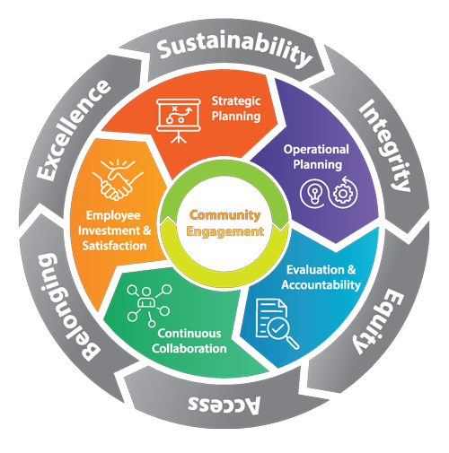

COUNTY STRUCTURE AND
STRATEGIC PLAN
Quentin Brooks
Group Program Manager
Notes:
Good morning/afternoon
My name is:
Today I will be presenting on County Structure including the General Management System and the Strategic Plan.

Slide 2







INTENT
Learn the history of the General Management System (GMS)
See how the GMS impacts County culture and operations
Make your work contribute to the end goal
Notes:
Today we will cover:
Learning the History of the General Management System – because it is important to know where we come from so we appreciate where we are and where we are going.
See how the GMS impacts our daily County culture and operations.
And, lastly, but most importantly leave today with a more concrete understanding of how the County is structured and operates.
Also, I would be remiss to not say that things are quickly changing
New Board, New Priorities, new initiatives…. We will explore that too - a little bit

Slide 3

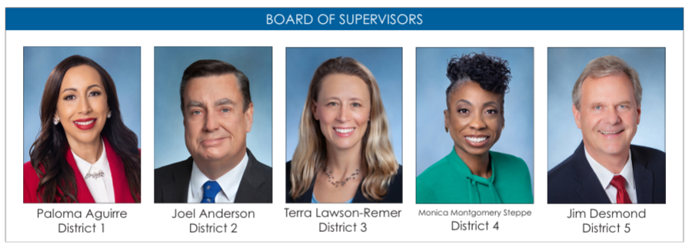
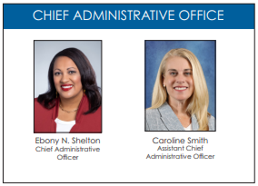
WHO’S WHO
WHO’S WHO
Residents of San Diego County
Notes:
As County employees we serve the public, our taxpayers and residents of San Diego.
We have a Board of Supervisors for the five different districts. This is a BOS that has been together now for about 2 years. Prior to this BOS we had a BOS that had been working together for 25+ years.
Staring from Left to right we have….
From there we have our Chief Administrative Officer Ebony Shelton and the Assistant Chief Administrative officer Caroline Smith
What are the benefits of having a group together for 25 years? (have them respond in chat) (possible answers: continuity, harmony, stagnation, group think…etc)
So, on the flip side, what are some things that we might see with a group that has been together for only 2 years? (have them respond in chat)
It is important to know that both things have good/bad/neutral, but both affect the organization in different ways, and that sets the stage for some of what we will discuss today. But before we go there, it is also important to explain that our Charter establishes that the BOS sets policy but do not set how we operationalize that…that is left to the CAO.
Our previous vision, mission and values had been in place for years and as we saw the shift in policy priorities we identified the need to refresh our GMS and Strat Plan and within those, our Mission, Vision and Values statement which we will cover shortly.

Slide 4
MISSION, VISION AND VALUES

Slide 5


VISION AND MISSION
Vision Statement
  A just, sustainable, and resilient future for all
Mission Statement
  Strengthen our communities with innovative, inclusive, and data-driven services through a skilled and supported workforce
Notes:
Read vision, what does this mean to you? (respond in chat)
Mission, what do you think about this? (respond in chat)

Slide 6

VALUES
  Integrity
  Equity
  Access
  Belonging
  Excellence
  Sustainability
Notes:
First read just the title of the Values, (in chat have participants share initial thoughts on these) – what resonates……
Then, go over each one individually.
Integrity
Earn the public’s trust through honest and fair behavior, exhibiting the courage to do the right thing for the right reason, and dedicating ourselves to the highest standards of ethical conduct.
Equity
Apply an equity lens to appropriately design programs and services so that underserved communities have equitable opportunities. Using data driven metrics, lived experiences and the voices of our community we weave equity through all policies and programs.
Access
Build trust with the residents we serve through transparent communication and neighborhood engagement that is accessible in the languages, facilities and methods that meet their needs
Belonging
Foster a sense of belonging, not just inclusion, for the people we serve and for the employees of the County who provide those services on a daily basis.
Excellence
Ensure exceptional service delivery to our customers by practicing fiscal prudence, encouraging innovation and leveraging best practices that promote continuous improvement to build strong, vibrant communities.
Sustainability
Secure the future of our region, by placing sustainability at the forefront of our operations deeply embedded into our culture. Dedicate ourselves to meeting our residents’ current resource needs without compromising our ability to meet the needs of generations to come.
Ask again if anything resonates now more than it did initially……

Slide 7

COUNTY CULTURE
New Executive Team
Guiding Principles

Slide 8
COUNTY GUIDING PRINCIPLES
  Be Kind
Be Curious
Be Bold
Do the Right Thing

Slide 9
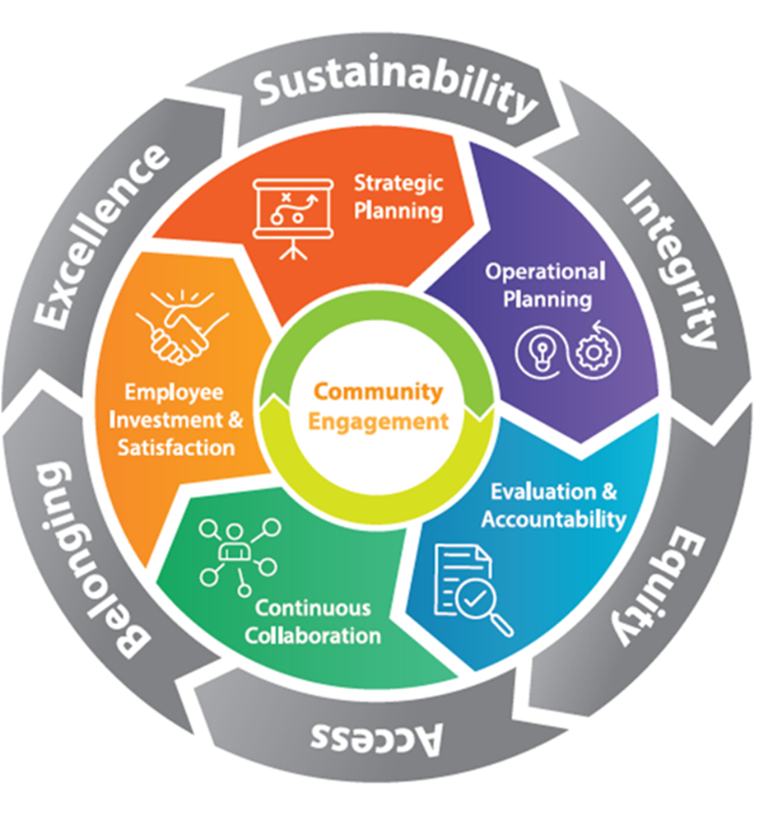



Boldly Forward
Notes:
Change in leadership/ Term limits implemented
Framework for the future
New GMS

Slide 10
GENERAL MANAGEMENT SYSTEM

Slide 11
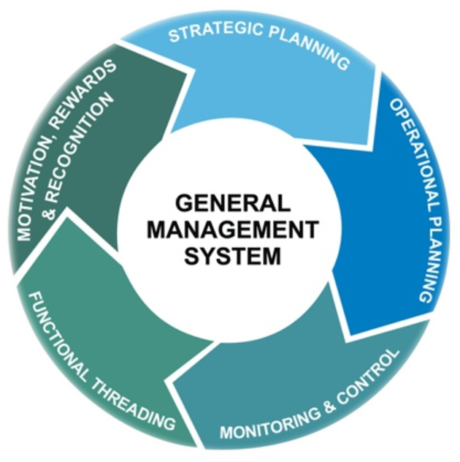

REIMAGINING THE GMS
PREVIOUS GMS
CURRENT GMS
Notes:
WHAT MAIN DIFFERENCES DO YOU SEE???? (put your answers in chat)
Well, other than colorful there have been many changes.
Starting with the central circle, we added Community Engagement – because it is at the heart of everything we do, we are centered on community engagement and it is ongoing as indicated by the arrows, it is not stagnant
Then the middle layer, Strategic Planning and Operational Planning stayed the same, because they are the first and crucial steps.
Strategic Planning – happens on a 5-year cycle, can find it on Insite
Operational Planning – 2-year document, also known as our ‘budget’ . The document is over 700 pages, but don’t feel overwhelmed, while you could certainly read it all, what is super important is that you read your department’s section, which is probably only 6-7 pages but really delineates your departments goals, resources and staffing, it really gives you a great idea of where your department is going and how it fits into the overall strategic plan of the enterprise. Side note: It is also good to read if you are interviewing or interested in another department as it gives you an inside look into what they are doing.
Then we shifted from Monitoring and Control to Evaluation and Accountability – this is huge. We are no longer just one-dimensionally looking at things by monitoring and controlling them, but really looking at how we evaluate and hold our programs/services accountable, it is exciting and much more dynamic.
We changed from Functional Threading to Continuous Collaboration – Nowadays there is nothing we do in silos, everything requires collaboration, whether internal or external it is important that we are hearing many voices and working together.
Then we now have Employee Investment & Satisfaction where Motivation, Rewards and Recognition once stood, and this is very important because it is our workforce that makes everything possible so we need to be continuously investing in them, in gaining and RETAINING our incredible staff.
The outer layer are our values, they hold it all together, because everything we do is through the values we hold as an organization

Slide 12
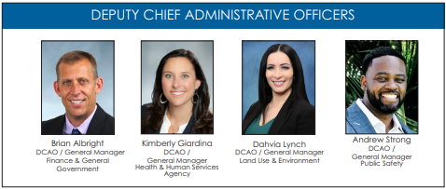
The County’s General Managers
Andrew Strong, DCAO
Dahvia Lynch, DCAO
Brian Albright, DCAO
Kimberly Giardina, DCAO
Public Safety Group
Land Use & Environment Group
Finance & General Government Group
Health & Human Services
  Animal Services
  Child Support Services
  District Attorney*
  Emergency Services
  Medical Examiner
  Probation**
  Public Defender
  County Fire
  Sheriff**
  Agriculture, Weights & Measures
  Library
  Environmental Health & Quality
  Office of Sustainability & Environmental Justice
  Parks & Recreation
  Planning & Development Services
  Public Works
  General Services
  Purchasing & Contracting
  Registrar of Voters
  Aging & Independence Services
  Behavioral Health Services
  Child & Family Wellbeing
  Self-Sufficiency Services
  Homeless Solutions & Equitable Communities
    Office of Equitable Communities
    Office of Homeless Solutions
    Office of Immigrant & Refugee Affairs
  Housing & Community Development Services
  Medical Care Services
  Public Health Services
Public Safety Group
Notes:
Our county is growing rapidly we have added departments at a record-pace. In order to best manage our departments, we have a structure that divides them into 4 business Groups. Hopefully you are all familiar with your GM but if not, here they are.
Name GM and Group
Gms oversee the 40+ departments and FGG has particularly been busy, they are the fastest growing Group.

Slide 13
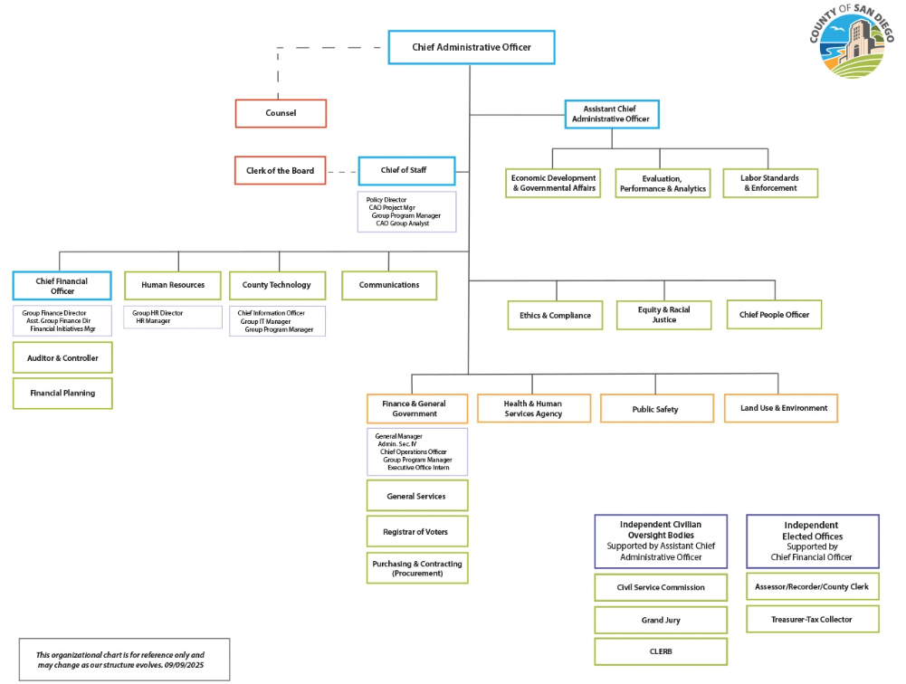
CAO’s Direct Reports

Slide 14
STRATEGIC PLAN

Slide 15
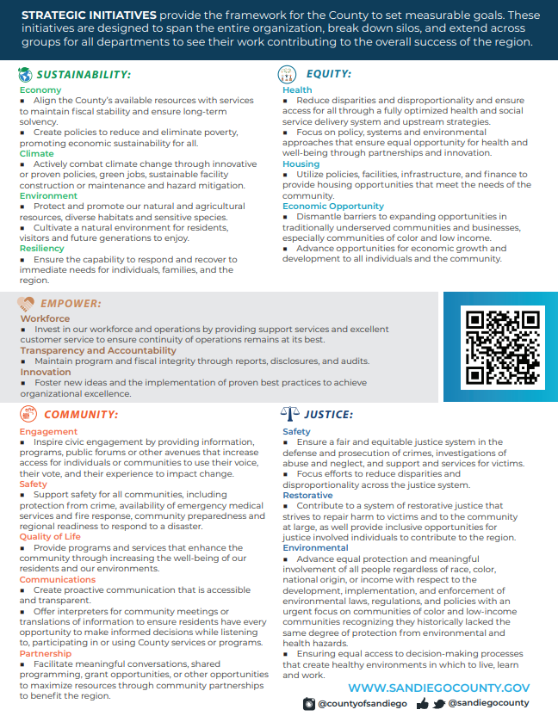
STRATEGIC PLAN
  First Step of the GMS
  Defines County culture by embracing specific values that lead into Strategic Initiatives
Notes:
As we saw before the Strategic Plan is the first step in the GMS. It helps define the County culture by embracing certain values that set the stage for the Strategic Initiatives under which all goals in the operational plan are developed.
When the alignment work began last year we knew we also needed to look at the Strategic Initiatives. Previously we had 4:
Building Better Health
Sustainable Environments & Thriving
Living Safely
Operational Excellence
While these were great they really forced us into boxes, if you were in PSG you mostly saw yourself in Living Safely, HHSA in Building Better Health, and so forth, but the reality is all our work touches so many different areas of the enterprise so when crafting the new strategic initiatives we wanted to make sure that people could see there work where it really is….enterprise wide.

Slide 16





STRATEGIC INITIATIVES
Sustainability
Equity
Empower
Community
Justice
Economy
Climate
Environment
Resiliency
Health
Housing
Economic Opportunity
Workforce
Transparency & Accountability
Innovation
Engagement
Safety
Quality of Life
Communications
Partnership
Safety
Restorative
Environmental
Notes:
These are the new Strategic Initiatives, and before we dive into them I would like to get your first impressions. In the chat, please tell me if it is easier to see yourself in more of them…it’s ok if you don’t, that just means I still have a few slides to convince you ☺

Slide 17

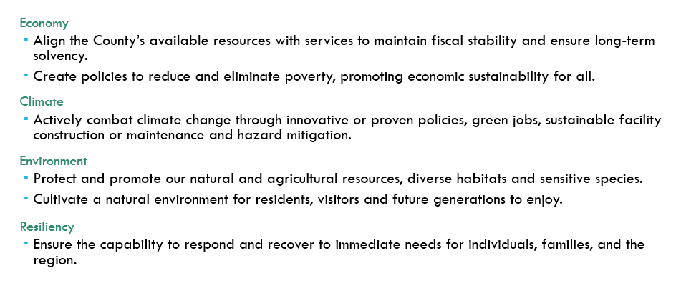
SUSTAINABILITY

Slide 18

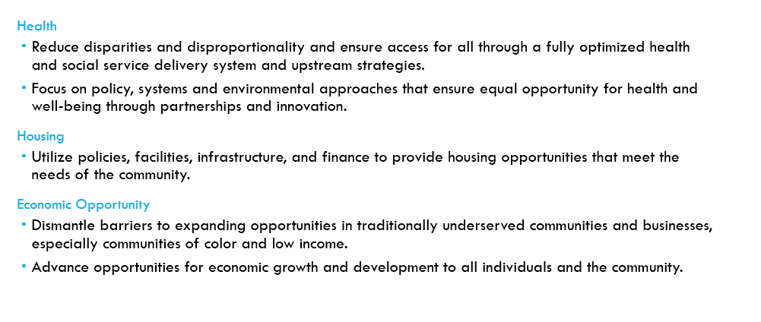
EQUITY

Slide 19

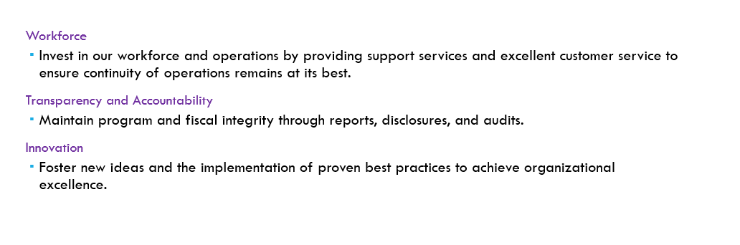
EMPOWER

Slide 20

COMMUNITY
Engagement
  Inspire civic engagement by providing information, programs, public forums or other avenues that increase access for individuals or communities to use their voice, their vote, and their experience to impact change.
Safety
  Support safety for all communities, including protection from crime, availability of emergency medical services and fire response, community preparedness and regional readiness to respond to disaster.
Quality of Life
  Provide programs and services that enhance the community through increasing the well-being of our residents and our environments.
Communications
  Create proactive communication that is accessible and transparent.
  Offer interpreters for community meetings or translations of information to ensure residents have every opportunity to make informed decisions while listening to, participating in our using County services or programs.
Partnership
  Facilitate meaningful conversations, shared programming, grant opportunities, or other opportunities to maximize resources through community partnerships to benefit the region.

Slide 21

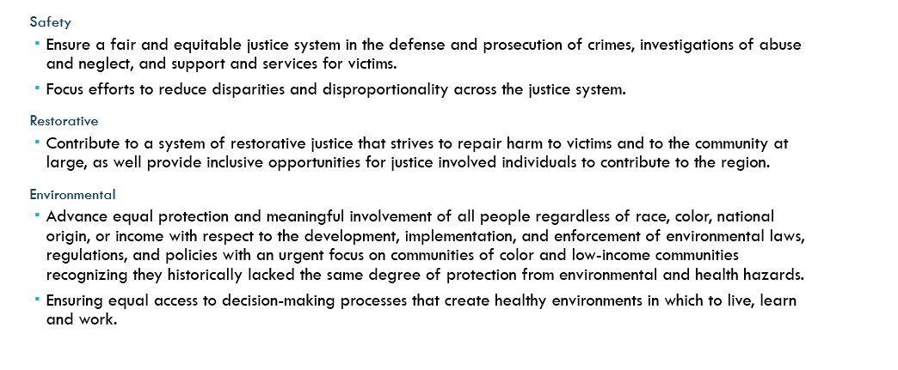
JUSTICE

Slide 22

THANK YOU!
Questions?

