Slide 1

Parliamentary Rules of Procedure
For the County’s Boards, Commissions, and Committees

Slide 2
Rules of Procedure
Board Policy A-74, Section E
Authorizing Authority for the BCC (e.g., Board ordinance, resolution or policy)
By-Laws adopted by the BCC and approved by the Board
Procedural Rules adopted by the BCC
Robert’s Rules of Order if not covered by the above

Slide 3
Policy A-74
Brief Overview of Governing Rules—conflict of interest laws, Brown Act, Board policies, purpose of advisory boards, training requirements, etc.
Membership nominations and filling vacancies processes
Requirements for meetings: Brown Act, subcommittees, officers, budgets, minutes, recommendations to County departments or the Board, etc.
By-Laws requirements: officers, minutes, voting, Brown Act, subcommittees, and organizational procedures

Slide 4
Options for Procedural Rules
Robert’s Rules of Order
Rosenberg’s Rules of Order
BCC’s own rules

Slide 5
Robert’s Rules of Order
The Rules have been in print since 1876 and are a guide for conducting meetings and making decisions as a group of purportedly any size (current = 12th Edition from 2020)
They are contained in a book that set forth how to make motions, which motions require a second, which motions can be amended, which motions can have discussion before calling the questions, the order of addressing conflicting or supplemental motions, etc.
Other portions of the book concern organization, nominations, and quorums that are addressed for BCCs in state law, A-74, and the BCC’s authorizing authority
Many organizations have created summaries of a few pages which the book explains in dozens or hundreds of pages
The official Robert’s Rules website has a Q&A database at: https://robertsrules.forumflash.com/
Notes:
The rules are somewhat archaic in their implementation and while stated for any size, they were designed for larger parliamentary groups.

Slide 6
Motions
Main Motion: All business to be considered by an assembly is introduced by a main motion; this type of motion may only be considered if no other business is pending
Subsidiary Motion: Change or affect how to handle a main motion by modifying it, delaying action on it, or disposing of it (vote on this before main motion)
Privileged Motion: Urgent or important matter unrelated to pending business but must be addressed immediately (usually related to members, the organization, or meeting procedure)
Incidental Motion: Questions procedure of other motions (must consider before the other motion)
Motion to Table: Kills a motion
Motion to Postpone: Delays a vote (can reopen debate on the main motion)

Slide 7
Motion Steps
Motion: A member rises or raises a hand to signal the chairperson and makes the motion
Second: Another member seconds the motion
Restate motion: The chairperson restates the motion
Debate: The members debate the motion; the person who makes a motion may speak on it first, if he or she expresses the desire to do so; debate is confined to the merits of the motion currently under consideration
Vote: When the members are ready for the question, the chairperson restates the motion, and then first asks for affirmative votes, and then negative votes
Announce the vote: The chairperson announces the result of the vote and any instructions

Slide 8
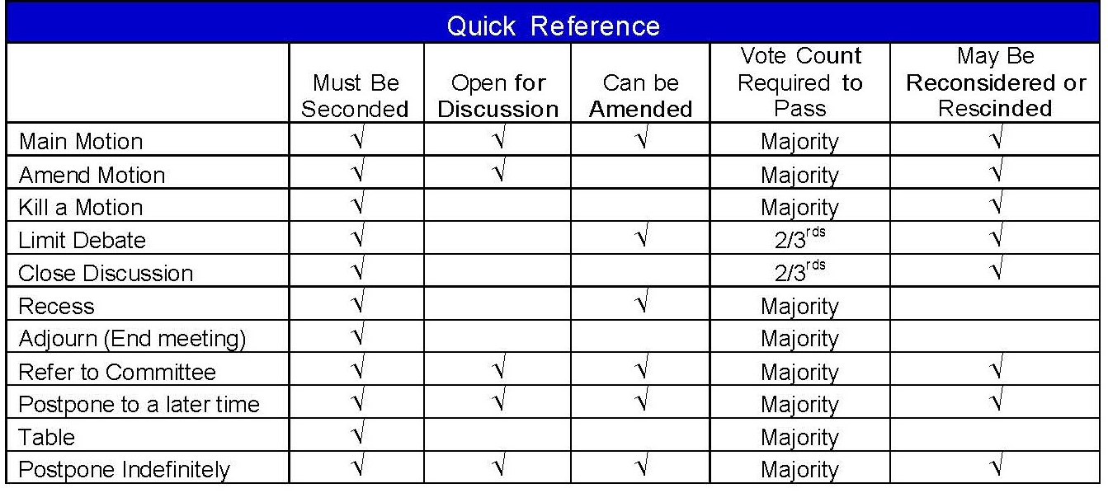
Robert’s Rules Summary Chart Example
Notes:
This is an example of a chart available online. There are dozens of available summaries and charts on the motion types.

Slide 9
Rosenberg’s Rules of Order
Judge Rosenberg created these rules for California groups based on Robert’s Rules—he has been an attorney, a judge, a supervisor, and a city councilmember.
He designed the rules to be easily understood and for smaller groups
The rules explain the quorum, the role of the chair, motions and motion procedures, debate on the motions, voting requirements, and decorum
The summary rules are only 10 pages and are available at: https://www.cacities.org/UploadedFiles/LeagueInternet/77/77d4ee2b-c0bc-4ec2-881b-42ccdbbe73c9.pdf

Slide 10
Explanation of Motions (Rosenberg’s Rules)
Debatable:
Basic or main motion
Motion to amend
Substitute motion
Motion to reconsider
No Debate:
Motion to adjourn
Motion to recess
Motion to fix the time to adjourn
Motion to table
Motion to limit debate
Two-Thirds Vote:
Motion to limit debate
Motion to close nominations
Motion to object to consideration of the question
Motion to suspend the rules
Notes:
Chair to call vote on amendments or substitute motions first before calling the question on the main motion.
Certain motions are to be voted on without debate.
Motions that cut off other members require 2/3 vote.
Motions to reconsider can only be made at the same meeting and by a members who was in the majority on the prior vote.

Slide 11
THANK YOU!
ANY QUESTIONS?

