Slide 1
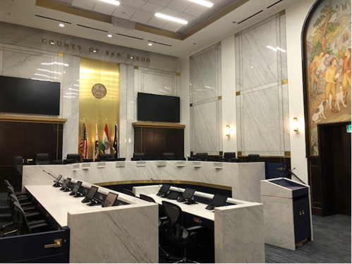
Building Public Trust Through Ethical Service
County of San Diego Code of Ethics
BCC Code of Conduct
Notes:
“Your actions shape how the public sees County government.”
Quick ice-breaker question: “What comes to mind when you hear ‘public trust’?”

Slide 2
Code of Conduct Timeline:
Creation and Adoption of the BCC and CPSG Code of Conduct
BOS Updated Rules of Procedure
A-74 Amendments
Code of Conduct Draft
Feedback from Stakeholders
Adoption of Code of Conduct
Notes:
November 10, 2021: In response to an increase in hostile and disruptive activity in meetings, the Board of Supervisors adopted amendments to the Rules of Procedures that attached the Code of Civil Discourse of the National Conflict Resolution Center as aspirational goals for public debate.
May 10, 2022: The BOS made several amendments to A-74 Participation in County Boards, Commissions and Committees. Recognizing that some boards, commissions, and committees were facing the same disruptive activity in meetings, the amendments included the formation of a County staff work group to draft a Code of Conduct that would be incorporated into A-74.
The Code of Conduct was added to A-74 Participation in County Boards, Commissions and Committees on September 27, 2022 by the Board of Supervisors
The BCC-CPSG Code of Conduct for the County of San Diego is a set of standards and expectations that all members of County boards, commissions, and committees (BCC), as well as community planning and sponsor groups (CPSG), are expected to abide by. It aligns with the County's values and the "Code of Civil Discourse" from the National Conflict Resolution Center, as adopted by the County’s Board of Supervisors. The Code emphasizes the importance of public service, honesty and integrity, vigilance against bias or conflict of interest, fairness, impartiality, active listening, informed decision-making, and promoting an inclusive culture. It also emphasizes the importance of civility and professional treatment for all members, elected officials, County staff, and residents.

Slide 3


Why Ethics & Conduct Matter
Ethical conduct shapes public perception: Each action by a BCC member influences how the community views the integrity and fairness of County governance.
Trust is the foundation of civic engagement: When trust is established, communities are more likely to participate and collaborate in local decision-making processes.
The public good is our highest aim: Serving with transparency, honesty, and accountability upholds the County’s motto: ‘The noblest motive is the public good.’
Public service demands public trust: Civic roles require adherence to shared values that ensure equity, access, and respect in all County-related interactions.
Notes:
Ethics and conduct are not just compliance checkboxes — they are the core of how we earn and maintain public trust. Every decision and every interaction you have as a member of a Board, Committee, or Commission contributes to the public’s perception of government. It’s not just about doing things right, but about doing the right things.
This is why we begin with trust. Trust forms the bedrock of community participation. When people believe in the integrity of their representatives, they are more engaged and more willing to collaborate. That’s how civic systems thrive.
We’ll begin today with a question: What comes to mind when you hear the phrase ‘public trust’? Think about that — and how your actions can either build or diminish it. Because ultimately, you’re not just serving on a board — you’re serving the people of San Diego County.

Slide 4




BCC’s: Your Role
Extending Civic Engagement
BCCs extend the voice of the community
Boards, Committees, and Commissions connect County leadership to local perspectives, enhancing responsiveness and transparency.
You are advisors, not decision-makers
Per County Policy A-74, BCCs serve in an advisory capacity and do not have the authority to enact binding decisions.
Transparency through structured input
Public forums and documented proceedings ensure that BCCs enhance democratic processes without circumventing elected authority.
Org structure ensures accountability
BCCs report to the Board of Supervisors, maintaining accountability while providing critical grassroots insights.
Notes:
Boards, Committees, and Commissions — or BCCs — are more than administrative bodies; they’re essential to connecting government to the people. Your participation bridges the gap between County leadership and the diverse communities we serve.
It’s important to clarify the nature of your role. As outlined in County Policy A-74, BCCs are strictly advisory. That means your guidance informs decision-makers but does not carry binding authority. This distinction protects both the democratic process and the integrity of your insights.
By fostering open discussions and structured feedback, BCCs help bring clarity and transparency to complex policy issues. Think of it as informed civic input — from the ground up. That’s the power of your contribution.

Slide 5
Code of Conduct: Our Shared Commitments
A Pledge to Serve with Integrity
Serve the public interest: Prioritize community welfare and ensure your actions reflect a commitment to the public good, not personal agendas.
  Avoid conflicts, real or perceived: Disclose any personal or financial interests that might compromise — or appear to compromise — your objectivity.
  Be fair, impartial, and civil: Engage respectfully with fellow members, staff, and the public, setting aside biases and upholding civil discourse.
  Promote diversity and transparency: Encourage inclusive participation, respect all viewpoints, and ensure decisions are made openly under the Brown Act.
  Comply with all laws and policies: Uphold the County’s Code of Ethics, Policy A-74, and relevant local and state statutes at all times.
Notes:
The Code of Conduct isn’t just a formality — it’s a pledge. When you join a BCC, you commit to a set of shared values that reflect the County’s expectations for ethical public service.
This slide highlights core commitments from the official Code. These values are grounded in the principle of public interest: serving others with integrity, openness, and fairness. You’ll notice that we also emphasize the importance of avoiding not just actual conflicts of interest, but even the appearance of them. Trust is fragile — and perception matters.
Now, take a moment to reflect: Which of these principles do you think gets tested most often during meetings? Is it civility? Transparency? Let’s use that as a jumping-off point for our discussion.

Slide 6
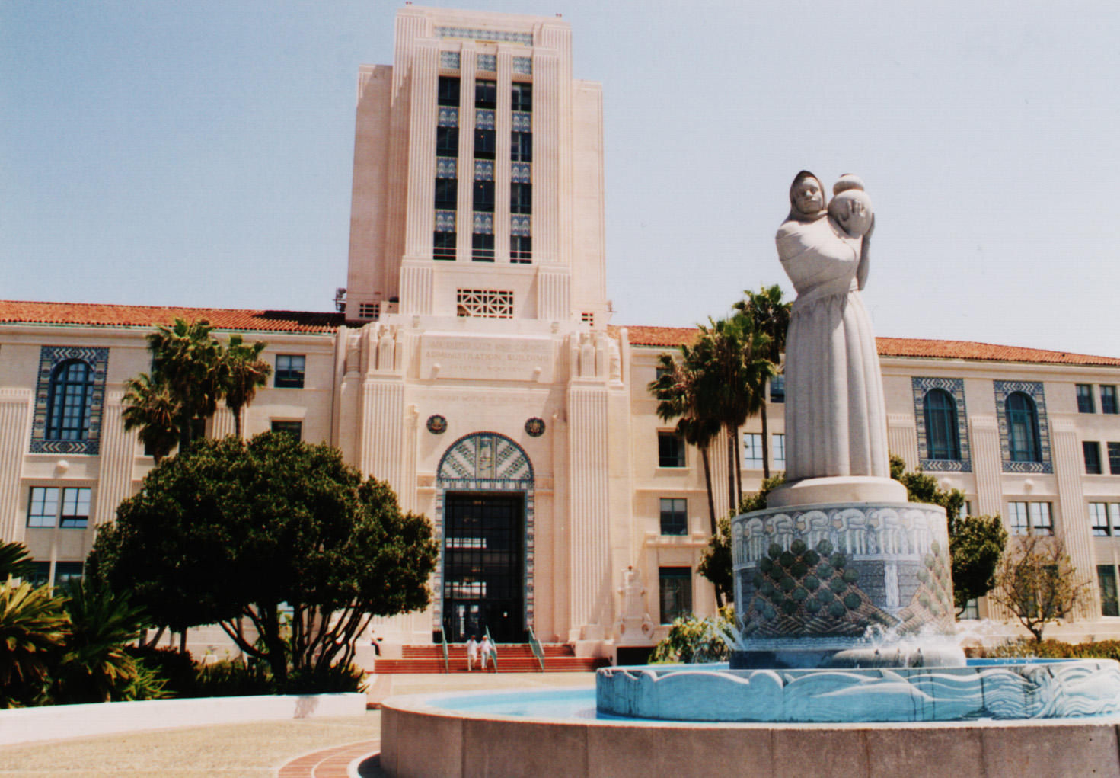
The Code of Ethics
Notes:
The Code of Ethics is a COUNTYWIDE code and is applicable in tandem with The code of conduct.

Slide 7
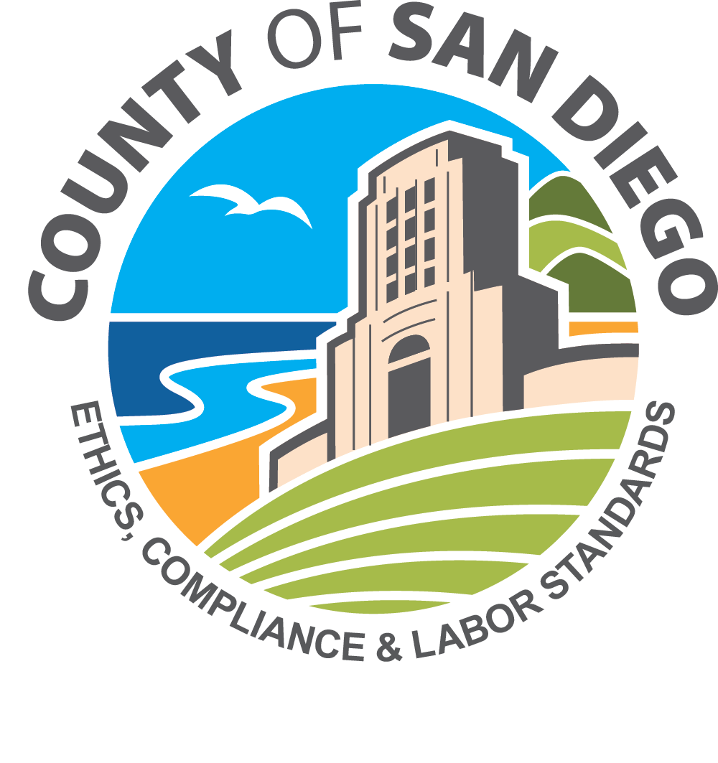
Integrity in Action
The Code of Ethics – Core Principles
Treat everyone with respect & fairness: Uphold dignity in all interactions and ensure decisions are impartial and inclusive of diverse perspectives.
  Obey the law and act ethically: Perform duties within the bounds of laws, avoiding any involvement in illegal or unethical conduct.
  Honor County policies and procedures: Carry out responsibilities in line with established regulations and uphold the highest standards of conduct.
  Use County resources responsibly: Safeguard public funds, equipment, and information as if they were your own — with care and accountability.
  Speak up without fear of retaliation: Promote a culture where ethical concerns can be raised safely and addressed without fear of reprisal.
  Know the rules: Understand the policies, regulations, and ethical expectations applicable to your BCC role.
Notes:
Ethics start with principle — and in San Diego County, those principles are clear and non-negotiable. The Code of Ethics is more than a document; it's a set of commitments that guide behavior across every department and every BCC.
Here, we’ve summarized the six pillars of ethical conduct. From respectful engagement to using public resources wisely, these principles reflect the County's core values and the legal and moral obligations you hold as a public servant.
A helpful reminder: Each BCC member is expected to know and internalize these principles. If in doubt, consult DHR Policy 115 or call the ethics hotline. Your integrity is the foundation of public trust.

Slide 8

Civility & Social Media
Respect in the Public Square
Communicate with accuracy and respect: Ensure all public posts and statements reflect factual information and civil engagement consistent with County values.
  Separate personal opinions from County representation: Always clarify when expressing personal viewpoints online; never imply official County endorsement.
  Avoid harassment, attacks, or inflammatory content: Disrespectful or aggressive online behavior undermines public trust and may violate DHR Policy 117.
  Model professionalism in digital spaces: Your digital conduct is a public reflection of your commitment to fairness, inclusion, and transparency.
  Scenario reflection: A BCC member posts criticism of staff on social media—what could go wrong? Consider reputational, ethical, and policy impacts.
Notes:
In today’s digital world, how we communicate online directly influences how the public perceives County governance. Civility doesn’t end when meetings adjourn—it extends to our online presence.
The County’s DHR 117 Social Networking policy reminds us that while you have the right to express personal opinions, you also have a responsibility to ensure your words don’t erode trust in the institution you serve. Distinguish clearly between personal and official communication.
Ask yourself: Does what I post reflect the County’s values of fairness, respect, and professionalism? If not, reconsider. Online civility is just as vital as civility in the meeting room.

Slide 9



Conflicts of Interest & Relationships
Recognizing and Managing Ethical Boundaries
Understand real vs. perceived conflicts
A real conflict involves direct personal benefit; a perceived conflict arises when others might question your impartiality.
Disclose early and recuse when in doubt
Transparency protects you and the County. When potential conflicts arise, disclose them immediately and step aside from deliberation.
Follow the Political Reform Act & DHR 119
State and County laws require public officials to avoid using positions for personal or financial gain.
Scenario reflection
Your neighbor applies for a County grant reviewed by your board. Even if you’re fair-minded, public perception of bias could harm trust.
Notes:
Conflicts of interest are among the most common ethical challenges in public service. They can be direct—when personal benefit is at stake—or perceived—when the public might reasonably question your impartiality.
San Diego County’s standards, including the Political Reform Act and DHR 119, require both disclosure and recusal when there’s any doubt. These policies exist not to limit participation but to preserve public trust.
Remember: perception often matters as much as reality. Disclose early, recuse when in doubt, and you protect both your reputation and the credibility of the entire BCC process.

Slide 10

Everyone Deserves Respect
Harassment, Discrimination & Retaliation
Zero tolerance for harassment and discrimination: Behavior that demeans, intimidates, or excludes violates County policy (CAO Item 0010‑11) and erodes public trust.
  Recognize, report, and respect: Use the 'See → Say → Stop' model: recognize unacceptable behavior, report it promptly, and maintain a culture of respect.
  Protect against retaliation: Anyone who reports or participates in an investigation is protected from retaliation by County policy and state law.
  Foster inclusion and belonging: Respect diversity in background, perspective, and identity to strengthen public dialogue and equitable decision-making.
Notes:
Respect is not optional — it is foundational. The County’s Non‑Discrimination and Anti‑Harassment Policy, CAO 0010‑11, makes clear that all forms of harassment, discrimination, or intimidation are prohibited, whether they occur in meetings or online.
The ‘See → Say → Stop’ model is a practical way to uphold this policy: recognize when behavior crosses the line, say something early, and take steps to stop it. This isn’t about punishment; it’s about creating a safe and inclusive environment for all participants.
When respect and civility guide our interactions, we build spaces where every voice can be heard — and where public service reflects the diversity of the communities we serve.

Slide 11
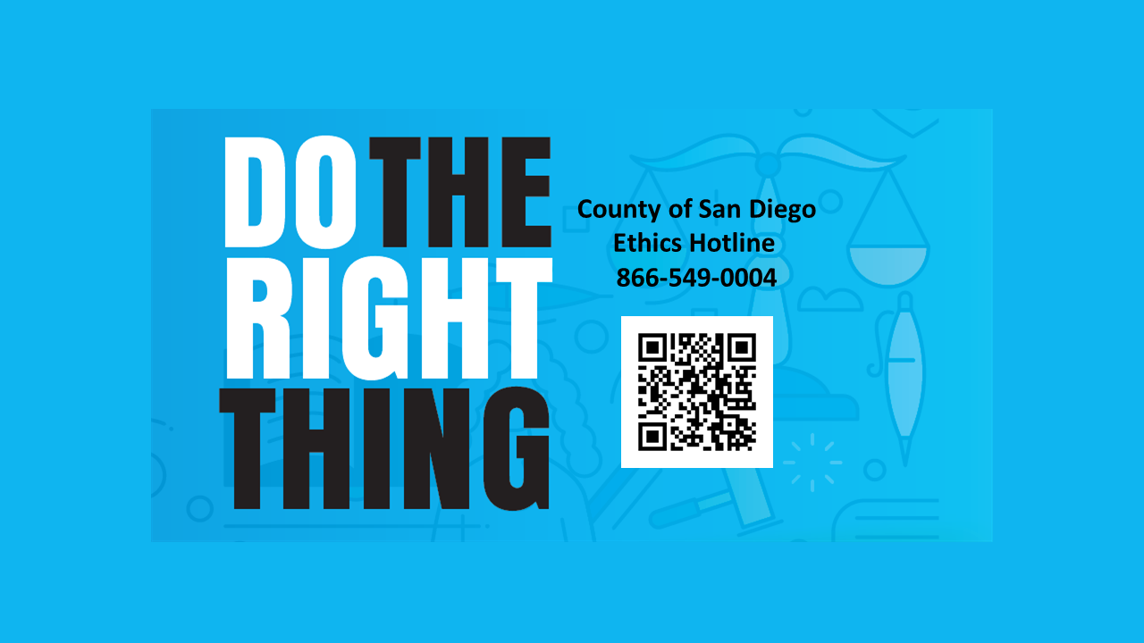

Improper Government Activity
Accountability Through Transparency
Report improper government activity: CAO Policy 0010‑10 authorizes the Office of Ethics & Compliance (OEC) to investigate misuse of County resources, fraud, or ethical violations.
  Know the reporting process: Improper activity reports follow a confidential sequence: Report → Review → Investigation → Outcome.
  Protection from retaliation: County and state law prohibit retaliation against anyone who reports in good faith or participates in an investigation.
  The County’s Ethics Hotline – 24 hours a day, 7 days a week
    Phone 866-549-0004
    Online (webform) mycompliancereport.com

Slide 12


Putting Ethics into Practice
What Would You Do? Apply ethical principles to real scenarios.
Test your understanding of the Code of Conduct and Ethics by evaluating realistic BCC situations.
Scenario 1: Conflict of interest
You discover a family member benefits from a County decision you’re advising on — do you disclose or recuse?
Scenario 2: Civility challenge
A heated exchange occurs during a public meeting — how do you model calm and professionalism?
Scenario 3: Confidentiality breach
A fellow member shares privileged County information on social media — what steps should follow?
Notes:
This is where the Code becomes more than words — it becomes action. Ethical decisions often arise in gray areas where policies may not offer an immediate answer.
Consider these three examples: a potential conflict of interest, a moment of incivility, and a confidentiality breach. In each case, the ethical path depends on applying the principles of transparency, fairness, and integrity.
Use these scenarios as opportunities to discuss, debate, and reflect. What would you do in each situation? Ethical leadership is not about perfection — it’s about awareness, courage, and consistent accountability.

Slide 13
Resources & Contacts
Where to Find Help and Guidance
Code of Conduct / BCC Administration: Clerk of the Board –
📧 bcc@sdcounty.ca.gov
BCC County representative
County Counsel: County Counsel assigned to your BCC
☎️ (619) 531-4860
Code of Ethics: Office of Ethics & Compliance –
📧 OEC@sdcounty.ca.gov | ☎️ (619) 531-5174
Notes:
Knowing where to go for information is essential. Ethical governance depends on both clear guidance and easy access to resources.
The Clerk of the Board oversees BCC operations and is your first stop for questions about the Code of Conduct. For ethical concerns or to file a confidential report, reach out to the Office of Ethics & Compliance through email or the hotline.
Human Resources remains a key partner for questions about workplace behavior, training, and compliance. Keep these contacts handy — they ensure support and accountability at every level of service.

Slide 14
Thank you!
Questions on the Code of Conduct?
Clerk of the Board Staff: bcc@sdcounty.ca.gov
Questions on the Code of Ethics?
Office of Ethics and Compliance: OEC@sdcounty.ca.gov

