Slide 1
HMD Workshop
Hazardous Materials & Hazardous Waste for Breweries, Wineries & Distilleries

Slide 2




Your Presenters
Kelly Robertson
Supervising Environmental Health Specialist
Kelly.Robertson@sdcounty.ca.gov
Chantal Eivaz
Environmental Health Specialist II
Chantal.Eivaz@sdcounty.ca.gov
Yvonne Chavarin
Environmental Health Specialist I
Yvonne.Chavarin@sdcounty.ca.gov
Kevin Valdez
Environmental Health Specialist I
Kevin.Valdez@sdcounty.ca.gov

Slide 3

Goals of the Workshop
Introduce you to the Hazardous Materials Division – otherwise known as the CUPA – and give you contact info
Give you high level information about how to recognize hazardous materials or hazardous waste in your workplace
Provide tips on how to easily be in compliance, how to find answers, and how to work safely with these hazards
Get assistance with permits and environmental reporting
Help you prepare for an inspection!

Slide 4

AGENDA
01
What are Hazardous Materials?
Chantal Eivaz
02
Hazardous Waste Basics
Kelly Robertson
03
Clean-In-Place Process and Wastewater Basics
Yvonne Chavarin
04
CERS Reporting
Kevin Valdez
05
HMD Compliance Inspections – What to Expect
Chantal Eivaz

Slide 5


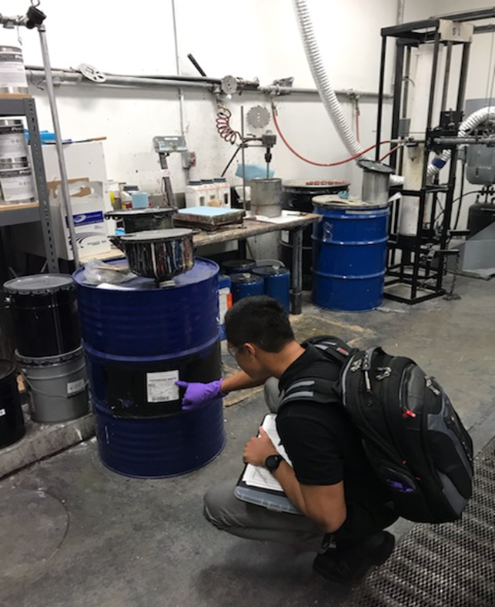
Hazardous Materials Division (HMD)
Also the CUPA (Certified Unified Program Agency)
Protecting public health and safeguarding environmental quality
Educating businesses and the public to increase awareness
Continuously provide expert and efficient chemical, biological and radiological emergency response

Slide 6
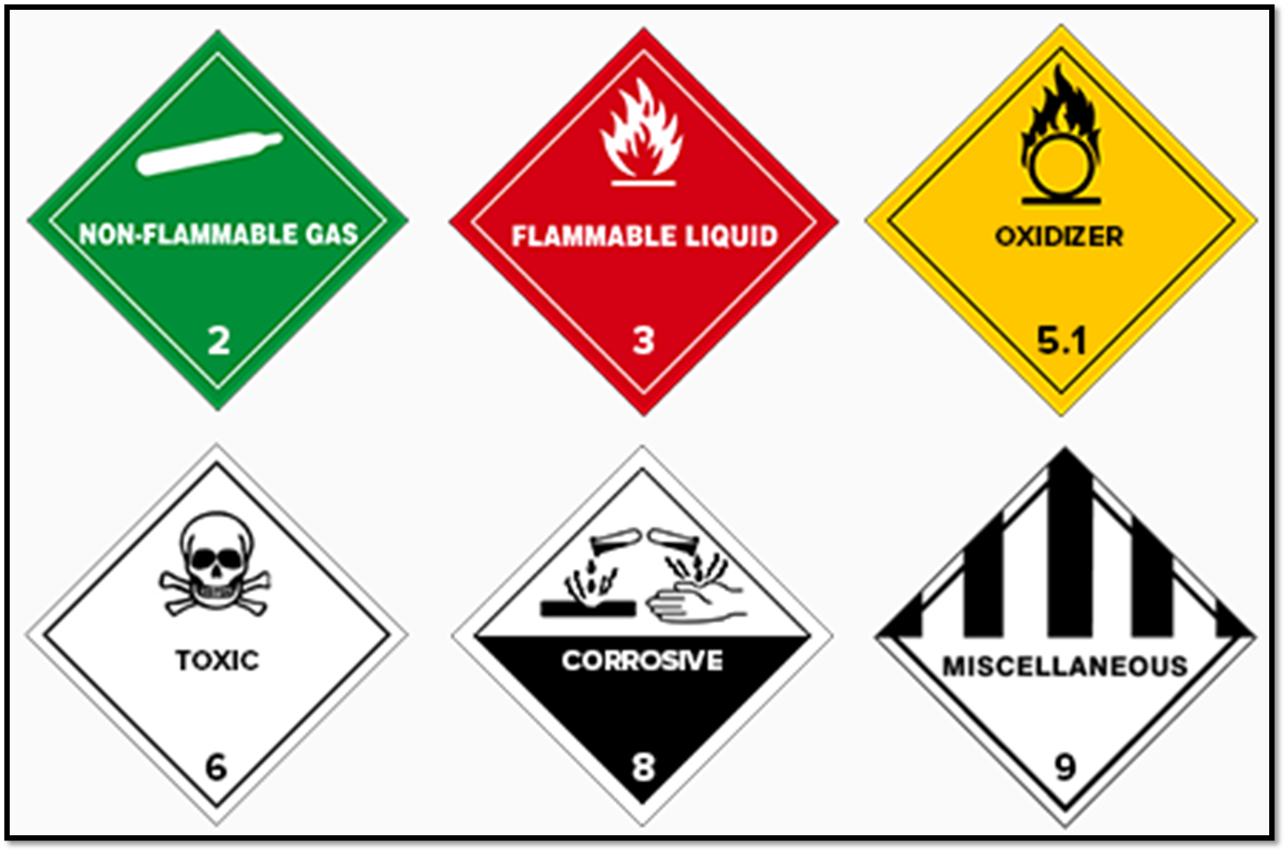
What are Hazardous Materials?

Slide 7
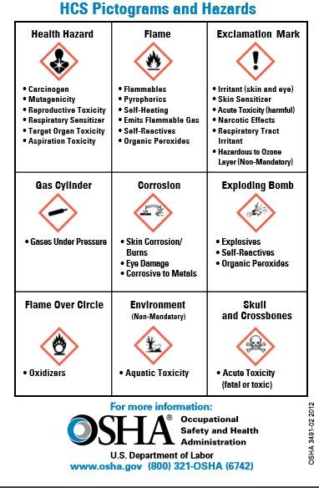
Definition: §HSC 25501
  Per Health & Safety Code §25501(n):
  (1) “Hazardous material” means a material listed in paragraph (2) that, because of its quantity, concentration, or physical or chemical characteristics, poses a significant present or potential hazard to human health and safety or to the environment if released into the workplace or the environment, or a material specified in an ordinance adopted pursuant to paragraph (3).
  (2) Hazardous materials include all of the following:
  (A) A substance or product for which the manufacturer or producer is required to prepare a material safety data sheet pursuant to the Hazardous Substances Information and Training Act (Chapter 2.5 (commencing with Section 6360) of Part 1 of Division 5 of the Labor Code) or pursuant to any applicable federal law or regulation.

Slide 8
Common Hazardous Materials
Compressed Gas
◦ Oxygen, Nitrogen, CO₂
Stabilizing additives
Acids & bases
◦ Used for wastewater neutralization
Caustic liquids, solvents, cleaning solutions
Propane
◦ Used for forklift operation
Ethanol

Slide 9
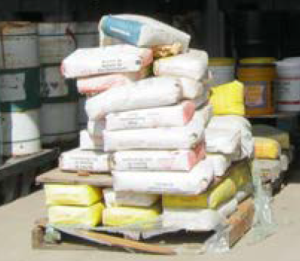
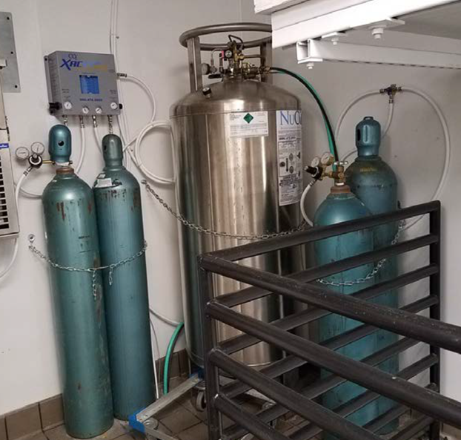
Hazardous Materials Business Plan Thresholds
55 gallons for liquids
500 pounds for solids
200 ft³ cubic feet for gases

Slide 10


Exemptions
CO₂ used for beverage carbonation
Reportable at 6000 ft³ (or 686 pounds, or 81 gallons, or 307 liters in tank capacity) for non-cryogenic compressed gas
Reportable at 3500 ft³ (or 400 pounds, or 47 gallons, or 179 liters in tank capacity) for cryogenic/liquefied compressed gas
Inert Gases Classified as Simple Asphyxiant or Pressure Release Only
Reportable at 1000 ft³
Materials Classified as Irritant or Sensitizer Only
Reportable at 550 gallons or 5,000 lbs
Propane
In use on forklift = exempt….spares are reportable
Exempt up to 1,000 gallons if used for the sole purpose of cooking, cooling, heating
https://www.sandiegocounty.gov/content/sdc/deh/hazmat/hazmat/hmd_chem_reporting_changes.html

Slide 11
HMBP Requirements
Facilities subject to Hazardous Materials Business Plan requirements are required to comply with the following in San Diego County:
Obtain a Unified Program Facility Permit
Establish an HMBP & submit electronic-ally in CERS
Annually certify HMBP in CERS
Update CERS account information within 30 days of any changes
HMBP readily available to facility personnel & the CUPA
Conduct & document annual HMBP training – Keep records for 3 years
Report hazardous materials releases & threatened releases to the CUPA & OES upon discovery

Slide 12


Hazardous Waste Basics

Slide 13




Does it exhibit a Characteristic?
[22 CCR, Div. 4.5, Ch. 11, Art. 3]
IGNITABILITY
Flash Point < 140ºF
CORROSIVITY
pH ≤ 2 or pH ≥ 12.5
D001
D002
Characteristic
D003
D004-D043
REACTIVITY
Unstable;
reacts violently with water
TOXICITY
Harmful or fatal
when absorbed, inhaled,
or ingested

Slide 14
Ignitability
A liquid with a flash point of < 140° F
Not a liquid capable of causing fire or that burns vigorously and persistently
An ignitable compressed gas
An oxidizer (per 49 CFR)
D001
Examples: solvents (acetone, solutions with >24% alcohol); thinners; chlorates, nitrates, organic peroxide, etc.
[22 CCR 66261.21]

Slide 15
Corrosivity
It’s aqueous and has a pH ≤ 2 or ≥ 12.5
It’s a liquid and corrodes steel at a rate ≥ 0.25 inch per year at 130°F
It’s not aqueous or liquid, but when mixed with water produces a solution that meets either of the above
D002
Examples: sulfuric acid, sodium hydroxide, etc.
[22 CCR 66261.22]

Slide 16

Reactivity
It’s normally unstable
It reacts violently with water
It generates toxic gases, vapor or fumes
D003
Examples: picric acid, ethyl ethers, dinitro compounds, sodium metal, peroxide forming chemicals, etc.
[22 CCR 66261.23]

Slide 17
Toxicity
Fails either of the following:
  Toxic Characteristic Leaching Procedure (TCLP)
  Wet Extraction Test (WET)
  Soluble Threshold Limit Concentration (STLC)
  Total Threshold Limit Concentration (TTLC)
  Aquatic Toxicity (fish bioassay)
LD50, LC50 calculations
  Acutely HW
  Extremely HW
Carcinogenic substances
D004 - D043
Examples: heavy metals (Pb, Hg, Cr, etc.), PCBs, DDT, etc.
[22 CCR 66261.24]

Slide 18
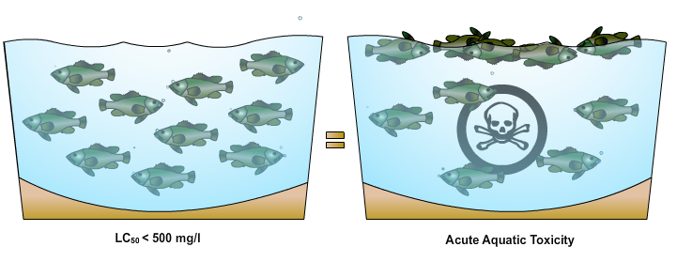
Aquatic Toxicity – Fish Bioassay
A waste can be tested for aquatic toxicity by placing some waste in a test water tank and introducing one of three acceptable fish species: fathead minnows, rainbow trout or golden shiners.
Waste is hazardous by aquatic toxicity if a 96-hour LC₅₀ is less than 500 mg/liter. 96-hour LC₅₀ < 500 mg/l = acute aquatic toxicity

Slide 19
Waste Classification – Point of Generation
Point of generation (POG): is when a material first meets the definition of a solid waste. Once a solid waste, the waste determination must be made.
Solid waste includes solids, liquids, semi-solids, and contained gaseous materials which are abandoned (thrown away), burned, or stored, treated, accumulated before or instead of being abandoned, and some recycled materials.
POG is important for making a proper waste determination.

Slide 20
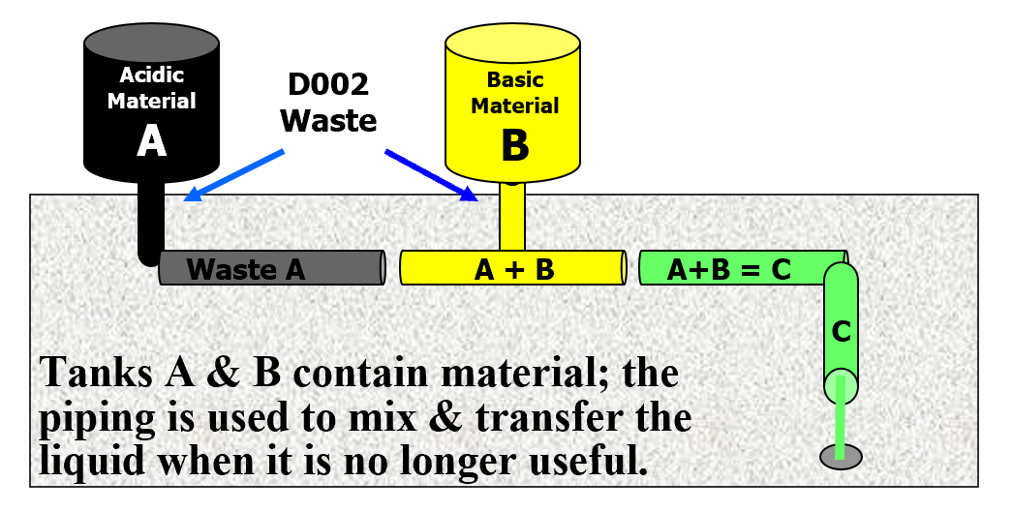
Hazardous Waste Classification & POG
Non-hazardous
Waste C
is discharged to POTW
Where is (are) the point(s) of generation?

Slide 21
What is a Hazardous Waste Generator?
[40 CFR 260.10]
Any person, by site, whose act or process produces a hazardous waste or whose act first causes a hazardous waste to become subject to regulation.

Slide 22
Hazardous Waste & Waste
Classification Issues
Who makes the HW determination?
THE GENERATOR

Slide 23
Accumulation Time Limits – Small
Quantity Generator (SQG)
Accumulation Time Limit for non-acute/non-extremely hazardous waste: 180 days or 270 days (if the destination facility is > 200 miles away)
Limit for acute/extremely hazardous waste: 90 days from the date 1 kg is first accumulated

Slide 24

Training Requirements – SQG
Must ensure all employees are thoroughly familiar with proper waste handling and emergency procedures, relevant to their responsibilities during normal facility operations and emergencies.
However, training documentation is required if you are subject to HMBP requirements, per HSC 6.95.

Slide 25
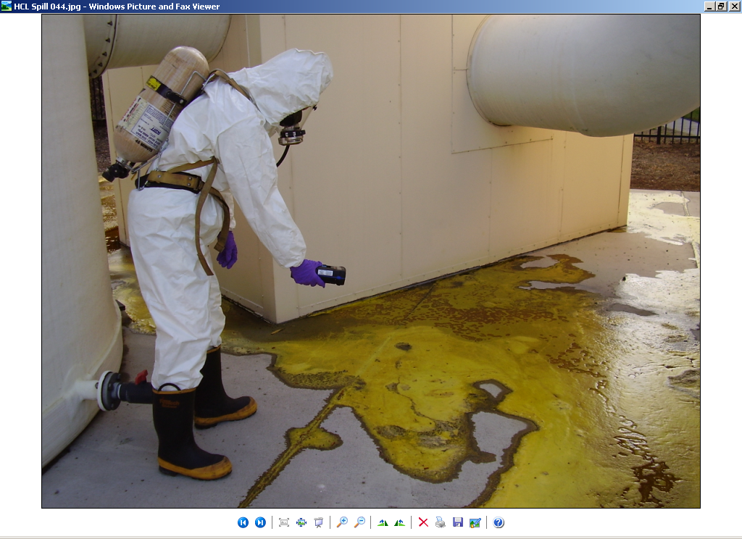
Contingency Plan
22 CCR §66265.50 - §66265.56
A written plan that has emergency procedures designed to minimize hazards to human health and the environment. The contingency plan will help all emergency responder teams handle any emergency involving stored hazardous waste.
All hazardous waste generators are responsible to plan for emergencies at their business and are required to have a contingency plan.

Slide 26
HW Container Management
22 CCR Chapter 15, Article 9
“Container” means any device that is open or closed, and portable in which a material can be stored, handled, treated, transported, recycled or disposed of. [22 CCR 66260.10]
Containers requirements:
Closed and labeled
Compatible with contents
In good condition and not leaking
Ignitable, reactive wastes 50 feet from the property line
Incompatibles stored separately
Inspected weekly
Adequate aisle space
A waste label must be placed on the waste container as soon as the first drop of waste is added

Slide 27
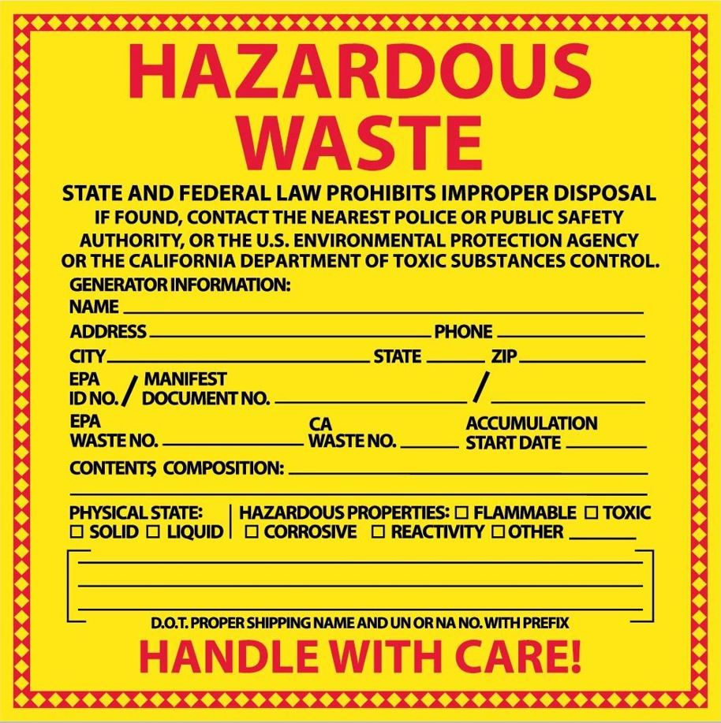
HW Container Management
22 CCR Chapter 15, Article 9
Information required to be clearly marked and visible on each container and tank:
“Hazardous Waste”
Accumulation start date
Additional information required on each container and portable tank:
Composition and physical state
Hazardous properties
Name and address of generator

Slide 28

Hazardous Waste Disposal
Hazardous waste may not be:
Dumped down the drain
Discharged to sanitary sewer
Discarded with the trash
Allowed to evaporate into the atmosphere

Slide 29
EPA ID Numbers
What type of ID number does a generator need?
Small Quantity Generators of Hazardous Waste need a California EPA ID number (Not a Federal EPA ID number)

Slide 30
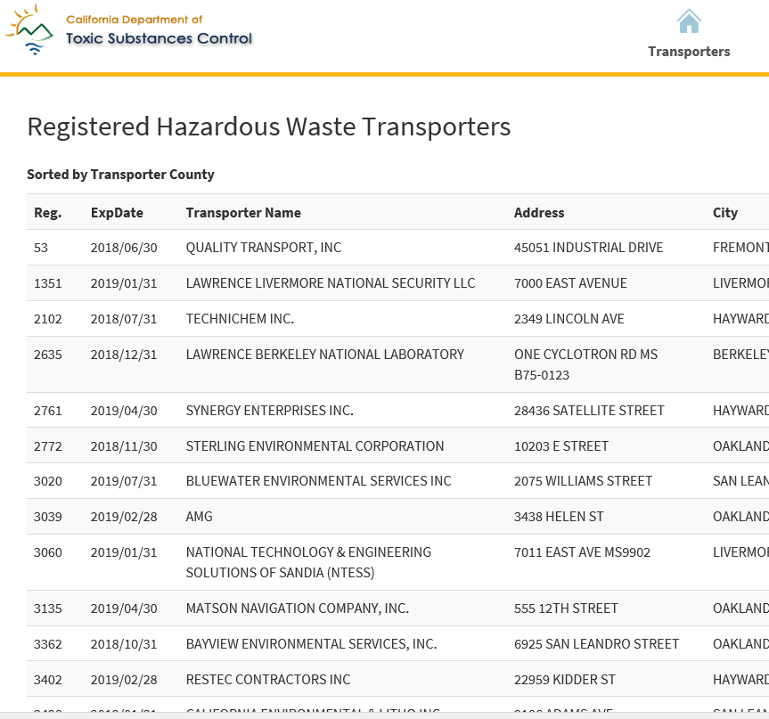
Registered Transporters
In California, unless specifically exempted, it is unlawful for any person to transport hazardous wastes unless the person holds a valid registration issued by the California Department of Toxic Substances Control (DTSC).
The list of California Registered Hazardous Waste Transporters is found on the DTSC webpage:
https://hwts.dtsc.ca.gov/transporters/

Slide 31
Clean-In-Place Process
and Wastewater Basics
from a CUPA perspective

Slide 32
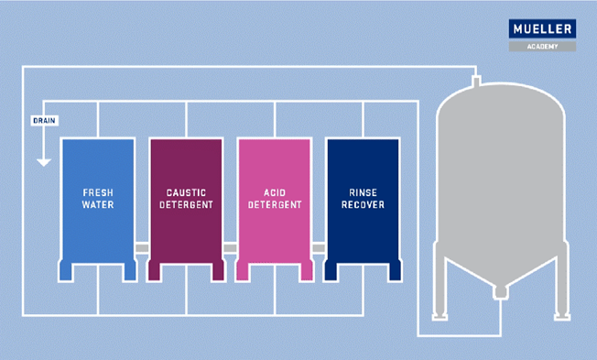
Clean-In-Place (CIP) Overview
CIP is a method used to routinely clean the interior surfaces of food-processing equipment (tanks, vessels, piping) without disassembly
Involves the use of various chemical agents which are cycled through the equipment at different concentrations and
temperatures

Slide 33
Clean-In-Place (CIP) Overview
CIP is used for quality control and food safety purposes
  Removes soils and unwanted microorganisms
  Prevents cross-contamination
  Optimizes chemical and water use
After CIP, the wastewater is discharged to sewer
  Wastewater may be treated before
  discharge to meet pretreatment
  requirements (regulated by Industrial Wastewater Agency)

Slide 34
How is CIP regulated by the HMD?
Hazardous materials used in your CIP process may be subject to environmental reporting requirements
Hazardous wastes are potentially generated from CIP and must be managed accordingly
Neutralization of hazardous wastes is a form of treatment which typically requires a treatment permit
from the CUPA
Treatment permit may be exempted under
certain conditions at food-processing facilities
PLEASE NOTE: HMD is not the industrial discharge agency
and any facility that is discharging industrial waste to the
sewer must contact the Industrial Wastewater Control
agency

Slide 35
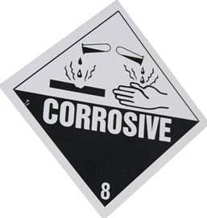
Hazardous Materials involved in CIP
Various acidic and alkaline materials (also called caustics or corrosives) are used in CIP
  Examples: sodium hydroxide (NaOH), peracetic acid (PAA), phosphoric acid
  Both solids and liquids
  If the quantity of any hazardous materials reaches 55-gallons (liquid) or 500-pounds (solid), the hazardous material must be reported in CERS as a part of your Hazardous Materials Business Plan (HMBP)
Review safety data sheet (SDS) to
determine chemical composition, hazards
and emergency procedures

Slide 36
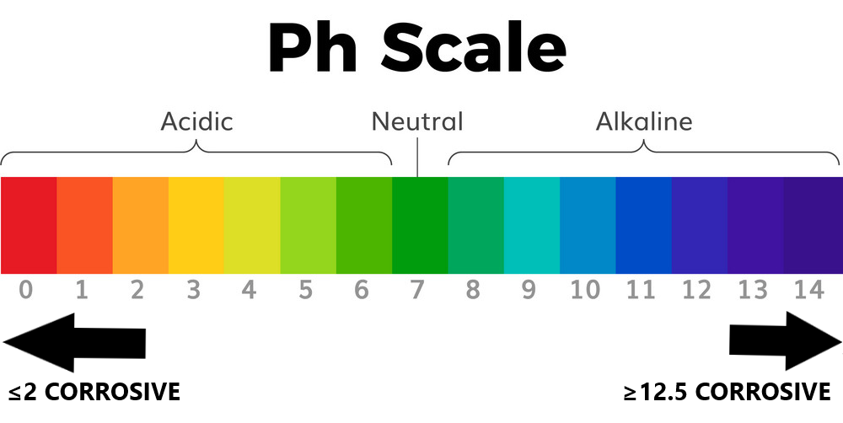
Hazardous Wastes may be generated from CIP
Acidic/alkaline materials will alter the pH of the CIP rinse water
Wastewater generated from CIP can be corrosive and/or toxic
Corrosive waste: pH less than or equal to 2.0 pH greater than or equal to 12.5 Liquid with the ability to corrode steel | Toxic waste: Harmful when ingested or absorbed Carcinogenic 8 characteristics defined in the California Code of Regulations, Section 66261.24 Depends on amount/concentration

Slide 37
CIP - Hazardous Waste Determination
The generator must make a hazardous waste determination at the point of generation
    The point-of-generation is the point at which the CIP rinse water in the food processing equipment becomes a waste (wastewater)
    CIP wastewater must be unadulterated at the point-of-generation
    pH meter, knowledge of process, laboratory analysis
The hazardous waste determination must be made before the CIP wastewater is altered and/or discharged to ensure proper management

Slide 38
Neutralization and discharge of CIP
Wastewater at SIC Group 20 Facilities
Neutralization of hazardous (corrosive) waste typically requires
a treatment permit from the local CUPA
Facilities in the SIC Code Major Group 20 (Food and Kindred
Products) conducting "food processing operations" are permitted to treat hazardous waste for discharge to sewer
  "Food processing operations" includes sanitizing of all
  associated equipment and vessel cleaning operations
SIC Group 20 facilities are either permitted under the
Conditionally Exempt-Specified Wastestreams tier
(HSC §25201.5(c)) or exempted from a treatment permit under certain conditions (HSC § 25201.13)

Slide 39
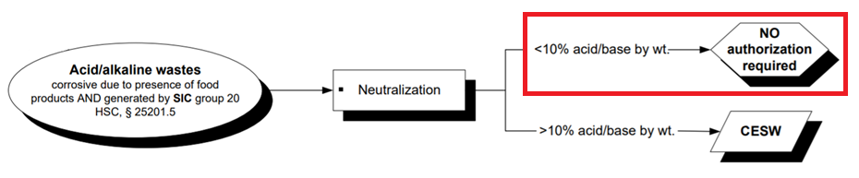
Conditions of Exemption from a Treatment Permit
Health & Safety Code § 25201.13
Neutralization of hazardous waste at SIC Group 20 facilities may be
exempted from a hazardous waste treatment permit, if all of the following
conditions are met:
  1. Wastewater is hazardous solely due to the corrosivity or toxicity
  characteristic
  2. Wastewater does not contain more than 10 percent acid or base
  concentration by weight and are treated in vessels and piping that are compatible with temperature and pH levels
If the wastewater contains more than 10 percent acid or base concentration by weight, the facility requires a Conditionally Exempt-Specified
Wastestreams (CESW) permit

Slide 40
HMD does not oversee industrial wastewater pretreatment/discharge requirements
  Although HMD permits the treatment of hazardous wastes generated in CIP, wastewater pretreatment and discharge requirements are regulated by your Industrial Wastewater Agency. For more information, contact the City of San Diego, Industrial Wastewater Control Program (IWCP):
  Industrial Wastewater Control Program (IWCP)
  https://www.sandiego.gov/public-utilities/permits-construction/industrial-user-permits
  9192 Topaz Way, MS 901D
  San Diego, CA 92123
  (858) 654-4100

Slide 41

BREAK

Slide 42
CERS REPORTING
  What a Hazardous Materials Business Plan (HMBP) consists of
  How to complete a submittal in CERS
  Provide tips for submittal process

Slide 43

Submittal Guidance
https://cers.calepa.ca.gov/
Businesses in the County of SD subject to a Unified Program Facility Permit are required by law to maintain their permit and submit their information
electronically through the CERS website
HMD uses information in the CERS website for permitting and regulating
  First Responders also use information in CERS
If facility has never had a Unified Program Facility Permit, a CERS Application
must be completed and returned to our Division.
Link: CERS Application

Slide 44
Submittal Elements
Facility Information
  Business Activities
  Business Owner/Operator Identification
Hazardous Materials Inventory
  Inventory
  Site Map
Emergency Response and Training Plans
  Response Plan
  Training Plan

Slide 45
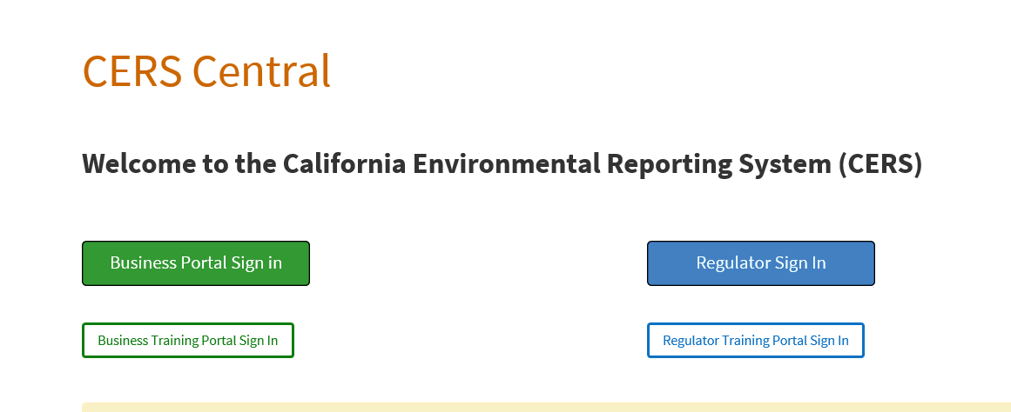
Submittal Example
https://cers.calepa.ca.gov/

Slide 46
Review of Submittal
by CUPA
Submittals must be accurate in order to be accepted
Business responsibility to update information if regulator places submittal in under review or not accepted status
Failure to make updates may result in violation since facility is not in compliance with requirements
If accepted, submittal element appears accurate to regulator at that time and a comment will be sent to the users
Submittal status may be updated to under review/ not accepted if inspector goes on site and determines submittal is not accurate

Slide 47
CERS Submittal Tips
CERS is your permitting information. Ensure it is accurate
CERS ID and permit # are address and owner specific
Documents should be uploaded in PDF format
Visit our HMD website for helpful resources

Slide 48
CERS Submittal Tips
AB 1429
  If facility has no changes to information, you can use recertify button in CERS
  Certify every year
HMBP submittal guidance Documents
  https://www.sandiegocounty.gov/content/dam/sdc/deh/hmd/pdf/hmbp/HM-952%20(04-2019).pdf
CERS Help Desk: 858 505-6990 (Hours: 8am-3pm)

Slide 49

HMD Compliance
Inspections – What to Expect

Slide 50

Introduction
Your CUPA Inspector will….
Display their credentials
Explain the purpose of their visit to the facility
Explain the type of inspection to be conducted (e.g., initial, routine, complaint investigation)
Explain inspection process (i.e., walkthrough + document review)
Request an escort for the walk-through

Slide 51
The Walkthrough
Areas that will be inspected include:
HM storage, fermentation, filtration, CIP, lab, even outside…
Verification of Hazardous Materials Business Plan elements
Verification of CERS inventory and site map
May take photographs and collect samples
Facility will receive a copy of photos/split sample

Slide 52
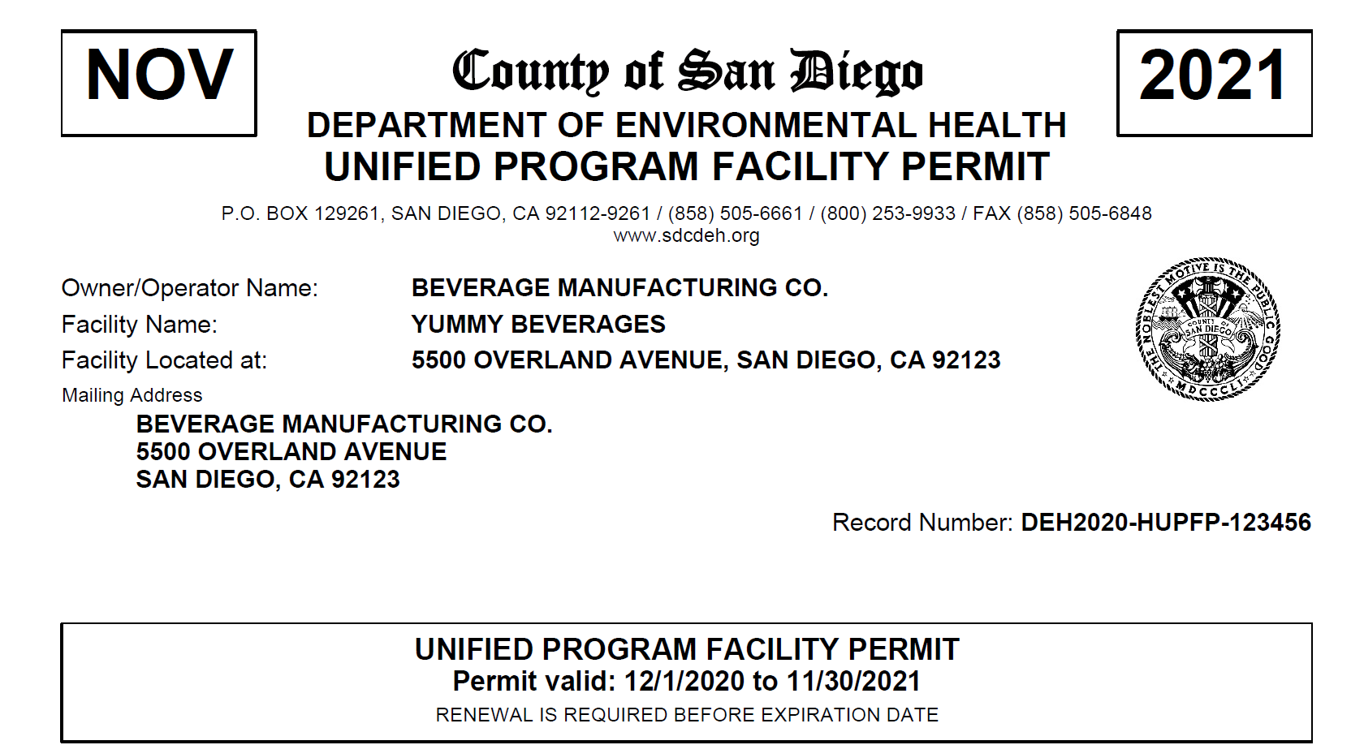
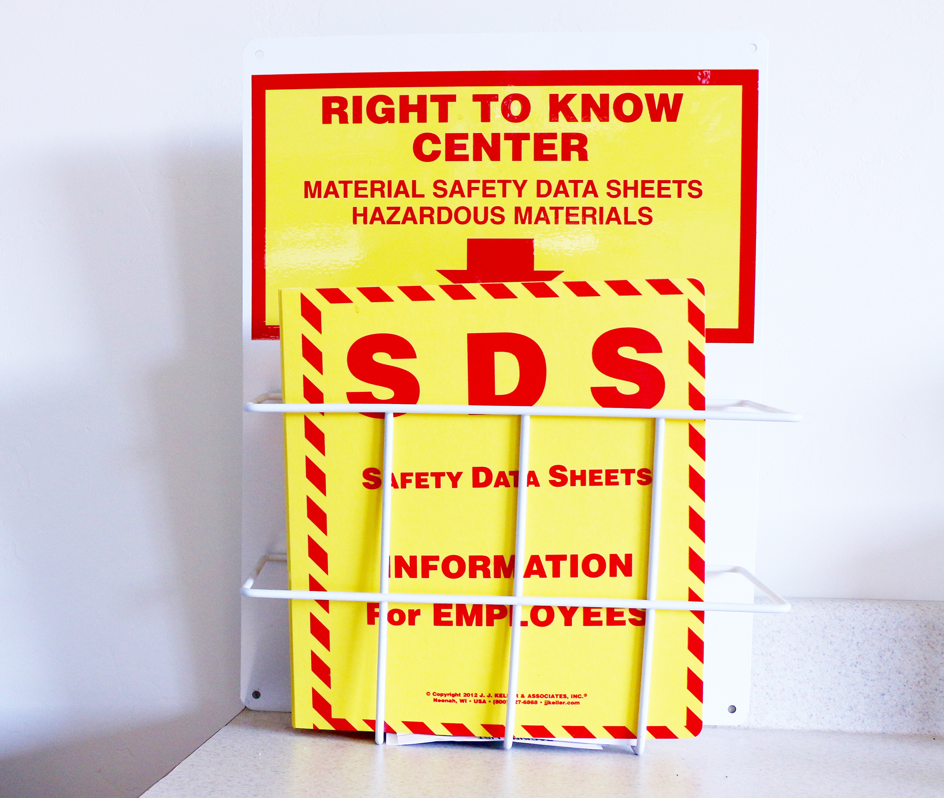

Document Review
The following items will be reviewed during the inspection:
Unified Program Facility Permit
Hazardous Materials Business Plan
  CERS annual certification
Safety Data Sheets
Employee training logs
https://www.chem-map.com/chemical_news/understanding-safety-data-sheets/

Slide 53

Report Review
Review report with facility contact →
Introduction, Violations, Corrective Action, Remarks (potential action items)
Obtain signature to confirm review of report with facility representative(s)
Email inspection report & photos to facility representative(s) following the inspection
  Your CUPA Inspector will….

Slide 54
Most Common Violations
Unified Program Facility Permit not obtained for hazardous materials
HMBP not established/submitted in CERS
HMBP not annually certified in CERS
HMBP not updated with 30 days of substantial change
Employee training not annually conducted and/or not documented

Slide 55
QUESTIONS?
HMD Duty Desk
Phone Number: (858) 505-6880
Email: hmdutyeh@sdcounty.ca.gov

