Slide 1

SAM FALL FORUM 2014
Site Assessment and Mitigation Program
Department of Environmental Health – County of San Diego

Slide 2
LEGISLATIVE UPDATE
Senate Bill (SB) 445, signed September 8, 2014, extended UST Program authorization for 10 years
The funding basis of 2 cents per gallon was renewed for remediation of UST releases
10-year program for removing remaining single-walled USTs initiated

Slide 3
CURRENT ACTIVE CASES
Funding Source # Cases
LOP UST Cleanup Fund 293
VAP Private Party 175
CAP Private Party 1
Site Designation Private Party 6

Slide 4
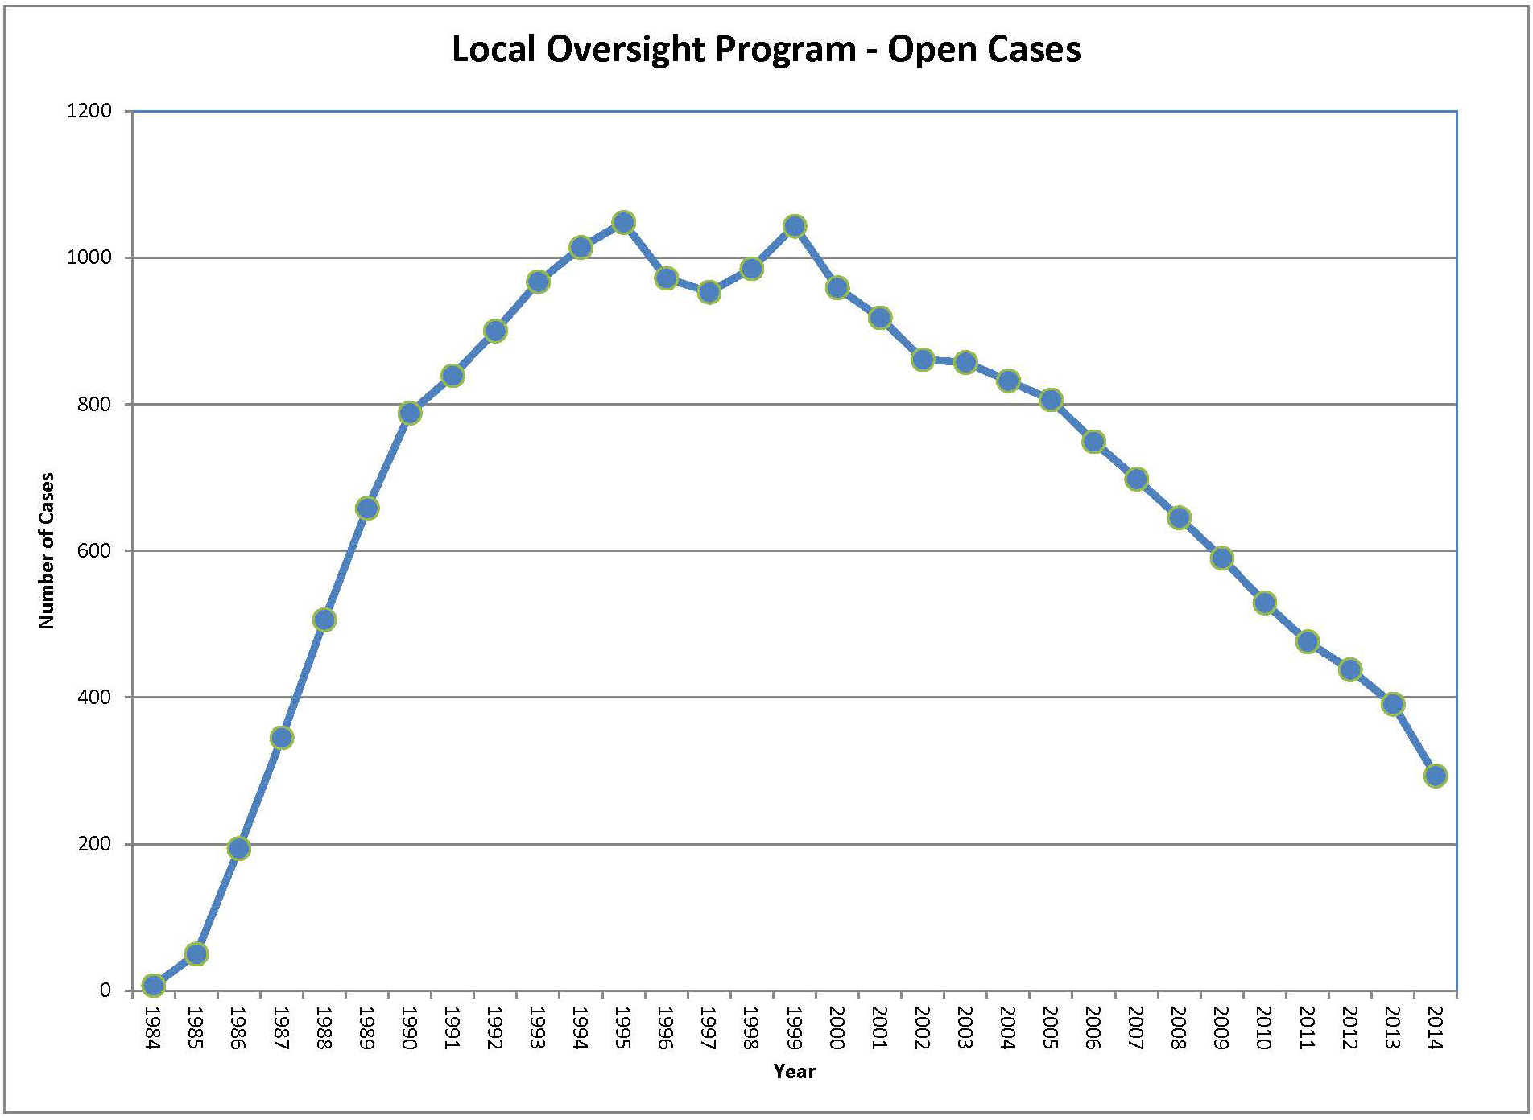

Slide 5
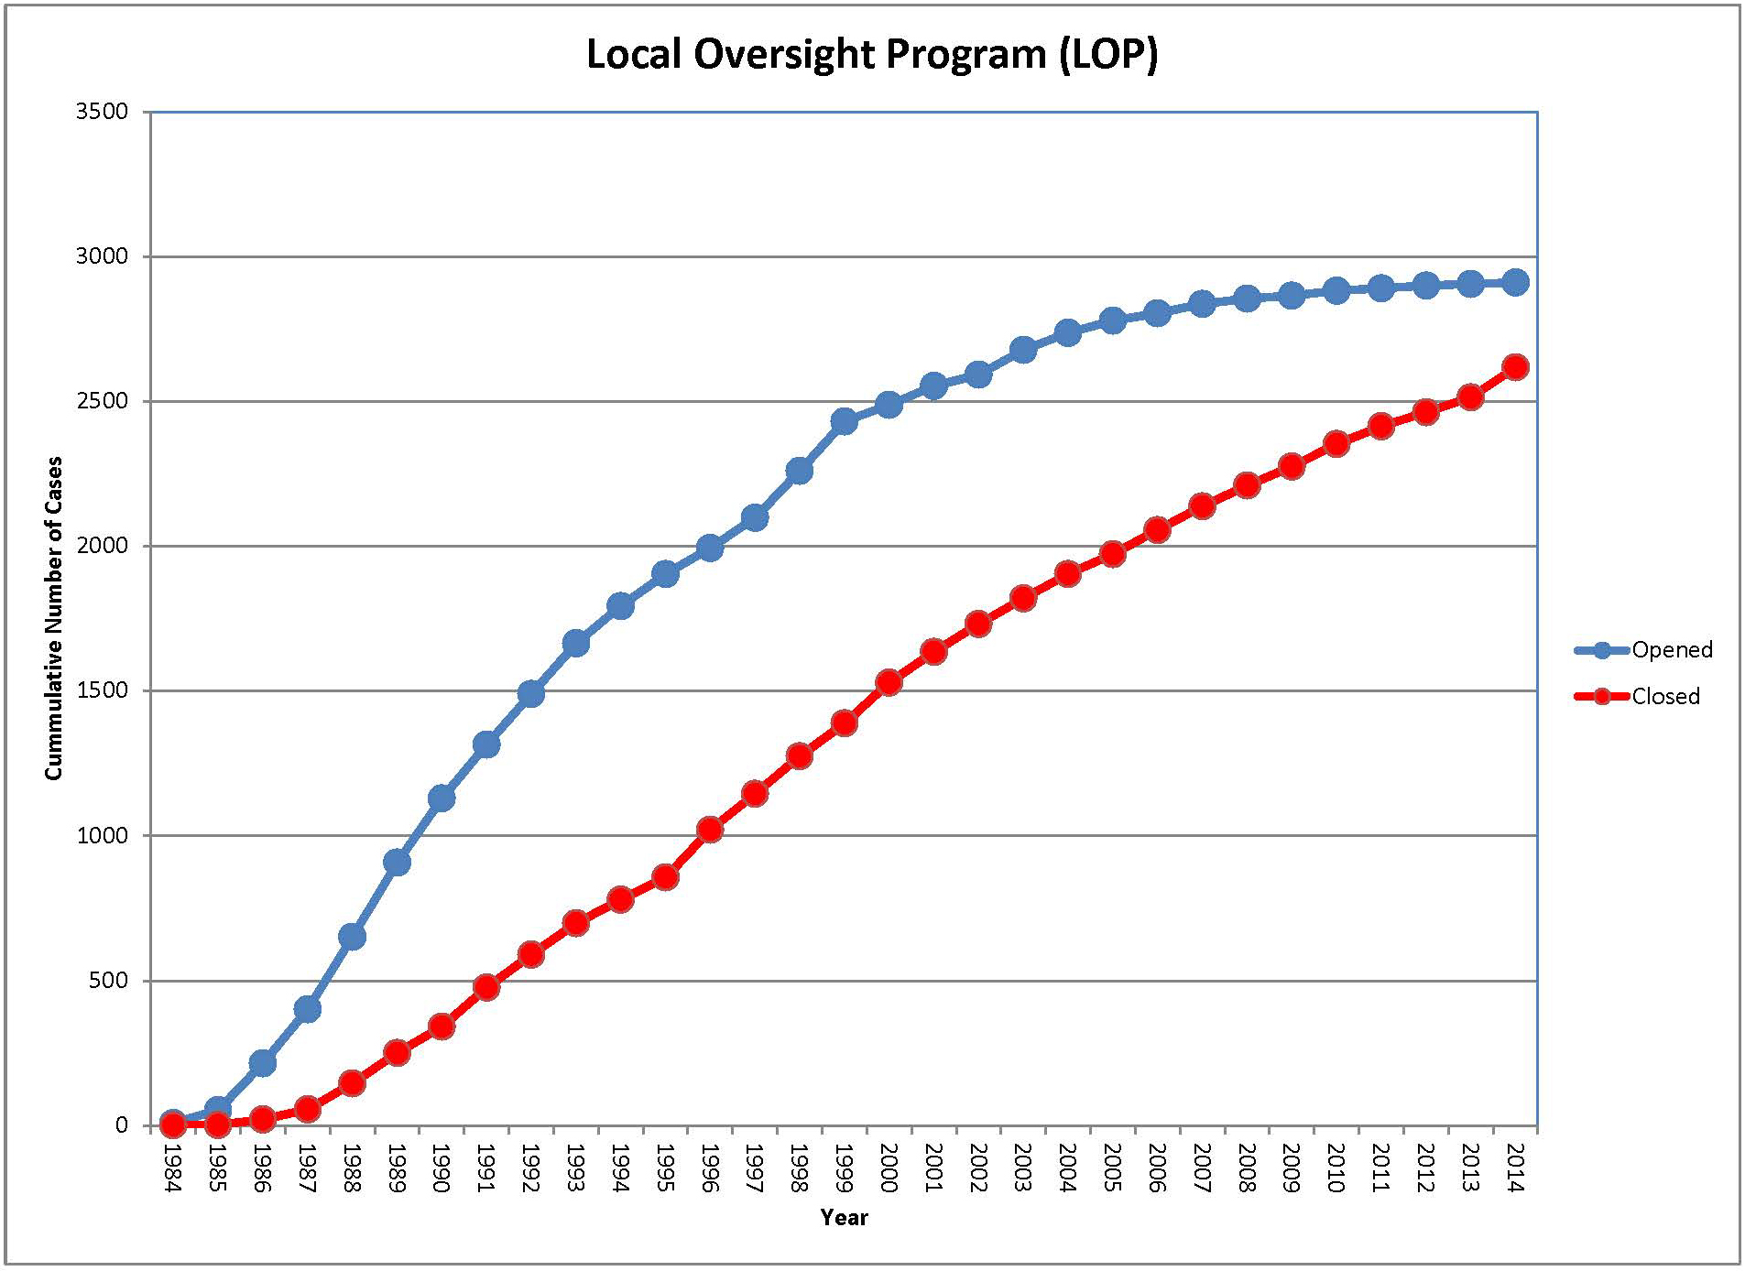

Slide 6
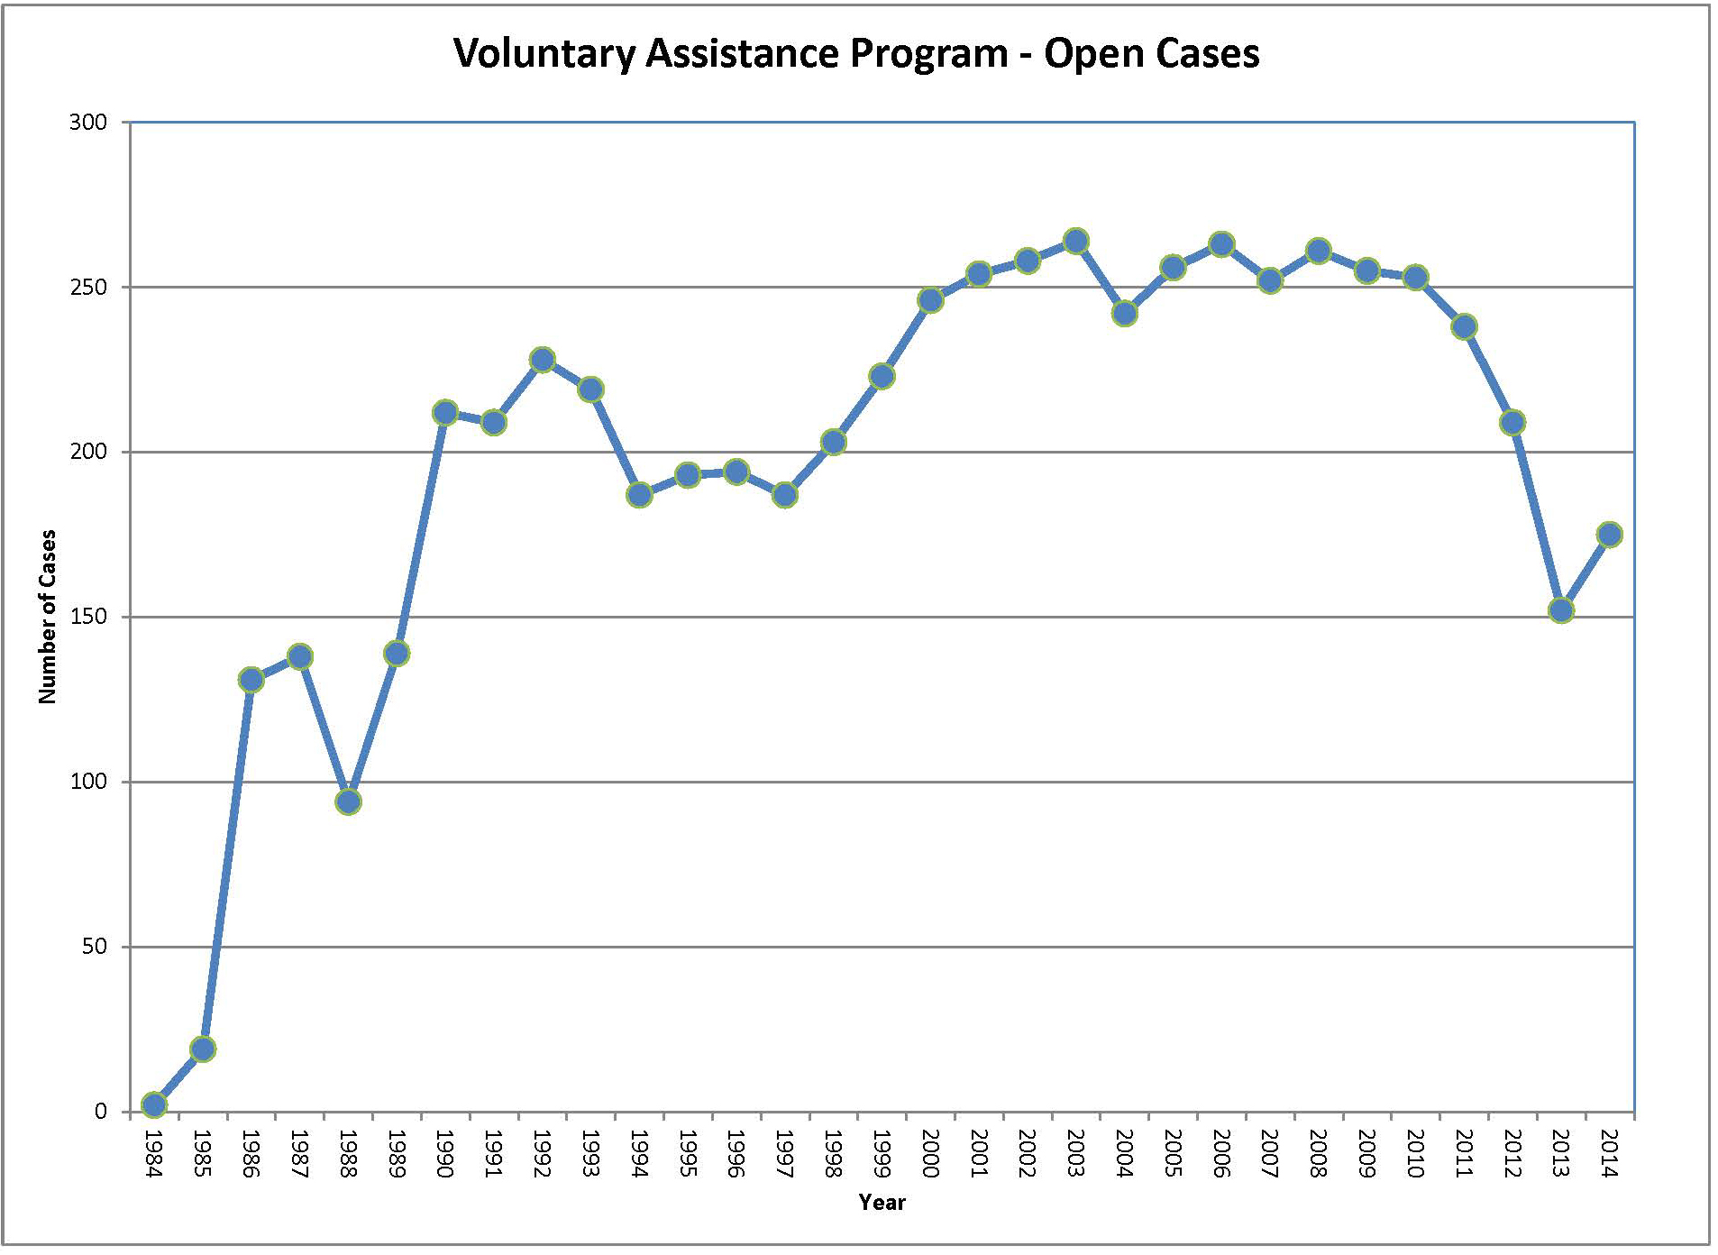

Slide 7
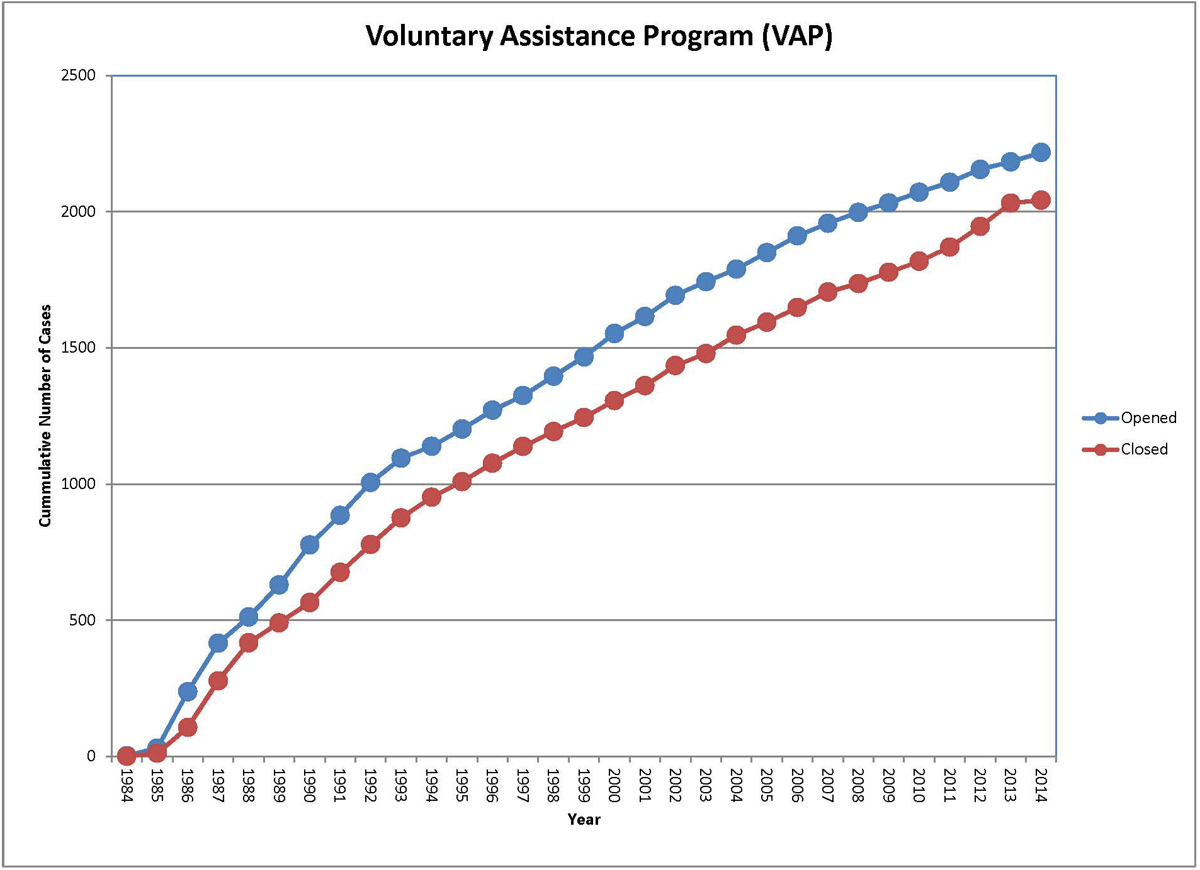

Slide 8
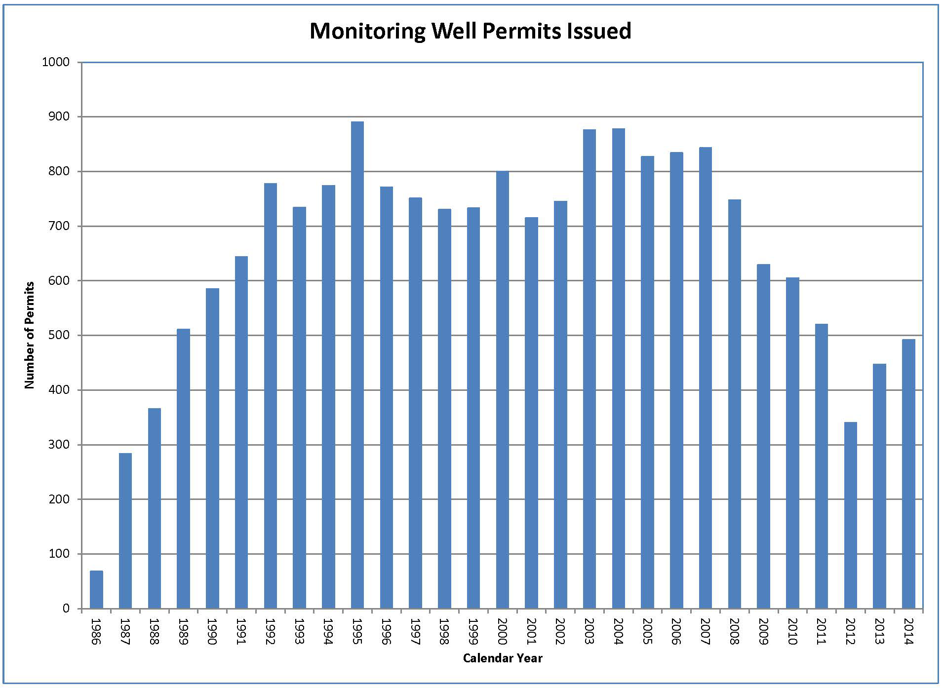

Slide 9
Corrective Action Program: Working with Your Local Agency to Solve Local Problems Neil Searing County of San Diego Department of Environmental Health Site Assessment & Mitigation Program

Slide 10
Corrective Action Designation
On February 28, 2014, the Department of Toxic Substances Control (DTSC) delegated authority to DEH, as the local Certified Unified Program Agency (CUPA), to oversee Corrective Action at permitted facilities in the County of San Diego.
Application submission and acceptance was a multi-year process.

Slide 11
What is Corrective Action?
Corrective Action is the term used in federal (RCRA) and state (HSC Ch. 6.5) law for the cleanup of hazardous waste or constituents at a facility engaged in the management of hazardous waste.
Corrective Action is all the activities taken to investigate, characterize, evaluate, remove, or remediate a release of a hazardous waste or constituents to a level of human health and environmental protection compatible with the use of the property.

Slide 12
Corrective Action cont.
Corrective Action does not apply to:
The cleanup of waste residue during closure of a hazardous waste management unit
Small spills and releases that are cleaned up as part of routine housekeeping
Emergency response actions

Slide 13
Corrective Action Delegation to CUPA
A two Tier delegation approach was adopted based on CUPA qualifications and the complexity of the site requiring corrective action.
A qualified CUPA and DTSC are the only agencies authorized to implement the corrective action requirements of the Unified Program (HSC 25404.1).

Slide 14
CA Delegation cont.
Tier 1 delegation authority allows a UPA to:
Oversee Preliminary Endangerment Assessments
Issue orders requiring corrective action at less complex sites
Oversee corrective action at less complex sites

Slide 15
Less Complex Site
Contaminants of Concern limited to those for which cleanup screening numbers have been developed (CHHSLs)
Cleanup will consist of removing less than 60 cubic yards of contaminated material
Cleanup will achieve 10-6 risk screening levels for all contaminants

Slide 16
CA Delegation cont.
Tier 2 delegation authority allows a UPA to:
Implement and enforce all Tier 1 activities
Enforce corrective action at all facilities within the jurisdiction of the CUPA
Oversee corrective action at complex sites

Slide 17
When is Corrective Action Required?
Phase II Environmental Assessment
Inspections
PBR/CA Closure
Suspected Release
No Further Investigation Required
Clean Closure
Further Investigation Required
Corrective Action Required

Slide 18
Title 22 CCR Section 68400.16
Requires a corrective action process that fulfills the following:
Meaningful public involvement
Site screening using Preliminary Endangerment Assessment (PEA) manual
Adequate site characterization of release and risk assessment that evaluates risk
Cleanup that is protective of human health and environment (10-6 risk level)

Slide 19
Title 22 CCR Section 68400.16 cont.
Adequate oversight to ensure corrective action is completed appropriately
Enforcement to ensure corrective action is performed
Financial assurance for long term implementation of corrective action remedies
Requirement for land use covenants for residual contamination left in place that is not suitable for unrestricted land use

Slide 20
Sources for Corrective Action Cases
Referrals from Hazardous Materials Division, including routine inspections and PBR/CA closures
Recalcitrant Voluntary Assistance Program cases that are or were CUPA permitted facilities
Analytical data submitted in compliance with Monitoring Well Program permits at sites that are were CUPA permitted facilities

Slide 21

Thank You

