Slide 1

San Diego Water Board Update
Craig L. Carlisle
Senior Engineering Geologist

Slide 2

POP QUIZ

Slide 3
POP QUIZ
1. Name the only Federal Superfund Site in San Diego County

Slide 4
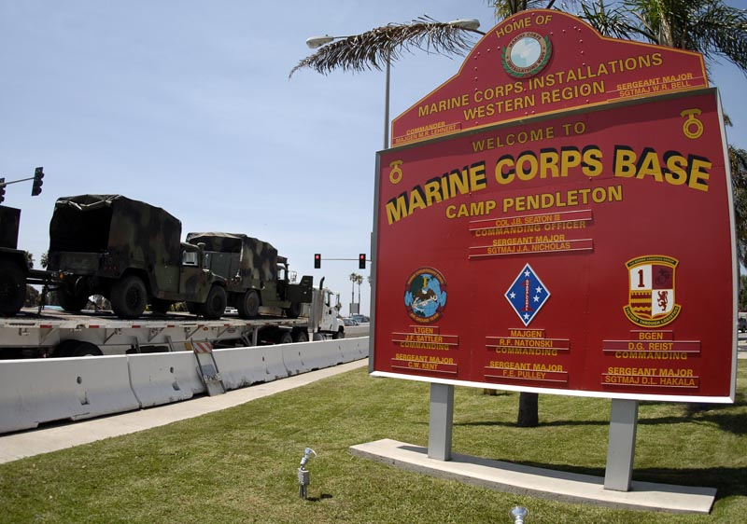
POP QUIZ

Slide 5
POP QUIZ
2. Name the two contaminants found over the MCL in the greatest number of water supply wells in California.

Slide 6
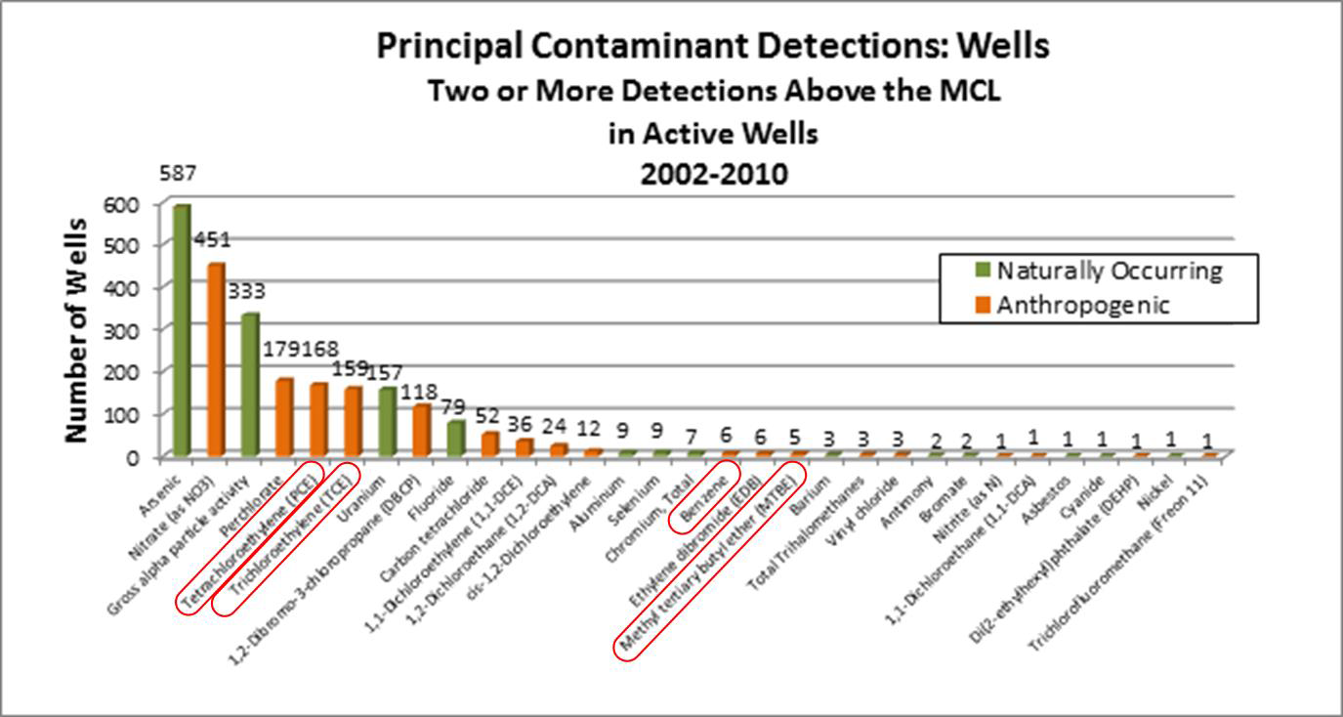
Arsenic and Nitrate

Slide 7
POP QUIZ
3. CalEPA consists of 2 Boards, 3 Departments and 1 Office.
Name the Office.
Hint: Starts with an “O”

Slide 8
POP QUIZ
Office of Environmental Health Hazard Assessment (OEHHA)
Air Resources Board (ARB)
Department of Pesticide Regulation (DPR)
Department of Resources Recycling and Recovery (CalRecycle)
Department of Toxic Substances Control (DTSC)
State Water Resources Control Board

Slide 9
San Diego Water Board
Public Meetings the second Wednesday of the month
Agendas and detailed information available online under “Board Info”
“Public Form” opportunity to raise any water quality issue
“Executive Officer’s Reports” each month

Slide 10
California Drought Emergency
State Water Board Approves Emergency Regulation to Ensure Agencies and State Residents Increase Water Conservation
“We are facing the worst drought impact that we or our grandparents have ever seen”
State Water Board Chair Felicia Marcus.

Slide 11
San Diego Water Board Org Chart
Groundwater Protection Branch (Julie Chan)
Land Discharge | Southern Cleanup | Central Cleanup | Northern Cleanup
John Odermatt | John Anderson | Craig Carlisle | Brian Kelly
http://www.waterboards.ca.gov/sandiego/about_us/org_charts/orgchart.pdf

Slide 12
Potential Staff Openings
http://www.waterboards.ca.gov/sandiego/about_us/employment/

Slide 13
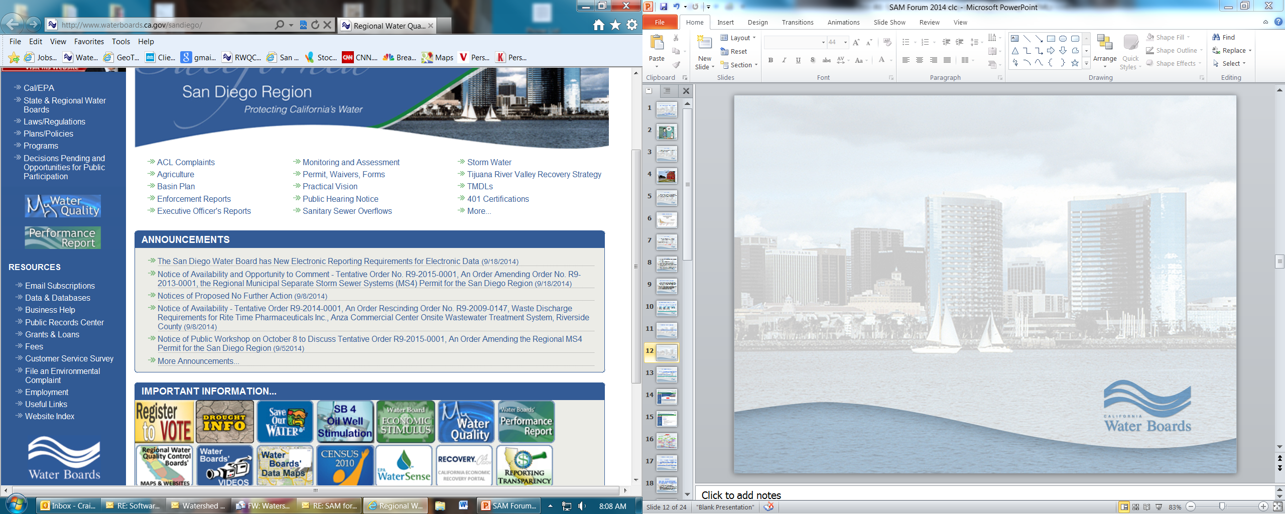

Slide 14
Do I Need a Permit?
“Permit” = Waste Discharge Requirements
General Order; or
Site Specific Waste Discharge Requirements (WDRs)
Waiver (in lieu of a “Permit”)
www.waterboards.ca.gov/sandiego/water_issues/programs/permits/index.shtml

Slide 15
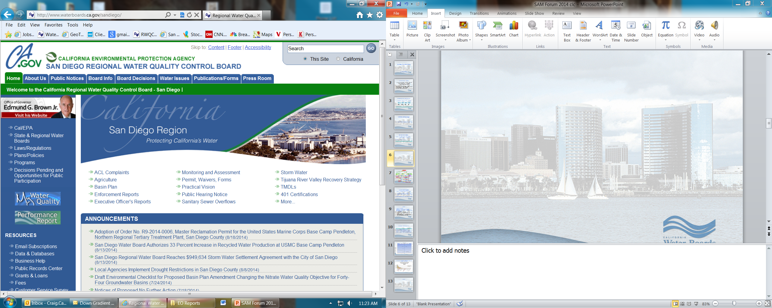

Slide 16
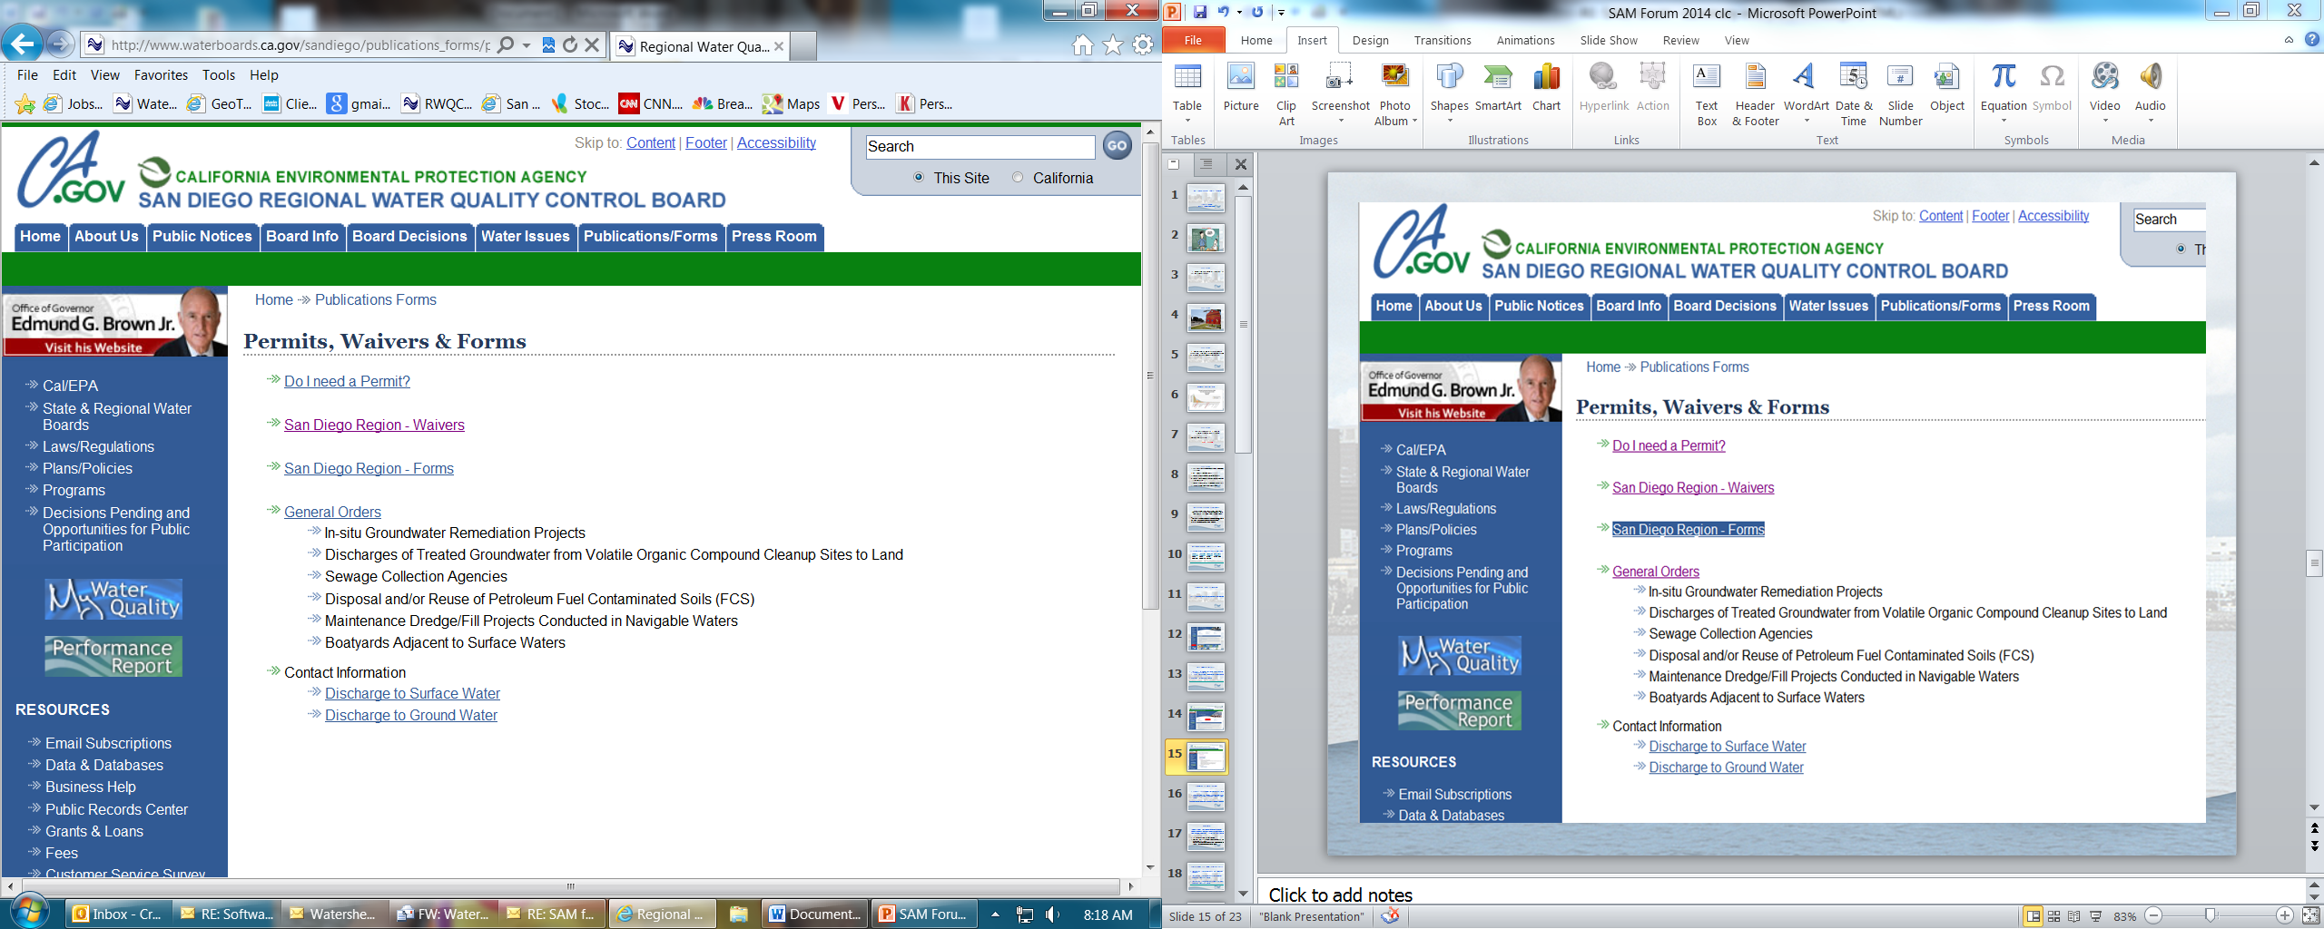

Slide 17
General Orders (WDRs)
In-situ Groundwater Remediation Projects
Discharges of Treated Groundwater to Land from Volatile Organic Compound Cleanup Sites
www.waterboards.ca.gov/sandiego/publications_forms/general_orders.shtml

Slide 18
Waivers
Conditional Waivers of Waste Discharge Requirements for Low Threat Discharges in the San Diego Region Order No. R9-2014-0041
12 Waivers covering 36 Categories of Discharges
Waiver No. 10: Discharges/Disposal of Solid Wastes to Land:

Slide 19
 | Enrollees
#2 Discharge of Recycled Water to Land | 3
#3 Misc. “low threat” discharges to land | 3
#4 Discharges of winery process water to lined ponds | 6
#5 Discharges to land at composting facilities | 2
#7 Discharges from animal operations | 3

Slide 20
 | Enrollees
#8 Discharges from aquatic animal facilities | 1
#9 Discharges of slurries to land | 2
#10 Discharges of solid waste to land | 9
#11 Aerial discharges of wastes over land | 4
#12 Discharges of emergency/disaster related wastes | 3

Slide 21
Low-Threat UST Case Closure Policy
Technical Justification for Soil Screening Levels
Technical Justification for Groundwater Media-Specific Criteria
Technical Justification for Vapor Intrusion Media-Specific Criteria
www.waterboards.ca.gov/water_issues/programs/ust/lt_cls_plcy.shtml

Slide 22
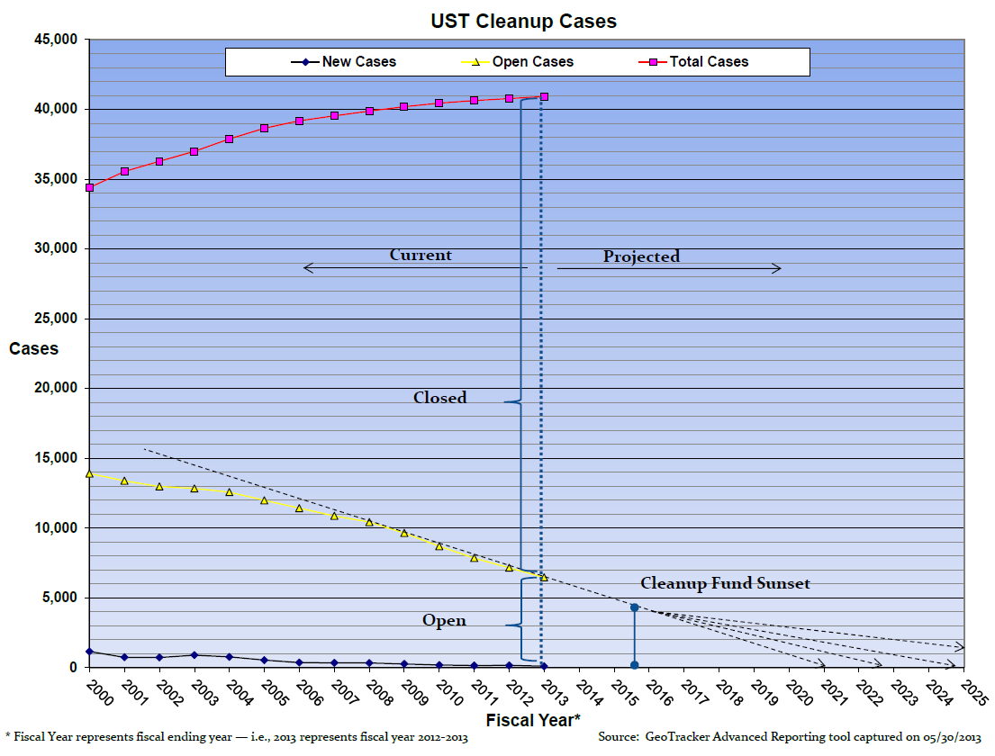

Slide 23
Future Focus: Chlorinated Solvents and Other VOCs in Water Supply Wells

Slide 24
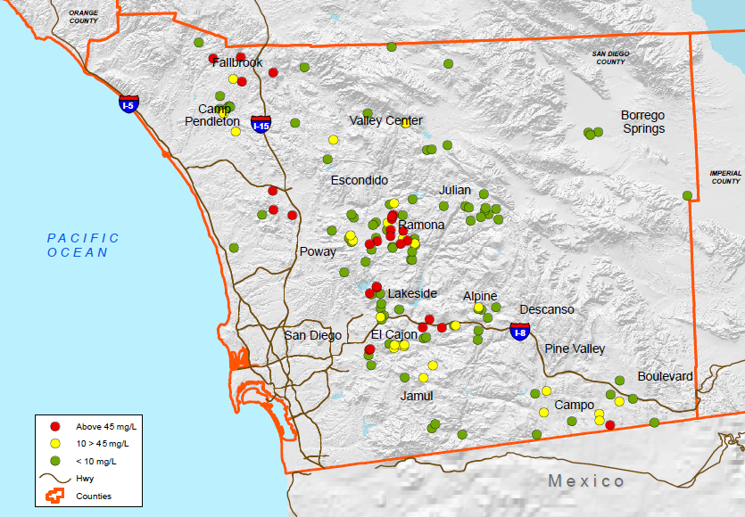
GAMA Groundwater Ambient Monitoring and Assessment

Slide 25
Miscellaneous
Increasing Recycled Water Use
Proposed Changing Nitrate Objective for Groundwater
Storm Water
Implementing 2013 Regional MS4 Permit
Enrolling Orange County in the
San Diego Bay Sediment Investigations and Cleanup
Implementing Bays and Estuaries Policy

Slide 26
Senate Bill 445 Adopted 9-25-2014
Extends Cleanup Fund by 10 years to Jan.1 2026
Increases fee from $0.014 to $0.02 per gallon
Dedicates 3 mils to small businesses
Increases State Water Board authority to address fraud
www.waterboards.ca.gov/water_issues/programs/ustcf

Slide 27

Questions?

