Slide 1

SAM FALL FORUM 2015
Site Assessment and Mitigation Program
Department of Environmental Health – County of San Diego

Slide 2
…(pause)…”What did you say
“U” “S” “T” stood for?
-Phone Duty Desk Engineer UST Fund

Slide 3
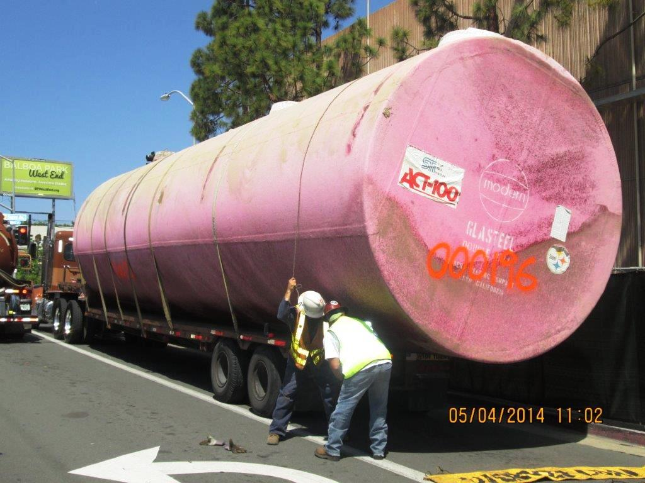
UST This!

Slide 4
SAM “Stats”
Program Funding Source # Cases
LOP UST Cleanup Fund 188
VAP Private Party 160
CAP Private Party 2

Slide 5
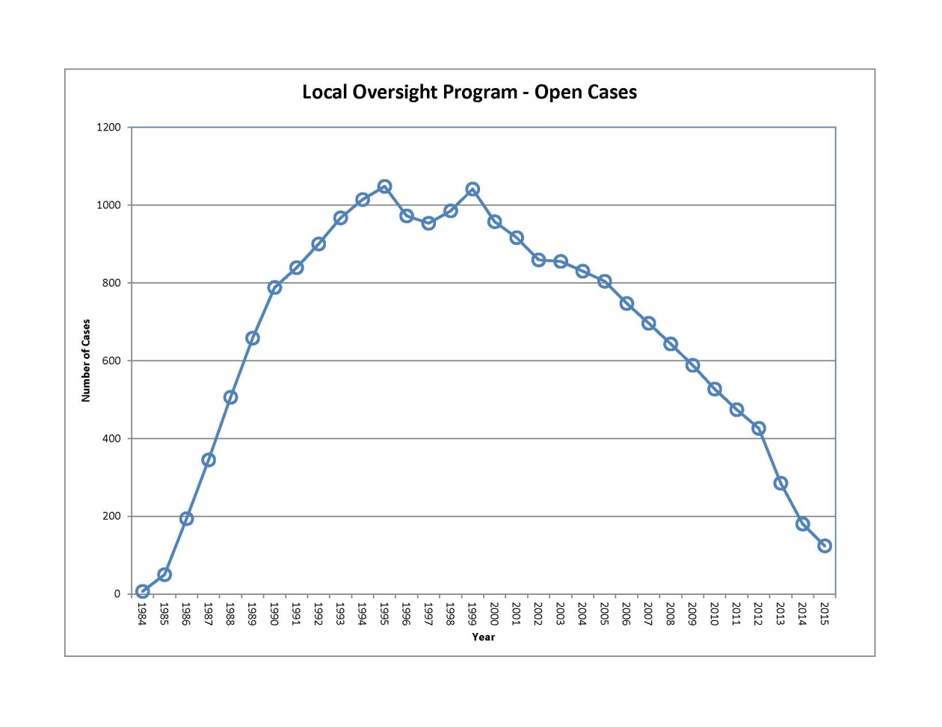

Slide 6
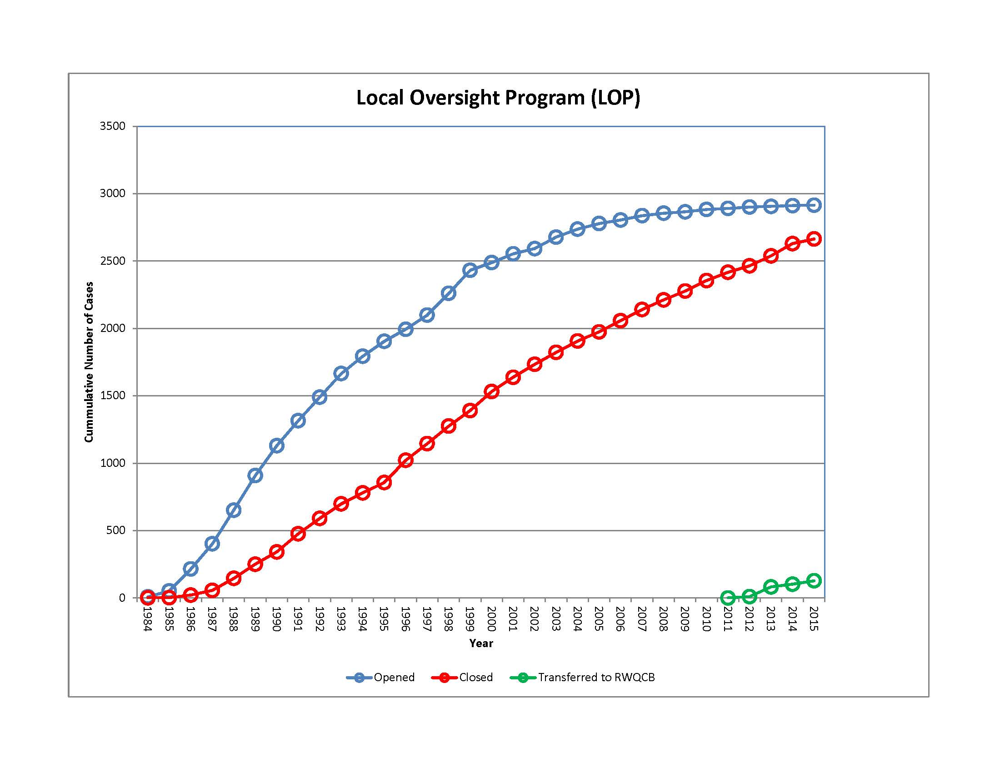

Slide 7
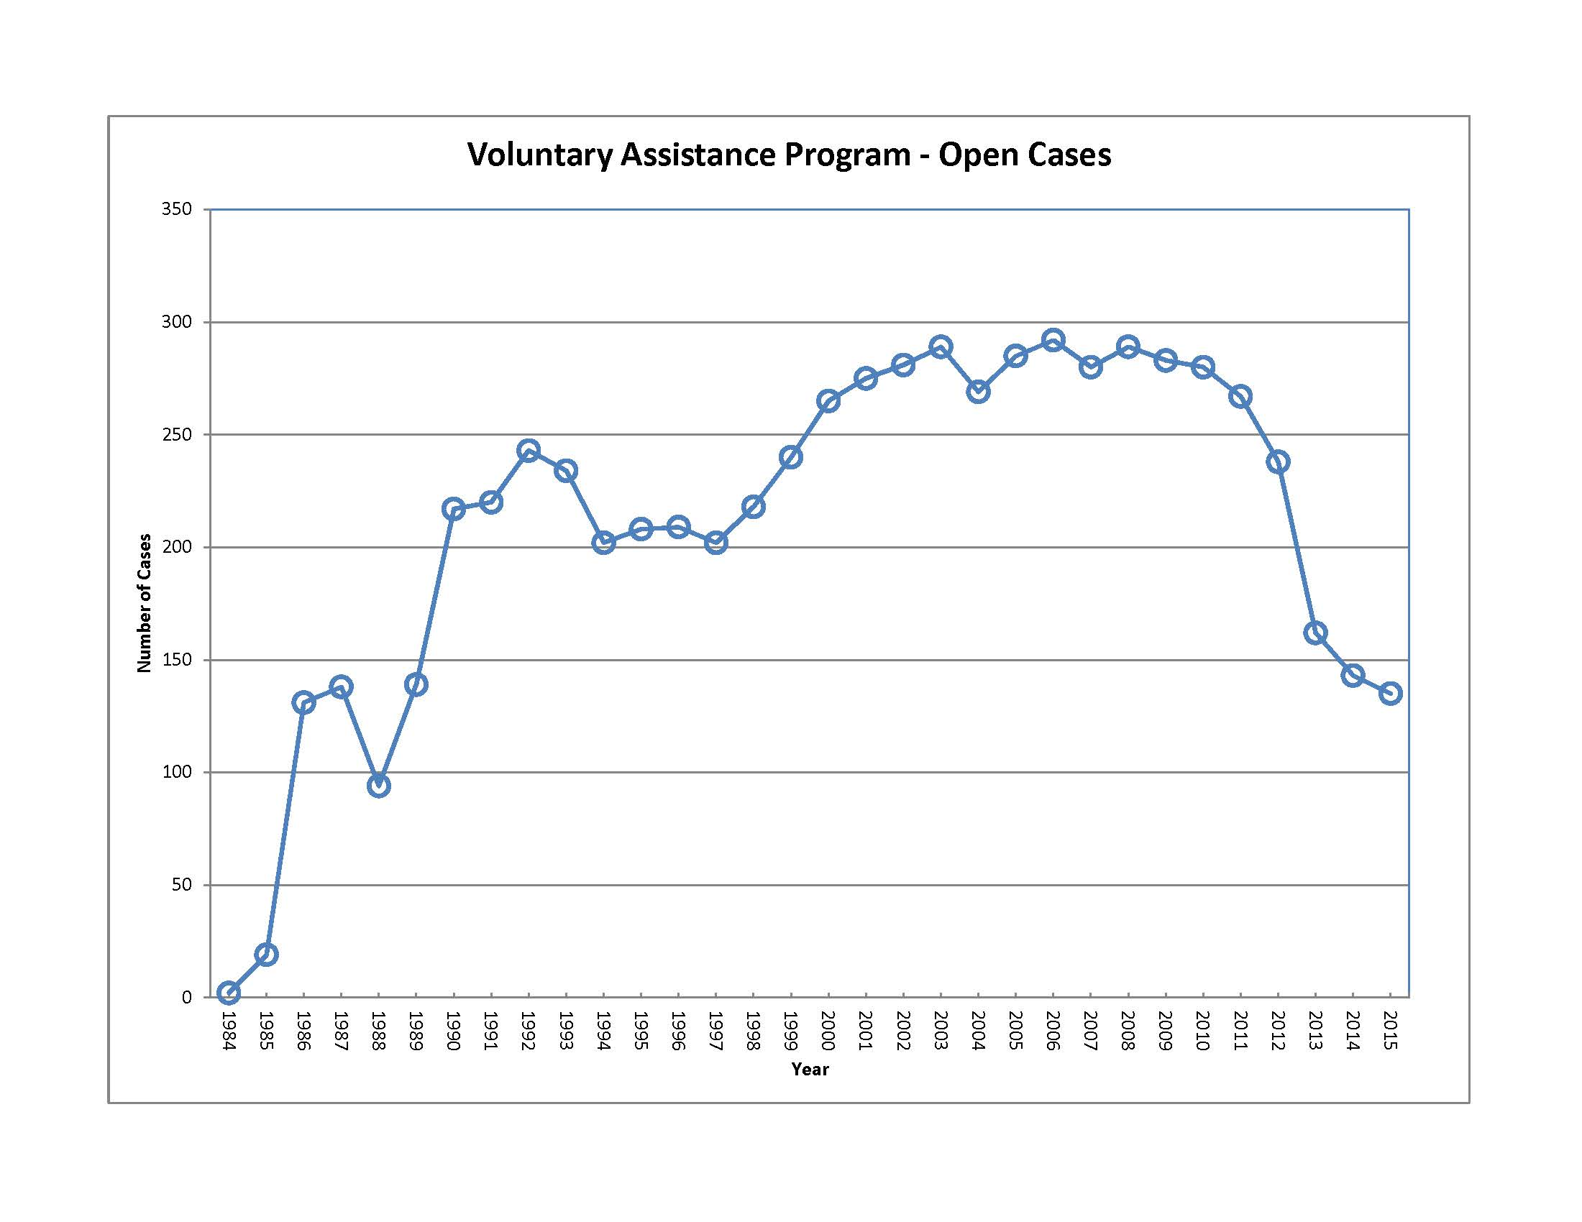

Slide 8
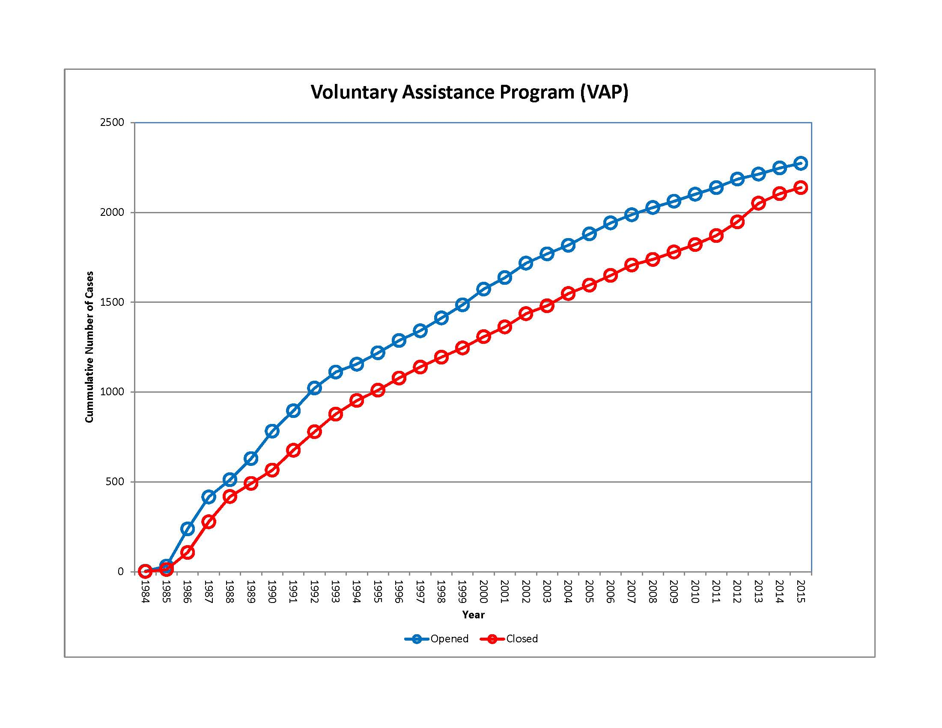

Slide 9
Corrective Action Program Update
Currently opening cases that are closures of permit-by-rule facilities where releases of hazardous waste have been identified
Two CAP cases are open at this time, and one case has been closed (certificate of completion pending)
Working with County Counsel to determine which permitted facilities may be addressed by the corrective action program

Slide 10
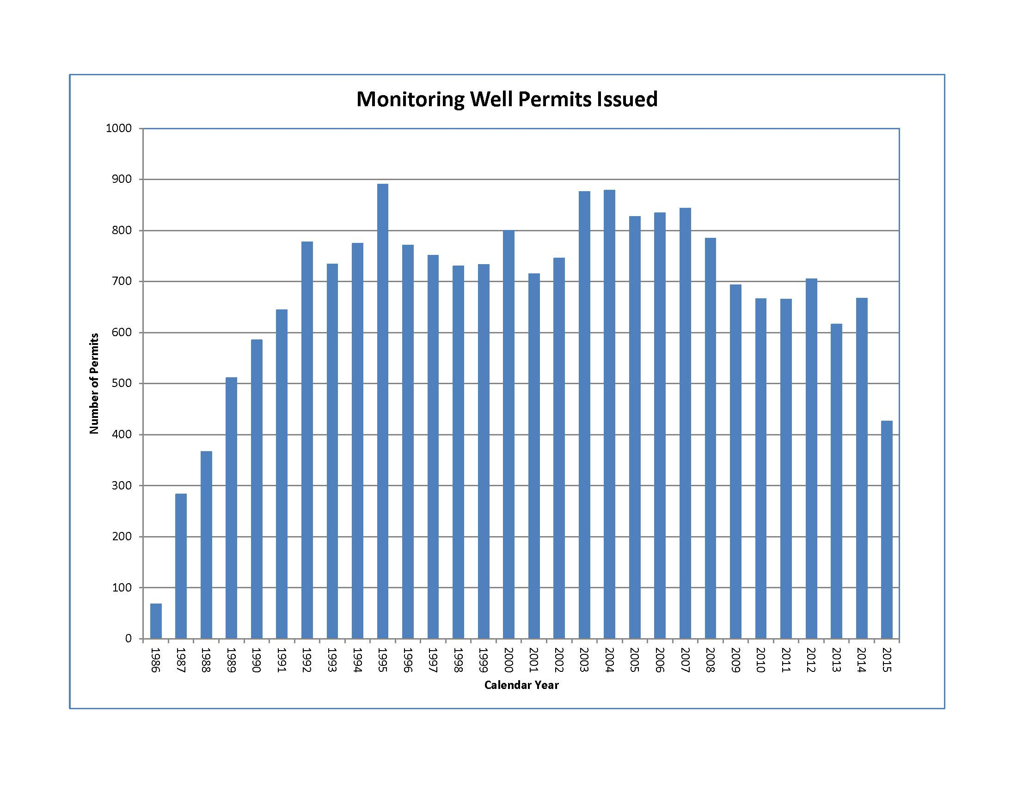

Slide 11
667 Well Permits issued in 2014 *
511 Well Permits issued to date in 2015 *
* Does not include geotechnical waivers

Slide 12
On-Line Access to DEH Records
Some SAM case files and monitoring well permit records are currently accessible via Citizen Access:
https:// publicservices.sdcounty.ca.gov/citizenaccess
Citizen Access does not support all Internet browsers at this time
Full access expected by January 2016

Slide 13
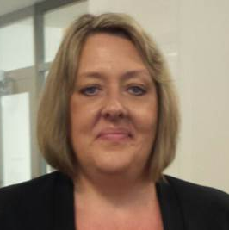
New SAM Supervisor
Colleen Hines, PhD, REHS

