Slide 1

Pesticides in Soil:
Assessment and Soil Management Considerations
2015 SAM FALL FORUM
SITE ASSESSMENT AND MITIGATION PROGRAM
October 13, 2015

Slide 2


Slide 3


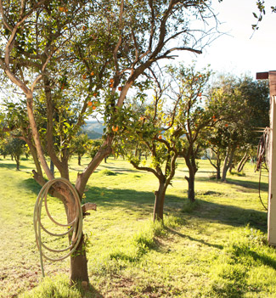
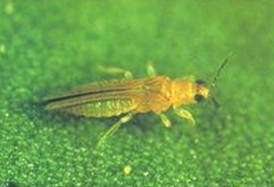

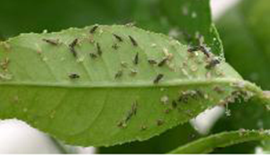
1930s - 1940s: Avocado Groves and Citrus Orchards

Slide 4
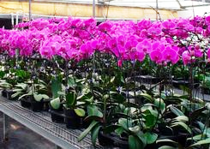
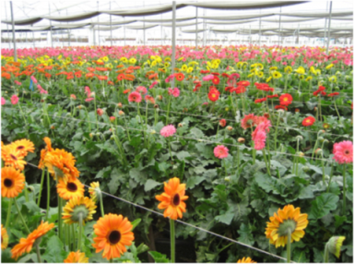
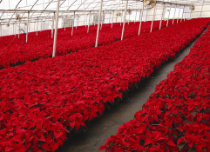
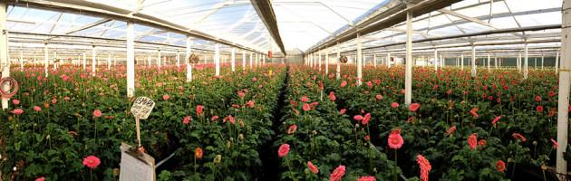
1960s - 2010: Ornamental Plants and Flowers

Slide 5
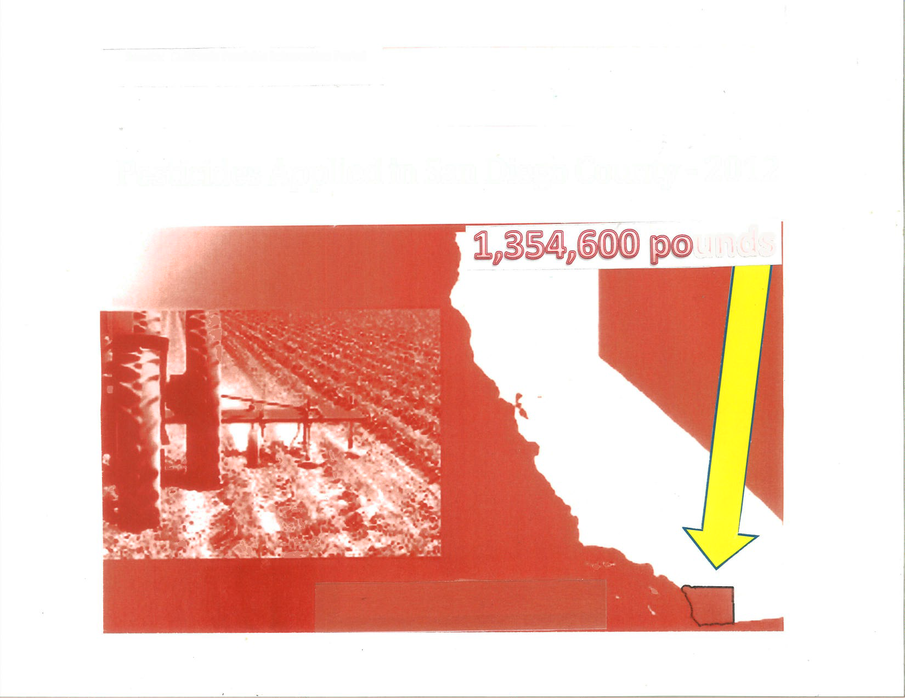
Pesticides Applied in San Diego County – 2012
Source: California Pesticide Information Portal

Slide 6
Pesticides With Agricultural Applications
Pesticides No Longer Used in U.S.
Metals lead arsenate, calcium arsenate
Organochlorine pesticides DDT, aldrin, chlordane, dieldrin, toxaphene, etc.
Pesticides Currently in Use in U.S. (> 1,300 are currently registered with US EPA)
Organophosphate pesticides parathion, malathion, diazinon, trichlorofon, etc.
Pyrethoids permethrin, fenvalerate, deltamethrin, cypermethrin, etc.
Carbamates carbaryl, bendiocarb, methonyl, propocur, etc.
Oil pesticides petroleum and mineral oils
Biopesticides Bacillus thuringiensis, vegetable oil, potassium bicarbonate, etc.
Sulfur

Slide 7
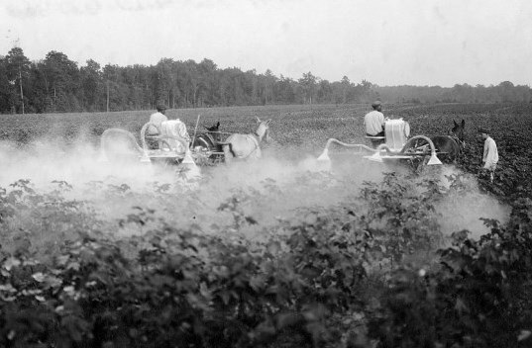
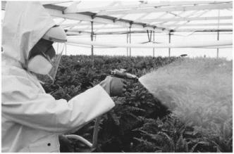
Arsenic dusting of cotton plants – 1920s
Greenhouse employee spraying plants –
San Diego County

Slide 8
Pesticides Currently in Use – San Diego County
Name | Type | Use | Impacts(s)
Sulfuryl Fluoride | Fumigant | Structural
Mineral Oil |  | Avocado
Glyphosate 1 * | Herbicide | Landscape | GW
Metam Salts | Fumigant | Tomato
Chloropicrin | Fumigant | Tomato, strawberry
DOT ** | Insecticide | Structural
Methyl Bromide | Fumigant | Strawberry
Glyphosate 2 *** | Herbicide | Landscape | GW
Sulfur | Fungicide | Grape, Tomato
Chlorothalonil | Fungicide | Ornamental plants
*Glyphosate isopropylamine **Disodium octaborate tetahydrate ***Glyphosate potassium salt

Slide 9
On-line Resources for Pesticide Use Information
San Diego County Department of Agriculture, Weights and Measures: sandiegocounty.gov/awm
California Department of Pesticide Registration, Pesticide Information Portal (CALPIP): calpip.cdpr.ca.gov
U. S. EPA Pesticides Databases: epa.gov/pesticides/science/databases

Slide 10
“Legacy” Metal and Organochlorine Pesticides
~ Year Introduced in U.S. ~ Year Banned in U.S.
Arsenic * 1860s 1980s
Aldrin * 1946 1974 - 1987
gamma-BHC (Lindane) * 1940s
Chlordane * 1948 1978 - 1988
4,4’-DDT * 1943 1972
Dieldrin * 1948 1974 - 1987
Endosulfan early 1950s 2010
Endrin * early 1950s
Heptachlor * 1952
Heptachlor Epoxide * 1952
Methoxychlor 1948 2003
Toxaphene * 1947 1990
* California Proposition 65-listed chemical

Slide 11
Attributes of Organochlorine Pesticides
Why they were initially embraced:
    Toxic (as nerve poison) to a wide range of pests
    Did not have to be re-applied often
    Not water soluble
    Easy and inexpensive to apply
    Why their use is being abandoned:
    Long half-lives (persistent in the environment)
    Bioconcentration (not metabolized rapidly)
    Biomagnification (an increase in concentration up the food chain)
    Impairment of reproduction in some species
    Most are carcinogenic

Slide 12
Assessment of Pesticides in Soil
What is the acreage of the property?
During what periods was the property used for agricultural purposes?
What crops were grown on the property?
How were the pesticides applied?
Were there specific areas on the property where pesticides were mixed and/or stored?
How many soil samples should be collected for initial and subsequent investigations?
How will sample locations be selected?
At what depths should soil samples be collected?
What equipment will be used for sample collection?
Which analytical methods will be used to test the samples?

Slide 13
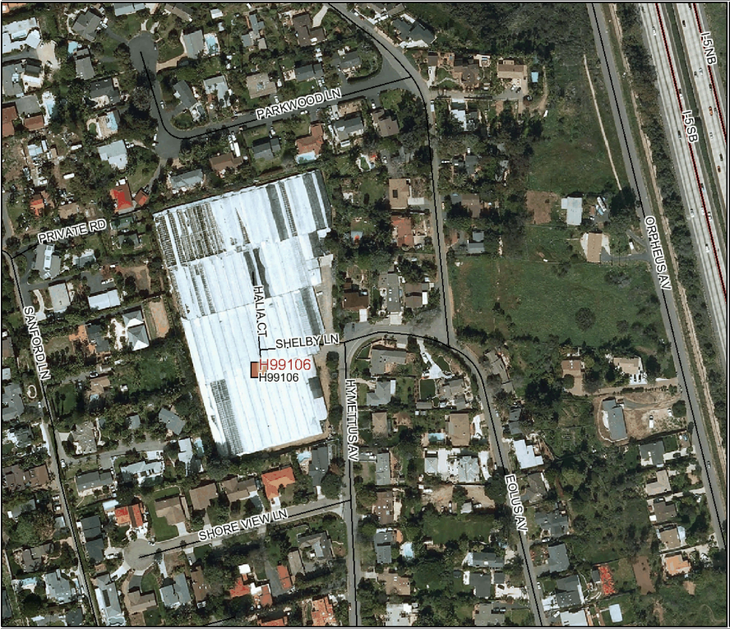
Former 5.5-Acre Greenhouse Site in San Diego County

Slide 14
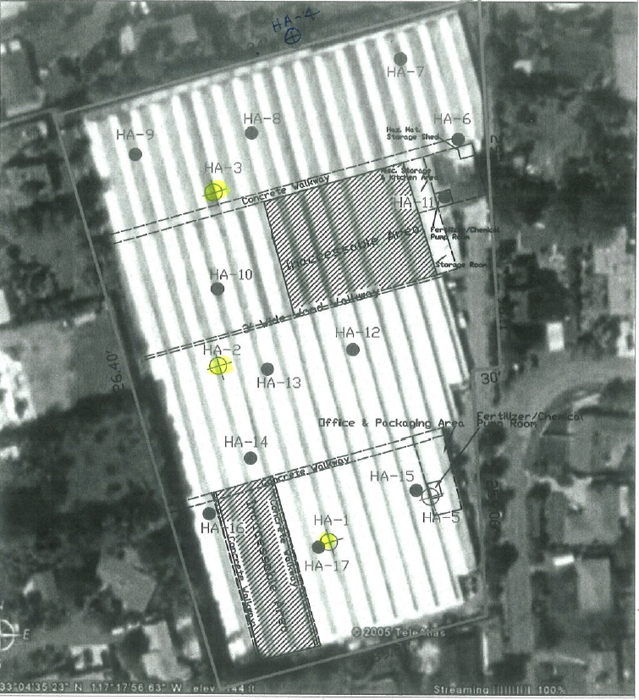
5.5-Acre Greenhouse Site: Soil Sampling Locations

Slide 15
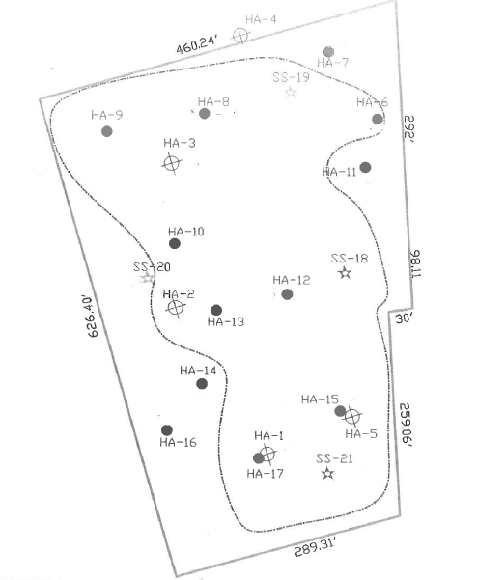
Soil Sample Collection, Analysis, and Interpretation –
5.5-Acre Greenhouse Site
Identify US EPA-approved test methods based on crop types and timeframe of agricultural use
Determine sampling location frequency that is representative of area using grid-based (e.g., one location per 500 ft²) and judgmental methods (e.g., more locations in mixing area)
Determine sampling depths
Outline areal extent of pesticide impacts; contour concentration data to assess location and depth of “hotspots”
Calculate estimated volume of pesticide-impacted soil
Compare concentration data to hazardous waste and US EPA regional screening levels (RSLs)

Slide 16
Organochlorine Pesticides Detected in Soil Samples
Former 5.5-Acre Greenhouse Site
                micrograms per kilogram
                Concentration Range RSL RSL
                residential industrial
Chlordane ND – 470 1,800 8,000
4,4’-DDD ND – 57 2,200 9,600
4,4’-DDE ND - 1,100 1,600 6,800
4,4’-DDT ND - 1,100 1,900 8,600
Dieldrin ND – 920 33 140
Endosulfan ND – 176 -- --
Methoxychlor ND – 130 -- --

Slide 17
Hazardous Waste Criteria
“Legacy” Metal and Organochlorine Pesticides
Total Threshold Leachate Concentration Soluble Leachate Threshold Concentration
(TTLC, milligrams per kilogram) (STLC, milligrams per liter)
Arsenic 500 5.0
Lead 1,000 5.0
_______________________________________________________________
Aldrin 1.4 0.14
Gamma BHC 4.0 0.4
(Lindane)
Chlordane 2.5 0.25
DDD, DDE, DDT 1.0 0.1
Dieldrin 8.0 0.80
Endrin 0.2 0.02
Heptachlor 4.7 0.47
Methoxychlor 100 10
Toxaphene 5 0.5

Slide 18
Human Health Screening Levels for Soil
Legacy Organochlorine Pesticides
Regional Screening Levels (RSLs) CHHSLs
Industrial Residential Industrial Residential
Aldrin 140 31 130 33
alpha-BHC 3,700 80
beta-BHC 1,300 300
gamma-BHC 2,500 560 2,000 500
(Lindane)
Chlordane 8,000 1,800 1,700 430
4,4’-DDD 9,600 2,200 9,000 2,300
4,4’-DDE 6,800 1,600 6,300 1,600
4,4’-DDT 8,600 1,900 6,300 1,600
Dieldrin 140 33 130 35
Endosulfan --- ---
Endrin --- --- 230,000 21,000
Heptachlor 510 120 520 130
Heptachlor epoxide 250 59
Methoxychlor --- --- 3,800,000 340,000
Toxaphene 2,100 480 1,800 460

Slide 19
Corrective Action for Pesticide-Impacted Properties
PLANNING PHASE / REMEDIAL ACTION PLAN PREPARATION
Residential or Commercial?
Criteria to be used for segregating soils for disposal
Confirmation sampling
Transport to appropriate landfill or bury onsite?
Determine specific areas of property where pesticide- impacted soil may be buried and depth of burial
Geotextile marker
Thickness and source of cover fill
Community interaction
IMPLEMENTATION PHASE
Access-egress concerns
Storm water mitigation measures
Air monitoring and sampling
Surveying
Environmental covenant for lots underlain by buried pesticide-impacted soils

Slide 20
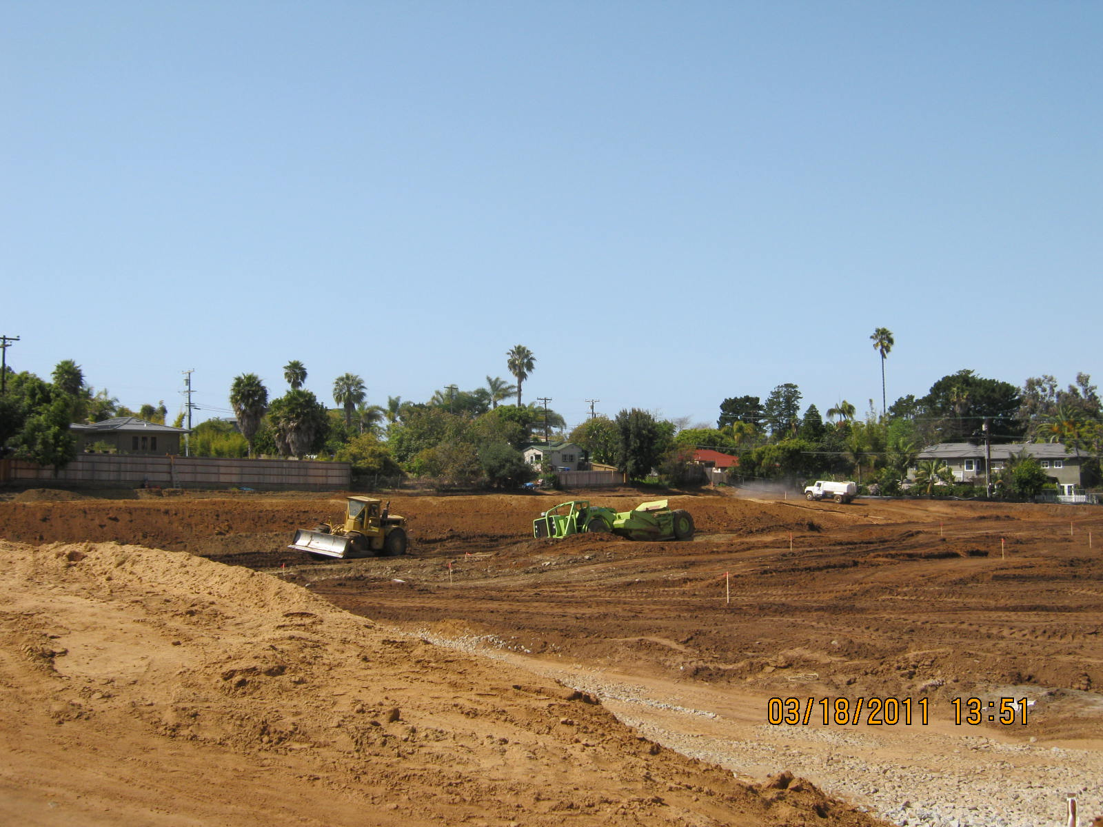

Slide 21
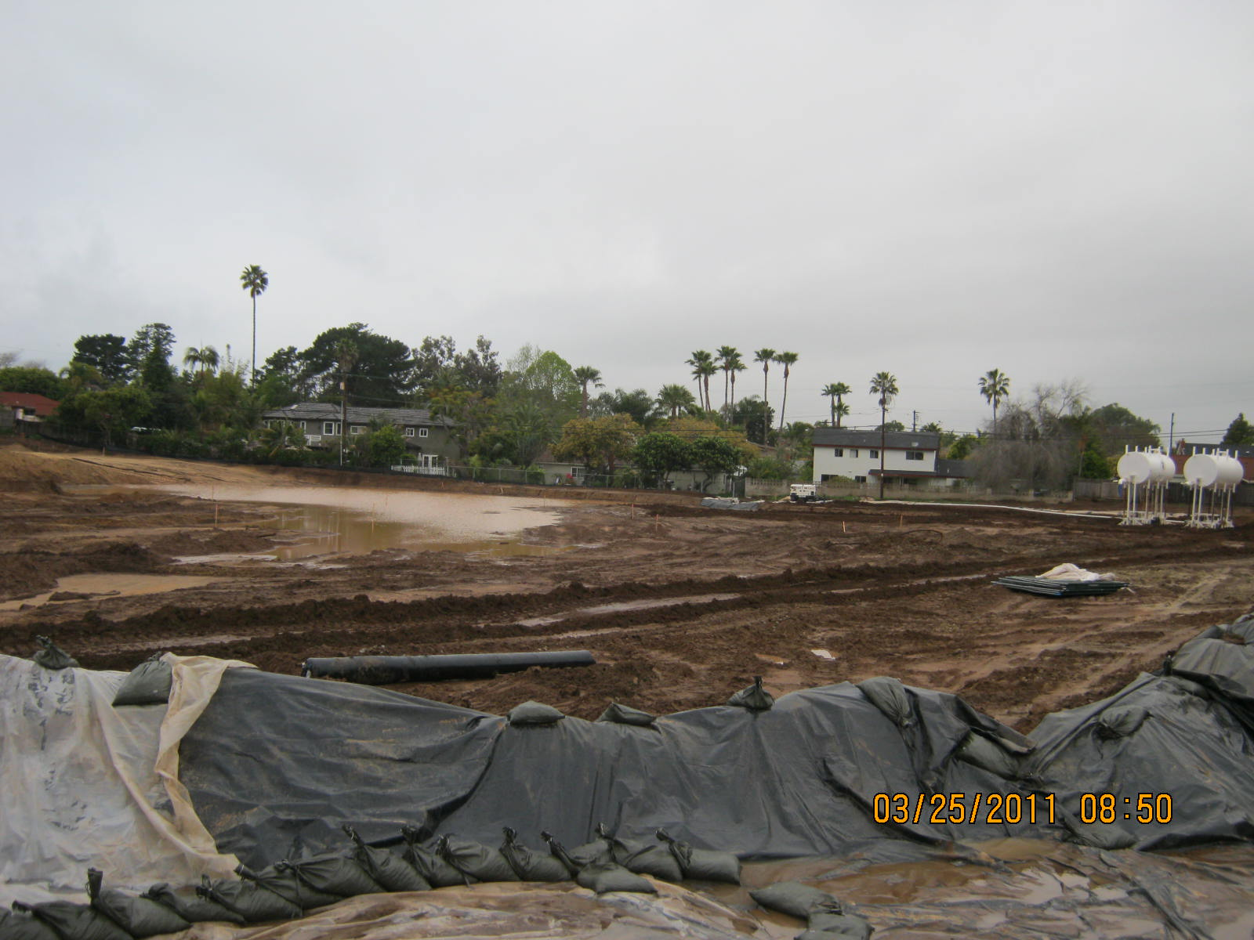

Slide 22
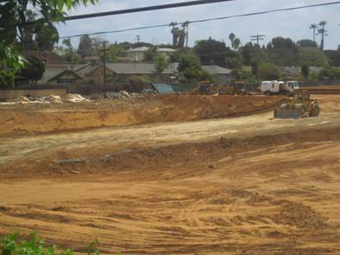

Slide 23
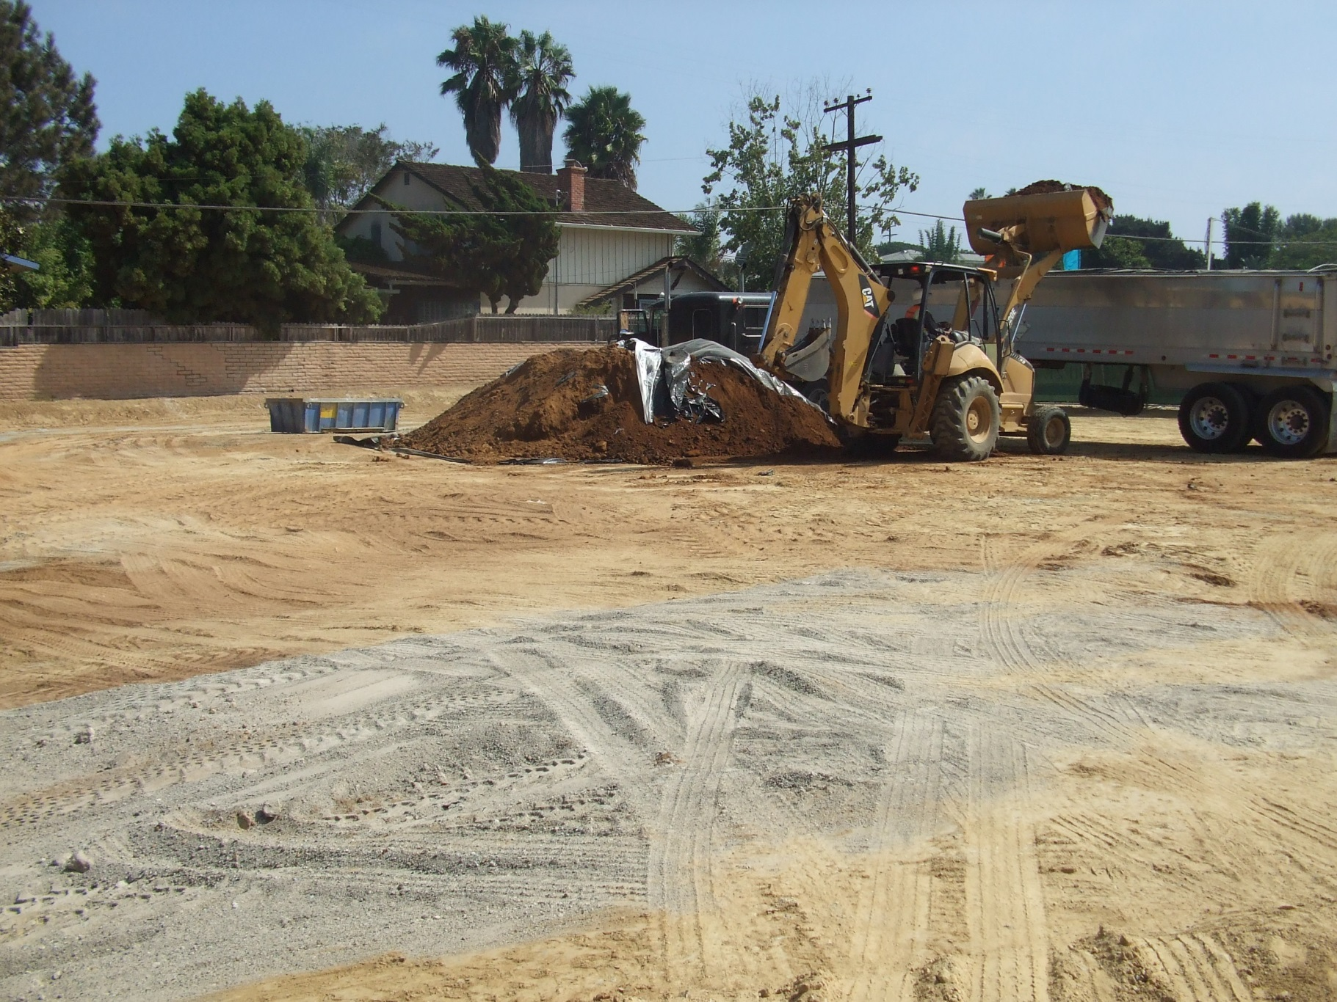

Slide 24
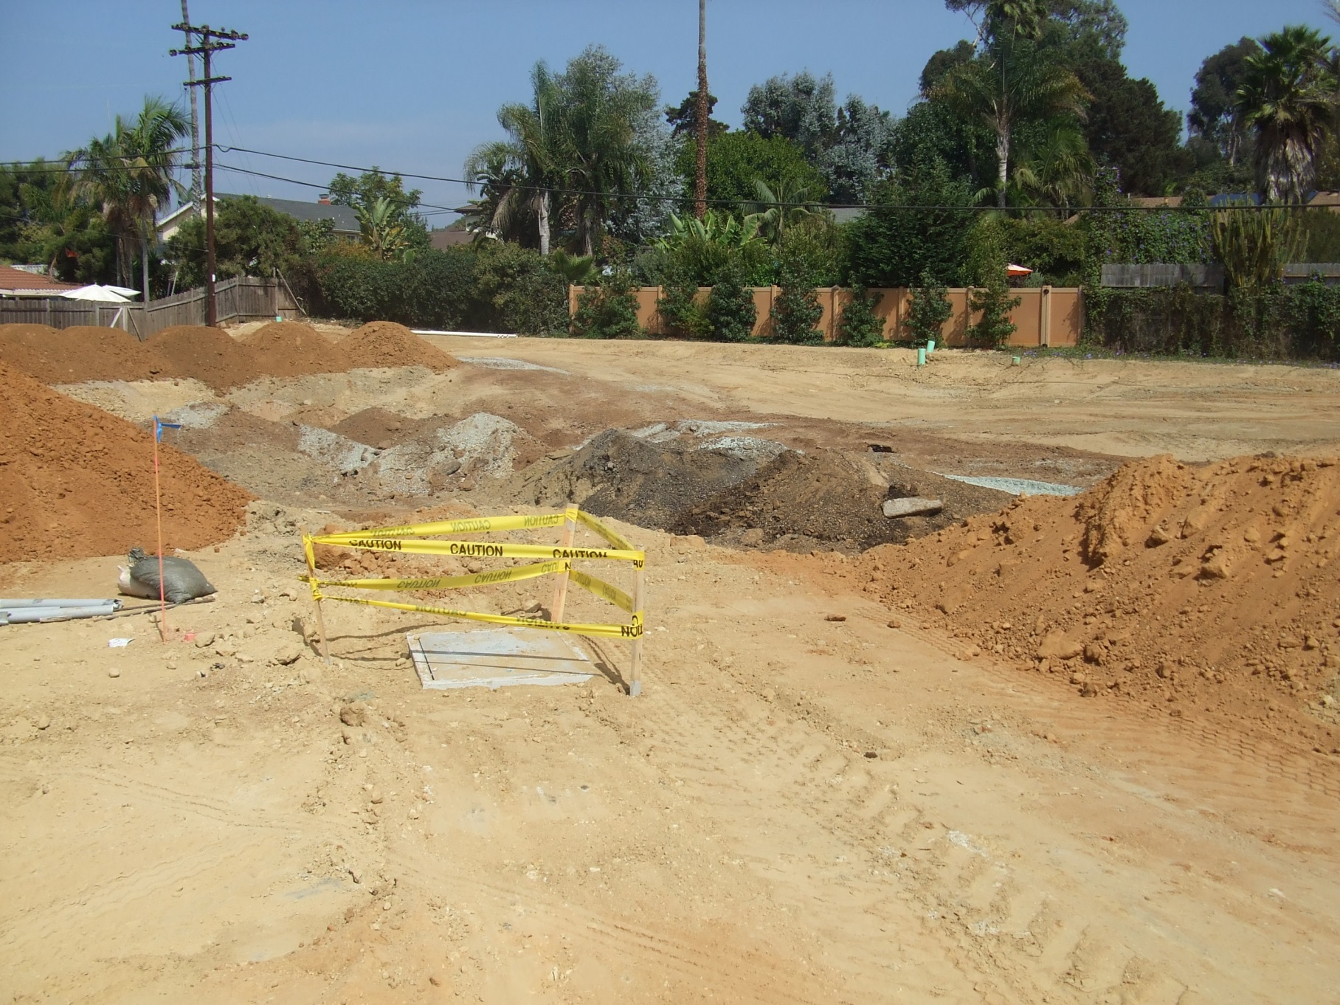

Slide 25
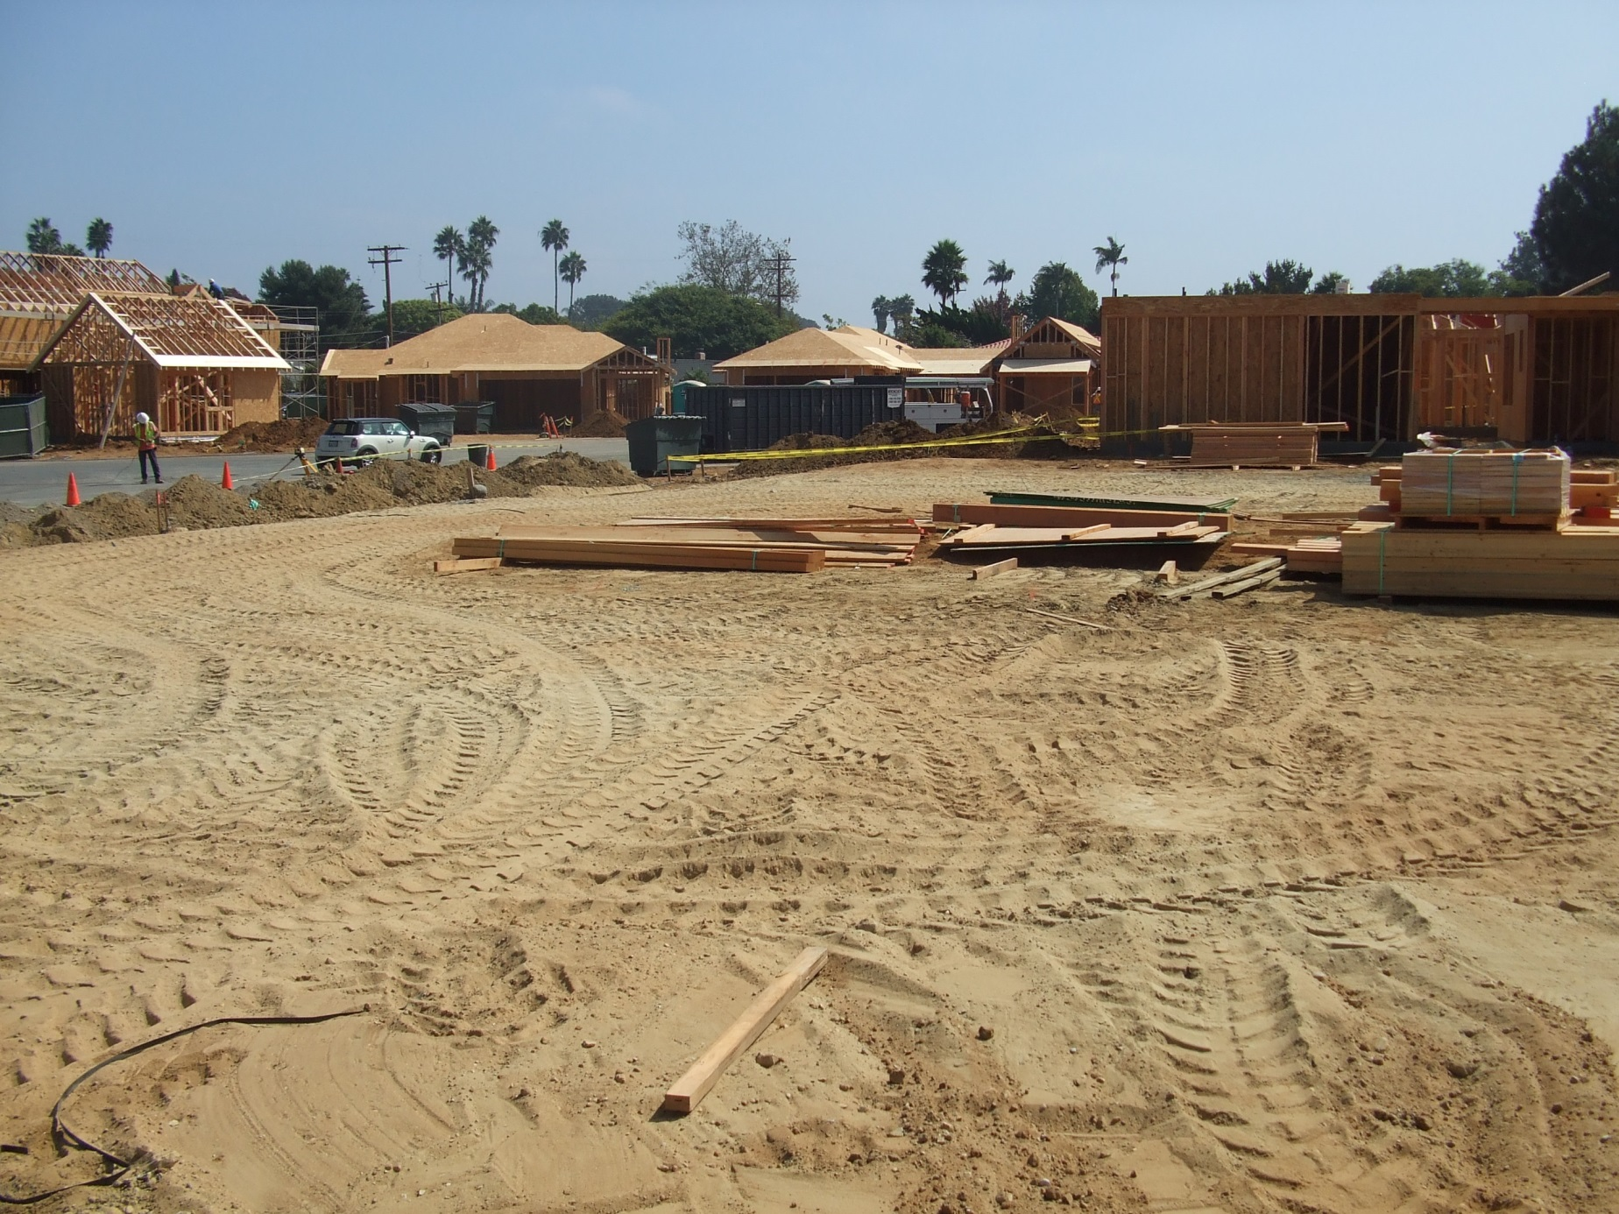

Slide 26
Human Health Screening Levels for Soil
Modern Pesticides
Pesticide Regional Screening Levels (RSLs) CHHSLs
Industrial Residential Industrial Residential
Alachlor 41,000 9,500
Atrazine 10,000 2,300
Carbon Tetrachloride 2,900 650
1,2-DBCP 64 5
Heptachlor 510 120
Heptachlor Epoxide 250 59
Hexachlorobenzene 1,400 330
Pentachlorophenol 4,000 99 13 44
Simazine 19,000 4,400

Slide 27
Hazardous Waste Criteria
Modern Pesticides/Herbicides
TTLC STLC mg/kg mg/L
“Modern” Pesticide/Herbicide
or Pesticide/Herbicide Ingredient
Arsenic 500 5
Barium 10,000 100
Chromium, Total 2,500 5
Chromium, hexavalent 500 5
Copper 2,500 25
Silver 500 5
Zinc 5,000 250
Mirex 21 2.1
Pentachlorophenol 17 1.7
2,4-Dichlorophenoxyacetate acid (“2,4-D”) 100 10
2,4,5-Trichlorophenoxyproprionic acid (“Silvex”) 10 1

Slide 28
Determining the Contamination Potential of a Pesticide
Source: Pesticide Safety Education Program, Cornell University (2012)
Partition Half-life Pathway Loss Potential
Coefficient Medium Impacted
Small Long Leaching Groundwater
Small Short Leaching Groundwater *
Large Long Runoff Surface Water
Large Short Runoff Surface Water*
* Only if heavy rain or irrigation occur soon after pesticide application

Slide 29
Drinking Water Standards for Pesticides
(RWQCB, Central Valley Region – November 2014)
Pesticide Primary MCL Secondary MCL
micrograms per liter
2,4-D 70 --
Alachlor 2 --
Atrazine 1 --
Bentazon 18 --
p-Dichlorobenzene 5 --
1,3-Dichloropropene 0.5 --
Diquat 20 --
Endothall 100 --
Glyphosate 700 --
Oxamyl 50 --
Pentachlorophenol 1 --
Simazine 4 --
Thiobencarb 70 1
  (Note: For approved general-purpose testing methods, reference US EPA’s website for “Clean Water Act Analytical Methods,” updated November 21, 2014)

