Slide 1
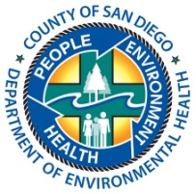
SAM FALL FORUM 2016
Site Assessment and Mitigation Program
Department of Environmental Health – County of San Diego

Slide 2
SAM “Stats”
Program Funding Source # Cases
LOP UST Cleanup Fund 140
VAP Private Party 162
CAP Private Party 3

Slide 3
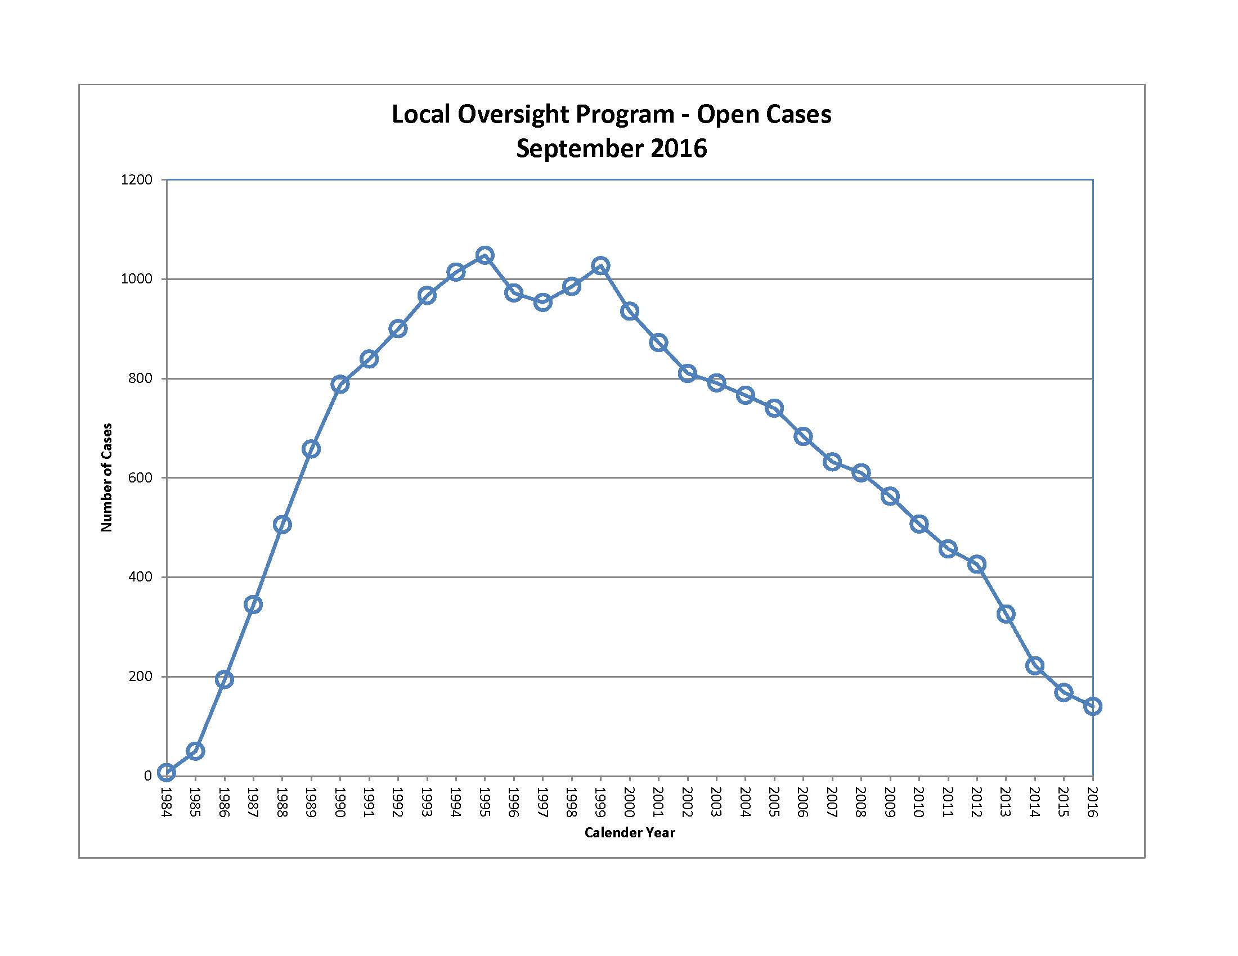

Slide 4
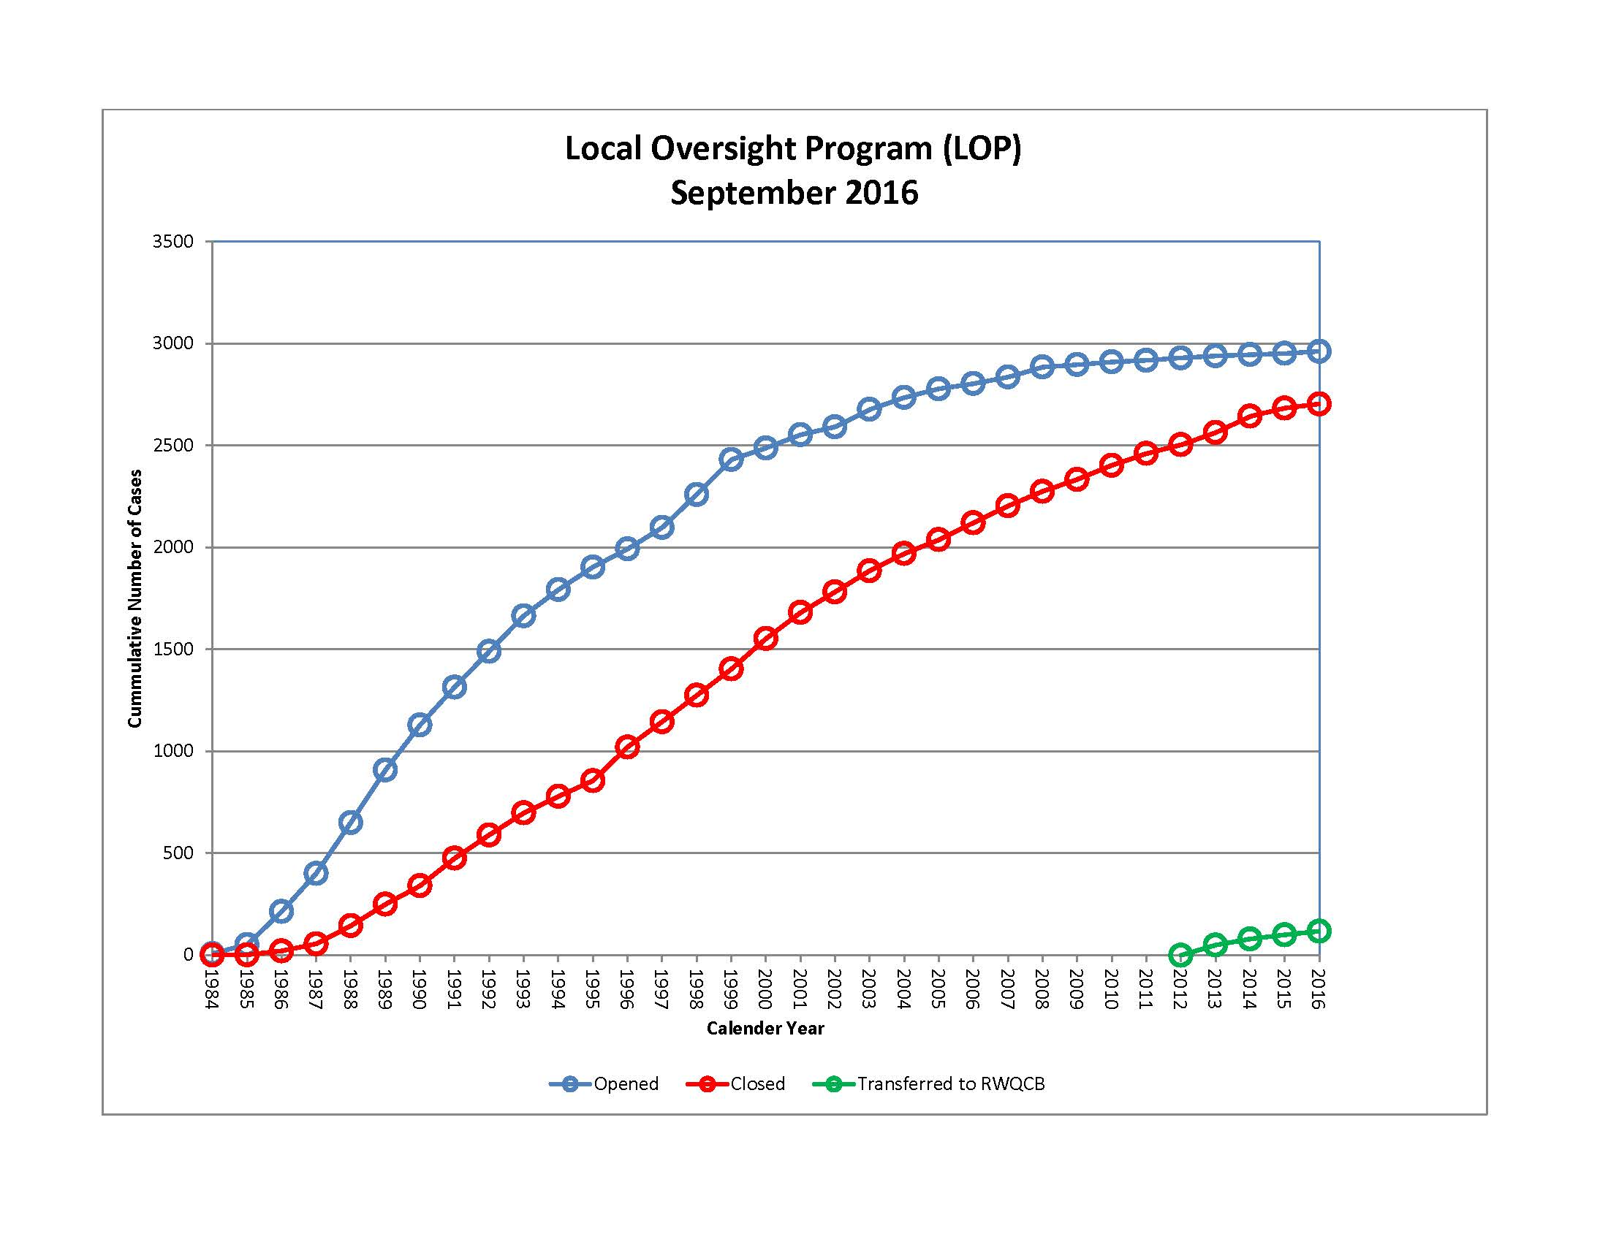

Slide 5
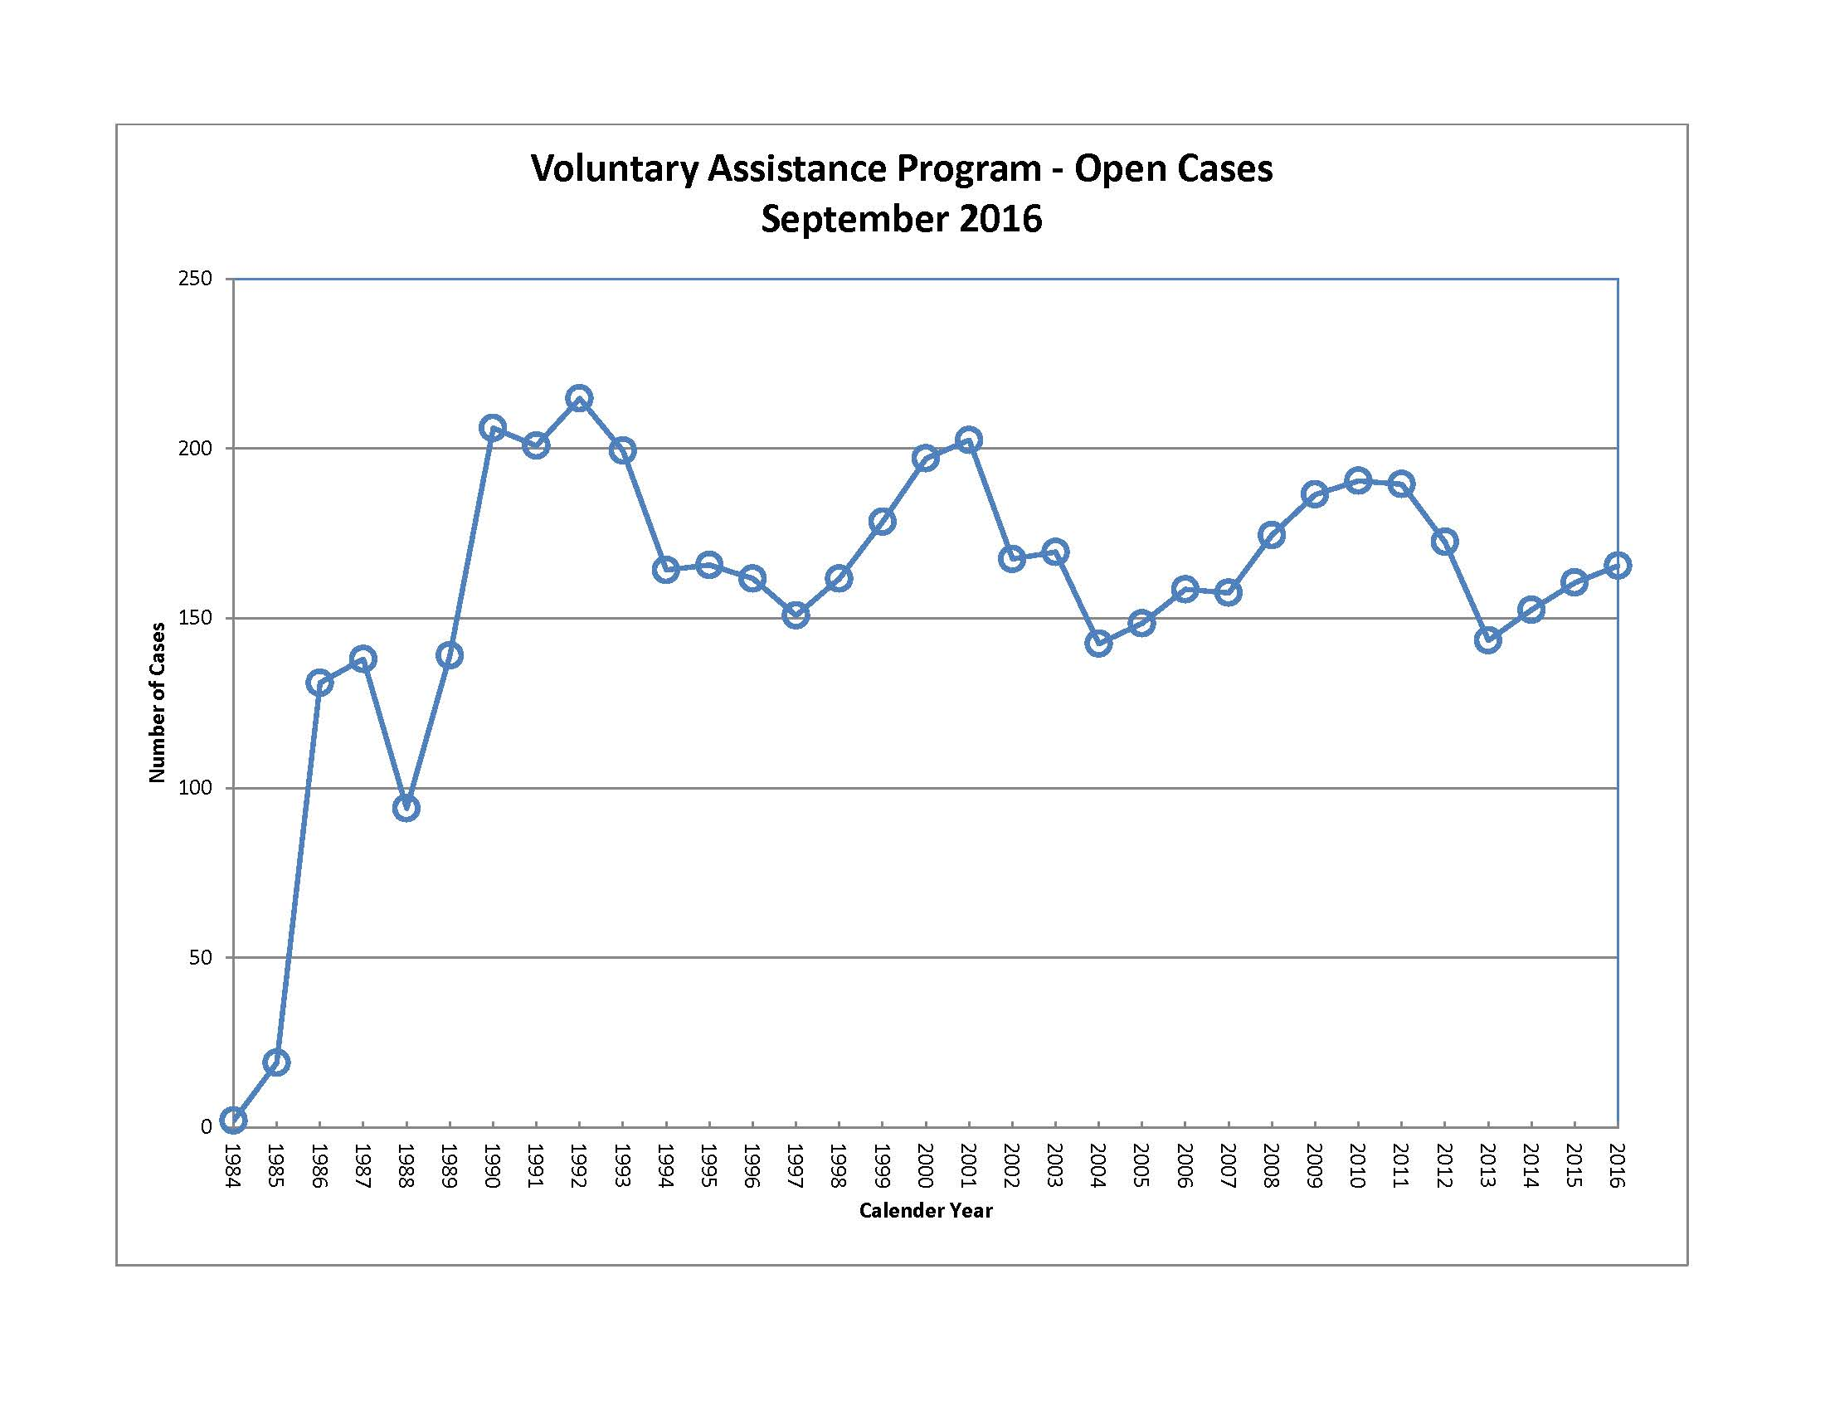

Slide 6
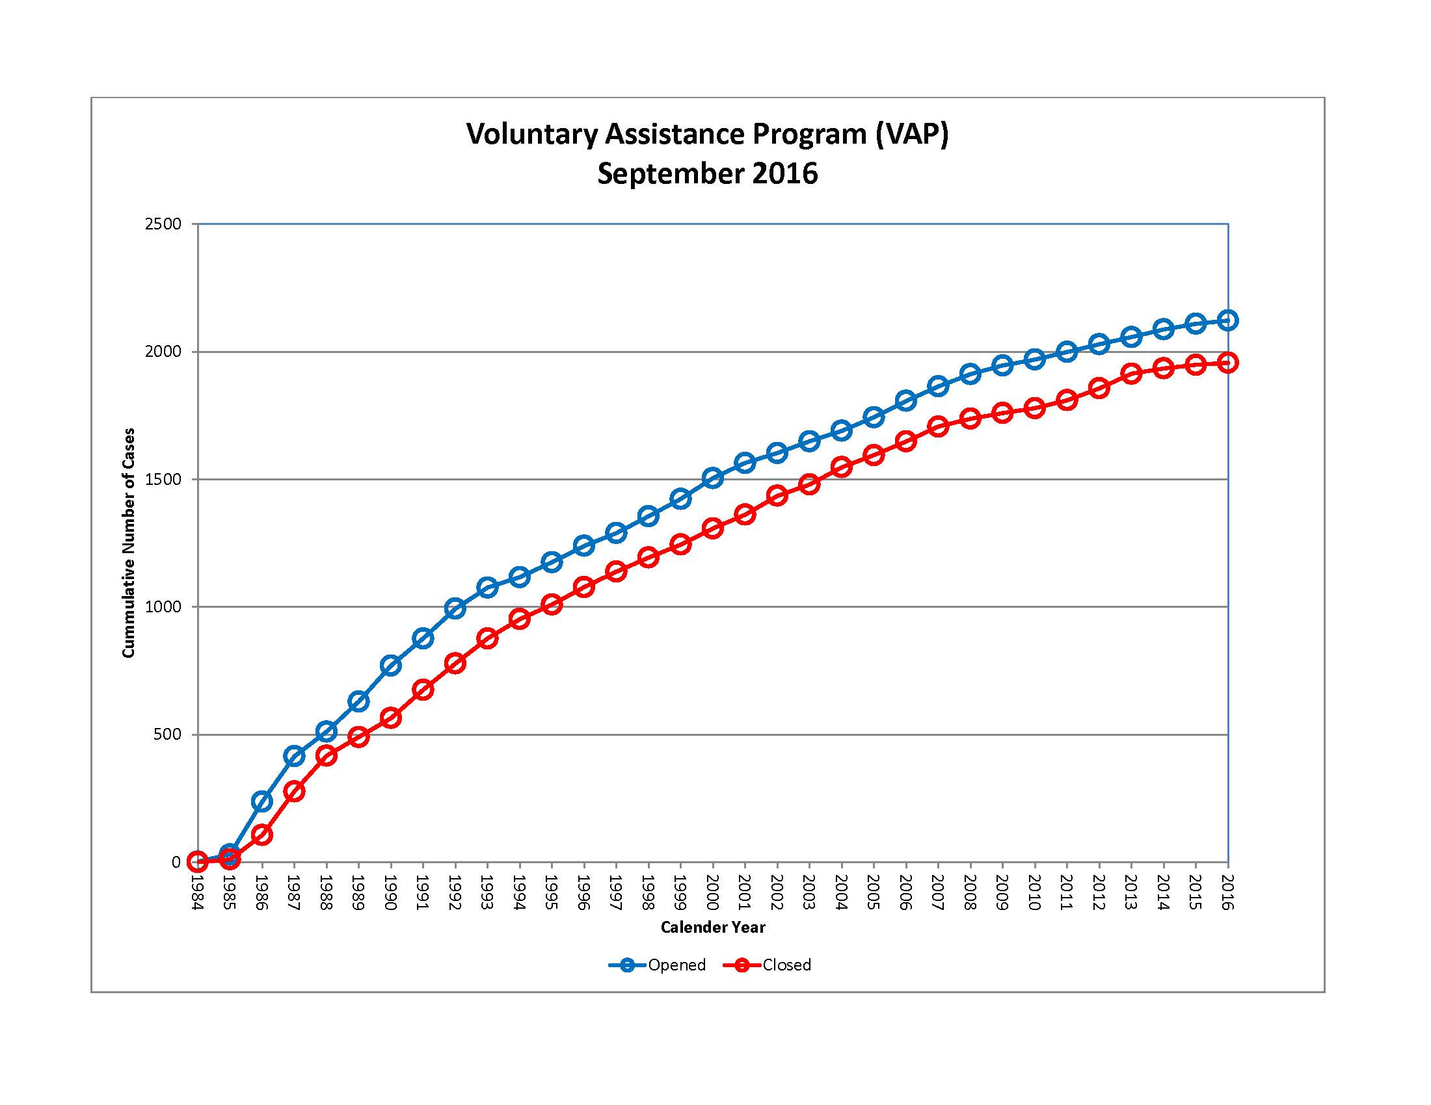

Slide 7
Corrective Action Program Update
Currently opening cases that are closures of permit-by-rule facilities where releases of hazardous waste have been identified.
Three CAP cases are open at this time, and one case has been closed.
Continuing to work with County Counsel to determine which permitted facilities may be addressed by the corrective action program.

Slide 8
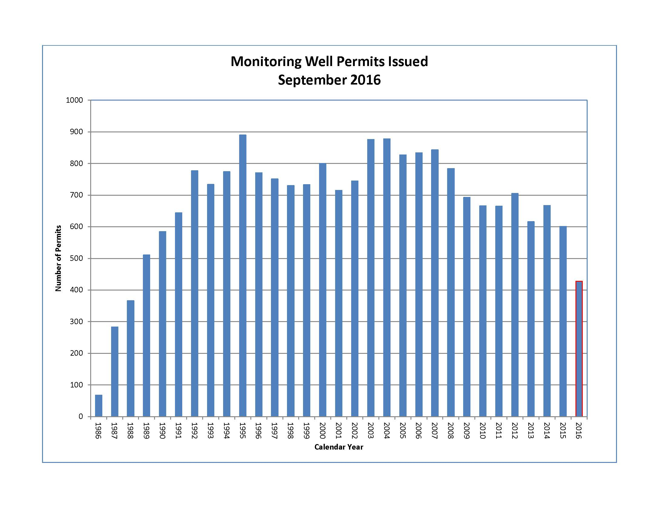

Slide 9
601 Monitoring Well Permits were issued in 2015. As of September 27, 2016 a total of 428 Monitoring Well Permits have been issued in 2016.

Slide 10
On-Line Access to DEH Records
Closed SAM case files and monitoring well permit records, with the exception of well completion reports, are currently accessible via Citizen Access:
https://publicservices.sdcounty.ca.gov/citizenaccess

Slide 11
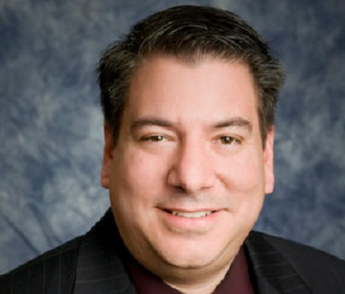
New DEH Public Records Contact: Edwin Andrus Office Support Specialist

