Slide 1
Leasing and Development at County Airports
Fallbrook Airpark Advisory Committee
April 7, 2025

Slide 2
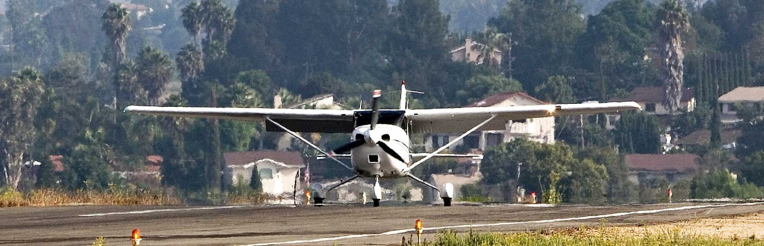
Overview
Development Process
Lease Revenue
Fallbrook Lease Revenue
Fallbrook Airpark Current Leases
Future Development
Airport Team and Goals

Slide 3
Airport Goals
Provide Air Transportation Infrastructure
Revenue to Operate Airport
Comply with Safety Standards
Support Aviation Services
Benefit Local Economy
Rehabilitate Runway 18/36

Slide 4

Airports Team
Contracts at 8 County Airports
3 Gillespie Field Industrial Parks.
Revenue must be used for Airport System
Used to Maintain and Operate all Airports
Fund Local Share of FAA Grants
The Airports Enterprise Fund is self-supporting.

Slide 5
Lease Development Process
∙ Project Description
∙ CEQA Analysis
∙ Changes to Lease?
∙ Property Team
∙ Engineering
∙ Operations
∙ ESU
∙ FAAC
∙ Director of Airports
or
∙ Board of Supervisors
Proposals
Review
Approval

Slide 6
Development Review
Review Agencies
Airport
Staff
FAA
Fallbrook
Airport
Advisory
Committee
Board of Supervisors
County
PDS

Slide 7
Fallbrook Airpark Contracts
Type | Amount
Aviation Leases | 4
Agricultural Leases | 4
Recreational Leases | 4
Public Services | 2
Tie-Downs | 4
Licenses | 1
Total | 19
Notes:
Explain why there is no fiscal revenue for 2023/24.

Slide 8
Fallbrook airpark Contract Names
Aviation Leases
Aircraft Hangar Management, LLC Fallbrook Air Service, Inc.
Murray Investment Company, LLC L18 Airpark, LLC
Craig B. Wiblemo (Tie-Down Lease) Matthew Young (Tie-Down Lease)
Joseph LaBarbera (Tie-Down Lease) James Patrick Frimodig (Tie-Down Lease)
Agricultural Leases Aviation License
Altman Specialty Plants, LLC (2 leases) Ascent Aviation Group
Avocado Groves; McDaniel Brothers, LLC (2 leases)
Airpark Ranch II, LLC
Recreational Leases
Fallbrook Community Youth Baseball Council, Inc.
Fallbrook Sports Association, Inc
Fallbrook Tennis Club
Public Safety Agreements
Vaisala, Inc.
Sheriff’s Copter 12

Slide 9
Fallbrook Aviation Lease Rates
Standard Rate Set at $548 Per Acre Per Month in 2024/25 FY
Subject to Annual CPI
Next New Lease
Tennis Club – BOS date TBD
Next Rent Adjustment
Fallbrook Sports Association
Altman

Slide 10
Future Developments
Project: Rehabilitation of Runway 18/36 at Fallbrook Airpark.
Funding: FAA & AEF
Cost: Estimated at $2.4 Million
Project Area: The project area includes the runway, shoulders, and blast area.
Status: The project is currently in the design and construction phase.
Possible construction this Fall
Notes:
Discuss 18/36

Slide 11
Fallbrook Airpark Expenditure Summary
Adopted FY 2024-25 Budget: $.4M
Services & Supplies
$.4M
100%
Notes:
Adopted Budget for Fallbrook for FY 24-25 which show the total Revenue and Expenses.
This slide shows budgeted expenditures for Fallbrook at $.4M.
Services & Supplies – $.4M
Drivers of Cost
Routine Maintenance, Major Maintenance and Landscaping - .1M
Consultant Contracts - .1M
Security System Services - .1M

Slide 12
Fallbrook Airpark Revenue Summary
Adopted FY 2024-25 Budget: $.7M
Rents/Lease Agreements
$.7M
100%
Notes:
This revenue slide shows budgeted revenue of $.7M for FY 24-25
Rents/Lease revenue from the current rents/lease contracts of $.7M

Slide 13
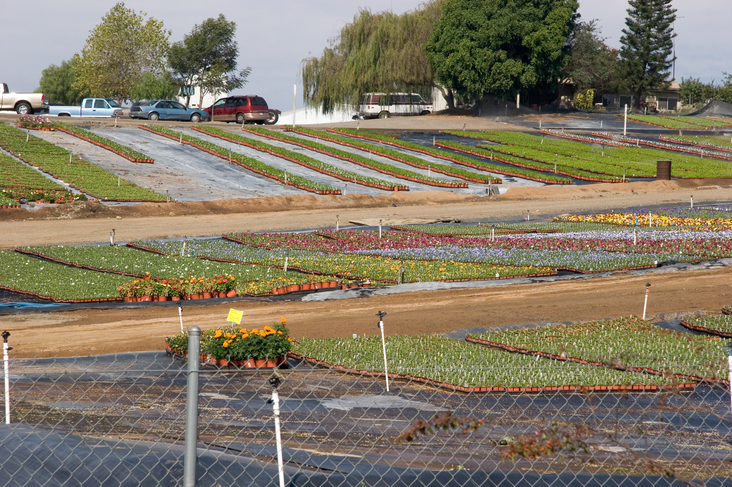
Altman Specialty Plants

Slide 14
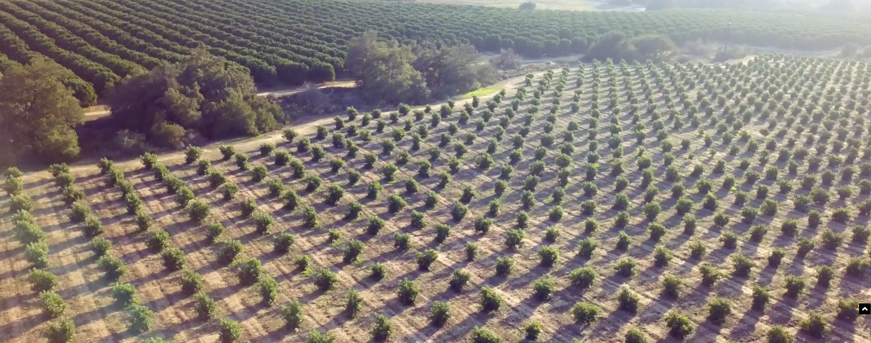
Avocado Groves

Slide 15
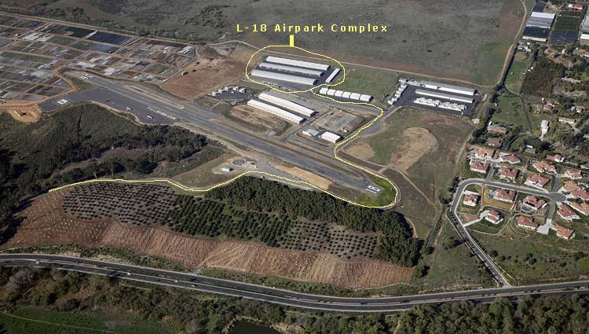
L18 Airpark, LLC

Slide 16
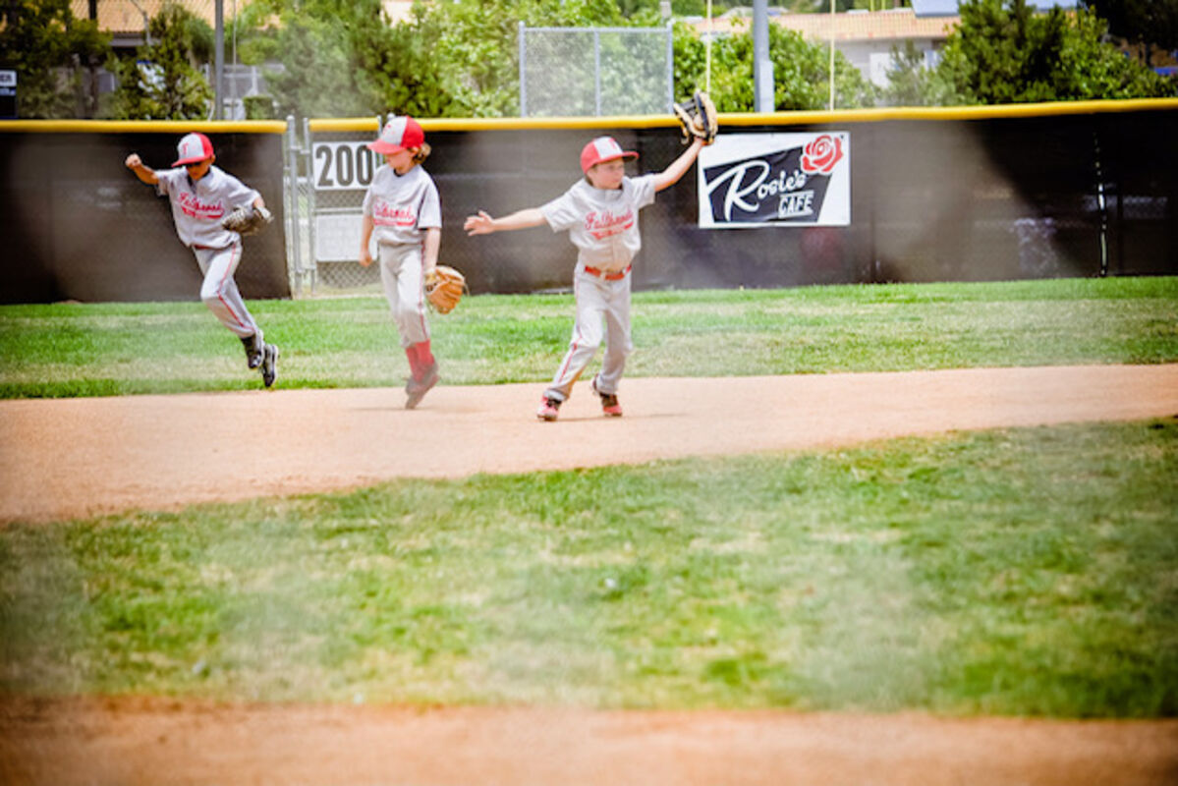
Fallbrook Community Youth Baseball

Slide 17

Sheriff’s Copter 12

Slide 18
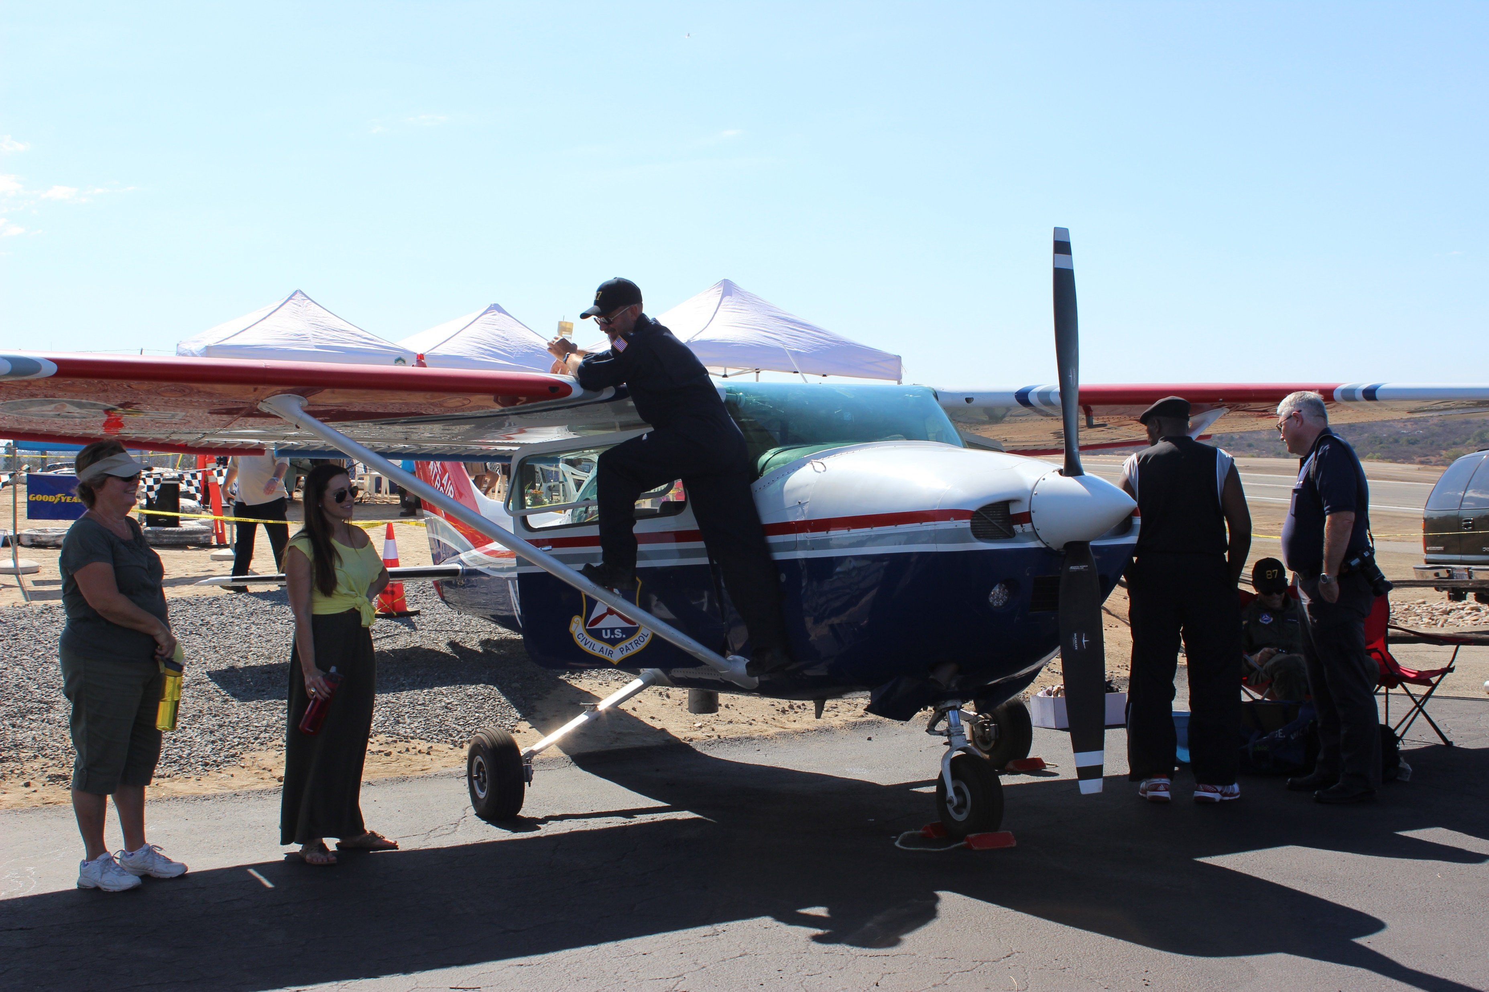
Fallbrook 50th Anniversary

Slide 19
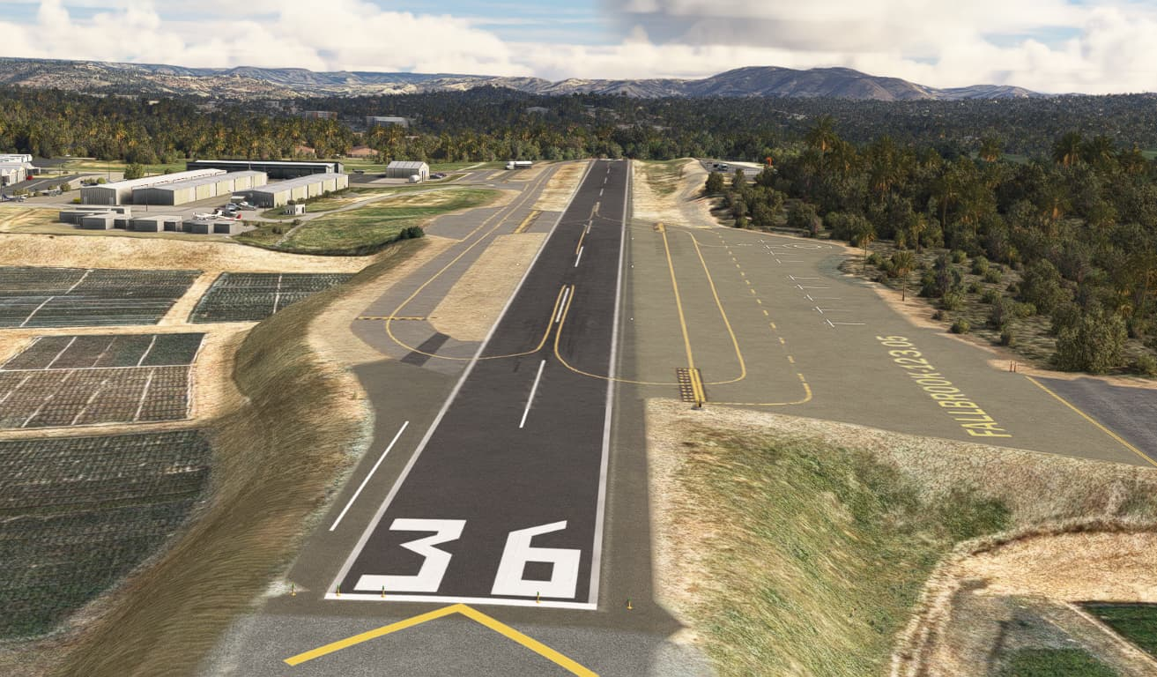

Slide 20
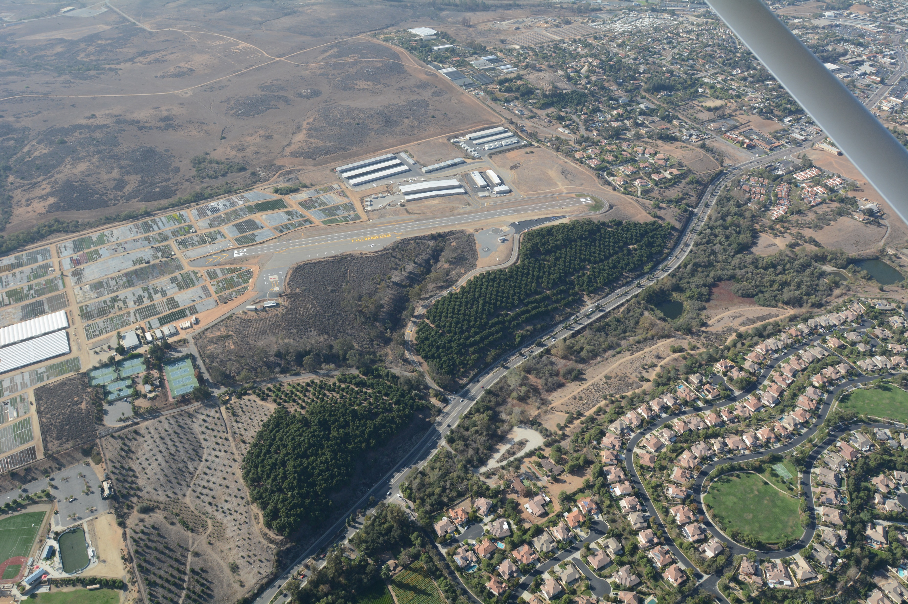

Slide 21
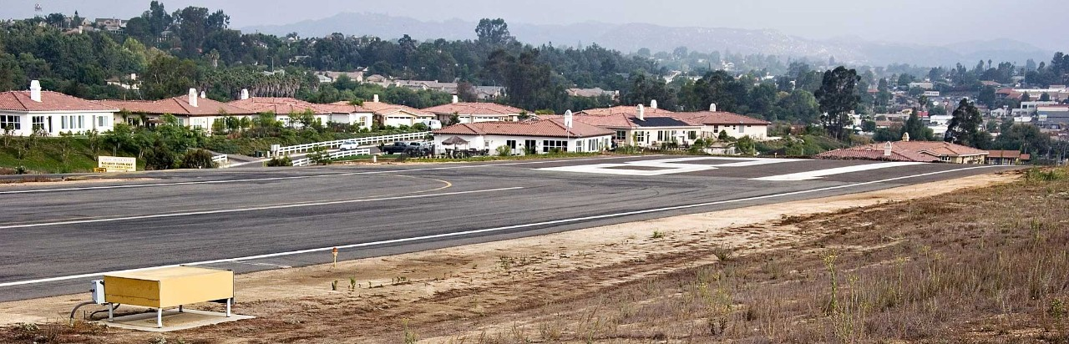

Questions?

