Slide 1



30-Day Mental Wellness Practice
Build a wellness routine with activities that work for YOU
Notes:
Directions: If presenting to an audience, provide audience members with print or digital copies of the practice materials so they can follow along.

Slide 2
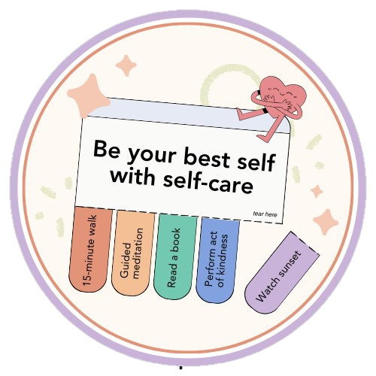
What is Mental Wellness?
Mental wellness is a state of well-being in which an individual is able to function and feel well
Mental wellness can be maintained through self-care
Self-care can help you...
  Cope with daily stressors
  Manage stress & anxiety
  Prevent burnout
  Boost your energy & mood

Slide 3
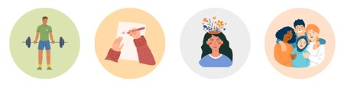
What does self-care
mean to you?
Notes:
Direction: Ask audience to self-reflect on what self-care means to them. Encourage audience members to share some of their answers, such as what they do for self-care.

Slide 4
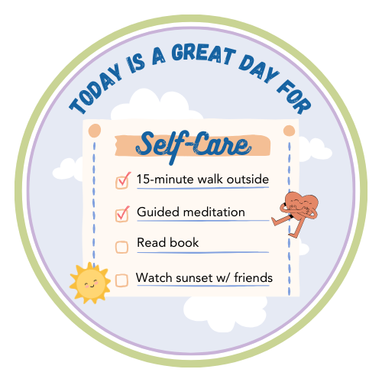
Prioritize Self-Care
Everyone can benefit from self-care!
Your version of self-care can look different from someone else's, and that's ok.
Self-care practices include:
  physical practices for your body
  cognitive practices for your mind
  emotional & social practices for your mood & relationships

Slide 5
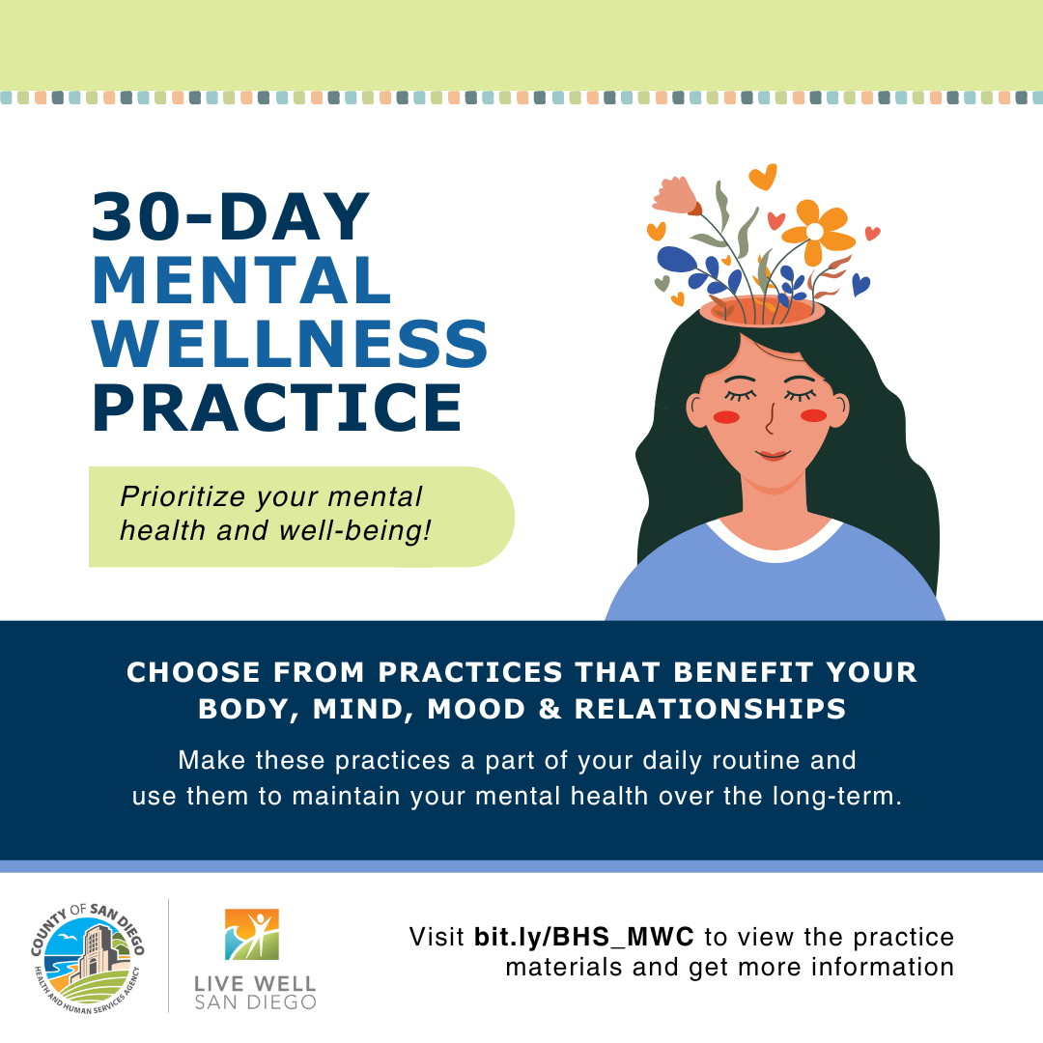
30-Day Practice Overview
Fun, free, & accessible way to engage in daily self-care activities that support mental wellness
Can be completed individually or with others
Materials available in English and Spanish at bit.ly/BHS_MWC

Slide 6
Webpage Outline
Introduction
Core Practice Materials
  What You Need to Know
  Self-Care Practices
  Practice Calendar
Optional Materials
  Weekly Planner
  Self-Reflection Worksheet
Wellness Graphics​​
  Social media posts​​
  Phone backgrounds​​
Feedback Form​​
Helpful Links​​
Notes:
This is an outline of the webpage for the 30-Day Mental Wellness Practice. Today we will be focusing on the Core Practice Materials and Optional Materials.

Slide 7
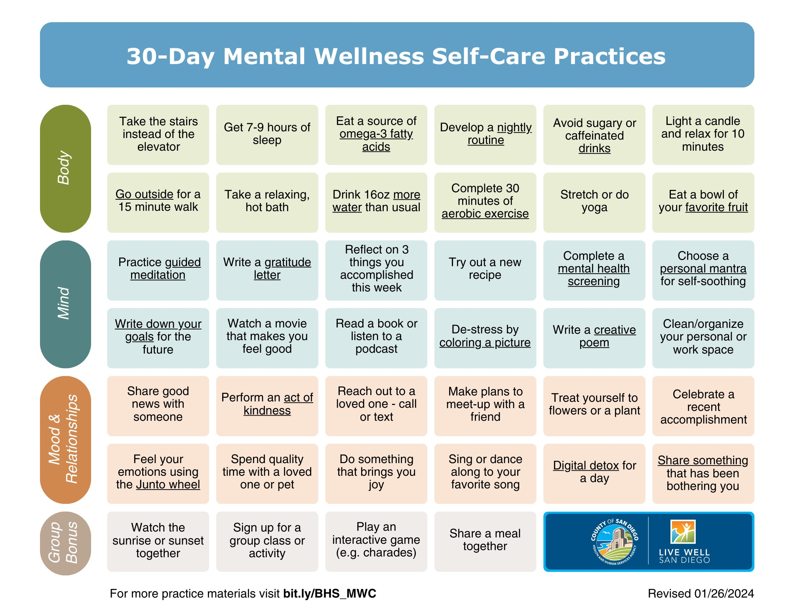
Underlined text is linked to resources with extra information
Practice Categories
Notes:
There are 40 self-care practices total and three main practice categories. The categories are body, mind, and mood and relationships. There is also a group bonus category. The group bonus practices are specifically meant to be completed with other practice participants; however, all practices can be completed with others.
Some self-care practices contain underlined text. These practices are linked to resources that further explain how to complete that particular self-care activity.

Slide 8
What You Need to Know
Self-Care Practices
  40 practices total
    Three main categories and group bonus activities
  Some include links to resources with extra guidance
  Select and complete at least one practice each day
  Complete at least one practice from each of the three main categories every week
    Three free REST DAYS on which you do not need to complete a self-care practice
Notes:
To successfully complete the 30-Day practice, you should complete at least one self-care practice each day and at least one practice from each of the three main categories every week.
It's important to remember that self-care is not meant to feel like a chore or burden. Therefore, you have three free rest days on which you do not need to complete a self-care practice. You can use them whenever you like.

Slide 9
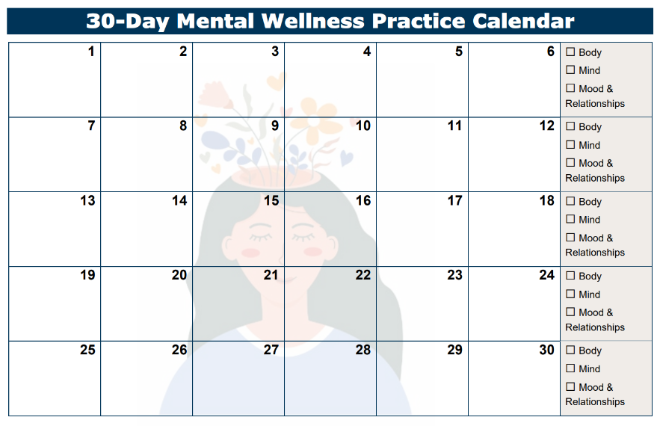
What You Need to Know
Practice Calendar
  Keep track of your progress over the 30 days!
  Write down which practice(s) you completed on the corresponding day
  At the end of each week, check off which categories you selected that week’s practices from
Notes:
Use the practice calendar to track your progress over your 30-day wellness journey! The calendar is a 30-day grid, and each cell represents a practice day. The right-most column lists the three main practice categories.
Write down which practice(s) you completed on the corresponding day. And at the end of each week, check off which categories you selected that week's practices from.

Slide 10
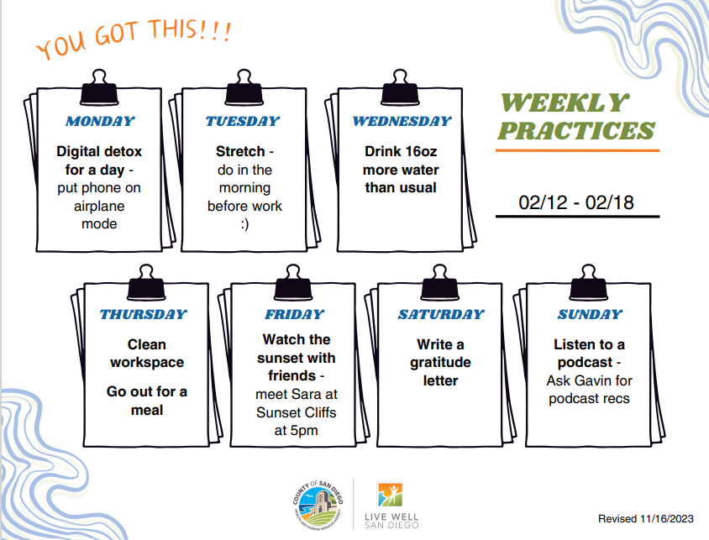
Activity Time
Use the weekly planner to decide which self-care practices you will complete during the upcoming week.
Choose practices that match your interests and lifestyle!
*Most practices take only 15 to 30 minutes to complete.
Notes:
Optional activity – have audience fill out the weekly planner with self-care practices

Slide 11

Activity Time!
(1) Choose a personal mantra
for self-soothing
OR
(2) Reflect on three things you accomplished this week
Notes:
Optional activity – give audience several minutes to complete one of the two self-care practices and allow time to share in group setting.

Slide 12
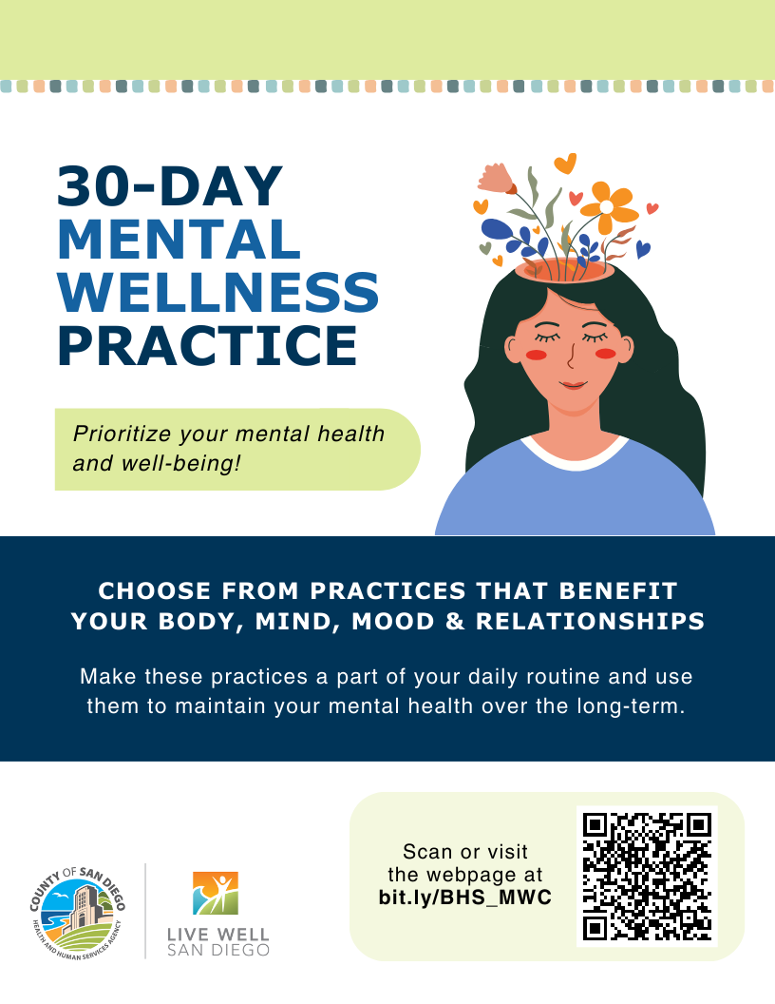
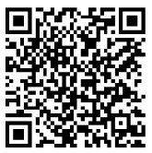
Start Today!
Take charge of your wellness.
Scan the QR code or visit the webpage at bit.ly/BHS_MWC
Webpage

