Slide 1



30-Day Mental Wellness Practice:
Youth Extension Pack
Designed for Youth, by Youth
Notes:
Directions: If presenting to an audience, provide audience members with print or digital copies of the full toolkit so they can follow along.

Slide 2
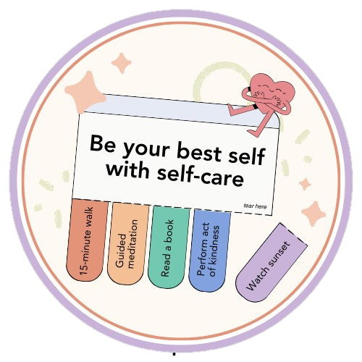
What is Mental Wellness?
Mental wellness is a state of well-being in which an individual is able to function and feel well
Mental wellness can be maintained through self-care
Self-care can help you...
  Cope with daily stressors
  Manage stress & anxiety
  Prevent burnout
  Boost your energy & mood

Slide 3
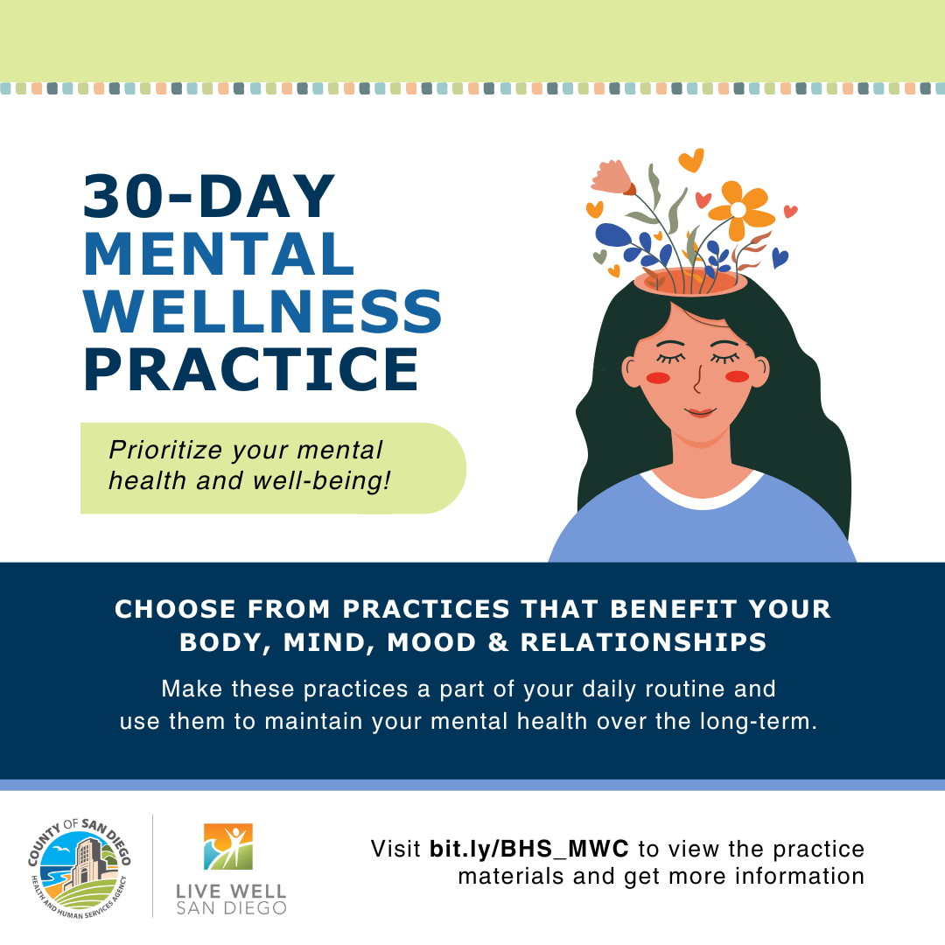
30-Day Practice Overview
Fun, free, & accessible way to engage in daily self-care activities that support mental wellness
Can be completed individually or with others
Materials available in English and Spanish at bit.ly/BHS_MWC

Slide 4
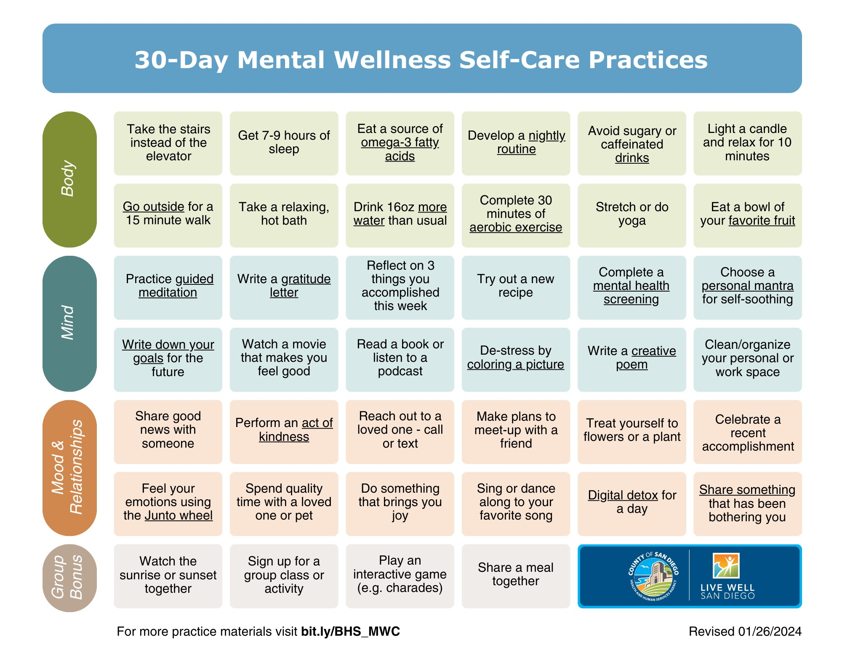
Self-Care Practice Calendar
Underlined text is linked to resources with extra information
Practice Categories
Notes:
There are 40 self-care practices total and three main practice categories. The categories are body, mind, and mood and relationships. There is also a group bonus category. The group bonus practices are specifically meant to be completed with other practice participants; however, all practices can be completed with others.
Some self-care practices contain underlined text. These practices are linked to resources that further explain how to complete that particular self-care activity.
To successfully complete the 30-Day practice, you should complete at least one self-care practice each day and at least one practice from each of the three main categories every week.
It's important to remember that self-care is not meant to feel like a chore or burden. Therefore, you have three free rest days on which you do not need to complete a self-care practice. You can use them whenever you like.

Slide 5

Youth Extension Pack Overview
Designed for youth looking to enhance their mental well-being
Provides youth-centered supplemental materials for the 30-Day Mental Wellness Practice
Materials available in English and Spanish at bit.ly/BHS_MWC
Notes:
The Youth Extension Pack was designed for youth, by youth to be completed alongside the 30-Day Mental Wellness Practice. The activities in the Youth Extension Pack can also be completed indvidually.

Slide 6
Webpage Outline
Introduction
A Message from the Creator
Mindful Support
  How to Make Positive Vision Boards
  Grounding Techniques Booklet
  How to Map My Support System
Activate Wellness
  Self-Care Checklist
  Morning/Night Routine Checklist
  Self-Esteem Journal Pages
  Reflection Journal Pages
Thrive Tools
  Youth Mental Wellness Guide
  School Advocacy Tips
  Promotional Materials
  Scoop for Youth Challenge
Continue Your Journey
  Additional Self-Care Opportunities
  Empower Your Voice
  Spread the Message
Helpful Links​​
Notes:
This is an outline of the webpage for the Youth Extension Pack. Today we will be focusing on the three key focus areas of the extension pack: Mindful Support, Activate Wellness, and Thrive Tools.

Slide 7
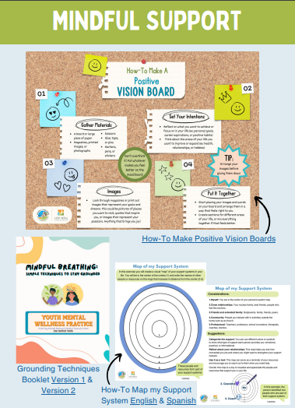
Mindful Support
How to Make Positive Vision Boards
  An exercise intended to help you clear your mind and set your intentions for well-being.
Grounding Techniques Booklet
  Includes step-by-step instructions on how to practice three breathing techniques.
How to Map My Support System
  An exercise with instructions for you to create a visual "map" of the support systems in your life.
Notes:
The Mindful Support focus area of the Youth Extension Pack provides resources designed to help visualize what mental well-being can look like in your life. The Grounding Techniques Booklet is a helpful resource for regulating your breathing when facing mental health challenges.

Slide 8
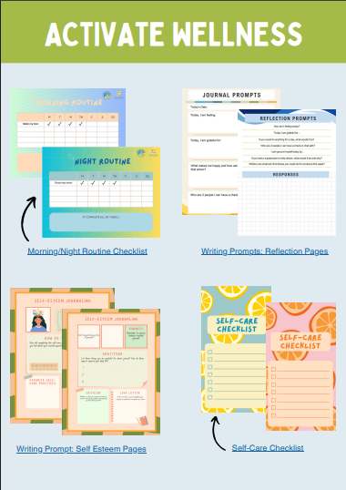
Activate Wellness
Morning/Night Routine Checklist
  Intended to help you stay on track to help manage your stress.
Reflection Journal Pages
  Includes different categories of journaling pages that can be used for reflection.
Self-Esteem Journal Pages
  Includes three journaling pages that can be used to reflect on and promote self-esteem.
Self-Care Checklist
  Phone wallpapers designed to help you prioritize self-care each day.
Notes:
The Activate Wellness focus area of the Youth Extension Pack provides resources designed to help you incorporate self-care practices into your day-to-day life and reflect on your mental well-being journey.

Slide 9
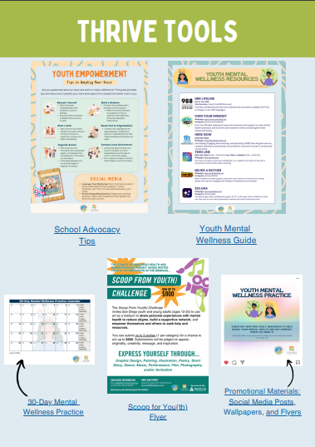
Thrive Tools
School Advocacy Tips
  A guide that provides tips and resources for you to advocate for the causes that matter most to you.
Youth Mental Wellness Guide
  A flyer that includes youth-related mental health resources available in San Diego County.
Scoop for You(th) Challenge
  A biennial challenge that invites youth and young adults to develop art pieces that highlight behavioral health topics to reduce stigma and normalize conversations
Notes:
The Thrive Tools focus area of the Youth Extension Pack provides tangible tips and resources for enhancing mental well-being individually and within the community.

Slide 10
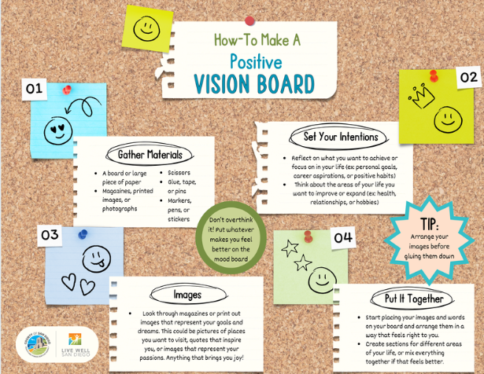
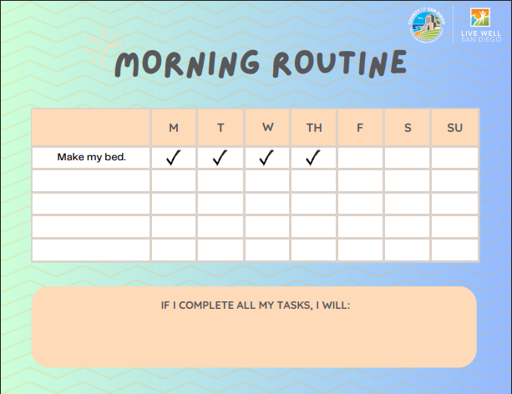
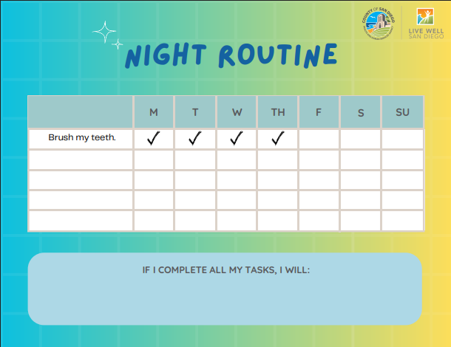
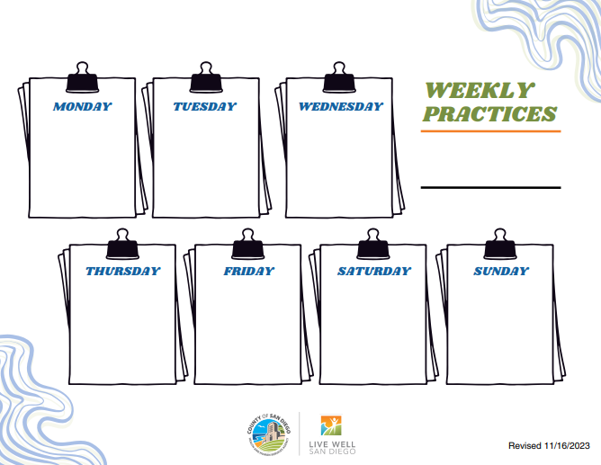
Activity Time
Select and complete an activity from one of the key Youth Extension Pack focus areas or the 30-Day Mental Wellness Practice!
*Most activities take only 15 to 30 minutes to complete.
Notes:
Optional activity – give audience several minutes to complete one of the exercises from the Youth Extension Pack or 30-Day Mental Wellness Practice and allow time to share in group setting.

Slide 11

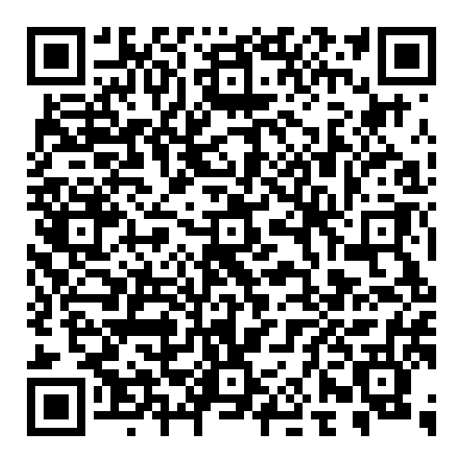
Start Today!
Take charge of your wellness.
Scan the QR code or visit the webpage at bit.ly/BHS_MWC
Webpage

