Slide 1
Annual Enrollment State-Purchased Influenza Vaccine Program for 2025-2026 Season
Araceli Montera, MPH – Community Health Program Spc.
State Flu Vaccine Admin Coordinator Epidemiology and Immunization Services Branch
Araceli.Montera@sdcounty.ca.gov
Office: 858-505-6724 | Phone: 619-366-7128
Mariana Venegas, MSN, RN – Sr. Public Health Nurse
Vaccine and Surge Coordinator
Epidemiology and Immunization Services Branch
Mariana.Venegas@sdcounty.ca.gov | Phone: 619-980-0419
Revised 6-13-2025

Slide 2
SPIVP ENROLLMENT

Slide 3
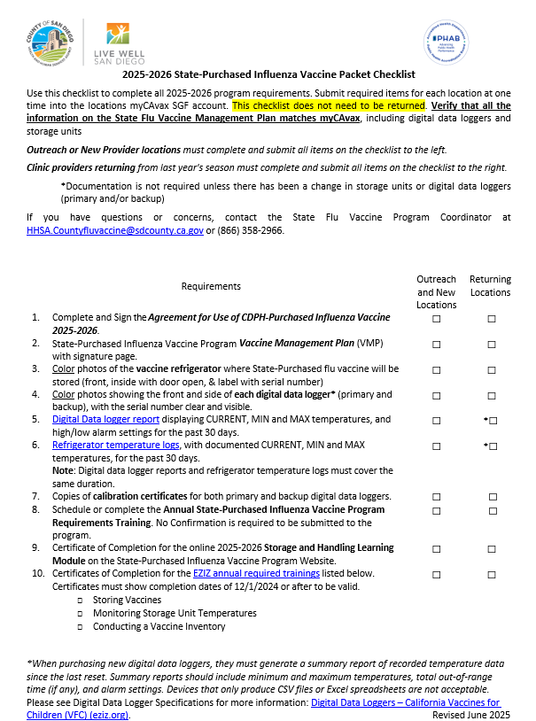
SGF PROVIDER ENROLLMENT CHECKLIST
Agreement for Use of CDPH-Purchased Influenza Vaccine 2024-2025
SPIVP Vaccine Management Plan (VMP) with Signature Page
Color Photos
Vaccine refrigerator (front, inside with door open & label with serial number)
Primary (main) & back-up data logger (front and side with data logger serial #
*Data Logger Report for the Last 30 Days from the date of submission
Displaying: Current, MIN and MAX temperatures
High/low alarm settings
Refrigerator Temperature Log for the Last 30 Days
*Note: Returning clinic providers from the 2024-25 season with an unchanged DDL, that hasn’t expired in the past year, do not need to submit the 30 days of data.

Slide 4
SGF PROVIDER ENROLLMENT CHECKLIST
Calibration Certificate for each Data Logger
Storage and Handling Learning Module
EZIZ Certificate of Completion
Primary Vaccine Coordinator and Backup Vaccine Coordinator
Certificates must be within the last year to be valid
Storing Vaccines
Monitoring Storage Unit Temperatures
Conducting a Vaccine Inventory

Slide 5


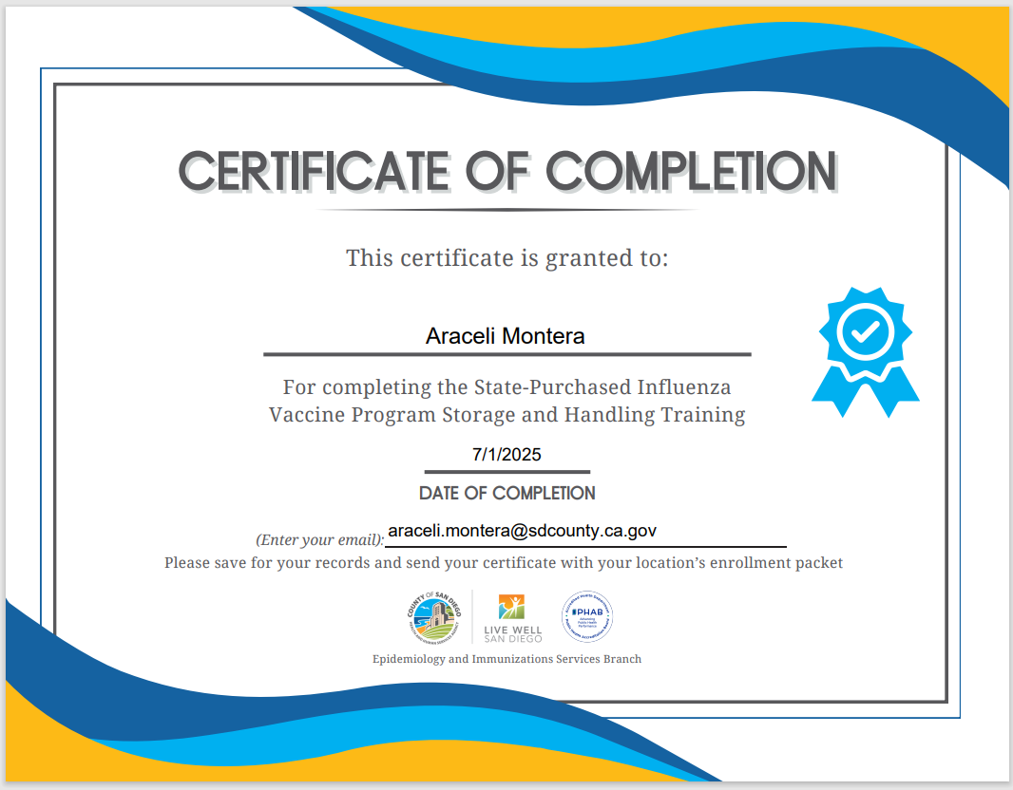
PROVIDER ENROLLMENT
LEARNING MODULE
Storage and Handling Learning Module
Accessed online using the State-Purchased Influenza Vaccine Program Resources Webpage
10 - 15 minutes to complete
Must pass all quiz questions to move forward
Click and Print the Certificate of Completion
Add your details (must be taken after 7/1/2025)
First and Last Name
Date Completed
Email Address
Include in the Enrollment Packet documents

Slide 6
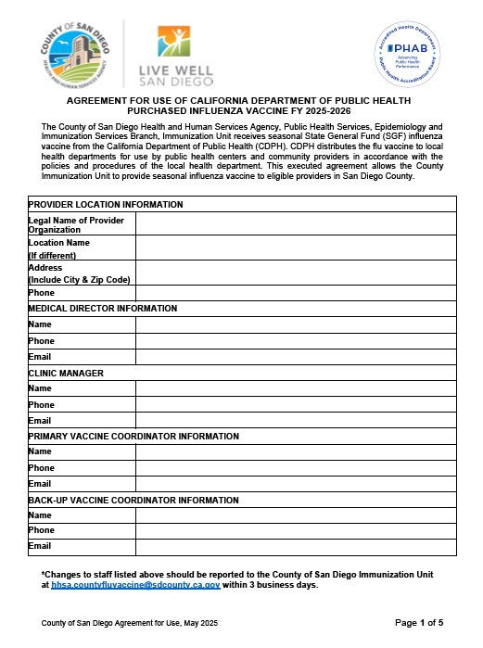
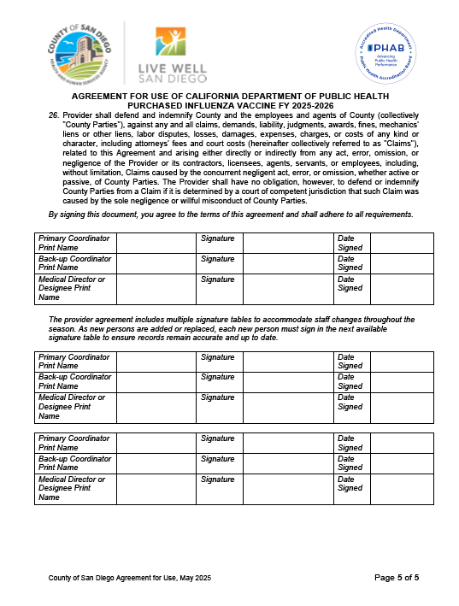
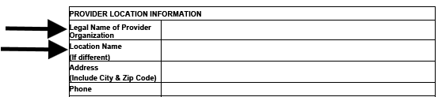
PROVIDER AGREEMENT
Agreement for Use of CDPH-Purchased Influenza Vaccine 2025-2026
Changes to staff, report within 3 business days. Including vacant or newly filled positions
Review all 26 listed points, for program requirements and compliance information
Medical Director, or Designee, Information
Each location must have a medical director or designee who is a licensed medical professional
This individual will oversee the vaccination process and be available for consultation and emergencies
Designee refers to someone who has been officially appointed to fulfill the responsibility of the Medical Director
Clinic Information, List the location’s legal name, that the agreement is with, and the location’s operational name (see two arrows below)

Slide 7
PROVIDER AGREEMENT
Agreement for Use of CDPH-Purchased Influenza Vaccine 2025-2026
Primary Vaccine Coordinator and Backup Vaccine Coordinator Information
Must be two separate individuals
If either coordinator is unavailable the location must assign another person to fulfill this role and meet the necessary requirements, even if it's temporary.
Who must sign the Agreement?
Primary Vaccine Coordinator
Backup Vaccine Coordinator
Medical Director or Designee
Additional signature spaces for changes in staff that occur during the season
Signature Required

Slide 8
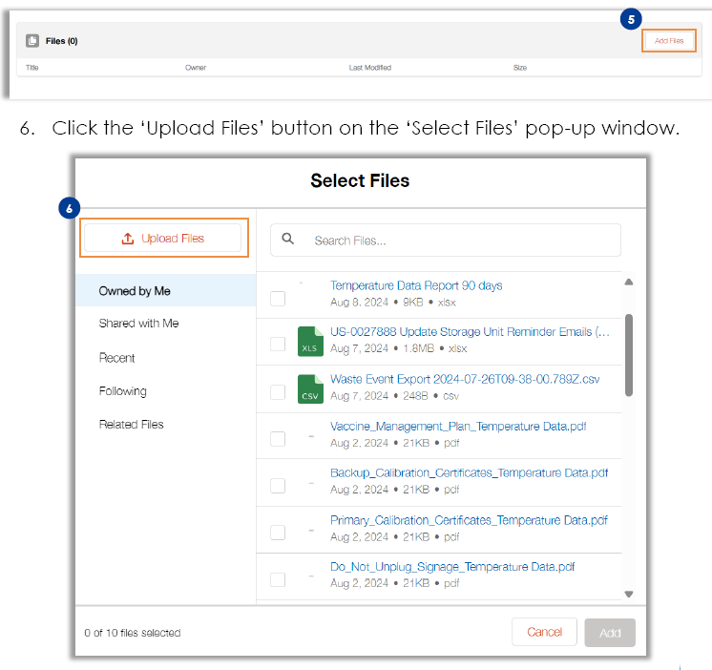
FILE UPLOAD myCAvax
Managing myCAvax Provider Accounts job aid
File Upload on a program location
Select Program Locations
Select State General Fund Program
Click “View Program Location” link
Select “Site Management” tab
Click “Add Files”
Click “Upload Files”
Select gathers documents for 25-26 enrollment
Click “Done”

Slide 9
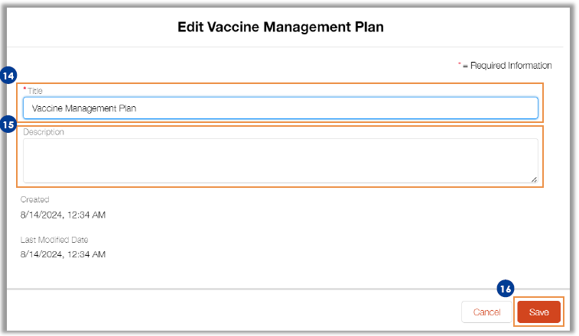
EDIT FILE DETAILS myCAvax
Managing myCAvax Provider Accounts job aid
File Upload on a program location – Edit File Details
Select file hyperlink to preview file
Click ‘caret’ icon on the file and Click “Edit File Details”
Enter the updated file title in the “Title” field
Click the “Save” button to save the changes

Slide 10
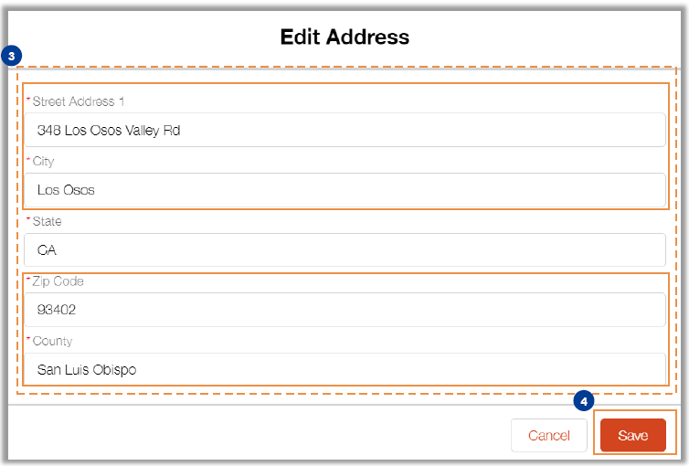
UPDATING THE PROVIDER ADDRESS IN myCAvax
Managing myCAvax Provider Accounts job aid
Updating the Provider’s Address
Under the location account, Click the “Update Address” button
Click the “Pencil” icon
Make necessary changes to the fields in the pop-up window
Click the “Save” button
Note:
Do not update the “State” field on the pop-up window
An error message will appear if the entered address is not valid

Slide 11
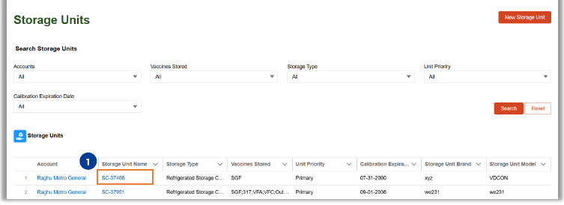
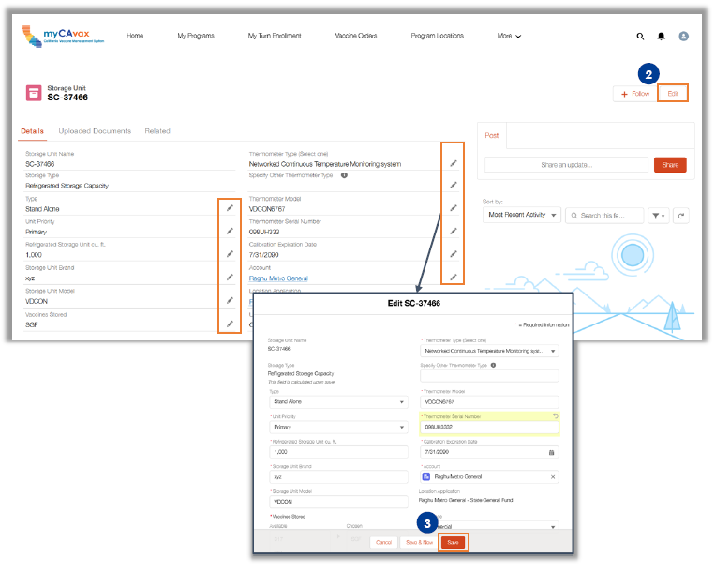

MODIFYING STORAGE UNITS IN myCAvax
Managing myCAvax Provider Accounts job aid
Modifying Storage Units: Update storage units as needed
Click “Storage Unit Number” hyperlink on the “Storage Units” Page
Click the “Edit” button OR Click the “Pencil” icon
Click the “Save” button
Note:
If the thermometer type, model, serial number or expiration date is updated a message will appear asking you to upload a calibration certificate.

Slide 12
MODIFYING STORAGE UNITS IN myCAvax NOTE
Managing myCAvax Provider Accounts job aid
Modifying Storage Units: Note
CDPH reviews any changes made to the storage units at a location to ensure compliance. Providers should expect a follow-up task from CDPH to confirm the updated storage units and equipment.
Vaccine Coordinators for each location and vaccine program receive email notifications regarding the calibration expiration dates of the storage units containing vaccines corresponding to the program they are participating in. Email notifications are sent when the storage units are:
90 days away from the calibration expiration date
30 days away from the calibration expiration date
0 days past the calibration expiration date
30 days past the calibration expiration date
When a storage unit is past the calibration expiration date, the corresponding Vaccine Program Location is placed on hold.

Slide 13
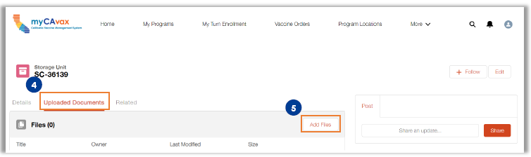
MODIFYING STORAGE UNITS IN myCAvax
Managing myCAvax Provider Accounts job aid
Modifying Storage Units: Upload Documents
Select Upload Documents tab on the storage unit
Click “Add Files”
Click “Upload Files”
Select and add the required documents
Click “Done”

Slide 14
myCAvax Resources

Slide 15
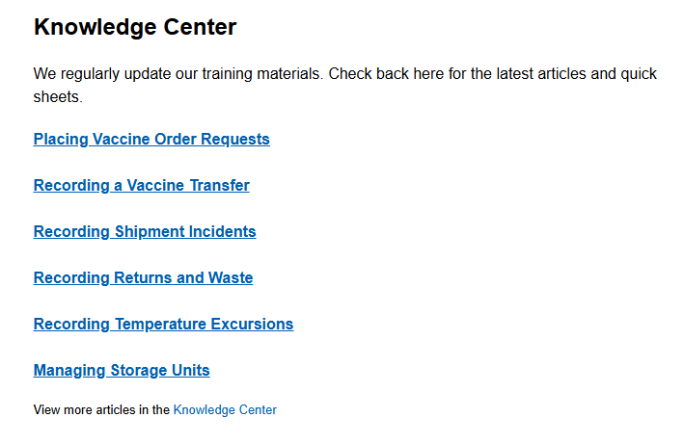
DOCUMENTS IN myCAvax
Knowledge Center Documents in myCAvax
Resource Materials
Managing Storage Units
Recording Shipment Incidents
Recording Returns and Waste
Recording Temperature Excursions
Reviewing Shipments
Placing Vaccine Order Requests
Training Materials
State General Fund Flu Vaccine FAQ
Getting Started with State General Fund Program in myCAvax for Providers
State General Fund Flu 101 for Providers
State General Fund Flu 102 for Providers
More training articles
For myCAvax SGF Flu program or policy inquiries, contact:
ProviderCallCenter@cdph.ca.gov
(833) 502-1245
Monday through Friday
8AM to 5PM
For Technical Difficulties, contact:
mycavax.hd@cdph.ca.gov

Slide 16
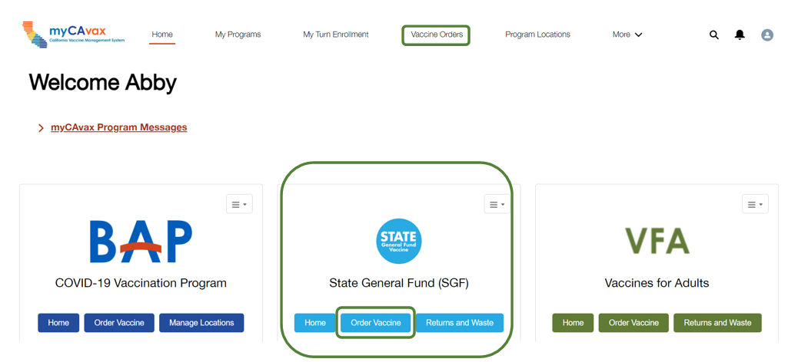
SUBMITTING VACCINE ORDER REQUESTS IN myCAvax
Only accounts with an active SGF program location in myCAvax are eligible to order vaccines.
How to Submit an Order in myCAvax
Click “Order Vaccine” on State General Fund (SGF) Tile
Enter “On-hand Inventory”, “Doses administered”, and “Doses Requested” for each product.
Vaccine Ordering Tips
Review allocated products in the email to prevent rejected orders.
Confirm the shipping address and verify the hours in myCAvax.
Note: Vaccine order requests are approved twice a week according to the CDPH cadence calendar.

Slide 17
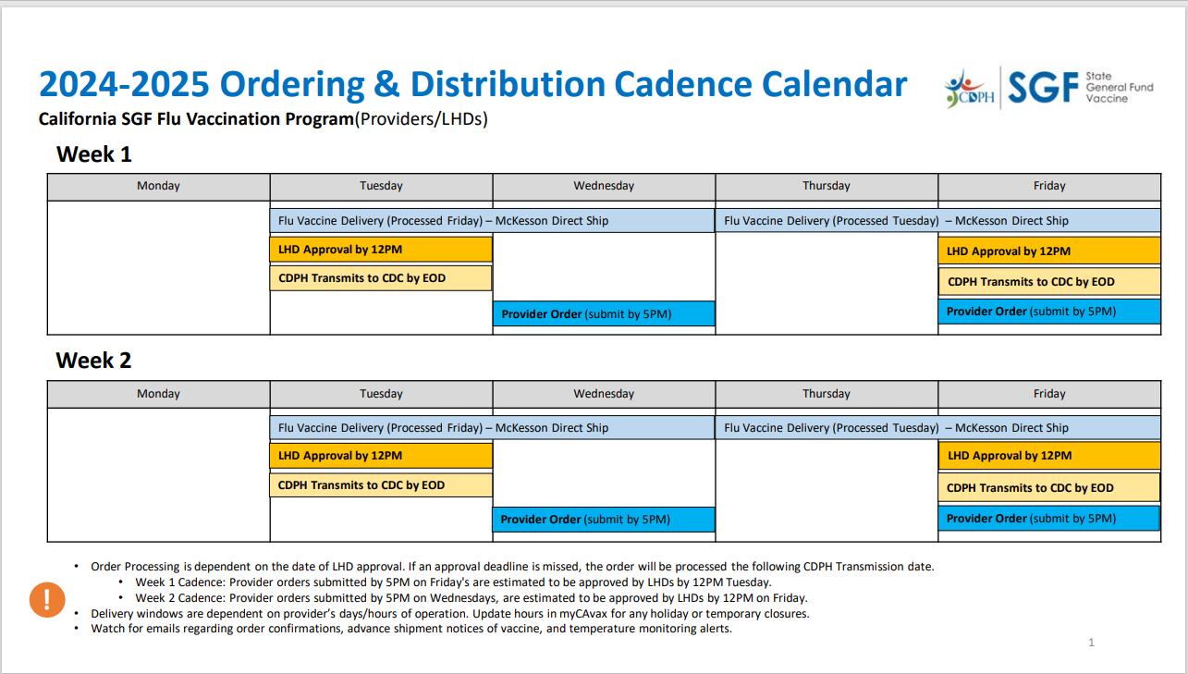
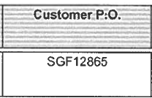
RECEIVING VACCINE ORDERS DIRECTLY
Tips for Receiving Vaccine Orders
Never reject a vaccine shipment.
Confirm staff are available to accept the vaccine upon receiving the shipment notification.
Check the products against the packing slip and add "State" stickers.
Confirm the funding source indicates SGF, especially if VFC vaccines are included.
In the process of being updated for the 2025-2026 season
Calendar can be found on EZIZ.org - IMM1475

Slide 18
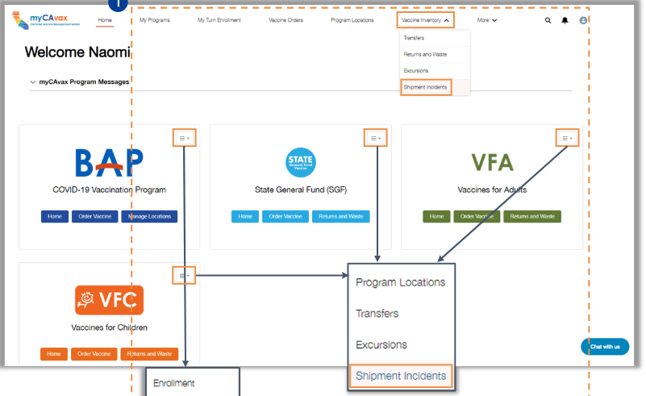
REPORTING SHIPMENT INCIDENTS IN myCAvax
The shipment incident must be reported on the day it occurs for a quick resolution.
If you select the “Not ordered/incorrect recipient” option in step 5
Indicate whether you agree to keep the doses or not.
If you do not agree to keep the doses, continue to store them until you receive further instructions from the program.
Notify the State Flu Program via email after reporting it in myCAvax.
Shipment Incident Types:
Broken, torn or tempered with
Not Ordered/incorrect recipient
Out-of-range temperature
Package never arrived
Previously Opened
Shipping content discrepancies

Slide 19
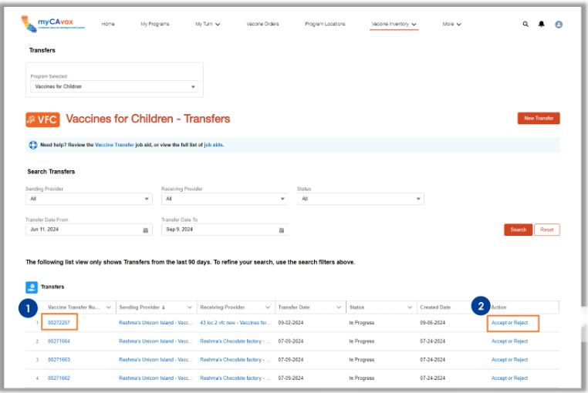
VACCINE TRANSFERS
Vaccine Transfers
State General Fund (SGF) Flu Vaccine Transfers can only be initiated in myCAvax by the Local Health Department.
Please inform the State Flu Program about any vaccine transfers before moving SGF Flu vaccines.
After the transfer: Review and Approve a Transfer as the Receiver
On the “Transfer” page, locate the vaccine transfer order status that is “In Progress.”
Click the “Accept or Reject” option on the transfer
Changes made after accepting a transfer will be communicated in an email notification sent to the Primary and Backup Vaccine Coordinators.

Slide 20
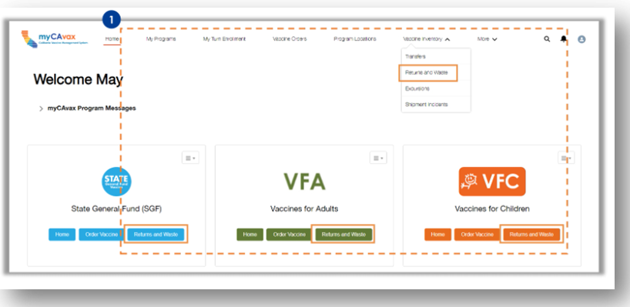
VACCINE RETURNS AND WASTE
Recording Vaccine Returns and Waste in myCAvax
Select “Returns and Waste” from the “Vaccine Inventory” dropdown or program tile
Click the “New Return and Waste” to create a new event
You may use the same form for multiple products associated with the selected program.
Select Type of Waste:
Expired
Spoiled
Wasted

Slide 21
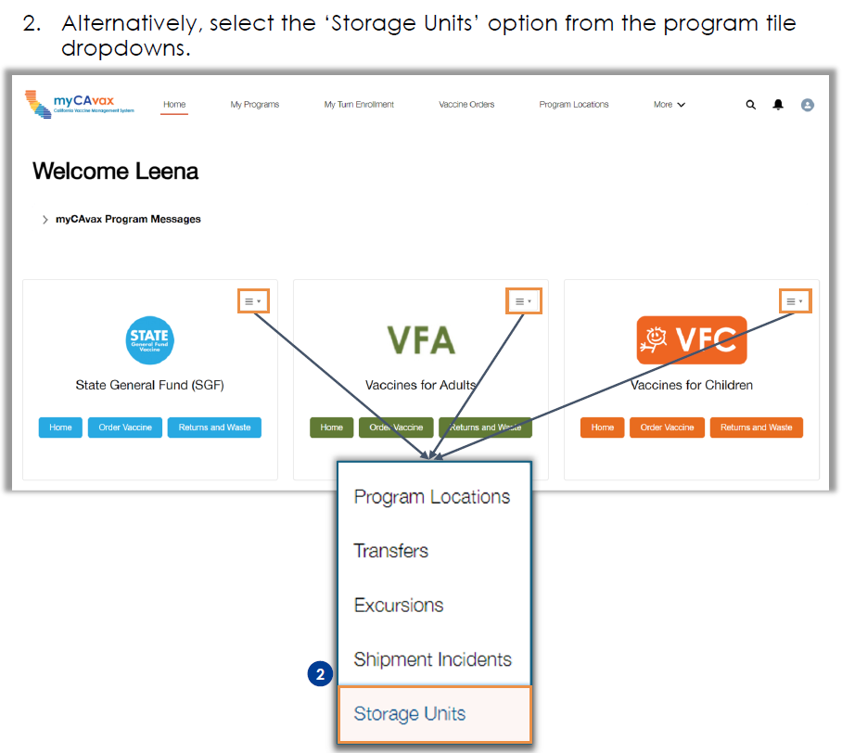
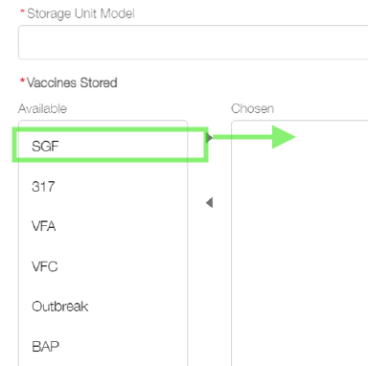
MANAGING STORAGE UNITS
Remember to keep all refrigerator storage units up to date in myCAvax.
Backup Thermometer
Primary Refrigerator
Backup Refrigerator
Mobile Unit
No Longer in use
Add new vaccine storage unit or edit an existing one
Mark storage units not in use as “No longer in use”
Add, Edit or Update Storage Unit & DDL details
Mark storage units with SGF products as “SGF”

Slide 22
SPIVP Resources

Slide 23
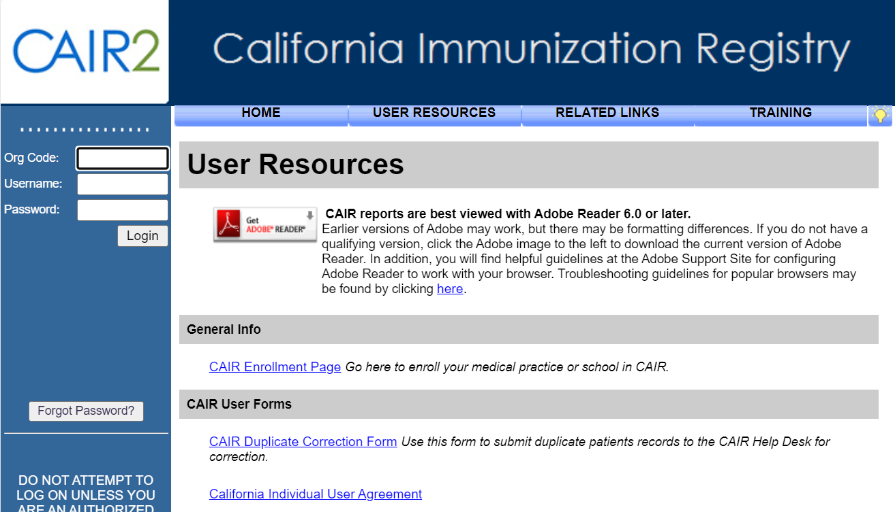
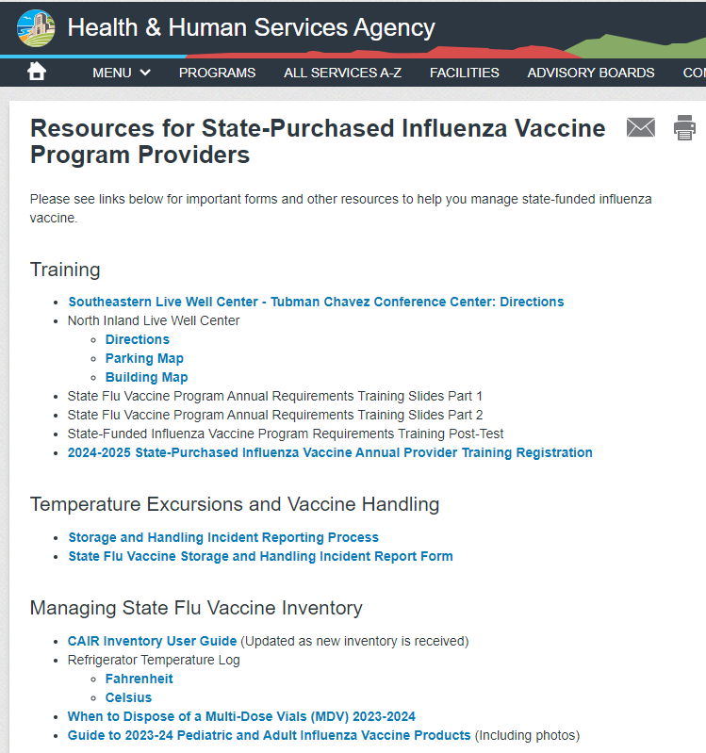
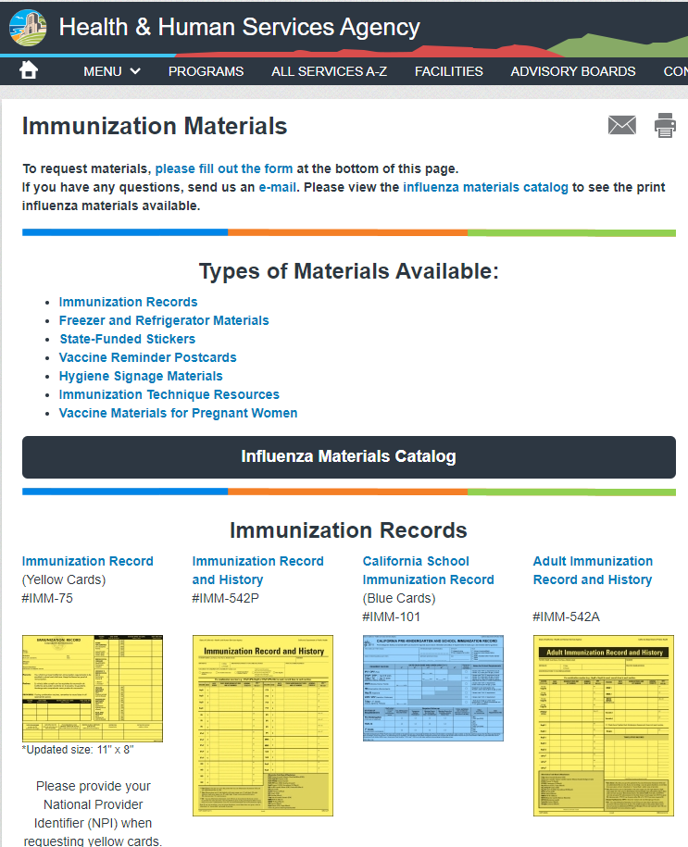
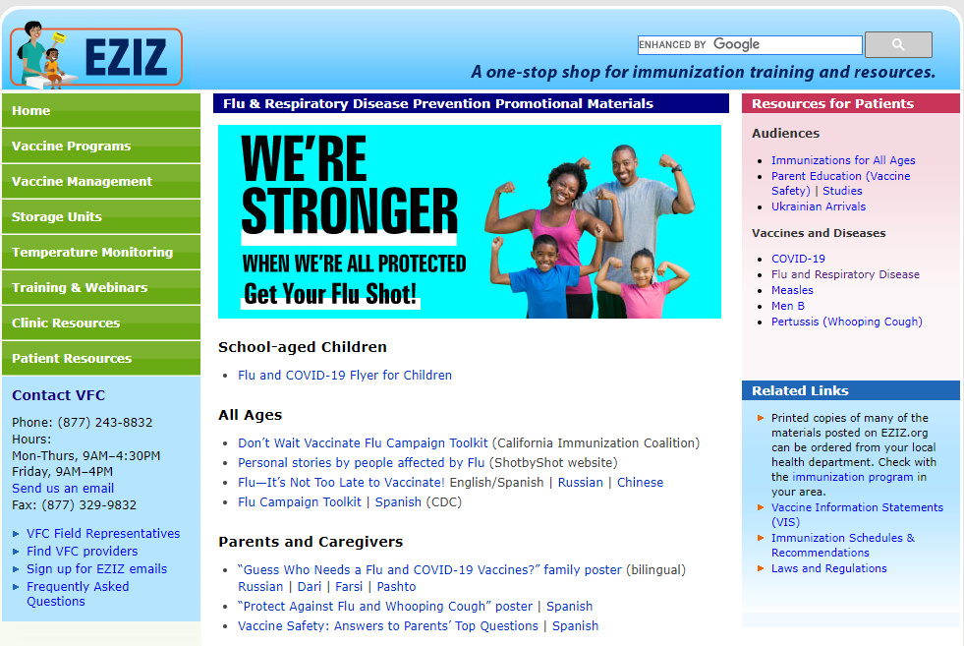
STATE-PURCHASED INFLUENZA VACCINE PROGRAM (SPIVP) SUMMARY OF WEBPAGE RESOURCES AND LINKS
State-Purchased Influenza Vaccine Program and Providers (County website)
EZIZ
CAIR2 Portal
myCAvax
My Turn
Immunization Material Requests
State Stickers *Now Available*
Temperature Logs
Yellow Cards

Slide 24
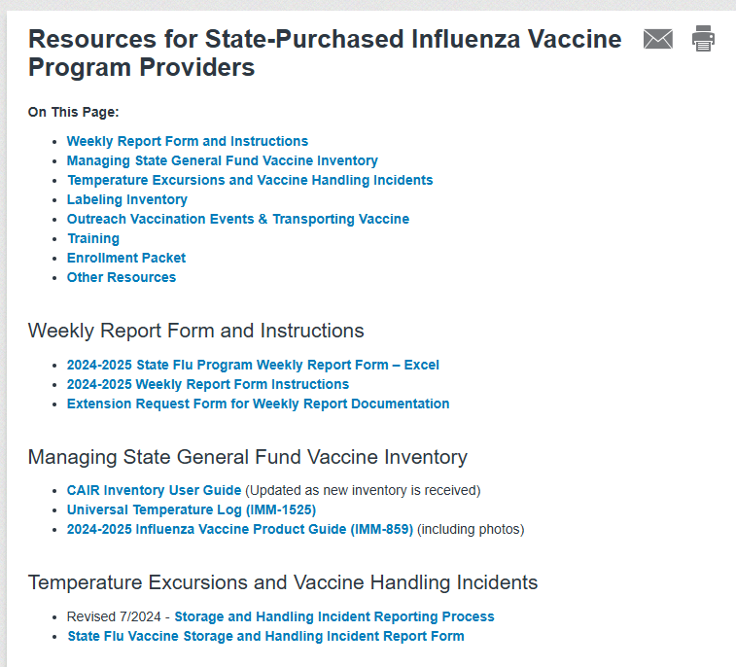
STATE-PURCHASED INFLUENZA VACCINE PROGRAM PROVIDER RESOURCES WEBPAGE
State-Purchased Influenza Vaccine Program and Providers
Weekly Report Form and Instructions
Managing SGF Vaccine Inventory
Temperature Excursions and Vaccine Handling Incidents
* Updated June 2025*
Process
Reporting Form
Outreach Vaccination Events and Transporting Vaccine
Training
PowerPoint *Available July 2025*
Location Map and Directions
Enrollment Packet Documents
Other Resources: EZIZ & CAIR2

Slide 25
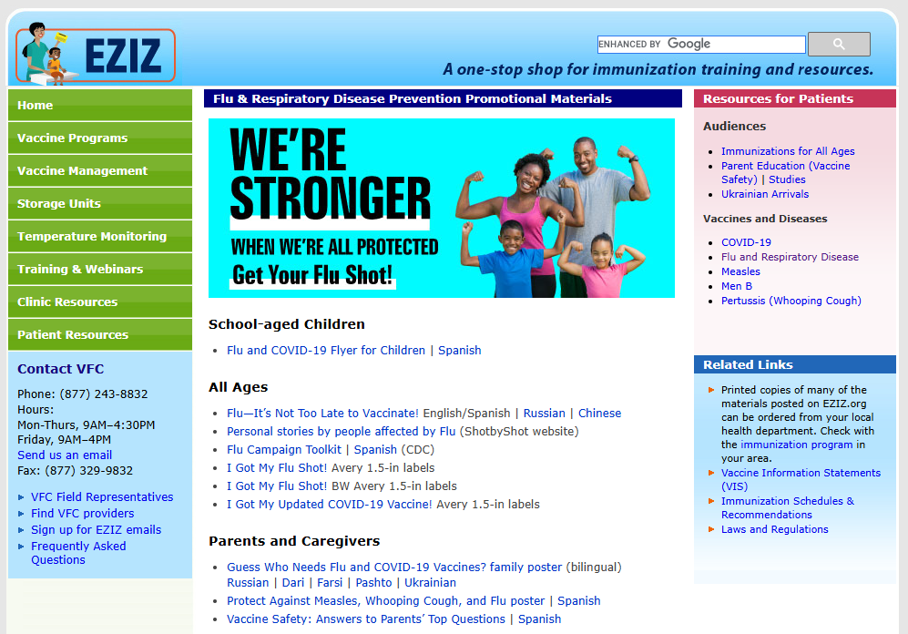
EZIZ RESOURCES
EZIZ
Flu & Respiratory Disease Prevention Promotional Material
Training & Webinars
Temperature Monitoring Documents
Vaccine Management Details and Documents
Clinic Resources

Slide 26
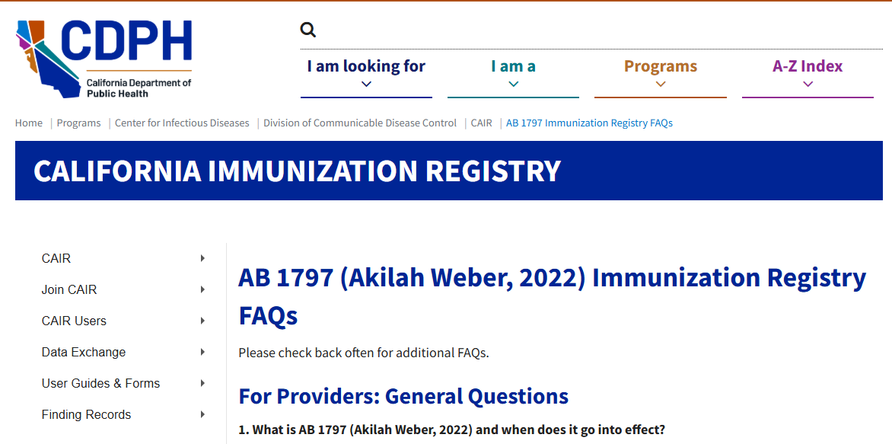
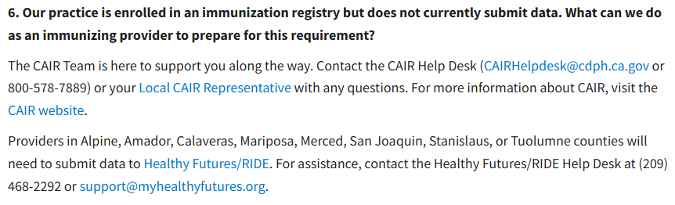
CAIR2 REQUIREMENT
All Providers are Required to Submit Immunization Data to California Immunization Registry (CAIR)
AB 1797 effective January 1, 2023 states that providers are required to document and report to the state immunization registry:
All immunizations administered in California.
Including the patient's race and ethnicity.
CAIR User Guides
CAIRHelpdesk@cdph.ca.gov
Phone: 800-578-7889 | Hours: 8am–5pm Monday to Friday

Slide 27
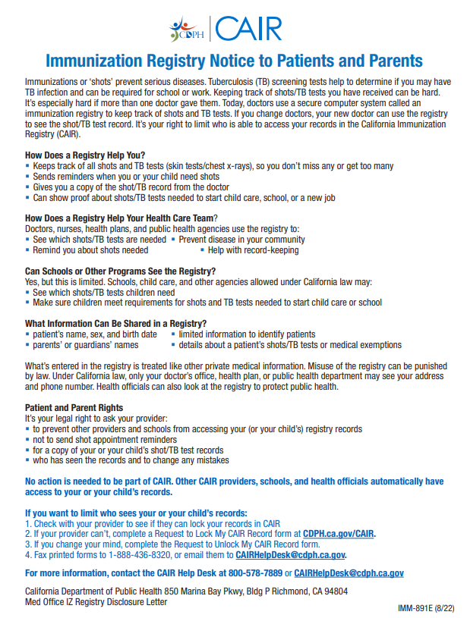
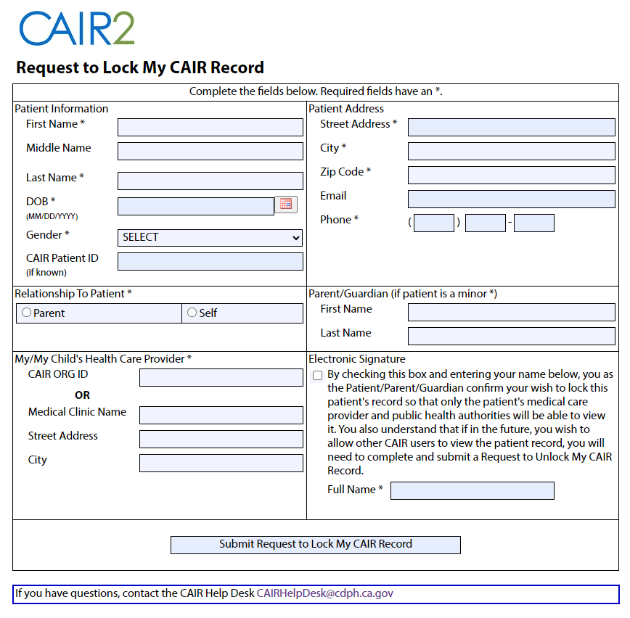
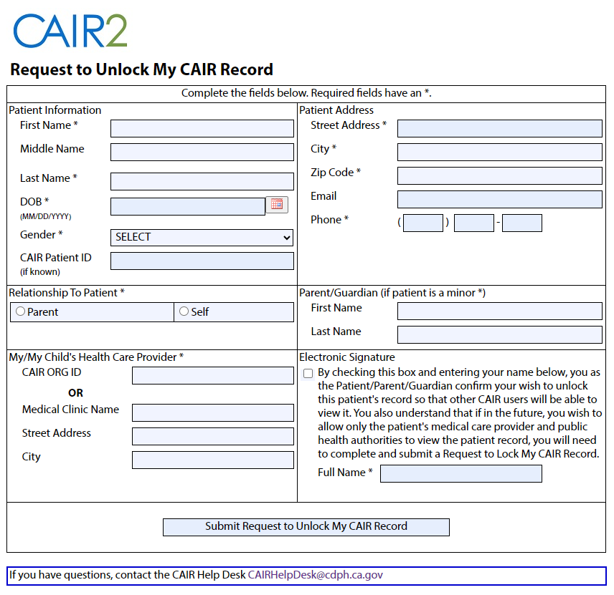
CAIR2 PORTAL AND NOTIFICATIONS
CAIR2 Portal
Immunization Registry Notice to Patients and Parents
Request to Lock or Unlock My CAIR Record
Merge Patients Form: CAIR2 Duplicate Record Correction Form Allows health care providers to request that duplicated patient records be merged into a single record by the CAIR2 Help Desk.
CAIRHelpdesk@cdph.ca.gov
Phone: 800-578-7889 | Hours: 8am–5pm Monday to Friday

Slide 28
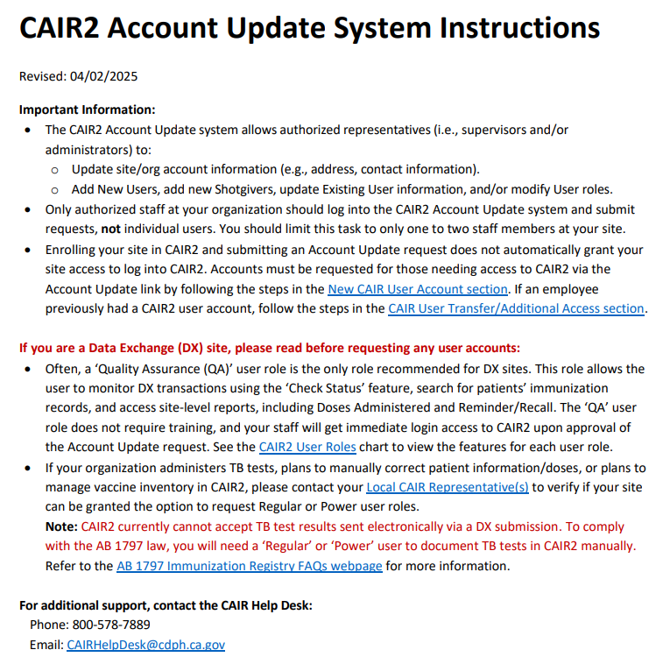
CAIR2 ACCOUNT UPDATE INSTRUCTIONS
CAIR2 Account Update
Can
Edit organization’s contact information,
VFC PIN
add licensed clinician information
Validate address
Add clinician (shot giver) to organization and edit name and title
Add new user
Edit user’s name, contact information, role (user level), active status (including deactivate)
Give access to a user for a different organization
CAIR2 San Diego Local CAIR Reps (LCRs):
Albert Lopez​
Phone: 510-672-4328
Email: albert.lopez@cdph.ca.gov
Ryan Thun
Phone: 559-375-4220
Email: ryan-christopher.thun@cdph.ca.gov​

Slide 29
Reminders

Slide 30
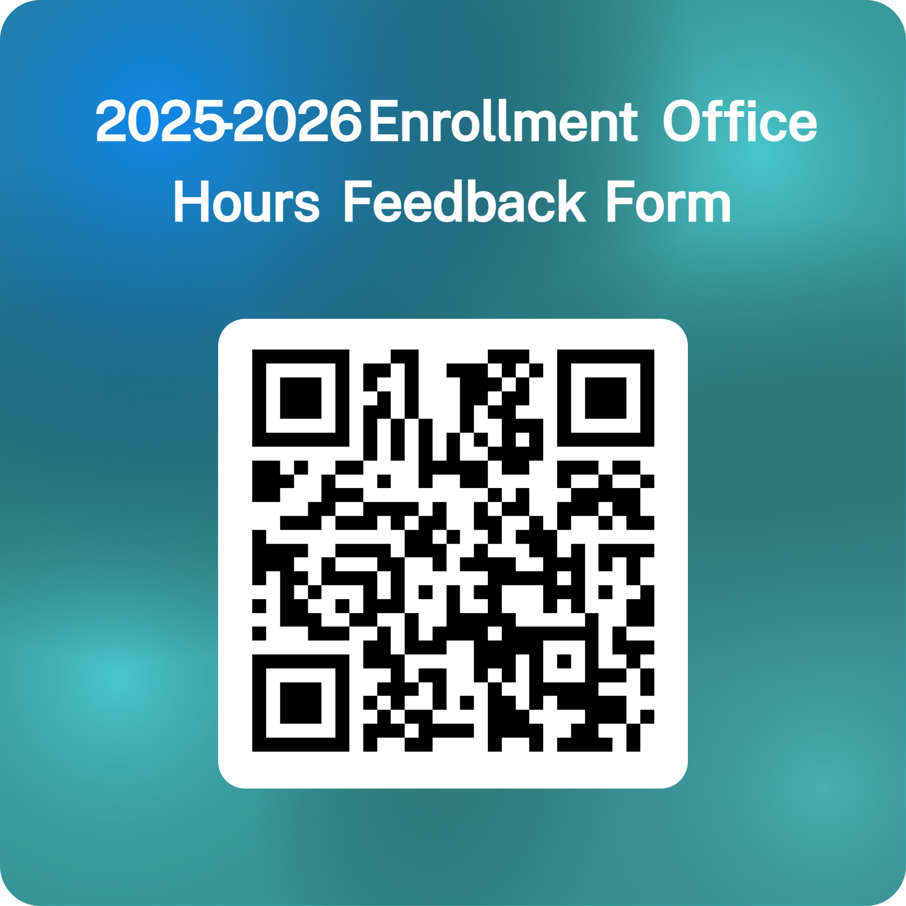

REMINDERS
Enrollment Reminders
Complete the annual enrollment packet for the 2025-2026 season, including a signed Provider Agreement.
Ensure all Primary and Backup Vaccine Coordinators attend the annual training.
Notify the program of any changes promptly.
Annual training is mandatory for all Primary and Backup Vaccine Coordinators.
Training certificates will be emailed to each person individually
Note: Training certificate links will expire within 10 days of being received, please save them ASAP when received.
https://forms.office.com/g/3qaWidfN2T

Slide 31
Thank You

