Slide 1





Public Health Services Response to
Outbreaks & Pandemics
An orientation for staff about management under
Incident Command System (ICS)
June 2025
Public Health Services
Notes:
Anuj/Jeff:
Good morning, everyone.
Welcome.
Thank you for being here today.
My name is _____________, I am your _______________, and I am joined today by ____________, from the _____________ team, and Angelica Bernal our Staff Development Specialist in our Office of Workforce Development.
Starting with an icebreaker question, (Example: what are you all doing for the 4th of July holiday?)
This is the new, abbreviated Public Health Services Response to Outbreaks & Pandemics training.
We think you are really going to enjoy it. We received very positive feedback on it from previous participants.
Hopefully, you have your coffee, scratch pads and phones ready for an interactive session.
This training is mandatory for all NEW permanent PHS staff (those hired on or after June 30, 2024) and existing staff that have not yet taken it.
At the end, we are going to review the participant polling, and it will be used to give you credit for successfully having completed this training.
As such, please ensure you stay until the end, otherwise, it will show as incomplete and reassigned.
Based on feedback from Branch Chiefs and Medical Directors, we want to ensure optimal engagement.
We all know it is easy to get distracted and disengaged so for these trainings we would like you to have your cameras on and we will be requiring all participants to complete the interactive activities including the pre-test, post-test and knowledge check questions as well as the evaluation survey.
If you are on camera and engaging 100% with the polling, you will receive credit for having taken this training.
We will just give it a couple of minutes while you come on camera. Thank you for participating fully.

Slide 2

Notes:
Anuj/Jeff:
And now we are going to do an interactive pre-test to determine how well you know the factors related to outbreak and pandemic response now, and then we will do a post-test after to show we moved the dial on advancing your knowledge of these.
So, get ready to click on the links in the upcoming slides.
Angelica will be launching a poll for you to participate in.
We need to have 100% participation in these tests and knowledge checks so please let Angelica know if you need help.
Angelica, take it away.

Slide 3
Pre-test Question 1
I feel confident in identifying the factors related to outbreak and pandemic response.
Not at all confident
Slightly confident
Moderately confident
Very confident
Extremely confident
Notes:
Angelica:
(Angelica launch the poll)
Thank you, _______ (presenter).
Yes, today we are expecting 100% engagement from you which is necessary to get credit for this training so please use the poll link to answer the pre-test questions.
If you are unable to access the poll or are having technical challenges, just LMK.
Do we have everyone?
(Angelica: If the group is small enough, and time permits, call out a person or two to make sure they are good for the first poll question).
Now, using the poll, please answer the following questions.
Read question and results aloud (if results are available).
Wonderful! I see we have full participation.
Next question…

Slide 4
Pre-test Question 2
I feel confident in describing the factors related to outbreak and pandemic response.
Not at all confident
Slightly confident
Moderately confident
Very confident
Extremely confident
Notes:
Angelica:
The next question is
Read question and results aloud.
Do we still have everyone with us?
No technical issues?
Great! Let’s keep going.
Next question…

Slide 5
Pre-test Question 3
I feel confident in describing factors related to outbreak and pandemic as they relate to my work.
Not at all confident
Slightly confident
Moderately confident
Very confident
Extremely confident
Notes:
Angelica:
Read questions and results aloud.
Next question…

Slide 6
Pre-test Question 4
I feel confident in my understanding of how the department (PHS) manages and responds to outbreaks or pandemics and their root causes.
Not at all confident
Slightly confident
Moderately confident
Very confident
Extremely confident
Notes:
Angelica:
Read questions and results aloud.
Now, back to __________ (Presenter)...

Slide 7
Purpose AND OUTCOME
To provide an annual update on the Public Health Service (PHS) response to outbreaks and pandemics utilizing the Incident Command System (ICS) and understanding/appreciating the role of Health & Human Services Agency (HHSA) personnel as Disaster Service Workers (DSW).
This training lesson examines the experiences of County of San Diego (CoSD) in managing events of public health significance, introduces a high-level look at ICS, and the integration with partnerships and the community.
This training should lead to improved confidence of staff in carrying out their public health practice as measured in the post training survey, achieving 60% moderately confident or above.
Notes:
Anuj/Jeff:
In terms of purpose and outcomes for this training, this training is designed:
To provide an annual update on the PHS response to outbreaks and pandemics utilizing the ICS and understanding/appreciating the role of HHSA personnel as DSW.
This training lesson examines the experiences of County of San Diego in managing events of public health significance, introduces a high-level look at ICS, and the integration with partnerships and the community.
This training should lead to improved confidence of staff in carrying out their public health practice as measured in the post training survey, achieving 60% moderately confident or above.

Slide 8
OBJECTIVES
Outbreak and Pandemic Management Under ICS
Consider infectious disease and outbreak management factors
Discuss purpose, process and required training for Disaster Service Workers
Understand core emergency operations plans, concepts, and principles used under ICS.
Introduce overarching guidance and decision making
Provide an overview of the Office of Emergency Services - Emergency Operation Center and the HHSA Medical Operations Center (MOC)
Summary and wrap-up
Examine the County of San Diego’s historic outbreak and infectious disease events managed under ICS.
1
2
3
4
5
6
7
Notes:
Anuj/Jeff:
In terms of objectives, at the end of these trainings, you will:
Be able to discuss the purpose, process and required training for Disaster Service Workers;
Have knowledge of infectious disease and outbreak management factors;
Understand core emergency operations plans, concepts, and principles used under ICS;
Have preliminary understanding of the overarching guidance and decision making involved with outbreak and pandemic response;
Be able to describe the basics of the Office of Emergency Services - Emergency Operation Center and the HHSA Medical Operations Center (MOC); and
Have basic information about the County of San Diego’s historic outbreak and infectious disease events managed under ICS.

Slide 9
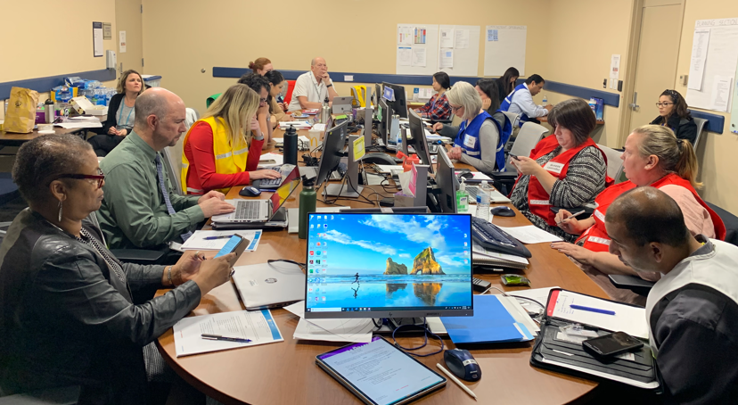
The Process
Disaster Preparedness and response
Outbreaks may result in a local emergency being declared.
CoSD prepares for emergency events that includes definitive plans, redundancy, integration, training, partnership and evaluation of experiences.
All HHSA personnel may have a role in the response to emergency events and need a basic understanding of the organizational process of ICS.
All public employees are Disaster Service Workers (DSWs) subject to activities by their supervisor or by law.
Notes:
Anuj/Jeff:
Why is this important?
Well, San Diego County has had emergencies (e.g., flu, Hepatitis A, COVID-19) over the last several years. In 2021, we had ongoing concurrent incidents for COVID-19, Shigella, and wildfires. County incidents will almost always involve the deployment of PHS staff as disaster service workers as per Government Code Sections 3100 and 3101.

Slide 10
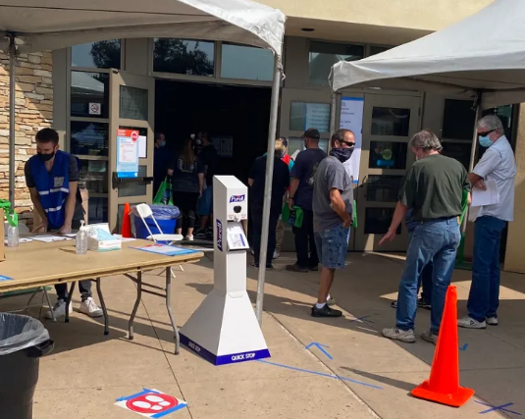
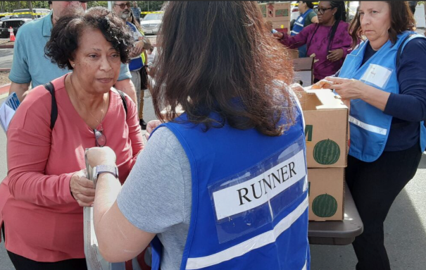
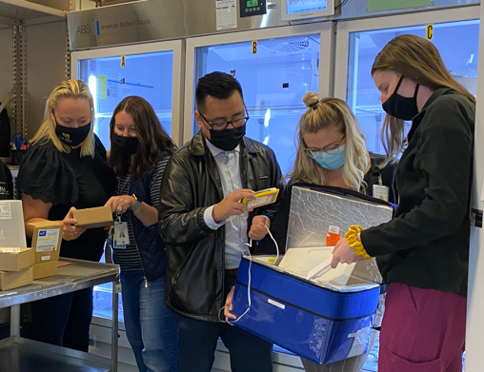

Assignments and deployments
DSW activities and training opportunities:
  All public employees are identified as DSWs subject to such activates as may be assigned to them by their supervisors or law under Government Code Section 3100 and 3101.
  CoSD employees may need to support additional or alternate activities in a disaster.
  County employees will be provided just in time training and can elect to attend special training available through the County of San Diego Office of Emergency Services (OES):
    2-1-1 phone operator emergency operations center support,
    Local assistance center worker, and
    Emergency shelter worker, and other support roles.
Notes:
Anuj/Jeff:
The DSW statement is located on the back of the identification badge worn by CoSD employees.
All public employees are identified as DSWs subject to such activates as may be assigned to them by their supervisors or law under Government Code Section 3100 and 3101.
CoSD employees may need to support additional or alternate activities in a disaster.
County employees can elect to attend special training available through the County of San Diego Office of Emergency Services (OES). The Ready Disaster Service Worker Program offers training to perform roles such as a 2-1-1 phone operator, emergency operations center support, local assistance center worker, emergency shelter worker, and other support roles.

Slide 11
Activation support
Activating Assistance
  Any Departments/Branches and personnel under CoSD may be requested to support the activation of ICS in response to anticipated public risk.
  Some Departments may be tasked with special assignments or required to divert their expertise to the response as the first priority and defer usual and customary CoSD Branch activities.
  This large reassignment of personnel and Branch support activity has occurred with firestorms and in response to the COVID-19 Pandemic.
Notes:
Anuj/Jeff:
Now let’s look at activation support and assistance.
Any departments/branches and personnel under CoSD may be requested to support the activation of ICS in response to anticipated public risk.
Some departments may be tasked with special assignments or required to divert their expertise to the response as the first priority and defer usual and customary CoSD branch activities.
This large reassignment of personnel and branch support activity has occurred with firestorms and in response to the COVID-19 Pandemic.

Slide 12

Shared preparedness training Minimal Requirements
Per PHAB standards, all permanent PHS staff must complete the 2 online training courses in Incident Command System (ICS) and National Incident Management System (NIMS) training series (i.e., IS-100, IS-700) to fulfill minimal responsibilities for emergency response and these are available via FEMA.gov.
Normally this would include IS-800 but IS-800 is currently offline.
Temporary PHS staff are encouraged to take the online classes especially if they may fill a position in response to an emergency.
For additional, high-level FEMA training please consult with your Branch Chief.
Send certificates of completion to branch Training Champion.
https://cdp.dhs.gov/femasid/register.
Independent.Study@fema.dhs.gov
Notes:
Anuj/Jeff:
Per PHAB standards, all permanent PHS staff must complete the 2 online training courses in Incident Command System (ICS) and National Incident Management System (NIMS) training series (i.e., IS-100, IS-700) to fulfill minimal responsibilities for emergency response and these are available via FEMA.gov.
Normally this would include IS-800 but IS-800 is currently offline. Angelica will advise if, and when, IS-800 is back online.
Temporary PHS staff are encouraged to take the online classes especially if they may fill a position in response to an emergency.
For additional, high-level FEMA training please consult with your Branch Chief.
Send FEMA issued certificates of completion to your branch Training Champion.
Angelica can provide you with a list of branch Training Champions.
100, 700 and 800 are one and done: At this time, and per PHS leadership, you only have to take these FEMA trainings once.
To get started, you will need to obtain your FEMA Student Identification (SID) number.
If you do not already have a SID, you can register for one at the link provided on this slide: https://cdp.dhs.gov/femasid/register.
And if you have any difficulties, you can contact the email also included for you on this slide: Independent.Study@fema.dhs.gov
HIP POCKET:
For additional, higher-level training (e.g., for Tier 2 or 3, such as Public Health Leaders, Senior Staff or those likely to have a leadership role within an emergency), please consult with your Branch Chief, and the FEMA NIMS Training Program website and resources to determine appropriate training. It is recommended by the CDC that any full time PHS staff that will be in a leadership role within a response, this includes all members of the Command staff, (PIO, Liaison, Safety, Medical Director) as well as the Section, Branch or Unit leaders should successfully complete the above (IS-100, 700) as well as the ICS 200 (online), 300 & 400 in person classes.
The additional trainings are not mandatory currently (as of 6/11/2025).
If you are interested in obtaining the in-person training for your potential role in an emergency, see the San Diego Urban Area Security Initiative Training Calendar website for in-person offerings at sduasi.org.

Slide 13

NIMS and ICS
Why is this important?
NIMS is a comprehensive, national approach to incident management developed by the Department of Homeland Security following the September 11 attacks.
NIMS is intended to facilitate coordination between all responders, including all levels of government with public, private and nongovernmental organizations.
ICS is a standardized approach to command, control, and coordinate emergency response by providing a common hierarchy within which responders from multiple agencies can be effective.
Notes:
Anuj/Jeff:
So, NIMS and ICS, why is this important to you?
Well, NIMS is a comprehensive, national approach to incident management developed by the Department of Homeland Security following the September 11 attacks.
NIMS is intended to facilitate coordination between all responders, including all levels of government with public, private and nongovernmental organizations.
ICS is a standardized approach to command, control, and coordinate emergency response by providing a common hierarchy within which responders from multiple agencies can be effective.
Now over to Angelica for the knowledge check.
HIP POCKET:
More information on NIMS is located at https://www.fema.gov/national-incident-management-system.

Slide 14

Check Understanding 1
Any Department under the County of San Diego may be requested to support the activation of an ICS structure in response to infectious diseases or anticipated public risk.
True
False
Notes:
Angelica: (Launch the Teams poll)
Thank you!
Now for our first round of Check Understanding questions.
Again, click on the link for the poll to answer the questions
Remember, if you are unable to access the poll or are having technical challenges, just LMK.
Do we have everyone?
(Angelica: If the group is small enough, and time permits, call out a person or two to make sure they are good for the first poll question).
Read question and results aloud (if results are available).
Wonderful! I see we have full participation.

Slide 15

answer check
True
Explanation
Any Department/Branch may be tagged to assist. All County personnel are expected to have completed at least baseline ICS on-line training available through FEMA. Certain personnel are expected to have achieved more advanced trainings. CoSD employees are considered public employees and are “Disaster Service Workers,” subject to such activities as may be assigned by their supervisors or by law.
Notes:
Angelica:
The correct answer is True.
Great job, everyone!
Now back to you….

Slide 16
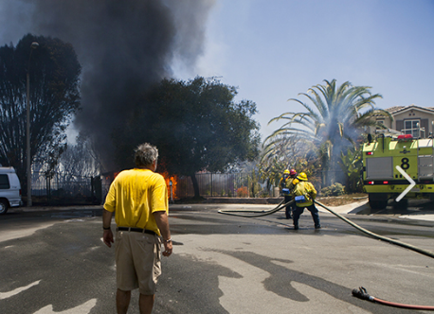
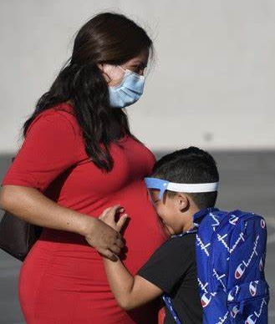
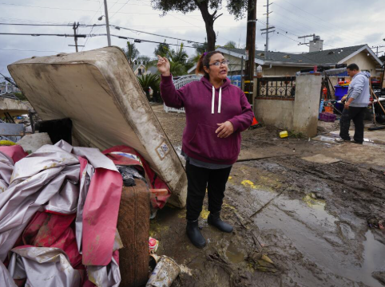
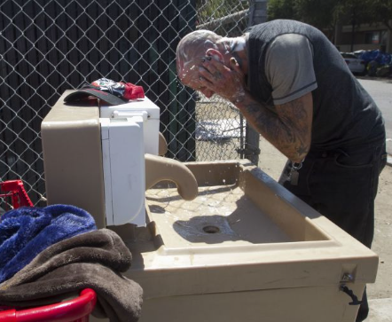
What is the impact?
Disasters and outbreaks may:
Create environmental imbalances which can contribute to increasing risks of communicable diseases including outbreaks and pandemics, and other environmental air, soil, and water hazards.
Cause illnesses, injuries, and deaths within the affected community.
Impact the psychological, emotional, and social well being of communities.
There are phases that are common to these events and include: mitigation, preparedness, response and recovery.
Notes:
Anuj/Jeff:
So, what is the impact?
Well, disasters and outbreaks may:
Create environmental imbalances which can contribute to increasing risks of communicable diseases including outbreaks and pandemics, and other environmental air, soil, and water hazards.
Cause illnesses, injuries, and deaths within the affected community.
Impact the psychological, emotional, and social well being of communities.
There are phases that are common to these events and include: mitigation, preparedness, response and recovery.
HIP POCKET:
Disasters that lead to disruption of health and mental healthcare services may cause long-term consequences in health outcomes, specifically related to increased morbidity and mortality.
Source: Veenema, Tener Goodwin (2018) Disaster Nursing and Emergency Preparedness for Chemical, Biological, and Radiological Terrorism, and Other Hazards (4th ed.). New York: Springer Publishing Company. (pg.8).

Slide 17
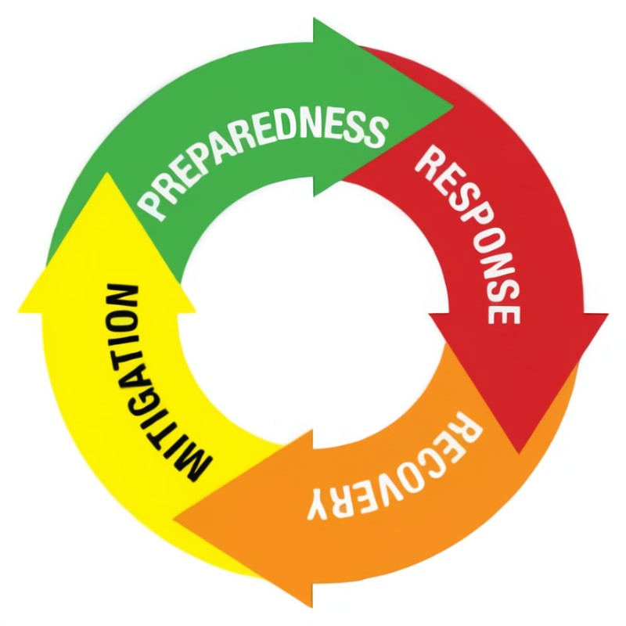
Phases of Disaster management
These Phases Can Be Concurrent
4. Actions taken to return to normal after a disaster:
1. Reduce the negative consequences of a disaster or decrease the probability of it happening by: public education, vulnerability assessment, and improve infrastructure.
3. Decrease morbidity, mortality, and property damage after a disaster by: Life safety, incident stabilization, and property preservation.
2. Plan, train, and educate before events that cannot be prevented.
DISASTER
Notes:
Anuj/Jeff:
Here are the phases of disaster management per FEMA (read aloud the 4 phases).
These phases can be con current.
HIP POCKET:
Mitigation This phase includes actions taken to prevent or reduce the cause, impact, and consequences of disasters. Examples: ground anchors to withstand wind damage; digging water channels to redirect water and planting vegetation to absorb water; constructing levees or permanent barriers; buying insurance policies.
Preparedness This phase includes planning, training, and educational activities for events that cannot be mitigated. Examples: developing disaster preparedness plans for what to do, where to go, or who to call for help; exercising plans through drills and exercises; creating a supply list of items that are useful in a disaster.
Response This phase occurs in the immediate aftermath of a disaster. During the response phase, business and other operations do not function normally. Personal safety and wellbeing in an emergency and the duration of the response phase depend on the level of preparedness.
Examples: Implementing disaster response plans; conducting search and rescue; taking actions to protect yourself, your family, your animals, and others.
Recovery During the recovery period, restoration efforts occur concurrently with regular operations and activities. The recovery period from a disaster can be prolonged. Examples: preventing or reducing stress-related illnesses and excessive financial burdens; rebuilding; reducing vulnerability to future disasters.

Slide 18




Outbreaks
Infectious disease & outbreak management
HHSA maintains continued awareness of potential infectious disease monitoring a vast network of information from global, federal, state, and local partners (i.e., World Health Organization (WHO), The Centers for Disease Control & Prevention (CDC), California Department of Public Health (CDPH), laboratory, health systems, provider reporting, and multiple public health systems.)
Notes:
Anuj/Jeff:
Now let’s turn to outbreaks, infectious disease and outbreak management.
HHSA maintains continued awareness of potential infectious disease monitoring a vast network of information from global, federal, state, and local partners (i.e., World Health Organization (WHO), The Centers for Disease Control & Prevention (CDC), California Department of Public Health (CDPH), laboratory, health systems, provider reporting, and multiple public health systems.

Slide 19

EPIDEMIOLOGY AND IMMUNIZATIONS SERVICES BRANCH (EISB)
Joins together four distinct units with the mission to protect community health, prevent communicable disease, and provide a record of vital life events.
The four programs are:
      Epidemiology Unit
      Public Health Laboratory (PHL)
      Immunizations Unit
      Office of Vital Records & Statistics (OVRS)
Notes:
Anuj/Jeff:
Turning to Epidemiology and Immunizations Services Branch (EISB).
EISB joins together four distinct units with the mission to protect community health, prevent communicable disease, and provide a record of vital life events.
The 4 programs are:
Epidemiology Unit
Public Health Laboratory (PHL)
Immunizations Unit
Office of Vital Records & Statistics (OVRS)

Slide 20
Recognizing Public Risks & Solutions via EISB Focused Activities
Epidemiology identifies, investigates, registers, and evaluates communicable, reportable, and emerging diseases and conditions to protect the health of the community.
PHL works in conjunction with public health clinics, local hospitals, healthcare providers, and EISB to analyze clinical and environmental samples, supporting the core activities of surveillance, assessment and assurance.
Immunization Unit stops vaccine-preventable diseases, promoting vaccines, disease tracking, education, working with the community and reporting to the California Immunization Registry.
OVRS reviews and registers birth, death, and fetal death records in San Diego.
  Death certificate includes circumstances and cause of death.
  Some information is coded for statistics, allowing agencies to assess health needs, trends and research.
Notes:
Anuj/Jeff:
EISB focuses on multiple functions that support the recognition and managements of infectious disease risks via multiple specialized teams from within EISB and in collaboration with other branches.
For example, Health Care Associated Infectious Program (HAI) run by EISB, which is notified by health care systems of any outbreaks and begin investigations and guidance.
Healthcare Provider Status Team (HCPS) run by PHPR – Responsible for logistics [Ex., Personal protective equipment (PPE) & other resources].
Epidemiology identifies, investigates, registers, and evaluates communicable, reportable, and emerging diseases and conditions to protect the health of the community.
PHL works in conjunction with public health clinics, local hospitals, healthcare providers, and EISB to analyze clinical and environmental samples, supporting the core activities of surveillance, assessment and assurance.
Immunization Unit mission is to stop vaccine-preventable diseases, promoting vaccines, disease tracking, education, working with the community and reporting to the California Immunization Registry.
OVRS reviews and registers birth, death, and fetal death records in San Diego. The death certificate includes the circumstances and cause of death. Some information is coded for statistics, allowing agencies to assess health needs, trends and research.

Slide 21

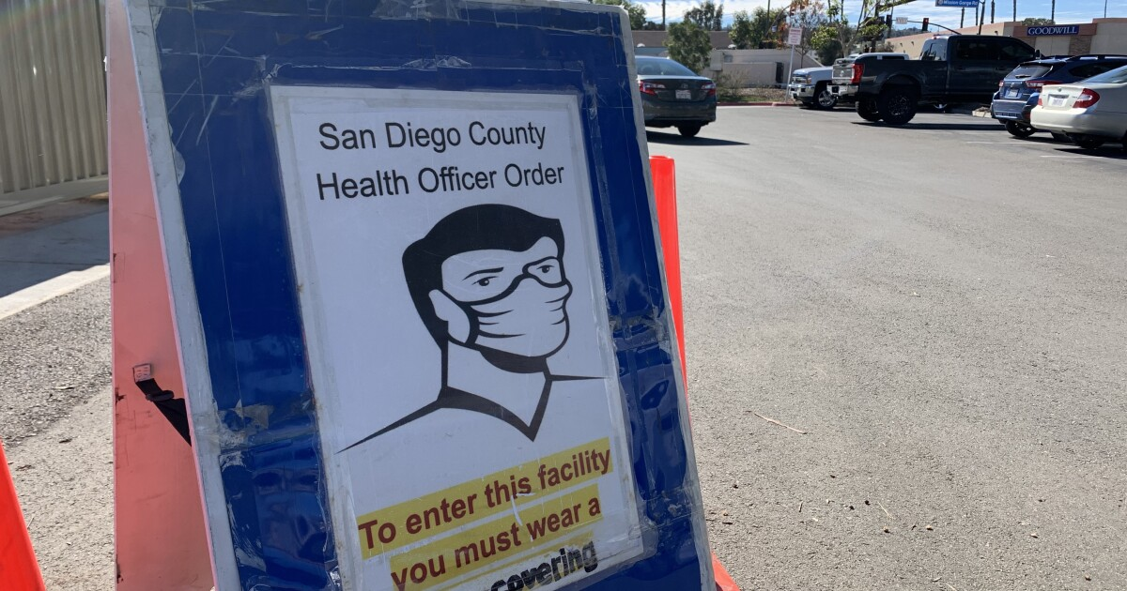
Public Health Officer (PHO)
Plans, directs, and coordinates all functions and medical activities of multiple public health programs or services, managing the overall activities of the region’s PHS including, epidemiology and communicable disease control, chronic disease control and prevention, and multiple other public health efforts.
Observes and enforces orders and ordinances from local governing bodies, pertaining to public health and sanitary matters; orders, including quarantine and other statues and regulations, prescribed by the department and statues relating to public health (Health & Safety Code § 101030, 101470).
May declare a local health emergency (Health & Safety Code § 101080).
May issue adaptive responses even prior to a declaration.
Notes:
Anuj/Jeff:
The PHO plans, directs, and coordinates all functions and medical activities of multiple public health programs or services, managing the overall activities of the region’s PHS including, epidemiology and communicable disease control, chronic disease control and prevention, and multiple other public health efforts.
They observe and enforce orders and ordinances from local governing bodies, pertaining to public health and sanitary matters; orders, including quarantine and other statues and regulations, prescribed by the department and statues relating to public health (Health & Safety Code § 101030, 101470).
The PHO may declare a local health emergency (Health & Safety Code § 101080).
The PHO may issue adaptive responses even prior to a declaration.
Picture credit: KPBS: San Diego County Reports 891 COVID-19 Cases, 30 Deaths As Vaccine Shortage Hits | KPBS Public Media Feb. 13, 2021

Slide 22
Adaptive Responses
Measures To Reduce Risk
Reducing Exposure To Disease
There may be measures implemented especially when there are no therapeutics, treatments nor available vaccines and include:
Actions supporting diseases control
Containment and mitigation
Restrictions on movement, travel advisory warnings
Nonpharmaceutical Interventions (NPIs) also called community mitigations strategies
Social distancing
External decontamination
Hygiene and repeated instructions and education
Isolation and quarantine
As an example, adapted responses were rapidly applied and reinforced throughout the COVID-19 outbreak and eventual global pandemic.
Notes:
Anuj/Jeff:
Turning now to adaptive responses.
(Read aloud).
Source: Centers for Disease Control and Prevention (CDC). Application and Integration of Nonpharmaceutical Interventions (NPI) into Pre-Pandemic Influenza Planning, Preparedness and Response. Retrieved 1/23/2020 from https://www.train.org/cdctrain/course/1051645/

Slide 23
San Diego County Actions
ICS is used by the COSD in all activations by the:
  County Offices of Emergency Services (OES) and activation of the Operational Area-Emergency Operations Center (OA-EOC)
  Public Health Preparedness & Response (PHPR) activation of Departmental Operations Center/Medical Operations Center (PHPR DOC/MOC). Commonly called MOC.
  Any incident that reaches a threshold where it becomes significant enough to merit special attention, require additional resources, results in an increased public safety threat or causes media attention. This could include an outbreak event.
Notes:
Rob/Dr. Shah:
We will explore some of these events later in this presentation.
County Offices of Emergency Services (OES) and activation of the Operational Area-Emergency Operations Center (OA-EOC)
Public Health Preparedness & Response (PHPR) activation of Departmental Operations Center/Medical Operations Center (PHPR DOC/MOC). Commonly called MOC.
Any incident that reaches a threshold where it becomes significant enough to merit special attention, require additional resources, results in an increased public safety threat or causes media attention. This could include an outbreak event.

Slide 24
Factors impacting ICS Activation
Unusual occurrences that will involve multiple agencies, or with credible threats of exposure, and or alerts issued from State and Federal authorities.
Scale of event and exposure with potential for overwhelmed jurisdictions, Emergency Medical Services (EMS) and medical /health resources.
Severity of transmission and/or a novel virus with human-to-human transmission.
Concerning and significant syndromic surveillance.
Large scale investigation and tracking beyond normal operational procedures.
Type of agent and public health response that is required to mitigate or limit spread, morbidity and mortality.
Necessity for points of distribution (PODS) for prophylaxis or vaccines.
Notes:
Rob/Dr. Shah:
They is a broad range of factors to be considered and is not limited to this list: Social distancing and isolation and quarantine, closure of venues, for public health reasons.
Optional information for Presenter:
Examples: Bioterrorism - Anthrax (not singular case of anthrax). Sentinel event. Any case of smallpox or special pathogens.
Naturally occurring significant outbreaks - (e.g., such as Measles, Mumps, Meningococcal Disease, Ebola or other hemorrhagic diseases).
Emerging infectious diseases - (e.g., Avian Influenza, Severe Acute Respiratory Syndrome (SARS), Middle East Respiratory Syndrome (MERS-CoV)).

Slide 25
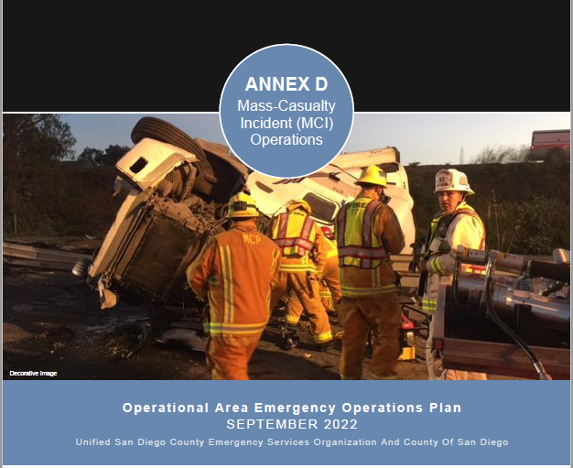
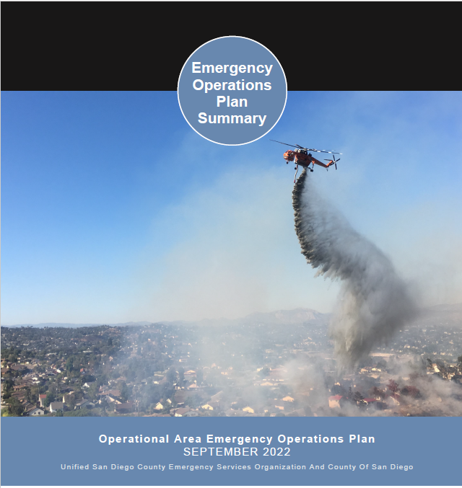
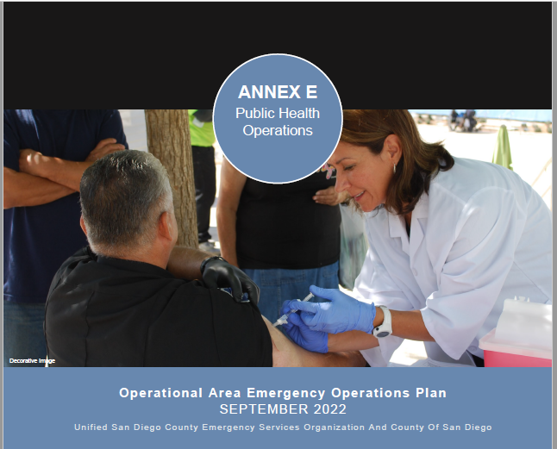
Local Guidance
San Diego County Emergency Operations Plan
  The San Diego County Emergency Operations Plan (EOP) is used by all key partner agencies within CoSD to respond to major emergencies and disasters. The EOP includes many annexes, including:
    Annex D (Multi-casualty Operations)
    Annex E (Public Health Operations)
  In some circumstances PHS may activate only the MOC and
  the full support of the County OA EOC may not be required.
Notes:
Jeff/Rob:
The San Diego County Emergency Operations Plan (EOP) is used by all key partner agencies within CoSD to respond to major emergencies and disasters. The EOP includes many annexes, including:
Annex D (Multi-casualty Operations)
Annex E (Public Health Operations)
In some circumstances PHS may activate only the MOC and the full support of the County OA EOC may not be required.
Annex D
Describes multiagency and jurisdictional resources that may be required in a mass casualty event. Assistance from the MOC is addressed in ANNEX D.
OA incidents are responded to according to local policy.
Annex D will be activated, if the response needs become greater than the available resources and/or threatens to overwhelm existing emergency systems.
Annex E
The MOC is the focal point of command and control, communications, response operations, specialized technologies, information collection, assessment, analysis and dissemination for HHSA components to support a common operating picture.

Slide 26
Check Understanding 2
ICS is used in all levels of government – Federal, State, Tribal, and Local.
True
False
Notes:
Angelica: (Launch the Teams poll)
Let’s begin the next round of Check Understanding questions.
Read question and results aloud (if results are available).

Slide 27
answer check
True
Explanation
ICS is used at all levels of government. It is also commonly used in the community, private agencies, non-governmental organizations (NGOs), all San Diego County hospitals and many healthcare organizations.
ICS is applicable across disciplines.
ICS enables integration across agencies or other facilities for common organizational structure.
Notes:
Angelica:
The correct answer is True.
Thanks for participating!
Now, back to you…

Slide 28
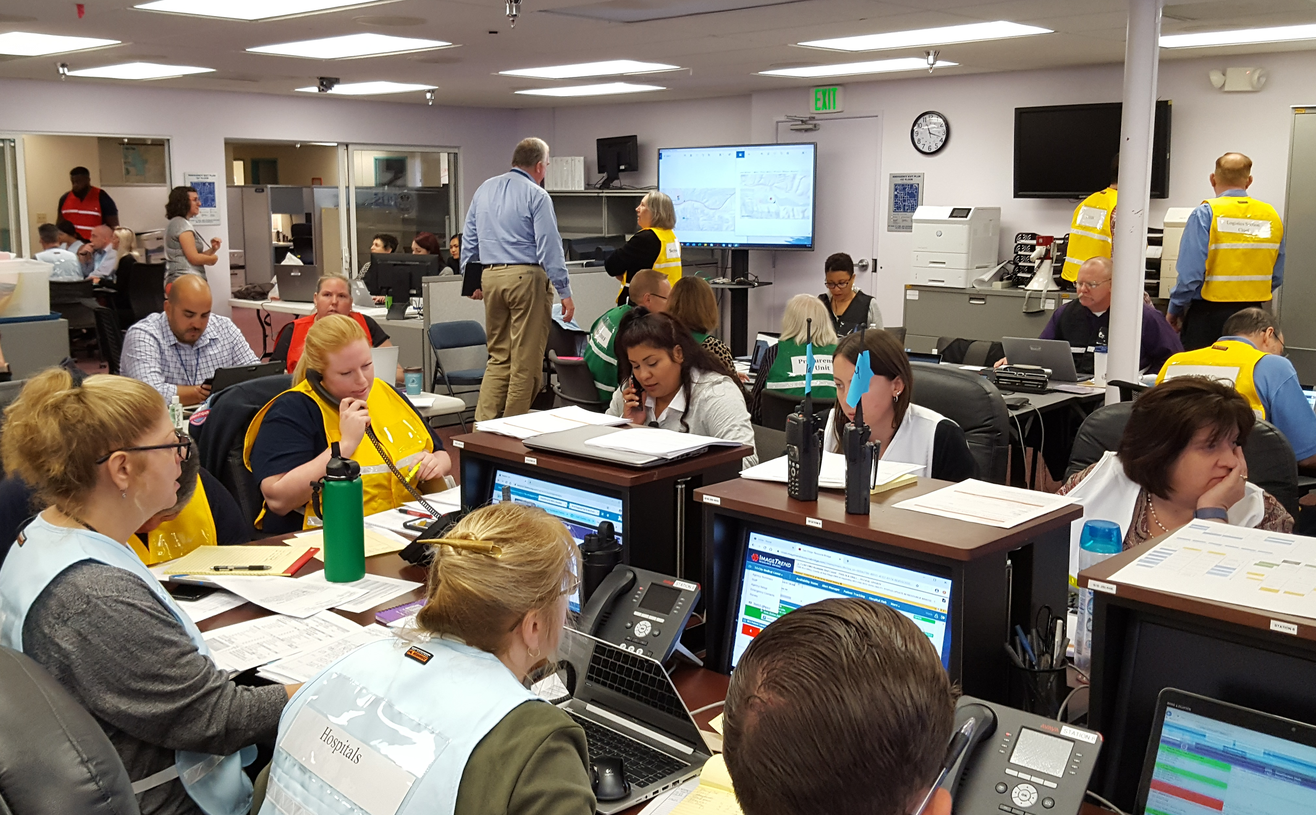
Medical operations center
Concept of the MOC was developed following the 2003 Firestorms.
At that point, the County OA-EOC was fully activated but the integration with healthcare was limited.
Establishment of a MOC addressed communication with health systems, staffing, medical and pharmaceutical assets, and other critical elements that occur with large scale events and impact healthcare in the region.
MOC operates using ICS structure and
may be stood up on its own for a response.
Photo: D DeBruin, PHPR HHSA CoSD 11/6/2019 Health & Medical Exercise
Notes:
Rob/Dr. Shah:
The PHO:
1) Reviews information from the "EISB Medical Director to determine:
a) if a public health emergency should be declared pursuant to HSC §101080;
b) If the MOC should be opened based on the acuity of the outbreak and the number and nature of affected populations and stakeholders (mandatorily if a public health emergency is declared);"
“ If the MOC should be opened, regardless of the decision to declare a public health emergency:
Notify and inform the Agency Director, for approval; present findings and recommendations to HHSA leadership for concurrence.”
Source: Outbreak Response Operational Policy POLICY NO: HHSA-PHS-ADMIN-AL-006 DATE: September 30, 2022

Slide 29
Who is in charge
Incident Commander (IC) is responsible for all activities and identifying objectives within the MOC Command Center.
IC can appoint other Command Staff and General Staff personnel to the Incident Management Team as the situation and resources warrant.
Common Command Staff roles include:
    Safety Officer – responsible for safety
    Public Information Officer (PIO) – internal/external communication
    Medical/Technical Specialist – expert who understand the specific risks of the event (i.e., Biologic/Infectious Disease, Pediatric Care, Medical Ethicist, Clinic Administration, Engineer, etc.)
    Liaison Officer – point of contact for outside agencies
Notes:
Rob/Dr. Shah:
The Medical/Technical Expert is the Subject Matter Expert/s (SME) who can best provide depth of understanding to the risk and to necessary responses to be considered.
This SME will report directly to the IC and informs the command group.
Any ICS structure requires the Incident Commander, but all other positions and the Sections are activated only according to need.

Slide 30
Common ICS Positions
ICS Positions
  In addition to Command Staff positions, Section (General Staff) may be assigned.
  Each section covered is directed by a designated Section Chief. If only limited resources are needed and a Section Chief not assigned, positions below chief will report directly to IC. They do not report to another section. All activations must maintain an IC position.
  Command Staff
    Incident Commander (always)
    Safety Officer
    Public Information Officer
    Medical/Technical Specialist
    Liaison Officer
Sections & General Staff
  Operations Section
  Planning Section
  Logistics Section
  Finance/Administration
Notes:
Rob/Dr. Shah:
The size and scope of the ICS structure depends on the need and remains very flexible. Small events use a fewer number of positions. Large and prolonged events may use many positions. The IC position must always be filled!
ICS Positions
In addition to Command Staff positions, Section (General Staff) may be assigned.
Each section covered is directed by a designated Section Chief. If only limited resources are needed and a Section Chief not assigned, positions below chief will report directly to IC. They do not report to another section. All activations must maintain an IC position.
Command Staff
Incident Commander (always)
Safety Officer
Public Information Officer
Medical/Technical Specialist
Liaison Officer
Sections & General Staff
Operations Section
Planning Section
Logistics Section
Finance/Administration

Slide 31
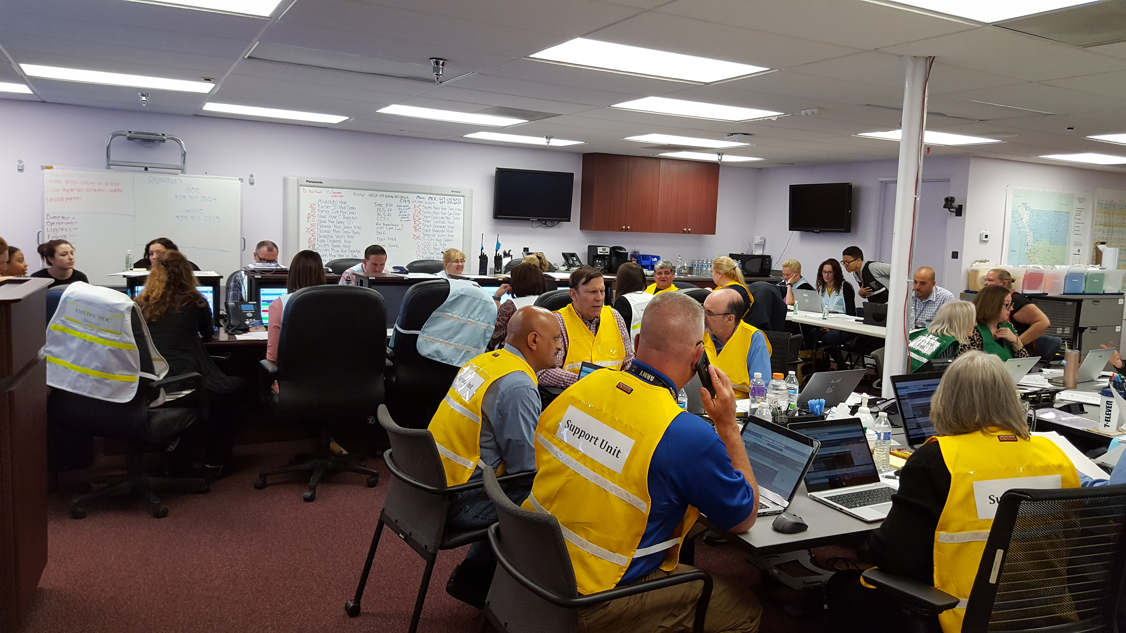
Who staffs the MOC?
Primary functions of the positions:
  Initial staffing is primarily from PHPR with support from other branches
  Command – Overall management and establishes objectives
    Operations Section – Manages tactical operations
    Planning Section – Gathers intelligence, develops plans, maintains documents and develops the Incident Action Plan (IAP)
    Logistics – Procures incident support needs
    Finance/Administration – Manages financial aspects
Staff are identified by wearing standardized color-coded vests, naming their positions.
Photo: D DeBruin, PHPR HHSA CoSD 11/6/2019
Notes:
Rob/Dr. Shah:
Positions are generally filled by individuals who have previous related experience and/or participated in emergency drills and exercises.
Who Staffs the MOC?
Initial staffing is primarily from PHPR with support from other branches
Command – Overall management and establishes objectives
Operations Section – Manages tactical operations
Planning Section – Gathers intelligence, develops plans, maintains documents and develops the Incident Action Plan (IAP)
Logistics – Procures incident support needs
Finance/Administration – Manages financial aspects

Slide 32

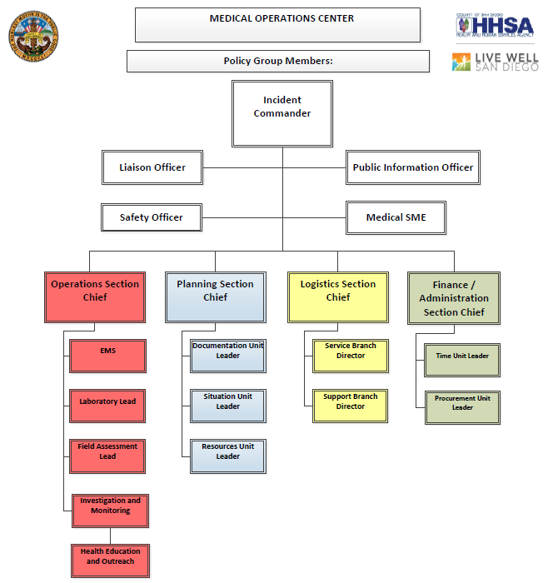
Common organizational chart under ICS
Operations
Planning
Logistics
Finance/
Administration
Notes:
Rob/Dr. Shah:
Sections are color-coded and the colors used are universal to ICS. This is a simple organizational chart that might be used in an early infectious disease investigation.
Common Organizational Chart Under ICS:
Operations
Planning
Logistics
Finance/
Administration

Slide 33
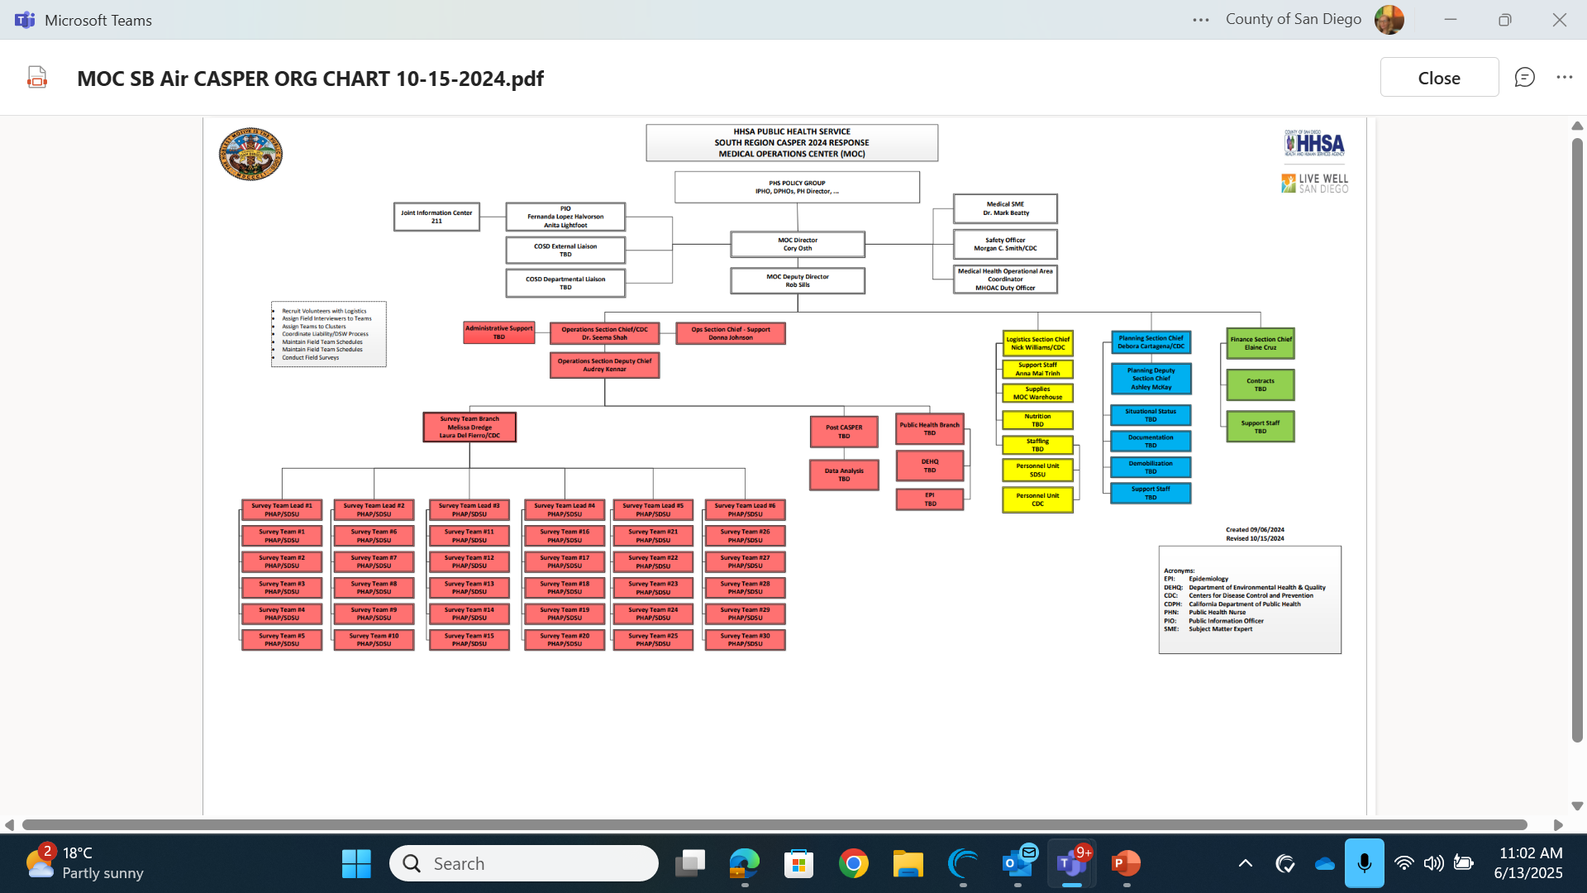
MOC MPOX Response
Notes:
Rob/Dr. Shah:
Here is what the response grew to with the MOC MPOX response so you can see what we started with on the previous slide then how it actually ended up.

Slide 34
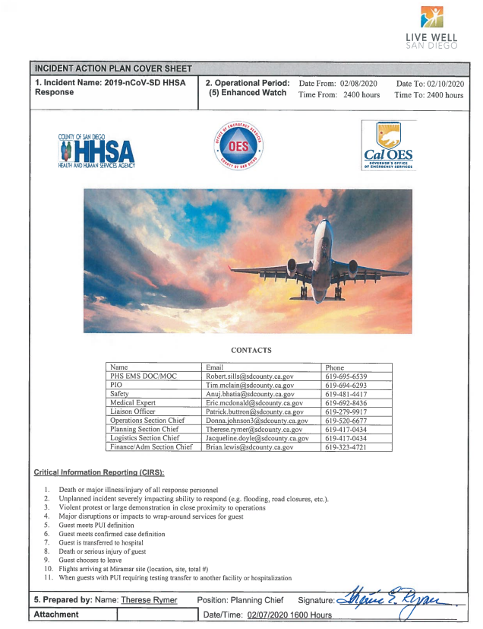
Keeping everybody in the know (IAP)
The Incident Action Plan (IAP) (prepared by Planning Section), is approved by IC, and distributed widely. It outlines specifics and critical information that will guide the response. The IAP includes:
    Name of the Incident.
    Operational period (start and end times).
    Brief situational summary.
    Assignments for the period for the Incident Management Team.
    Health and safety briefings (example: remove hazard, use personal protective equipment (PPE), warnings).
    Objectives (strategies/tactics, resources required, assignment and timeline).
    Who prepared, date, time, facility and signature.
Notes:
Rob/Dr. Shah:
Keeping everybody in the know (IAP)
The Incident Action Plan (IAP) (prepared by Planning Section), is approved by IC, and distributed widely. It outlines specifics and critical information that will guide the response. The IAP includes:
Name of the Incident.
Operational period (start and end times).
Brief situational summary.
Assignments for the period for the Incident Management Team.
Health and safety briefings (example: remove hazard, use personal protective equipment (PPE), warnings).
Objectives (strategies/tactics, resources required, assignment and timeline).
Who prepared, date, time, facility and signature.
Optional information for the Presenter:
IAP is based on standardized concise ICS forms.
Healthcare communities in San Diego also use these Hospital Incident Command System (HICS) forms but adapted slightly to better support healthcare operations.
Healthcare institutions may refer to Hospital Incident Command System (HICS), published by the California Emergency Medical Services Authority https://emsa.ca.gov/ and Emergency Preparedness – Preparing Hospitals for Disasters, California Hospital Association https://www.calhospitalprepare.org/hics-forms

Slide 35
Requirements for AAR
Guidelines For Generating An After-Action Report
  The state requires an After-Action Report (AAR) for any disasters managed by OES when the EOC is activated (ex., wildfires).
  For significant public health infectious disease events, where a local health emergency is declared, the response is reviewed for both successes and opportunities for improvement.
  Examples of AARs conducted following infectious diseases outbreaks include:
    H1N1 AAR, published in August 2011
    Hepatitis A AAR, published in May 2018
    County of San Diego COVID-19 AAR, published March 10, 2023.
    County of San Diego COVID-19 Response After Action Report
Notes:
Rob/Dr. Shah:
Requirements for AAR
Guidelines for generating an After-Action Report:
The state requires an After-Action Report (AAR) for any disasters managed by OES when the EOC is activated (ex., wildfires).
For significant public health infectious disease events, where a local health emergency is declared, the response is reviewed for both successes and opportunities for improvement.
Examples of AARs conducted following infectious diseases outbreaks include:
H1N1 AAR, published in August 2011
Hepatitis A AAR, published in May 2018
County of San Diego COVID-19 AAR, published March 10, 2023.

Slide 36
CHECK Understanding 3
In a limited event, the response may be managed by activating only the Operations Section.
True
False
Notes:
Angelica
(Launch the Teams poll)
Here is the next Check Understanding question…
Read question and answers to the group.

Slide 37
answer check
False
Explanation:
The one position which must always be filled regardless of the scope or size of the event is the Incident Commander (IC).
The IC can manage the problem alone; or assign any sections; and/or other support command or general staff positions as is needed to manage the situation.
Notes:
Angelica
The correct answer is False.
Transition back to the Presenter:

Slide 38

A look back at
Past Disasters & Changes Made as a Result
Notes:
Jeff/Anuj: Let’s look at a few events
A look back at Past Disasters & Changes Made as a Result…

Slide 39
A Look Back at Public Health Hazards and Threats: Major events
2010 - Pertussis Outbreak
2011 - Southwest Blackout
2014-2015 - Wildfires, Pertussis Outbreak, Measles
2015 - Ebola (0 cases)
2016 - Zika (83 cases)
2017-2018 - Hepatitis A Outbreak (592 cases), Wildfire, Severe Flu Season (FY17/18, 342 deaths), Pertussis Outbreak
2018-2020 - Meningococcal GpB Outbreak,
2020-2023 - COVID-19 Pandemic
2021 - Shigella Outbreak
2022 - Human Mpox
Add image
Notes:
Jeff/Anuj:
Here is a Look Back at Public Health Hazards and Threats:
Major events
2003 - Wildfires
2007 - Wildfires (physical hazard)
2008 - Measles Outbreak (13 cases)
2009 - H1N1 Pandemic (Ground Zero)
2010 - Pertussis Outbreak
2011 - Southwest Blackout
2014-2015 - Wildfires, Pertussis Outbreak, Measles
2015 - Ebola (0 cases)
2016 - Zika (83 cases)
2017-2018 - Hepatitis A Outbreak (592 cases), Wildfire, Severe Flu Season (FY17/18, 342 deaths), Pertussis Outbreak
2018-2020 - Meningococcal GpB Outbreak,
2020-2023 - COVID-19 Pandemic
2021 - Shigella Outbreak
2022 - Human Mpox
Optional information for Presenter:
County PHS has had a VERY DIVERSE array of public health issues.
Almost EVERY YEAR – one, or more, challenging issues have occurred.
ICS is the organizational management system activated to support the responses.

Slide 40
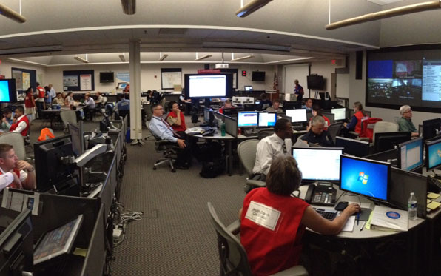
Historic activations
A few of the ICS implementations in COSD
H1N1 Pandemic
April 2009 – 2010 & MEGA PODS 2010
Hepatitis A (HAV) Outbreak (March 2017 – October 2018)
Meningococcal B Outbreak
(June 2018 – April 2020)
COVID-19 Pandemic
(March 2020 – 2023)
Notes:
Jeff/Anuj:
The events reviewed for this presentation are focused on infectious diseases response or on prevention.
We will briefly consider each of these events.
Historic activations
A few of the ICS implementations in COSD
H1N1 Pandemic
April 2009 – 2010 & MEGA PODS 2010
Hepatitis A (HAV) Outbreak (March 2017 – October 2018)
Meningococcal B Outbreak
(June 2018 – April 2020)
COVID-19 Pandemic
(March 2020 – 2023)

Slide 41
H1N1 Outbreak: 2009 – 2010
The index case of the novel virus H1N1 occurred in San Diego County.
This resulted in the activation of ICS and ultimately large points of dispensing (PODs). The MOC provided intelligence, managed resources, secured vaccine, distributed N-95 respirators, Tamiflu and other supplies to hospitals and negotiated resources gaps.
  OA-EOC was not activated but had representation in the MOC.
  Local hospitals and healthcare organization were significantly impacted and supported by information, resources and collaboration via the MOC. Many opened their Hospital Command Centers.
  Resulted in many improvements for future response.
Add image
Notes:
Jeff/Anuj:
H1N1 Outbreak: 2009 – 2010
The index case of the novel virus H1N1 occurred in San Diego County.
This resulted in the activation of ICS and ultimately large points of dispensing (PODs). The MOC provided intelligence, managed resources, secured vaccine, distributed N-95 respirators, Tamiflu and other supplies to hospitals and negotiated resources gaps.
OA-EOC was not activated but had representation in the MOC.
Local hospitals and healthcare organization were significantly impacted and supported by information, resources and collaboration via the MOC. Many opened their Hospital Command Centers.
The H1N1 experience resulted in the development of an Emergency Response and Pandemic Influenza Plan, electronic information systems for epidemiology activities, laboratory capacity, and material caches.
Optional information for Presenter::
The County distributed to healthcare organizations:
N-95 respirators due to shortages.
Prophylaxis in the form of oseltamivir (brand name Tamiflu), an antiviral used to treat and prevent influenza for distribution to at risk persons. This was often done at POD levels by the healthcare organization.

Slide 42
Hepatitis A Virus Outbreak:
2017-2018
The HAV Outbreak required a comprehensive response to reach the primarily affected and difficult to reach unsheltered and/or illicit drug user populations.
Over 600+ cases over 20 deaths.
The focus was to prevent the continued spread of this infection in these at-risk populations and to prevent extension of this infection to the general public.
ICS was activated to manage outbreak, surveillance, obtain vaccines, notify CDPH, CDC, and connection with service providers and the medical community.
9/1/17 – Declaration of Local Health Emergency by PHO.
9/16/17 – Activated MOC.
10/13/17 – State Declaration
Partnerships supported vaccinations, sanitation, education and communication efforts.
Notes:
Jeff/Anuj:
Hepatitis A Virus Outbreak: 2017-2018
The HAV Outbreak required a comprehensive response to reach the primarily affected and difficult to reach unsheltered and/or illicit drug user populations.
Over 600+ cases over 20 deaths.
The focus was to prevent the continued spread of this infection in these at-risk populations and to prevent extension of this infection to the general public.
ICS was activated to manage outbreak, surveillance, obtain vaccines, notify CDPH, CDC, and connection with service providers and the medical community.
9/1/17 – Declaration of Local Health Emergency by PHO.
9/16/17 – Activated MOC.
10/13/17 – State Declaration
Partnerships supported vaccinations, sanitation, education and communication efforts.
Request was made to the Advisory Committee on Immunization Practice (ACIP) to the CDC to include “homeless persons” in the list of those who should be recommended to receive HAV vaccine.
Optional information for Presenter:: California Health Alert Network (CAHAN). Update #7: Hepatitis A Virus Outbreak in San Diego County. Oct. 31, 2017. The outbreak is being transmitted person-to-person and is primarily affecting homeless people, injection and non-injection illicit drug users, and individuals in dense living conditions with shared restrooms.
“The majority of the HAV cases in the outbreak were, and continue to be, among people who are homeless and/or illicit drug users. These populations may lack regular access to sanitary living conditions; personal hygiene and a sanitary living environment, especially among those who live in close quarters to each other, are key to preventing and stopping the person-to-person transmission of HAV.” SanDiegoHepatitisAOutbreak-2017-18-AfterActionReport.pdf Section: Response Strategy

Slide 43
HEP A RESPONSE
VACCINATION
SANITATION
EDUCATION
Support from law enforcement to accompany Public Health Nurses on homeless outreach teams.
Vaccinate employees who have contact with at-risk populations.
Support indoor disinfection of bathrooms in municipality and business facilities.
Assist with identification of locations to place handwashing stations.
Increase access to public bathrooms & ensure proper sanitation.
Consider other options.
Dissemination of letters to stakeholders.
Distribution of educational materials.
Request presentation to educate employees about Hepatitis A.
Provide connections to specific stakeholders in municipality.
Notes:
Jeff/Anuj:
Strategic approaches with Partners
Vaccination
Support from law enforcement to accompany Public Health Nurses on homeless outreach teams.
Vaccinate employees who have contact with at-risk populations.
Sanitation
Support indoor disinfection of bathrooms in municipality and business facilities.
Assist with identification of locations to place handwashing stations
Increase access to public bathrooms & ensure proper sanitation.
Consider other options.
Education
Dissemination of letters to stakeholders.
Distribution of educational materials.
Request presentation to educate employees about Hepatitis A.
Provide connections to specific stakeholders in municipality.

Slide 44
Meningococcal B OUTBREAK
Outbreak Background
  Three cases of Meningococcal serogroup B occurred at San Diego State University (SDSU) over a 4-month period resulting in the declaration of an outbreak among undergraduate students aged 23 and younger.
  In joint-collaboration with and under the ICS structure, CoSD and SDSU identified the at-risk population, addressed the vaccination status of students, and identified the vaccination goals for the identified student population.
  Response included multiple vaccination PODS, collaboration with community partners, and effective communication strategies.
  The Meningococcal outbreak experience resulted in development of long-term policy solutions to decrease the risk for future students.
Notes:
Jeff/Anuj:
Turning to the Meningococcal B Outbreak.
Three cases of Meningococcal serogroup B occurred at San Diego State University (SDSU) over a 4-month period resulting in the declaration of an outbreak among undergraduate students aged 23 and younger.
In joint-collaboration with and under the ICS structure, CoSD and SDSU identified the at-risk population, addressed the vaccination status of students, and identified the vaccination goals for the identified student population.
Response included multiple vaccination PODS, collaboration with community partners, and effective communication strategies.
The Meningococcal outbreak experience resulted in development of long-term policy solutions to decrease the risk for future students.
Optional information for Presenter:: Vaccinations programs were concurrently conducted in partnership with Walgreens., Kaiser, SDSU and Naval Regional Medical Center for their covered populations.
Extensive community strategies included multi-media avenues.
Meningococcal B is considered an outbreak until one year after the last case!
The time frame for an outbreak to be declared over - depends on the disease.

Slide 45
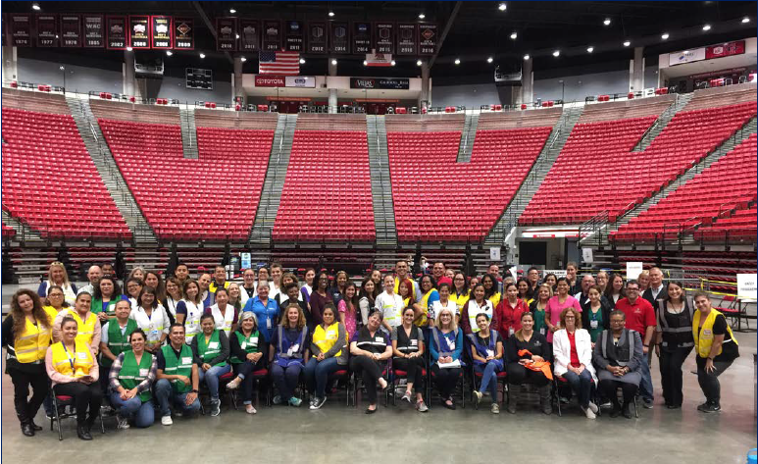
The Viejas arena pod team
meningococcal outbreak response
Notes:
Jeff/Anuj:
Here is a picture of the Pod Team at the Viejas Arena for the Meningococcal Outbreak Response.

Slide 46
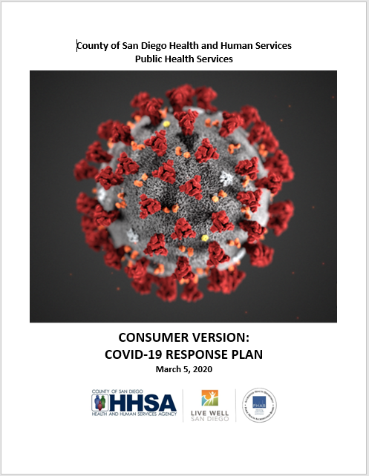
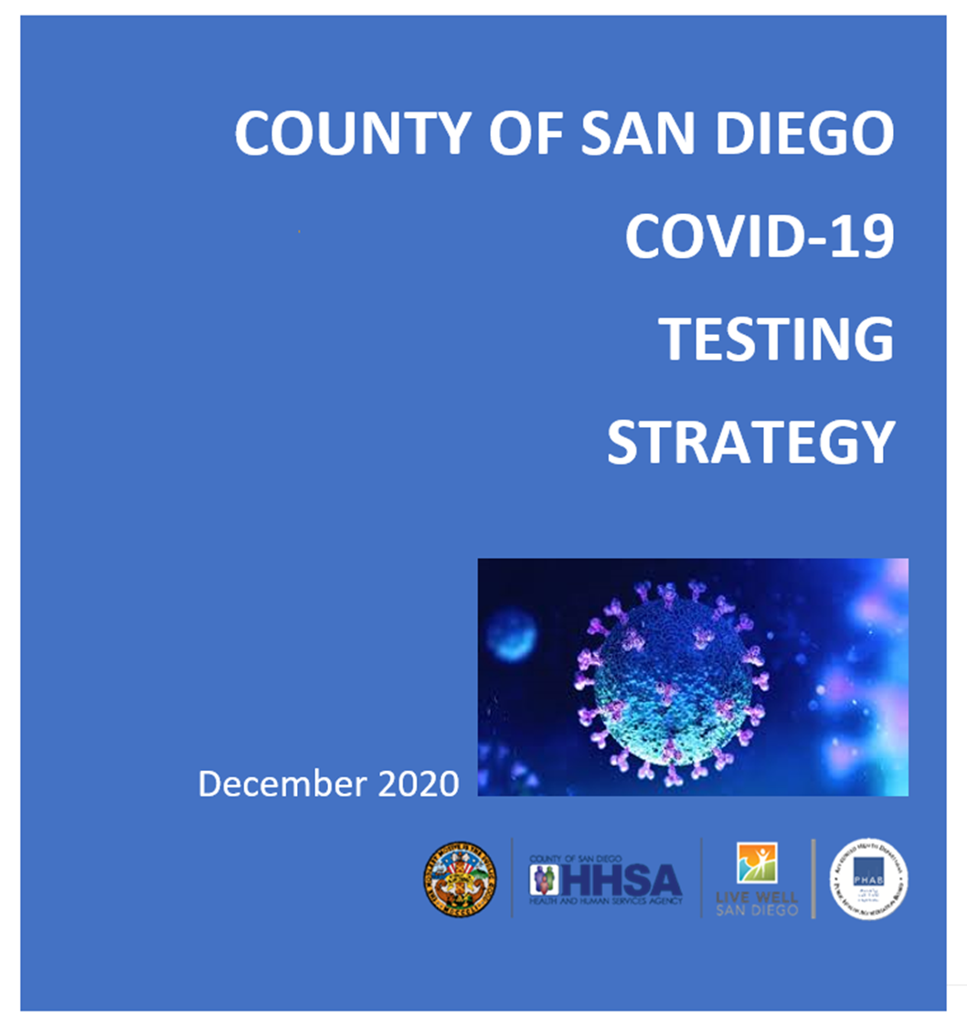

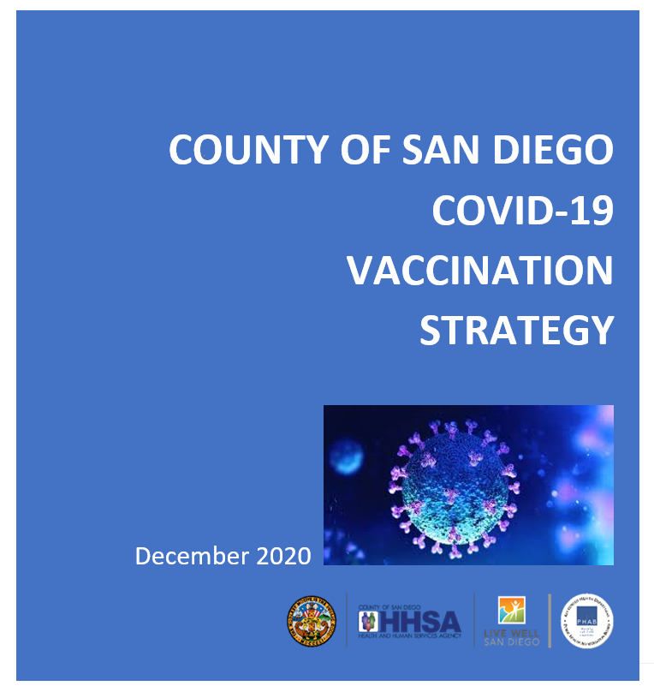
COVID-19 Strategic Response Plan
Notes:
Jeff/Anuj:
And now let’s turn briefly to the COVID-19 Response.
On this slide you will see images of our 3 strategy documents and the consumer version of the response plan.

Slide 47



T3 STRATEGY: TEST, TRACE & TREAT
Test
Trace
Treat
Accessible COVID-19
Testing
Culturally
Competent
Disease Investigation
Assistance with
Safe Isolation and
Individualized
Services
Notes:
Jeff/Anuj:
During Covid, we developed the T3 Strategy of Test, Trace and Treat.
For testing, it was about accessible COVID-19 Testing, especially for those communities disproportionally affected by the virus
For trace, we focused our efforts on culturally competent disease investigation.
And for Treat, we ensured that we are able to provide assistance for safe isolation and services that are individualized to the various cultural needs

Slide 48
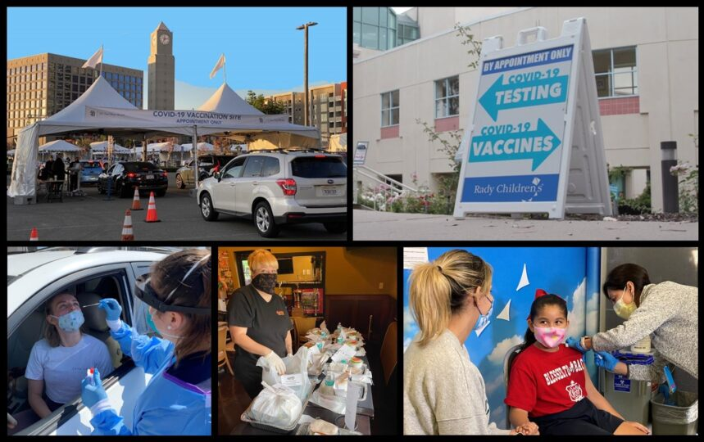
COVID-19 Activities
Source: County Communications Office April 20, 2023
Notes:
Jeff/Anuj:
Here are some pictures from the County News Center from the Covid-19 response.
Source: COUNTYNEWSCENTER. After-action Report Cites Strengths of County’s COVID-19 Response. April 20.2023. Article by Gig Conaughton.

Slide 49
COVID-19 AAR results
Strengths & Opportunities for Improvement
There were numerous strengths and opportunities identified. A few included:
Strengths: Previous ICS training, advisory boards which informed policy decisions, information sharing including publicly published data. Data driven, equity focused strategies for testing and vaccination, education and community partnerships.
Opportunities: focus on continued training and sharing with municipal partners, preparation for national supply shortages, examining barriers to staffing, Disaster Service Worker training, Continuity of Operations Plans and remote work.
Notes:
Jeff/Anuj:
Turning to the After Action Report results, what were some of the strengths and opportunities identified?
Well, as for strengths: Previous ICS training, advisory boards which informed policy decisions, information sharing including publicly published data. Data driven, equity focused strategies for testing and vaccination, education and community partnerships.
Opportunities: Focus on continued training and sharing with municipal partners, preparation for national supply shortages, examining barriers to staffing, Disaster Service Worker training, Continuity of Operations Plans and remote work.

Slide 50
summary
WRAP-UP AND OPEN DISCUSSION
Large scale outbreaks occur every few years in San Diego county.
The CoSD response to large outbreaks are primarily managed through ICS and activation of the MOC and/or EOC.
Any Branch or Department can be called upon to support or provide personnel and other resources necessary to respond to a public health emergency.
All public employees are DSWs subject to such activities that may be assigned to them by their supervisors or by law, under State law, Title I, Section 3100 and 3101 of the California Government Code.
Notes:
Jeff/Anuj:
So in summary:
Large scale outbreaks occur every few years in San Diego county.
The CoSD response to large outbreaks are primarily managed through ICS and activation of the MOC and/or EOC.
Any Branch or Department can be called upon to support or provide personnel and other resources necessary to respond to a public health emergency.
All public employees are DSWs subject to such activities that may be assigned to them by their supervisors or by law, under State law, Title I, Section 3100 and 3101 of the California Government Code.
And now back over to Angelica.

Slide 51
Knowledge Check 4
Any County employee could be deployed to assist with a MOC emergency response (e.g., outbreak, pandemic, fires).
True
False
Notes:
Angelica:
(Launch the Teams poll)
Read the question and answers

Slide 52
answer check
True
Explanation
Any staff can be deployed to assist in an emergency (e.g., outbreak, pandemic, fire).
Notes:
Angelica:
The correct answer is True.
Well done, everyone!

Slide 53
POST-TEST
Notes:
Angelica:
The Knowledge Check is complete, and it is time for the Post-Test.
Launch the poll

Slide 54
POST-test Question 1
I feel confident in identifying the factors related to outbreak and pandemic response.
Not at all confident
Slightly confident
Moderately confident
Very confident
Extremely confident
Notes:
Angelica:
Read questions and results aloud.

Slide 55
POST-test Question 2
I feel confident in describing the factors related to outbreak and pandemic response.
Not at all confident
Slightly confident
Moderately confident
Very confident
Extremely confident
Notes:
Angelica
Read questions and results aloud.

Slide 56
POST-test Question 3
I feel confident in describing factors related to outbreak and pandemic as they relate to my work.
Not at all confident
Slightly confident
Moderately confident
Very confident
Extremely confident
Notes:
Angelica:
Read questions and results aloud.

Slide 57
POST-test Question 4
I feel confident in my understanding of how the department (PHS) manages and responds to outbreaks or pandemics and their root causes.
Not at all confident
Slightly confident
Moderately confident
Very confident
Extremely confident
Notes:
Angelica:
Read questions and results aloud.

Slide 58


Thank you. Any Questions?
We invite you to take a brief post training evaluation survey. You can take the survey by scanning the QR code below or going to this link: https://www.surveymonkey.com/r/KXTBBYY
Notes:
Angelica:
Thank you all for participating in the PHS Outbreak and Pandemic Management training!
There is a brief survey before you exit the course. Your feedback is valued and will be reviewed.
Feedback is used to implement changes that will help to improve future course offerings.
This concludes the training.
Have a great day!

