Slide 1
Health literacy Strategies for guiding people from health information to healthy decisions
Notes:
Public health professionals face the challenge of communicating complex, changing information to diverse audiences with different beliefs, values, resources, and skills that affect their understanding and use of health information and services.
How often should you exercise? Is it 150 minutes or 5 days a week? What is moderate and what is vigorous?
How many glasses of water should you drink per day?
This medication should be taken 3 times a day; does that mean before or after meals? With or without food?
Where do I find the form?
…and the list goes on and on
Communication is vital to the work we do as public health professionals. Whether we're designing a campaign for handwashing, developing a presenting data, or teaching a class on healthy eating, clear communication is important to help ensure that audiences can understand and act upon our messages
Examples of health information and services include the following:
Health promotion materials
Forms and instructions
Warnings and public advisories
Test results
Press releases and other media
One-on-one instruction and community education
Family planning
Vaccinations and immunizations
Preventive screenings
Today we will be talking about health literacy and the role it plays in health and I hope you walk away with strategies for guiding people from health information to healthy decisions.

Slide 2
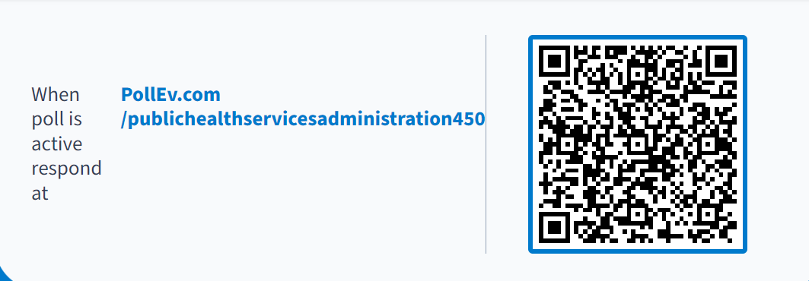
Before we get started
Notes:
Before we get started, we’re going to start with a few pretest questions
phsas's presentation | Poll Everywhere
https://pollev.com/phsas

Slide 3
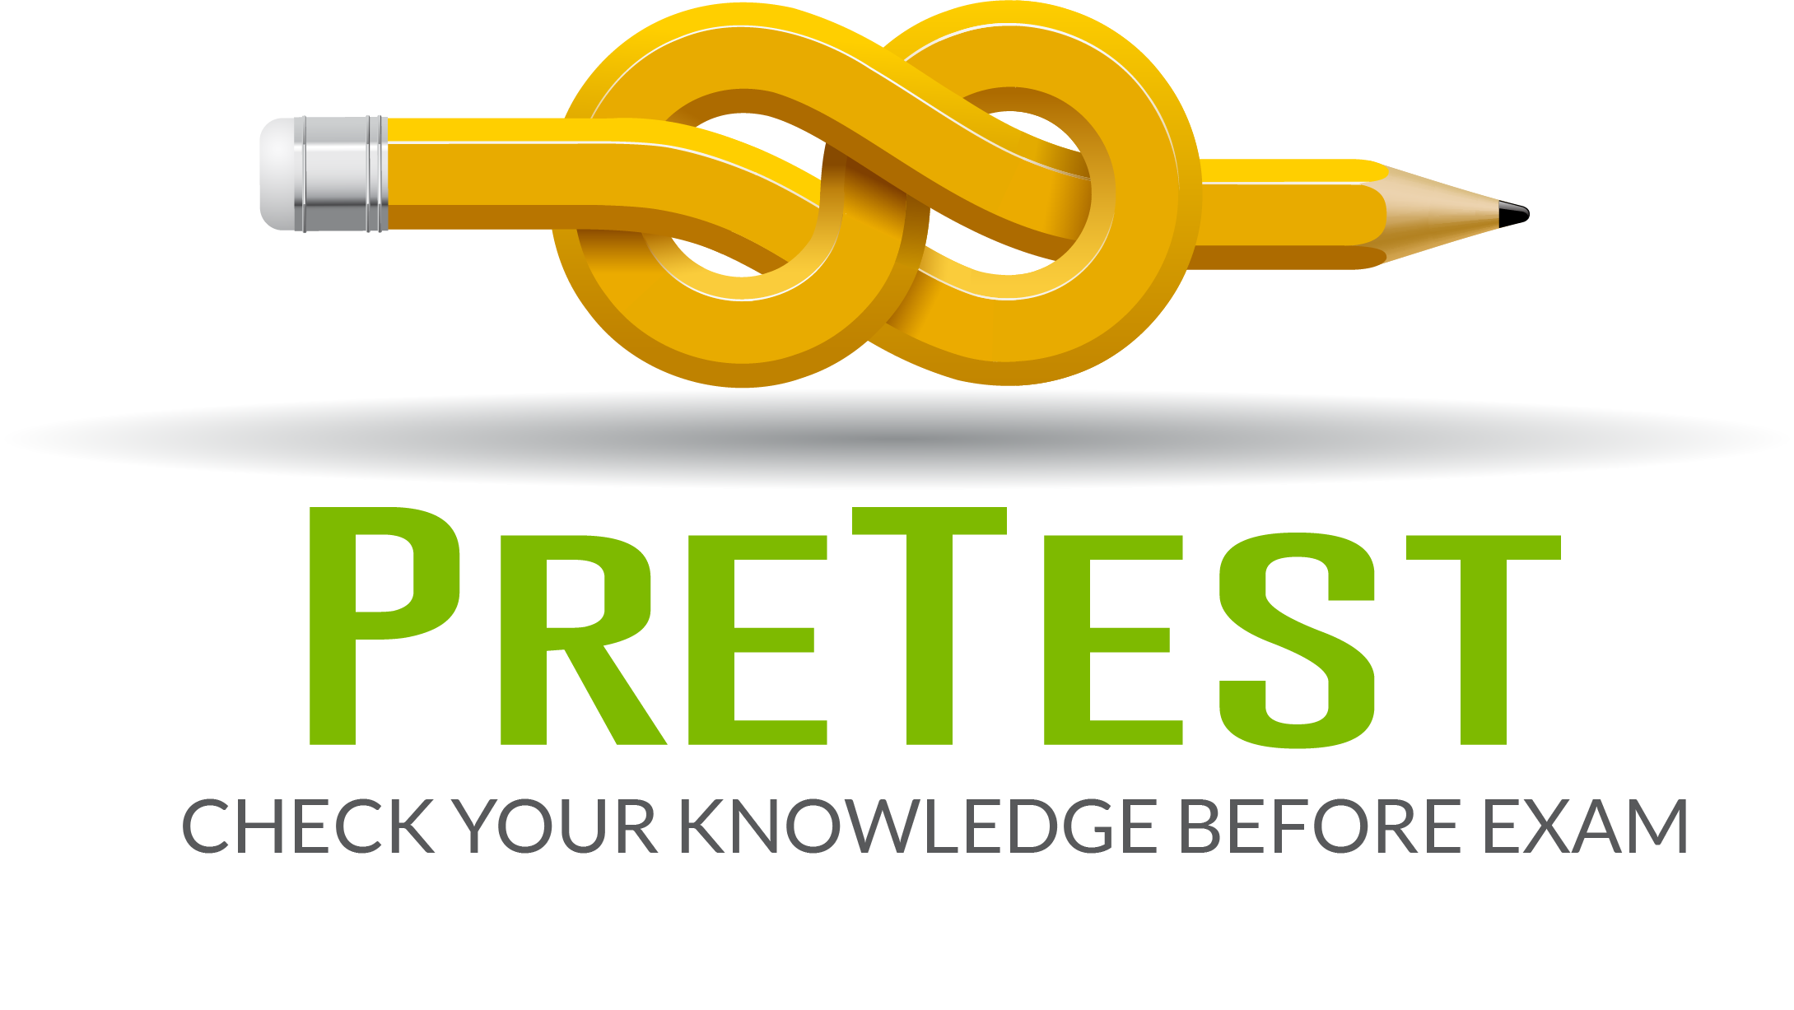
Pre-test
Notes:
What is health literacy?
(T/F) Health literacy is a stronger predictor of health than age, income, employment status, educational level, or race.
Nearly _9 _ out of 10 adults struggle to understand and use health information.
Which of these scenarios require health literacy skills?
Share your favorite emoji as we transition back to the training!
phsas's presentation | Poll Everywhere
https://pollev.com/phsas

Slide 4

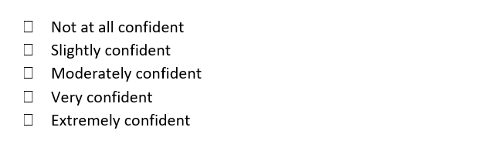
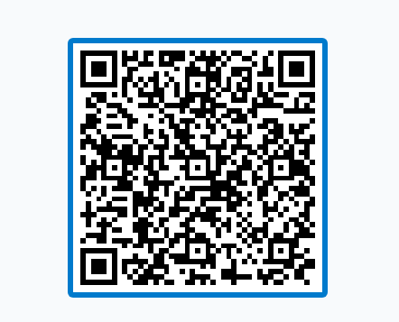
PRETEST QUESTION 1
“I feel confident assessing the literacy of internal and external audiences (e.g., reading level; ability to obtain, interpret and use health and other information; social media literacy; numeracy)” (CCPHP Domain 3, 1.4)
Notes:
1. How confident do you feel assessing the literacy of internal and external audiences (e.g., reading level; ability to obtain, interpret, and use health and other information; social media literacy; numeracy) (3.1.4)

Slide 5
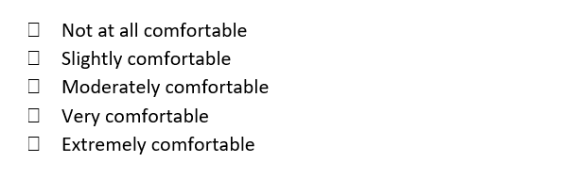
PRETEST QUESTION 2
“I feel comfortable developing messaging using health literacy techniques to disseminate public health information and data?” (CCPHP Domain 3, 1.6)
Notes:
2. How comfortable do you feel developing messaging using health literacy techniques to disseminate public health information and data? (3.1.6)

Slide 6
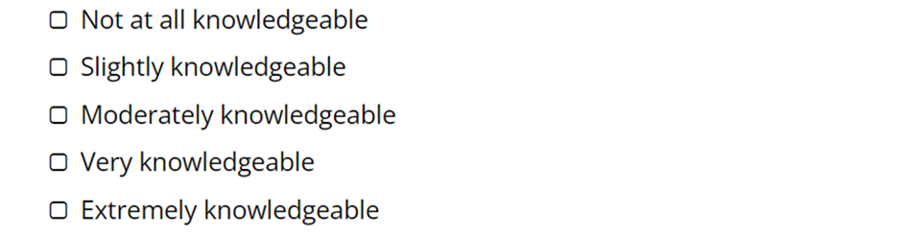
PRETEST QUESTION 3
“I feel confident in my understanding of linguistic and culturally proficient communication? (e.g., tailoring messages for different audiences, using age-appropriate materials, incorporating images, using plain language, etc.)” (CCPHP Domain 3, 2.1)
Notes:
3. What is your understanding of linguistic and culturally proficient communication? (e.g., tailoring messages for different audiences, using age-appropriate materials, incorporating images, using plain language, etc.) (3.2.1)

Slide 7
PRETEST QUESTION 4
“I feel confident in my ability to communicate information to influence behavior and improve health” (CCPHP Domain 3, 2.6)
Notes:
4. How would you rate your ability to communicate information to influence behavior and improve health? (3.2.6)

Slide 8
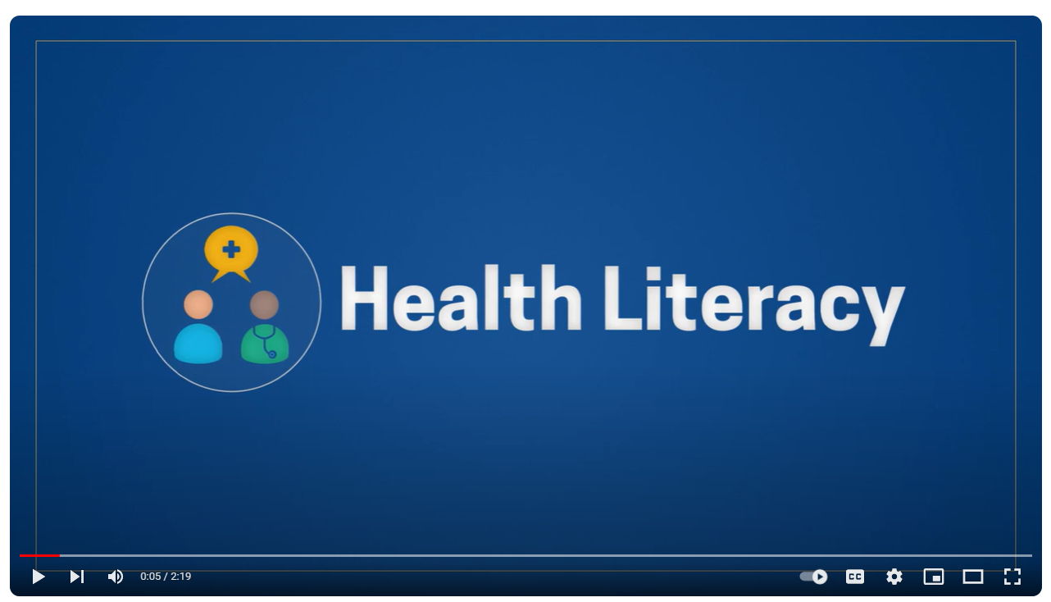
Short Introduction to health Literacy
Health Literacy: 5 Things to know About Health Literacy
Notes:
As a public health professional, you are in the business of promoting, protecting, and improving community health and the quality of life through communication, education, disease surveillance, evaluation, and research.
We’re going to start with a short video that introduces the concept of health literacy and what you all will be learning about in today’s training.

Slide 9
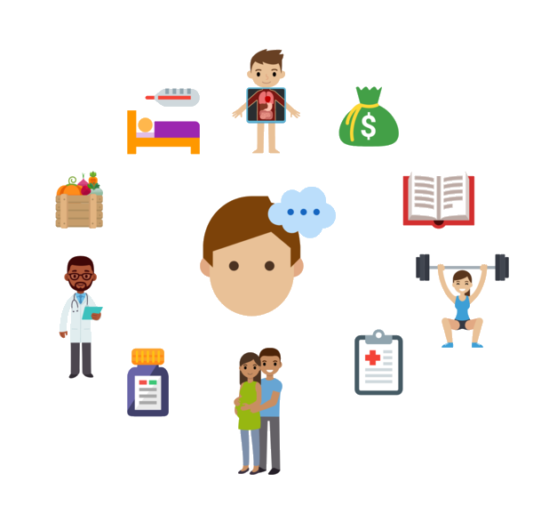
PURPOSE AND OUTCOMES
This training aligns with the Core Competencies of Public Health and PHS’s commitment to developing a strong workforce that has the knowledge, skills, abilities, and behaviors required to succeed in their roles
PURPOSE: Today’s training will help you understand:
What health literacy is
The prevalence of low health literacy and why it matters
How you can improve health literacy through your work
How to apply health literacy techniques to the work that you do
OUTCOMES: After the training, you will know specific strategies that can be applied to your work!
Notes:
This training aligns with the Core Competencies of Public Health and PHS’s commitment to developing a strong workforce that has the knowledge, skills, abilities, and behaviors required to succeed in their roles; this is a competency-based training that will provide you with tools to help you do your job as part of the 10 Essential Public Health Services to achieve health equity.
In public health, successful mastery of the Core Competencies is vital to developing a strong workforce that supports both our organizational and community needs.
Training staff in clear communication, cultural competence, and effective message delivery increases awareness of health literacy needs in the workplace while improving staff communication skills (when working with people with limited literacy)
Purpose and Outcomes
Extra Info:
The Essential Public Health Services describe the public health activities that should be undertaken in all communities to help achieve health equity

Slide 10

What is health literacy?
According to the Centers for Disease Control and Prevention, Health Literacy is Defined in Two Ways
Personal health literacy is the degree to which individuals have the ability to find, understand, and use information and services to inform health-related decisions and actions for themselves and others.
Organizational health literacy is the degree to which organizations equitably enable individuals to find, understand, and use information and services to inform health-related decisions and actions for themselves and others.
Source: What Is Health Literacy? | Health Literacy | CDC
Notes:
Read the definition. Note the irony that the very definition of health literacy isn’t written according to best practices of health literacy. Point out that many educational materials are written at a literacy level that are not accessible to those who need to access them.
Today’s focus will be on building an understanding of the limitations of the populations we serve, and will also include strategies we can use to address them and make our communications accessible to all levels of literacy. Literacy is an equity issue.
The new definitions of health literacy
Emphasize people’s ability to use health information rather than just understand it
Focus on the ability to make “well-informed” decisions rather than “appropriate” ones
Incorporate a public health perspective
Acknowledge that organizations have a responsibility to address health literacy

Slide 11
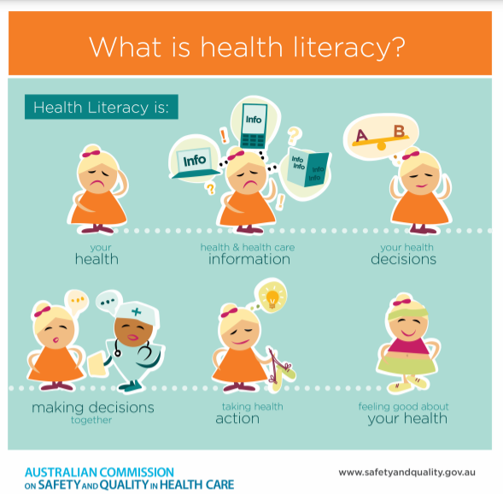
Health Literacy in Plain Language
Personal health literacy is a measure of your ability to find, understand, and apply health information and guidance to your decisions and actions.
Organizational health literacy is how well we promote health by supporting people of all literacy levels through our services and communication.
Notes:
Present an easier description of health literacy. The paraphrase to the right can be edited to your own simpler definition of the CDC definition.

Slide 12

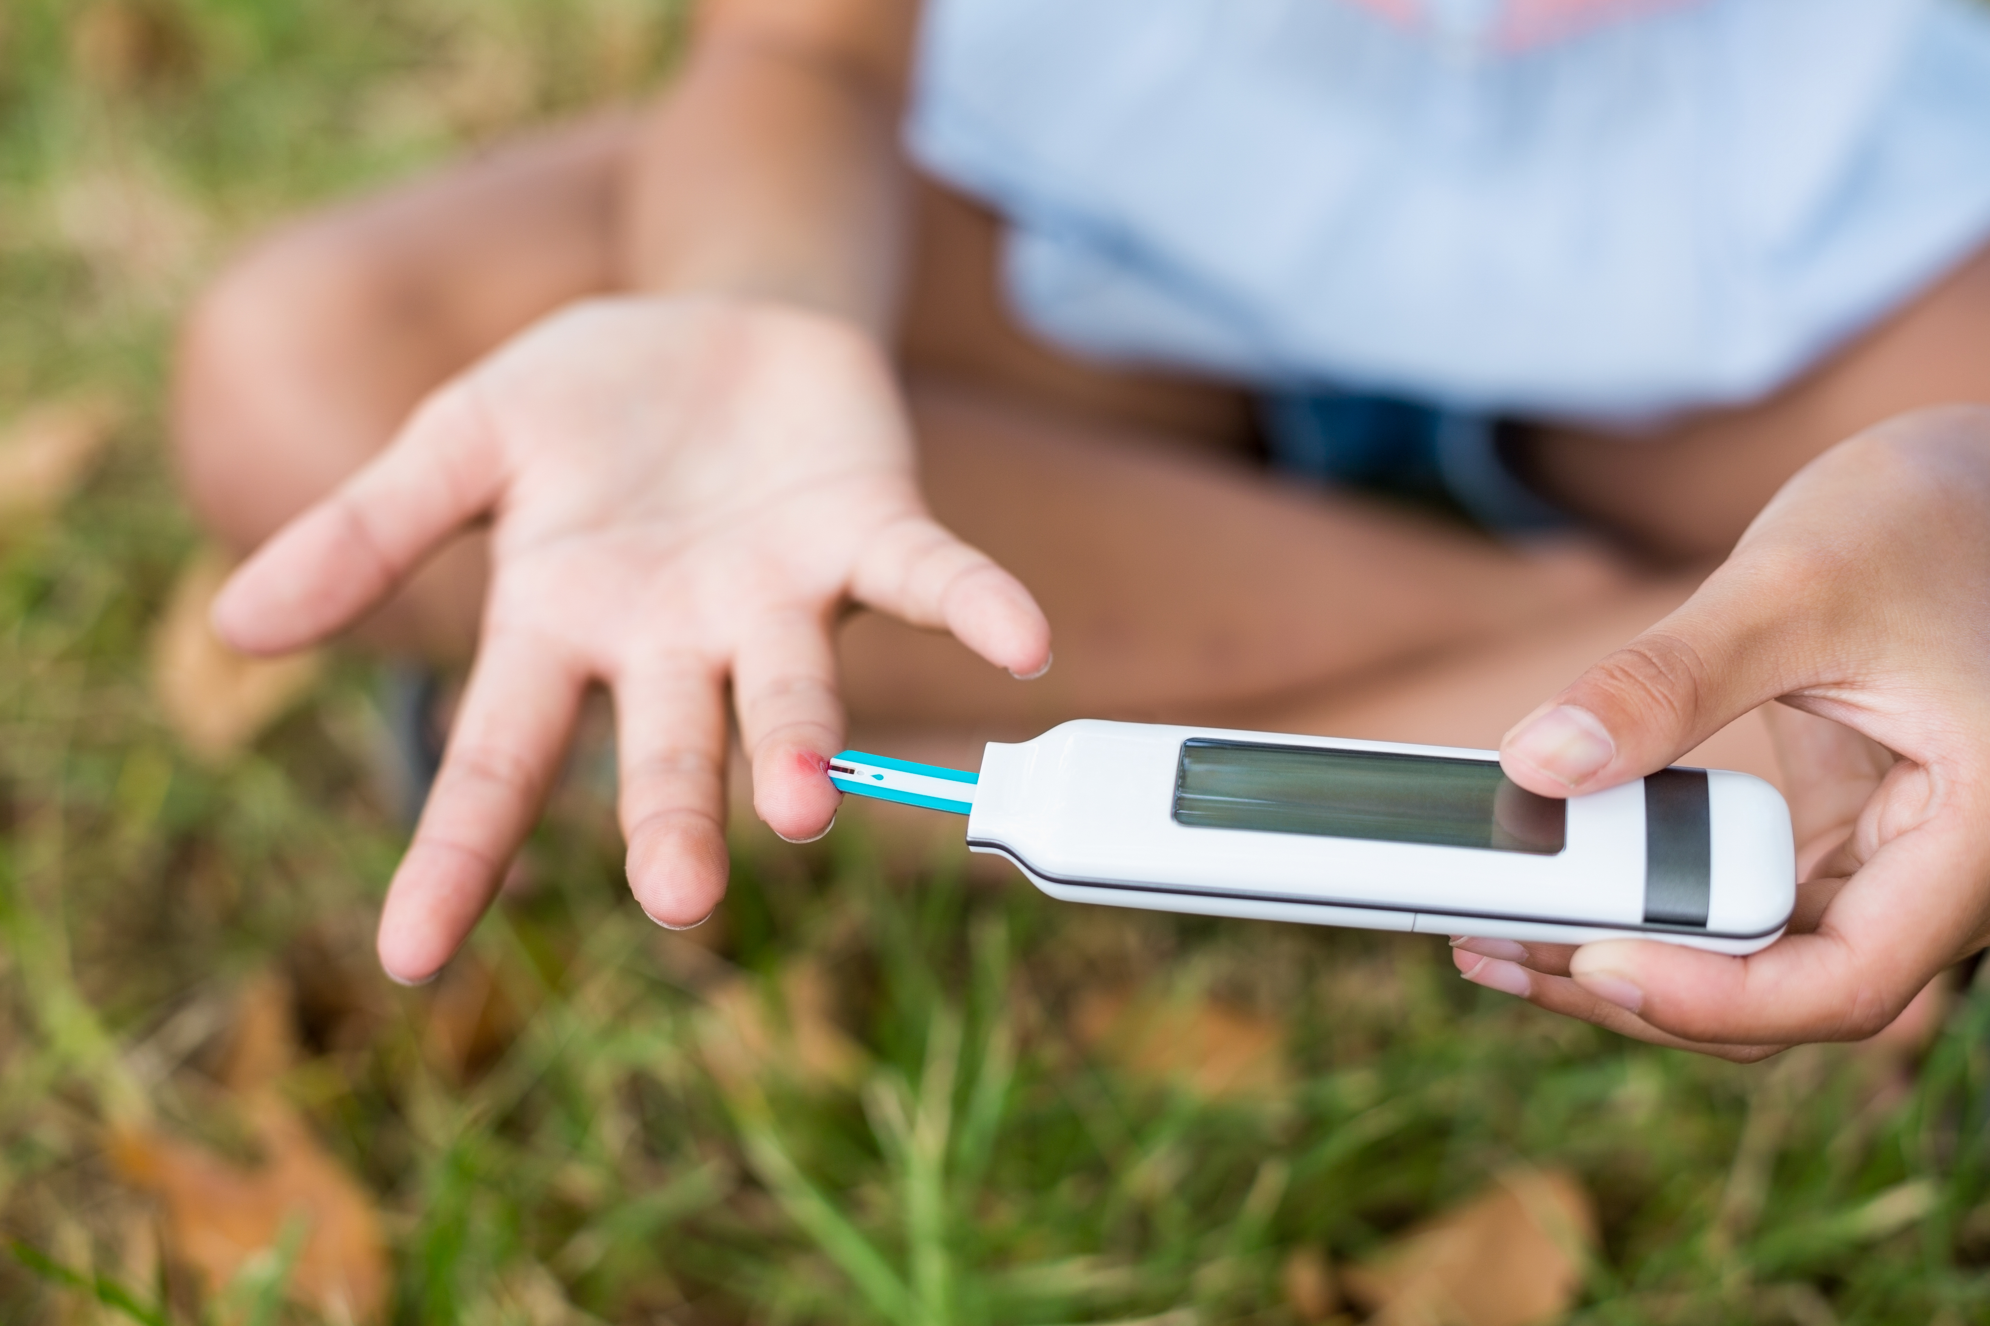

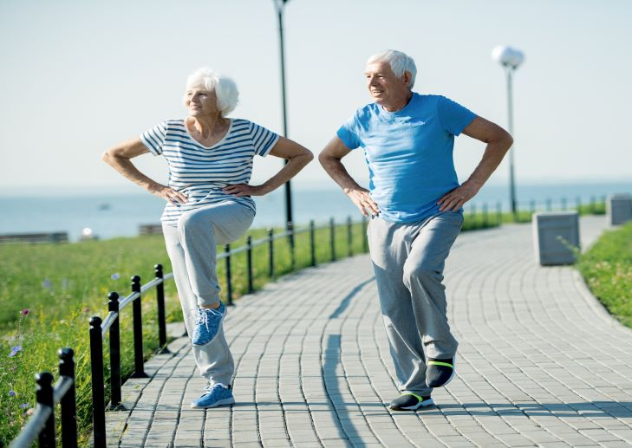
Why is health literacy important?
Health literacy measures how well you can manage your health independently. This includes both day-to-day habits as well as navigating the healthcare system, such as:
Recognizing when you need to see a doctor
Understanding healthcare coverage available to you and how to use it
Filling out healthcare forms
Preparing for an emergency
Communicating effectively with your healthcare providers
Managing chronic conditions
Knowing where to find accurate health information
Notes:
Read slide.
Point out that…our understanding and actions we take to manage our health, are limited to our health literacy level

Slide 13
Health Literacy - Check Understanding
Which of these scenarios require health literacy skills?
Communicating with your doctor
Understanding nutrition labels
Filling out insurance forms
All of the above

Slide 14

answer check
All of the above
Notes:
All of these scenarios require health literacy skills
Communicating with your doctor
Understanding nutrition labels
Filling out insurance forms

Slide 15
How Is Health Literacy Measured and Scored?
The 2003 National Assessment of Adult Literacy (NAAL) is the only national data on adult health literacy skills in the United States.
The Program for the International Assessment of Adult Competencies (PIAAC) is the most current indicator of adult literacy in the United States.
Categories of Assessment Used for Testing Literacy Level
NAAL | PIAAC
Written and Spoken Language (Prose) Brochures Instructional materials Information with Numbers (Numeracy) Nutrition information Medication instructions Documents Intake forms Insurance paperwork | Literacy (Read and Understand Written text) Numeracy (Ability to use, apply, interpret, and communicate mathematical information and ideas) Problem Solving in Technology-rich Environments (Use technology to solve problems and accomplish tasks.
Sources:
Understanding Literacy & Numeracy | Health Literacy | CDC
Source: National Assessment of Adult Literacy 2003
Program for the International Assessment for Adult Competencies (PIAAC)
Notes:
How is health literacy measured and scored?
I want to start by stating that literacy and health literacy are not the same, but they are related.
The U.S. Department of Education collects and reports data on adult literacy and numeracy skills.
In 2006, they published findings from the 2003 National Assessment of Adult Literacy, the only national data on health literacy skills.
The study found that adults who self-report the worst health also have the most limited literacy, numeracy, and health literacy skills.
The Program for the International Assessment of Adult Competencies (PIAAC) study provides information on literacy and numeracy of adults ages 16–74. This is a large-scale international study of cognitive and workplace skills of adults is a comparative study across 39 participating countries.
The U.S. PIAAC data is based on the combined PIAAC data collected in 2012, 2014, and 2017 and the data from the American Community Survey (ACS)
Both studies provided the survey in both English and Spanish and used different buy similar categories of assessment to determine literacy level.
Managing health requires working with many types of information.
Some materials require multiple types of literacy, such as fact sheets with written words and numbers related to statistics or percentages.
Strong literacy and numeracy skills do help people understand and use health information and services, but research shows that most people still say that information and services related to health are unfamiliar, complicated, and too technical.
NAAL/PIAAC

Slide 16
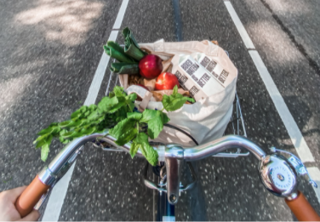
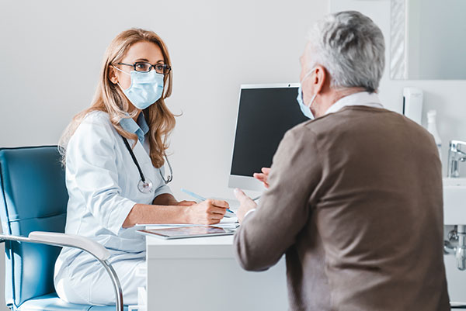

How Is Health Literacy Measured? 3 domains
Health literacy is measured by a person’s ability to perform tasks across 3 domains:
Prevention/Self-Care: Day-to-day actions to stay healthy and manage your health conditions
Clinical: Your relationship with your providers, especially in communication and taking an active role in decision-making and following health recommendations
Navigation of the Health Care System: The way you understand the healthcare system and health services available to you, including coverage, eligibility, and consent
Source: National Assessment of Adult Literacy, 2003
Notes:
Examples
managing stress/exercising/eating healthy/taking medication as prescribed
2) Preparing for doctors appt/asking questions during/accurately describing symptoms/letting your provider if you’ve gotten care/meds anywhere else
3) Getting coverage/understanding of premium and deductible costs/ choosing an appropriate healthcare plan for your needs, in your neighborhood, that speaks your language, etc.
Lack of understanding how to use healthcare can lead to delays in seeking care that cause health conditions to get worse. Lack of confidence and communication when interacting with your care providers can result in inaccurate or incomplete diagnosis and care plans. It can also mean someone doesn’t ask for clarification and leaves without an understanding of how they need to manage their health.
■ The clinical domain encompasses those activities associated with the health care provider-patient interaction, clinical encounters, diagnosis and treatment of illness, and medication.Tasks from the clinical domain are filling out a patient information form for an office visit, understanding dosing instructions for medication, and following a health care provider’s recommendation for a diagnostic test.
■ The prevention domain encompasses those activities associated with maintaining and improving health, preventing disease, intervening early in emerging health problems, and engaging in selfcare and self-management of illness. Examples are following guidelines for age-appropriate preventive health services, identifying signs and symptoms of health problems that should be addressed with a health professional, and understanding how eating and exercise habits decrease risks for developing serious illness.
■ The navigation of the health care system domain encompasses those activities related to understanding how the health care system works and individual rights and responsibilities. Examples are understanding what a health insurance plan will and will not pay for, determining eligibility for public insurance or assistance programs, and being able to give informed consent for a health care service. (HHS, 2003, p. 37)

Slide 17
How is Health Literacy Scored Through NAAL?
Scores for health literacy are categorized into 4 performance levels:
Below Basic, Basic, Intermediate, and Proficient
Predictions about health literacy skills a person may or may not have are based on their literacy level.
Level | Examples of Health Tasks at This Level
Below Basic | Find and circle the date of a medical appointment on a piece of paper
Basic | Recall two pieces of information from a clearly written pamphlet
Intermediate | Determine a healthy weight from a chart that compares height and weight for body mass index
Proficient | Infer the meaning of a medical term from context
Source: National Assessment of Adult Literacy 2003
Notes:
Just because a person is scored at a certain literacy level doesn’t guarantee they can do these tasks, but it is reasonable to assume that they have trouble doing more complicated tasks than the examples given.
It is best to offer help to people when they are asked to complete a task.
Use universal precaution: offer help to every person, every time.
Many people will not ask for help, as they may feel embarrassed.

Slide 18
How Does PIAAC SORE Literacy?
Scores for literacy are categorized into a 6-level scale:
Level | Examples of Health Tasks at This Level
Below Level 1 0-175 points | Only knowledge of basic vocabulary Not required to understand structure of sentences or paragraphs or use digital text
Level 1 176-225 points (low proficiency) | Can read short text on familiar topics Locate a single piece of information
Level 2 226-275 points (moderate proficiency) | Remember two or more pieces of information Compare and contrast; solve basic problems
Level 3 276-325 points (proficient) | Understand and respond appropriately to dense or lengthy text. Identify and evaluate information
Level 4/5 326-500 (high proficiency) | Understand complex and abstract information from context Perform multi-step operations
Source: PIAAC - U.S. State and County Estimates Resources
Notes:
Even a person is literate and can read well and is comfortable using numbers, they can still have limited health literacy if...
They aren’t familiar with medical terms or how their bodies work.
They have to interpret statistics and evaluate risks and benefits that affect their health and safety.
They are diagnosed with a serious illness and are scared or confused.
They have health conditions that require complicated self-care.
They are voting on an issue affecting the community’s health and relying on unfamiliar technical information.

Slide 19
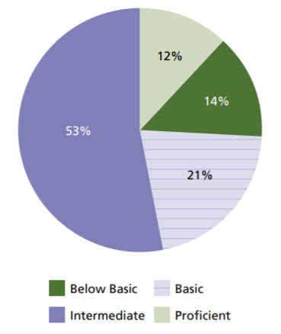
Results from the National Assessment of Adult Literacy Survey (NAAL)
Distribution of Health Literacy Levels
At the time of this study, 21% of San Diego County residents were estimated to fall at the Below Basic literacy level.
Current predictive modeling estimates that in some San Diego County neighborhoods 60% or more of the residents have a Basic or Below Basic literacy level.
In the United States, 14% of people operate at the Below Basic literacy level.
Source: National Assessment of Adult Literacy (NAAL), 2003.
Notes:
Only 12% of people are estimated to be proficient/fully capable of taking care of their health,
Over a third of the population was found to be basic or below basic.
San Diego P
Some neighborhoods are as high as 60+%.
Ask students if they see trends in places that are lower-explain you will go on to look at the factors associated with health literacy, and how these projections are made.
In the next slides we will look at health literacy in San Diego County by some of health equity lenses (there are 5) including: age, gender, geography, race/ ethnicity, and education (socioeconomic status is the official lens).

Slide 20
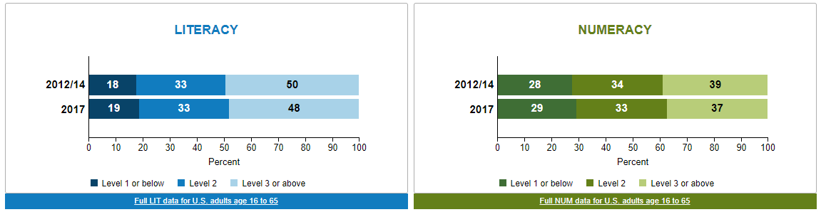
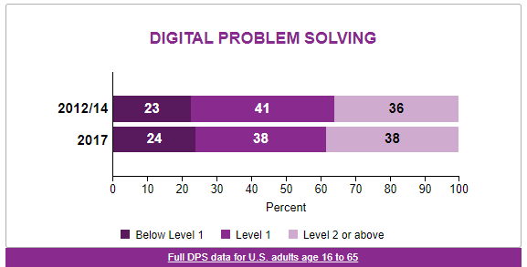
Results from the 2014/2014 and 2017 Program for the International Assessment of Adult Competencies (PIAAC)
Distribution of U.S. Adults at Select Levels of Proficiency
In the United States, more than 50% of adults scored as moderately proficient (level 2) or lower in each category of assessment.
Source: Program for the International Assessment of Adult Competencies (PIAAC), 2017.
Notes:
Only 12% of people are estimated to be proficient/fully capable of taking care of their health,
Over a third of the population was found to be basic or below basic.
San Diego P
Some neighborhoods are as high as 60+%.
Ask students if they see trends in places that are lower-explain you will go on to look at the factors associated with health literacy, and how these projections are made.
In the next slides we will look at health literacy in San Diego County by some of health equity lenses (there are 5) including: age, gender, geography, race/ ethnicity, and education (socioeconomic status is the official lens).

Slide 21
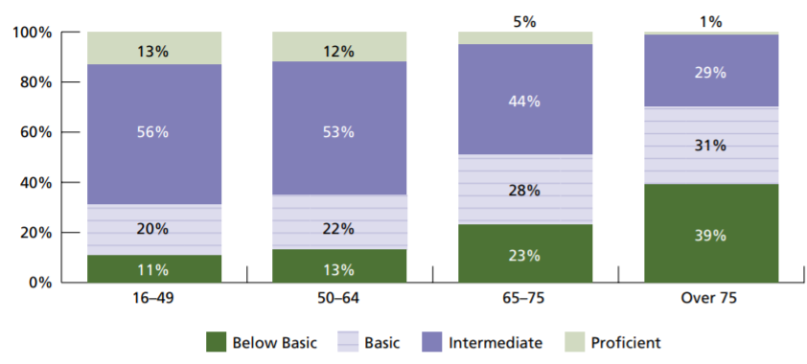
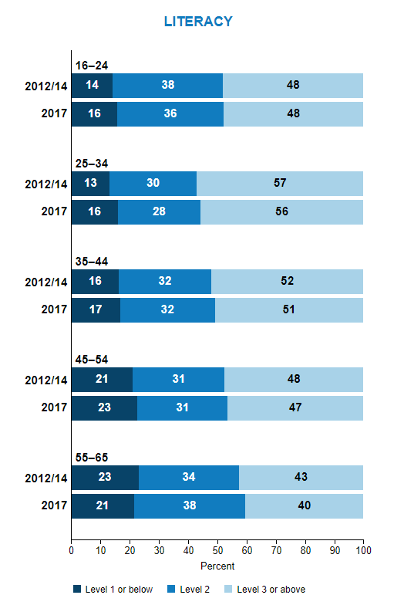
Literacy Data by Age
Age and Literacy Levels
NAAL Health Literacy
PIAAC Literacy Scores
Health literacy levels vary by age groups. Older people in both studies showed lower levels of literacy.
Notes:
Adults 65+ showed significantly lower health literacy scores; similarly, adults 55-65 also showed the lowest literacy scored in the PIAAC study.
Again, ask for why they think this impacts health literacy. Give a chance for answers.
Possible Reasons
Disabilities
poor eyesight
less familiarity with technology
less education (government mandated), etc.
Older generations may also view questioning doctors’ guidance as disrespectful. This can vary between cultures

Slide 22
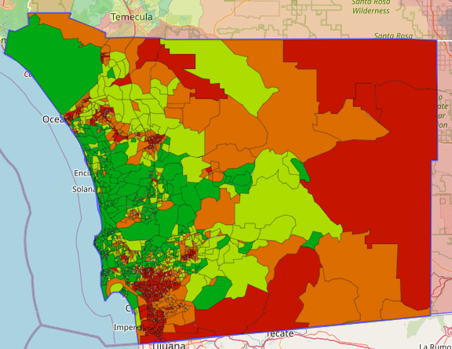
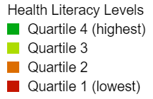
Health Literacy by Geography
Geography and Health Literacy Levels
Health literacy levels in San Diego County vary dramatically throughout the region. This map shows predictive health literacy estimates based on data from the U.S. Census and the American Community Surveys.
Health Literacy Data Map: The University of North Carolina at Chapel Hill
Notes:
This website provides an interactive, searchable, national map of health literacy estimates for 216,864 census block groups in the United States. There are usually between 600 and 3,000 people living in a census block group.
Health literacy is the ability to obtain, process, and understand information needed to make health decisions. Health literacy is not only a reflection of an individual’s skills and abilities, but also how well health systems provide information and services.
This map will help identify geographic areas that may be most affected by limited health literacy and are in the greatest need of health care services and improvements. The literacy estimates may also be used to study health literacy on a larger scale than previously possible with assessments administered in person.
How were these health literacy estimates created?
These health literacy estimates were created through a predictive model that uses data from the 2010 U.S. Census and 2011 5-year American Community Surveys (ACS) summary files. This predictive model estimates the mean health literacy of individuals living in each census block group.
The following variables are included in the model:
Gender
Age
Race/ethnicity
Language spoken at home
Income
Education
Marital status
Time spent in the United States
Metropolitan statistical area
-----------------------------------------------------------------
A note on limitations to this model: It’s important to realize that these are health literacy estimates based on demographic characteristics of census block groups. Therefore, the estimates may not be accurate for every person who lives in a particular census block group.
If you’re interested in additional information on the model used to create these estimates, please review this publication. You can also contact us with questions.
Please note: The map and the underlying data driving the geographic representations are publically available to inform and benefit policy and practice. Find information about how to use and cite the data.
The development and maintenance of this website was funded by National Institute on Aging (NIA) (Grant Number: 1R01AG046267-01A1; PIs: Bailey/Fang) and is a collaboration between the University of North Carolina at Chapel Hill, Boston University Medical Center, Northwestern University, RAND Corporation, and the University of Michigan.
Disclaimer: The content of this website does not necessarily represent the official views of the National Institutes of Health (NIH).
Next: Understanding the Data.

Slide 23
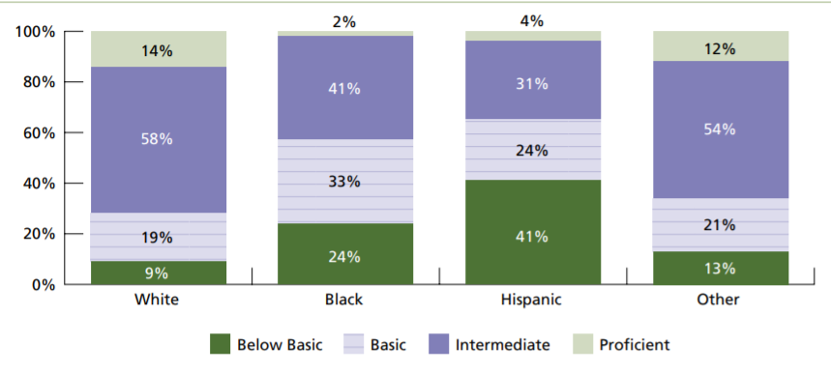
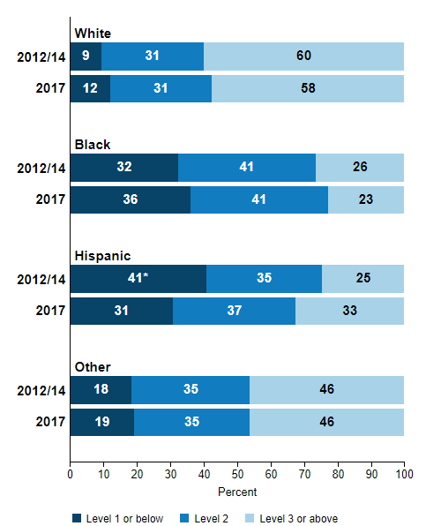
Health literacy data comparing race/ethnicity
Race and Ethnicity and Literacy Levels
NAAL Health Literacy
PIAAC Literacy Scores
Literacy varies significantly by race and ethnicity. Literacy was lowest among Black and Latino adults in both studies. Hispanics showed the lowest health literacy levels compared to other racial/ethnic groups in the United States.
Notes:
Ask why they think race is a factor. Give a chance for answers.
Possible Reasons
socioeconomic factors like
Poverty
Education
cultural norms regarding healthcare consumption and beliefs about health.

Slide 24
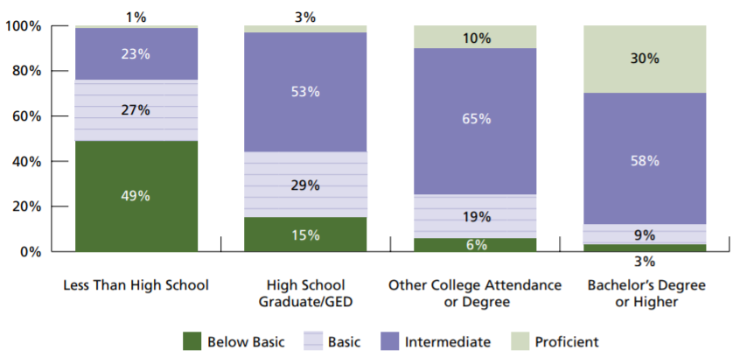
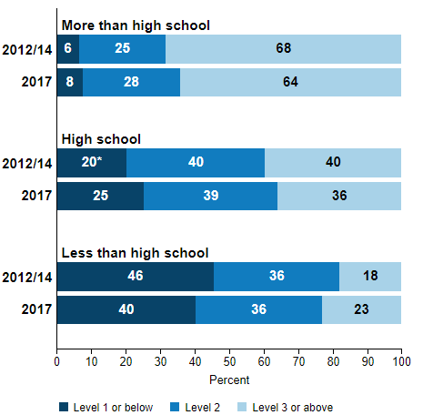
Health Literacy by Education
Education and Health Literacy Levels
NAAL Health Literacy
PIAAC Literacy Scores
The San Diego Council on Literacy found that 20-25% of adults in San Diego County read at the lowest level of literacy (grade level equivalent of 0-4).
Education level is a strong predictor of literacy. The more education a person has, the more likely they are to also show high literacy and health literacy.
Notes:
Ask why the think education is a factor, and why San Diego has such a high prevalence of low literacy. Allow for answers.
Some answers may be lower literacy in general
Poverty
lack of confidence in discussing health
high population of non-native English speakers.
Continue to emphasize that lack of fluency in English can create barriers to understanding but is not tied to intelligence level.

Slide 25
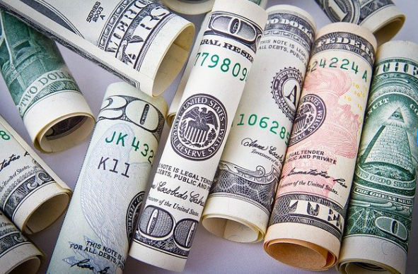

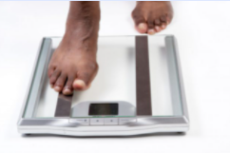
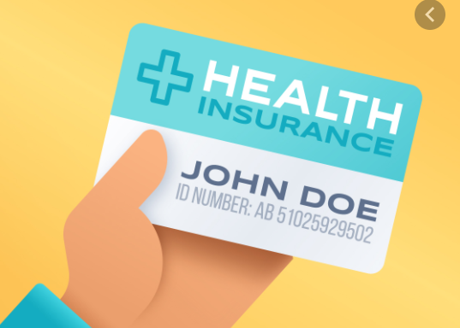
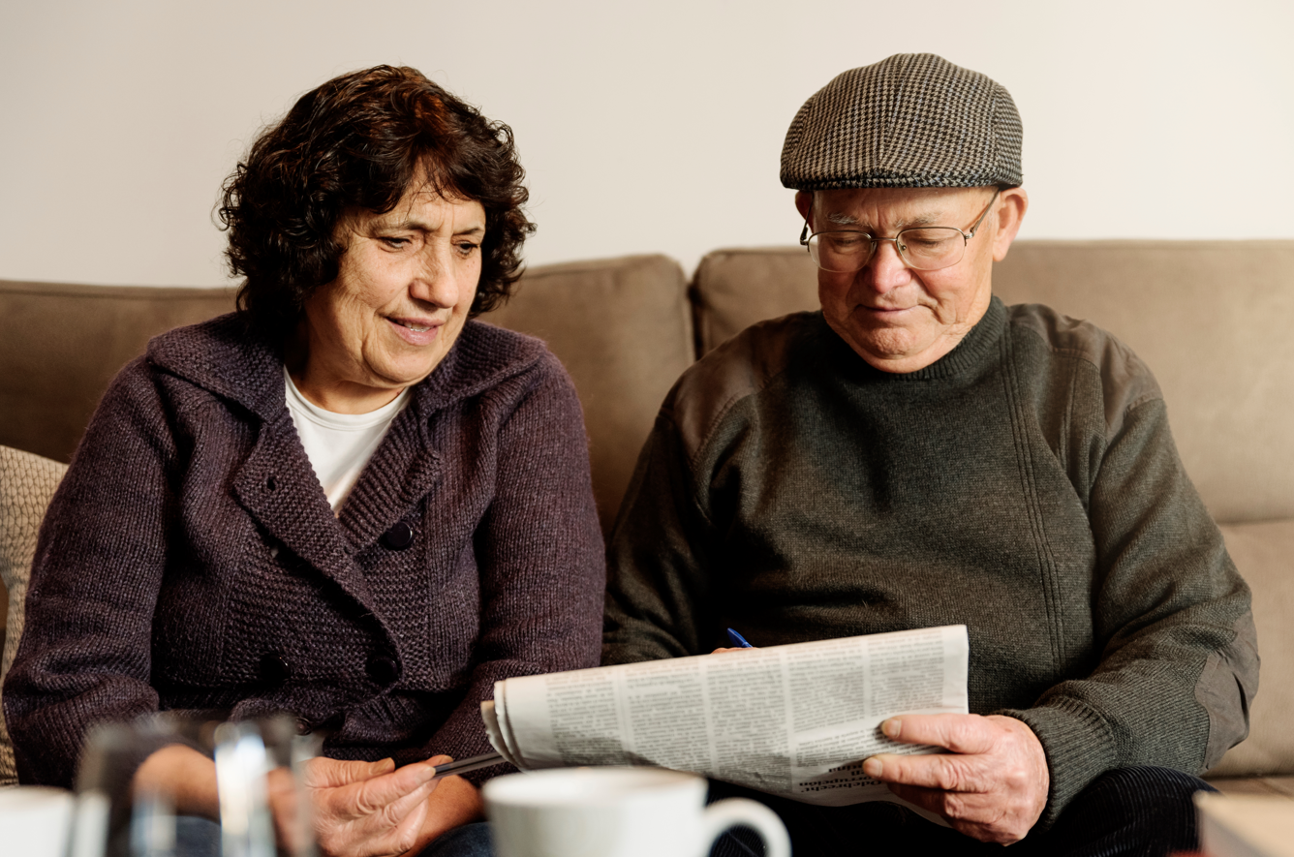


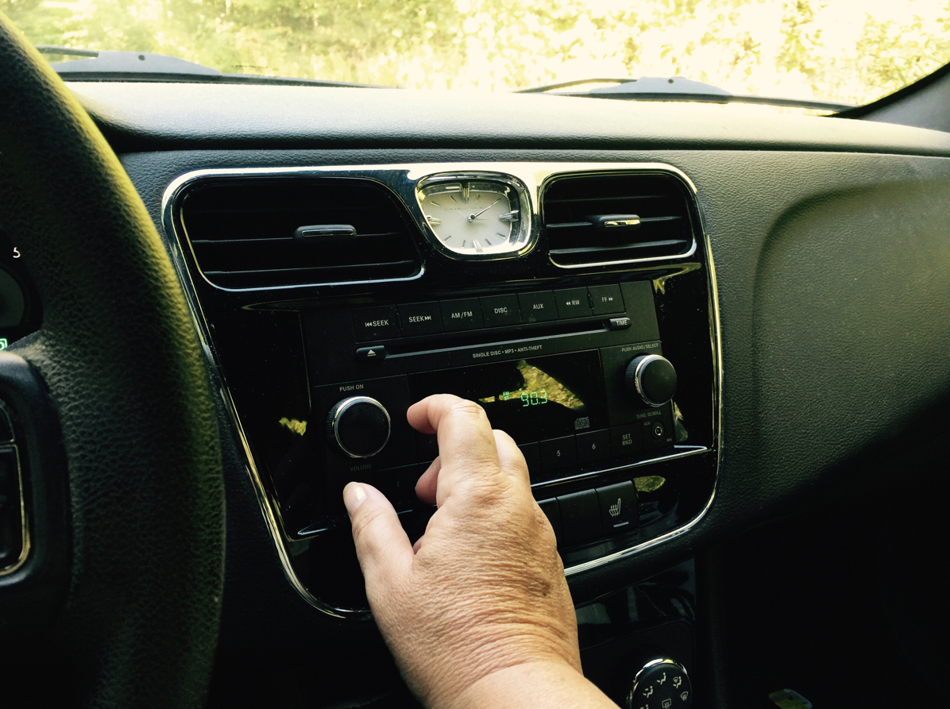
Other Factors associated with Health Literacy Level
Income
Self-Assessment of Health
Civic Participation
Type of Healthcare Coverage
Health Information Channels
Civic Participation and Health Literacy
Notes:
Read the different factors. Point out they may be correlative (consistently seen with different factors) versus causative (the factors cause the literacy levels).
Higher income is associated with higher health literacy
higher self-assessment of health (“How healthy do you think you are?”), and
civic participation (voting and volunteerism) are associated with higher health literacy
Those who rely on government insurance, such as MediCal and MediCare, as well as those who DON’T have insurance, tend to have lower health literacy.
Those who receive health information through non-print communication (radio, television, other people) tend to show lower health literacy.
It should be noted that smartphones are increasingly more popular. Currently, Hispanics and Black/African Americans are more likely to have a smartphone than a computer, and all groups have high rates of using the smartphone to look up health information.
Because of the complexity and the overwhelming amount of health information available today, Americans of all literacy levels have difficulty processing and understanding public health messages.

Slide 26




Factors Associated with low health literacy
Based on the NAAL and PIAAC Literacy Studies, these factors were associated with low literacy.
Someone who…
Did not graduate from high school
Did not speak English before starting school
Describes their health as “poor”
Is a Hispanic adult
Is a Black adult
Is 65 years old or older
Has no medical insurance
Has one or more disabilities
Notes:
These are the traits most strongly associated with low health literacy.
Rates of people with low health literacy are disproportionately higher among people with these factors.
People may have one or multiple factors on this list, increasing the chance they will have low health literacy.

Slide 27
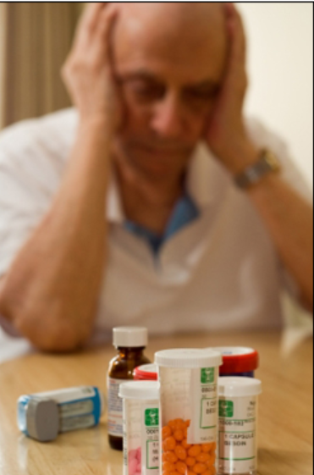
How Does Low Health Literacy Affect the Individual?
People with low health literacy:
Are less likely to seek preventative care, such as annual check-ups, mammograms, flu shots, and other screenings.
Are likely to have a harder time managing chronic conditions, such as:
Diabetes
Heart disease
Cancer
Are more likely to describe their health as poor
Are more likely to report a sense of shame about their ability to understand health information and communicate with health providers.
Health literacy is a stronger predictor of health than age, income, employment status, educational level, or race.
Notes:
Read slide. (Ask for examples of observations of these trends with their patients/clients)
If a person is less likely to seek preventative care, they are less likely to detect health issues early enough to properly treat them in time, leading to worse health outcomes and higher likelihood of preventable death.
Similarly, when a person has trouble managing their diseases, it can lead to worsening conditions and preventable death.
Low confidence in your health status can affect your ability to manage your health.
Poor emotional health can also weaken your body's immune system. This makes you more likely to get colds and other infections during emotionally difficult times. Also, when you are feeling stressed, anxious, or upset, you may not take care of your health as well as you should.

Slide 28
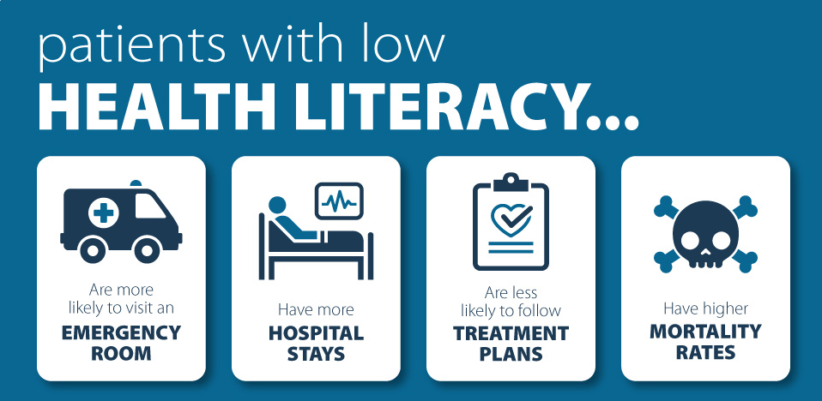
What Are Consequences of Low Health Literacy?
Notes:
If someone doesn’t seek care in a timely manner, the conditions can escalate to an emergency, real or perceived.
A person may also go to the emergency room when it would be more appropriate to go to primary care, b/c they don’t have or understand how to use their insurance which can crowd emergency services.
Poor management of health and delaying care also leads to worse health conditions and worse health outcomes.
This leads to disparities in the morbidity of health conditions, and increase the likelihood of an earlier death.
Ultimately, low health literacy drives up healthcare costs (for all of us.)

Slide 29
Health literacy - Check Understanding
Health Literacy is a stronger predictor of health than age, income, employment status, educational level, or race.
True
False

Slide 30
answer check
True
Notes:
True, Health Literacy is a stronger predictor of health than age, income, employment status, educational level, or race.

Slide 31

Ways health professionals unknowingly create barriers
According to the CDC, these are common errors health professionals make when communicating with patients:
Using technical or medical terminology It's important to use plain language, words that the person you're speaking to can understand the first time they hear them.
Relying on print communication as a single source of communication to reach an audience Relying on one source does not take into consideration different learning styles.
Focusing on information rather than actions Knowing does not equal doing. In addition to understanding information about their health, people need guidance on next steps: what to do, how to do it, and how to overcome barriers.
Not considering language or cultural differences Certain words, concepts or guidance can be foreign, confusing, or even insulting.
Notes:
These are common mistakes made by health professionals that prevent understanding from people with low literacy, unknowingly creating barriers (Read slide).
(You may be able to think of examples you have seen or even made yourself)
Read slide, add:
When providing clinical services, consider referring to staff who have the background and skills to provide this guidance, such as dietician, lactation consultant, social worker, health coach, etc.
People with limited English skills may agree, even when they don’t understand.

Slide 32
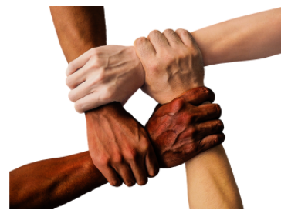
Cross-Cultural Competency
We must consider how people think,
rather than what people think
A person’s priorities affect how they receive information
and whether they consider it important and something they’re motivated to act on
Consider these differences in priorities:
Conceptual thinking: theory, science, logic and facts
Relational thinking: relationships and interpersonal interactions
Psychical thinking: intuition, inner experience, values
Source: TRAIN Learning Network, Course CE002
Notes:
Read slide. Ask people if one of the styles resonates with them personally, or if they can think of examples of people or groups they’d associate with one style.
Example of your own of how to appeal to different groups.
For instance, promoting the COVID-19 vaccine can be done by emphasizing the science (conceptual) or the fact you’re helping protect others (relational). Psychical can be a challenge, appealing to values, so using a trusted person can be a good strategy
Conceptual tends to be based on logic and based on hard facts.
Relational thinkers prioritize intersocial impact.
Psychical thinkers prioritize ideas and values
(CE002) Cross-Cultural Communications, Cognition and Linguistics | NDPHTN

Slide 33

Cultural Sensitivity
Culture gives significance to health information and messages— It can interfere with or support effective communication
Culture includes race, ethnicity, and geography or a shared collection of beliefs, values, customs, or ways of thinking, communicating, and behaving that are specific to a group.
Cultural Sensitivity Considerations:
Support cultural and linguistic diversity among staff and through trainings
Tailor services and materials to meet cultural and language preferences
Information should be culturally responsive, accessible, and available
Materials should represent the intended community (language, graphics, images, etc.)
Partner with the community to ensure cultural and linguistic appropriateness
Health Literacy: Culture and Language
Think Cultural Health (hhs.gov)
Health Equity Guiding Principles for Inclusive Communication
Notes:
Culture must be considered in the context of health literacy
When developing community guidance and public health communications, consider the following:
Build a diverse workforce throughout levels, including leadership positions; consider the benefits of hiring people from the communities you serve, including those who are disproportionately affected, and who “look and sound” like the communities you serve.
2)
Ensure information is culturally responsive, accessible, and available. Information should represent people in the communities for whom the information is intended, be available in forms (print, FB, etc.) or locations where those people are able to access it.
Similarly, ensure that information is available in appropriate formats (e.g., audio, video, braille or large print formats, visual/graphic imagery).
Avoid jargon and use straightforward, easy to understand language.
3) Work with community partners to identify priorities and strategies, including the need to build community awareness and acceptance, before communication products are developed and released.

Slide 34
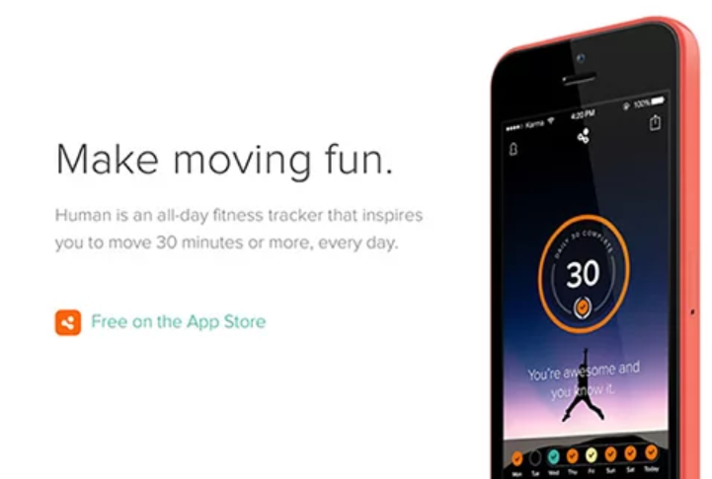

Creating Literacy Friendly Materials: Content
Bottom Line Up Front (BLUF)
Give the most important information first.
For Example:
If you’re creating a webpage, the most important information should be above the fold so users don’t have to scroll to read it.
Materials you should quickly state the purpose and desired action (Answer the 5 W’s: who, what, when, where, why)
Messages should focus on action items.
Notes:
BLUF is originally a military communications technique, in which the conclusion — the most important information and actions are placed right at the start. People have short attention spans, don’t assume they’ll read the whole webpage or flyer.
Describe just the basics, introduce the behavior and specific actionable guidance.
Think “need” to know vs. “nice” to know
In mobile view, key information should be available on one screen.
These are examples of BLUF: Starbucks promoted each new sentence with an enticing pictures and limited text.
Another example of BLUF: this app promotes 30 minutes of exercise every day, and that is clear from one screenshot
Both examples give the BLUF in one screen, no need to go through links to get the main info
https://health.gov/healthliteracyonline/table-of-contents/

Slide 35

Creating Literacy Friendly Materials: Tone
Tone refers to the words used
and the way the message makes a person feel.
Tone Tips:
A good habit is to explain the topic as if you are talking to a child or a friend who knows nothing about the topic.
Communicate like you speak.
It’s okay to use contractions and informal language.
Be friendly, polite and encouraging.
Create a positive tone by focusing on the benefits of the behavior, not risks.
Make sure your messages answer the question “What’s in it for me?”
Research has shown that the less a person knows about a topic, the more they prefer positive messaging, rather than risk messaging. On the contrary, people well-educated on a topic prefer risk-oriented messaging.
Source: Positive Effect Related to Health and Risk Messaging
Notes:
X
X
People are more likely to listen if they feel respected or liked.
People like to know what they are getting out of it, how does it help ME
More educated people may have more confidence problem solving and feel less threatened by risks, while people less familiar with the topic may be intimidated by focusing on risks.

Slide 36
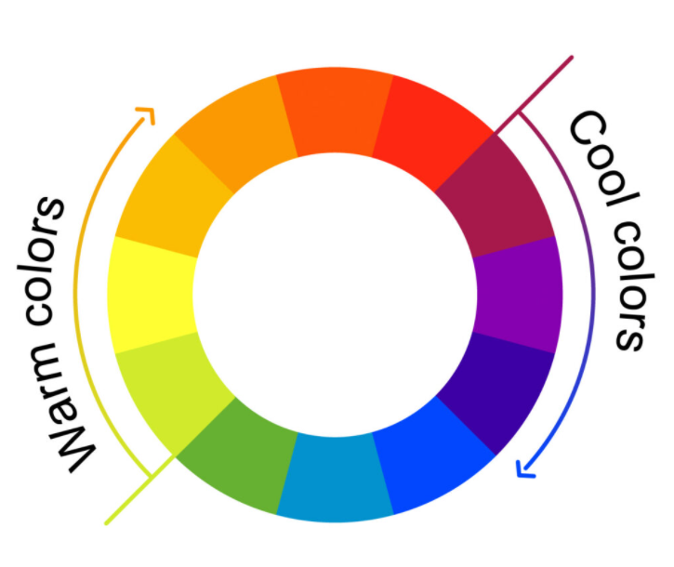
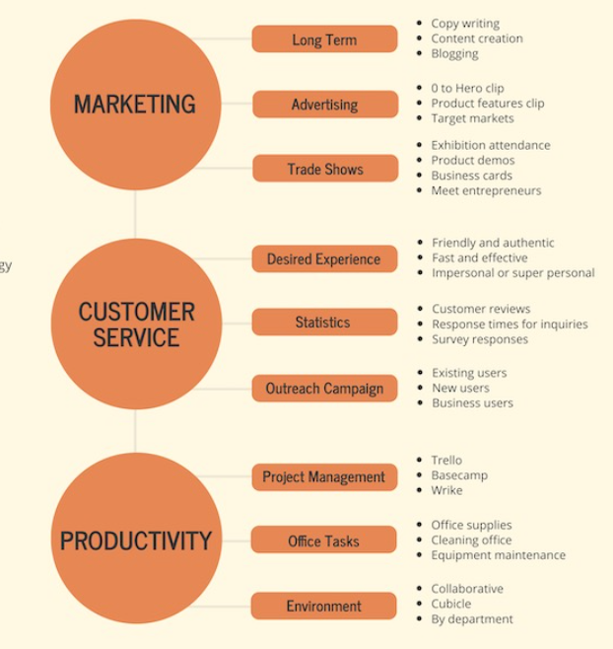
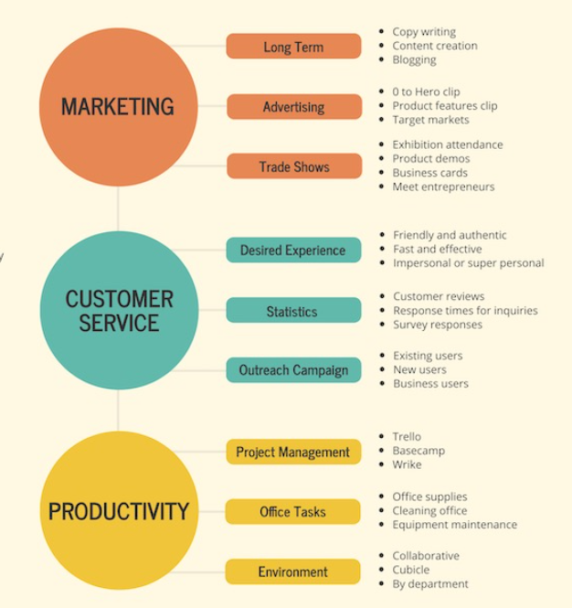
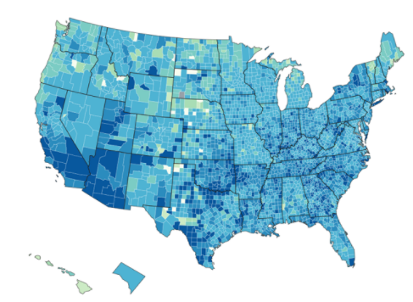
Use Color Strategically: Tone and Clarity
Use Color to Promote Clarity, Tone, and Aesthetics
Make things stand out visually (salience)
Use color to make the most important information stand out.
Studies show warm colors demand our attention.
Logical grouping
Use color to group related information
Show progression and quantity
Color intensity can show progression
Symbolic tone
Consider the tone that a color creates—This can vary by culture
Source: How to Pick Colors to Captivate Readers and Communicate Effectively
Notes:
Color helps emphasize your most important points.
Warm colors (red, orange, yellow) motivate energy and action
Cool colors (blue, green, pastels) are calming.
It’s ideal to use cool colors for background, and warm colors to emphasized information.
Symbolic Tone
For instance, you wouldn’t use bright pink to announce a funeral.
When we think of funerals and mourning in the U.S. and in many countries, we think of the color black
But in other cultures (Ethiopia, China and religions such as Buddhism and Hindu) white is the color of mourning
Other colors during morning including, purple or red.
Its always important to consider culture and what’s appropriate

Slide 37
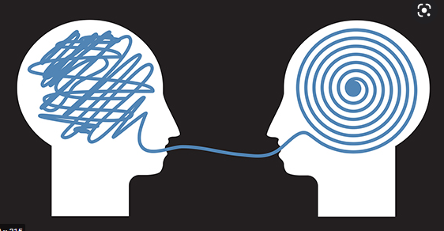
Creating Literacy Friendly Materials: Plain Language
Use Plain Language
Use simple and familiar words that are recognized the first time they are used
Use the active voice
Active: You may need tests
Passive: Tests may be needed
If you need to use a complex word, define it in the context the first time the word is used
Your doctor may refer you to a neurologist. A neurologist is a doctor who treats problems related to the brain and nervous system.
Check grade level after writing (resources to be provided)
The appropriate grade level depends on your audience, but for a general audience, aim for a 5th grade reading level or lower
Resources:
Plainlanguage.gov
CDC Everyday Words for Public Health Communication (PDF)
CDC Everyday Words for Public Health Communication (URL)
Plain Writing Checklist
Notes:
These are basic concepts for writing in plain language. You can follow the links for more in-depth guidance
You don’t want people trying getting stuck trying to process a word you used, meanwhile you are a sentence away and they’ve missed all that additional information.
The active voice is easier to understand, and it is clear who you are talking about.
You can still use the big words/official words, because they may need to know or learn them to understand their condition, but help them understand
This is to ensure understanding by most people

Slide 38
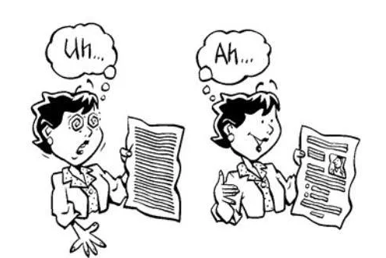
Plain Language Examples
Instead of this… | Say:
Respiratory | Affects the nose, throat, and lungs (breathing)
Nephrologist | Kidney doctor
Monitor | Check
Myocardial infarction | Heart attack
Pulmonary | Affects the lungs
Stakeholder | People interested in the topic
Let’s practice rephrasing words in plain language:
Lowest Sugar Content
Contagious
Benign
Hypertension
Notes:
It’s helpful to think of how to say your message using plain language and vocabulary the general population will understand
(Think of other examples of how to simplify language you use in your work or give examples of ways you have simplified language in the past.)
Practice:
Lowest sugar content: least amount of sugar; low or no sugar; less than x grams of sugar
Contagious: spreads from person to person
Benign: Not cancerous
Hypertension High Blood Pressure, blood pressure higher than normal, blood pushing against the walls of your arteries (arteries carry blood from your heart to other parts of your body); 140/90 or higher (others say 130/80)

Slide 39
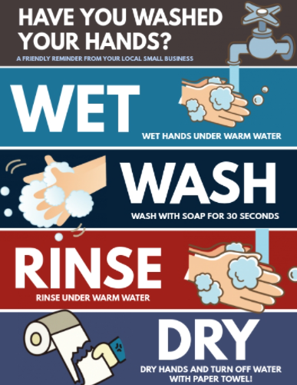
How to Use Plain Language
Use Simple and Familiar Words
Notes:
As you can see, simple and familiar words are immediately noticeable. The action steps are an easy takeaway and images reinforce the message/ask
Have you washed your hands today?
Wet
Wash
Rinse
Dry

Slide 40
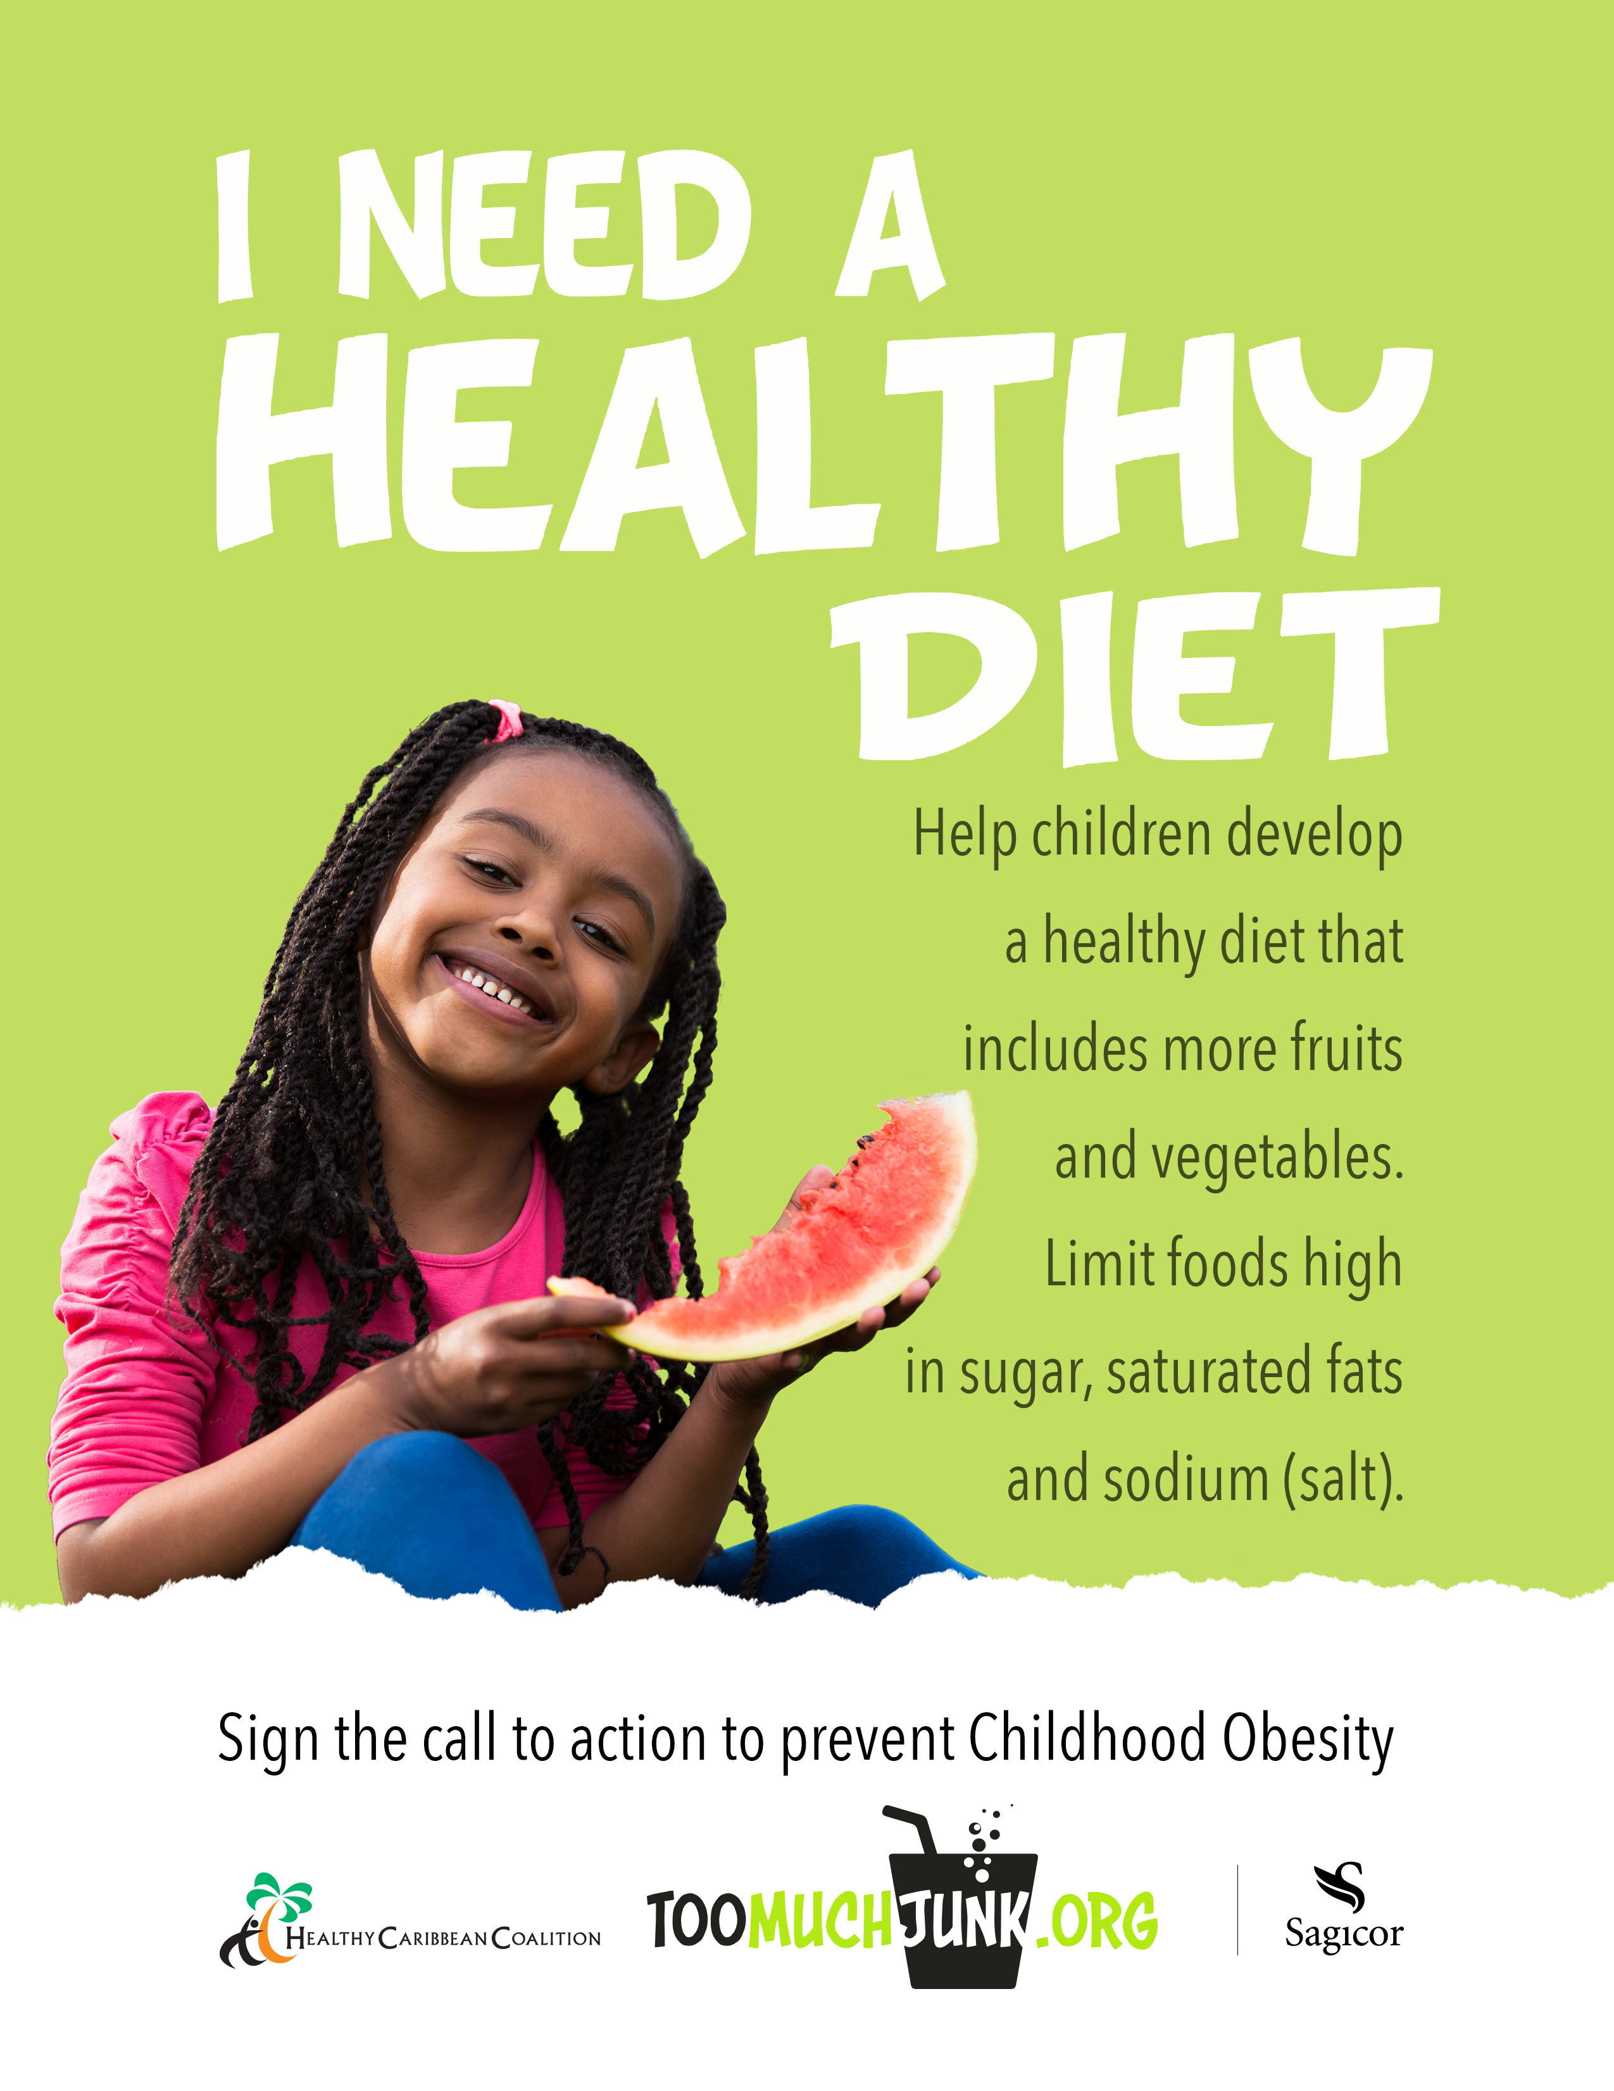

How to Use Plain Language
Define New Or Complex Words Right Away
Notes:
Point out sodium is immediately defined as salt in the first image
The second image takes it a step further and defines a relaxation strategy by guiding step-by-step action (It gives an example of how to relax!)

Slide 41
Creating Literacy Friendly Materials: Check Your Numbers
Use words with one or two syllables when you can
Aim for 20 words or less in each sentence.
Try to limit paragraphs to 3-5 sentences (or 3 lines or less)
Use lists instead of paragraphs when possible—Lists are easier to read.
Keep lists to 7 items.
Use columns if list is longer than 7 items.
Use a readability test tools to assess the grade level of materials.
Paragraph:
To be healthy, your body needs to get enough vitamins, minerals, and other nutrients. Eating healthy means getting plenty of vegetables and fruits, whole grains, fat-free or low-fat milk products, seafood, lean meats and poultry, eggs, beans and peas, and seeds and nuts.
------------------------Versus-------------------------
Lists/Dot Points:
To be healthy, your body needs to get enough vitamins, minerals, and other nutrients. Eating healthy means getting plenty of:
Vegetables
Fruits
Whole grains
Fat-free or low-fat milk products
Seafood
Lean meats and poultry
Eggs
Beans
Peas
Seeds
Nuts
Notes:
These are specific rules to help you write in plain and concise language.
These are helpful to keep in mind while you work and are good to refer back to
Know that some worlds with more than 2 syllables are familiar words for people, like hospital or emergency (You can always define those harder words)
Aim
Try
Lists; you can see an example of this. The same information is provided and both provide guidance for healthy foods to choose.
Which is easier to read, the paragraph or the dotted list?
This also makes the information quicker and easier to read.

Slide 42
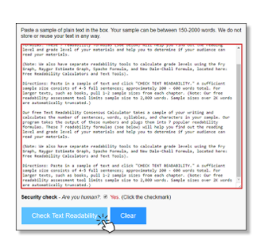
Readability Evaluation Resources
There are over 200 reading level tools available!
The ReadabilityFormulas.com website lets you use free automated readability checkers, including:
Fry Readability Graph
SMOG (Simple Measure of Gobbledygook)
Gunning FOG
Flesch Reading Ease
Text Readability Consensus Calculator
With so many readability formulas to choose from, you may wonder “How do I decide which a readability formula to use?” This website explains the difference between readability formulas, and describes which formulas are the best match for the type of material you’re reviewing.
Notes:
Here are some of the most common readability formulas.
There are many free resources online to test readability.

Slide 43
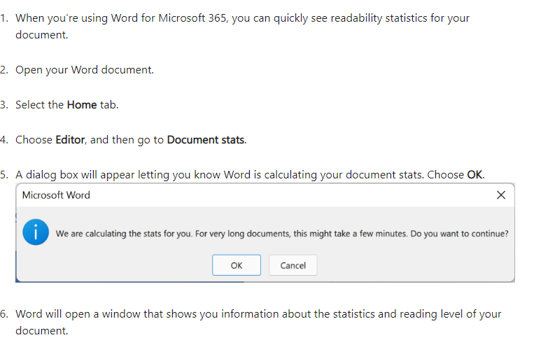
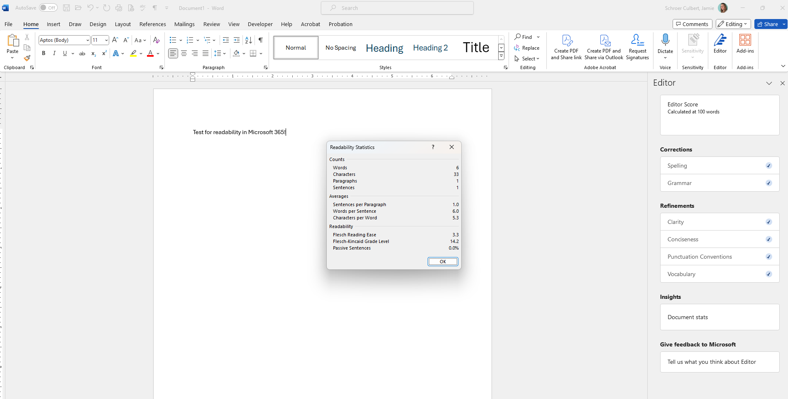
Did you know that Microsoft Word Also has a Readability Tool?
Get your document's readability and level statistics - Microsoft Support
Notes:
You can also just use Microsoft Word to measure readability. (This slide is for reference to use after the workshop.)

Slide 44
Prep Materials for the Grade Level Scan before Checking Readability
Readability formulas are quantitative and certain factors can misrepresent the grade level.
Here are some tips to help you get an accurate grade level assessment:
Remove headings
The lack of a period makes it look like a run-on sentence with the first line.
Remove periods that don’t end sentences, such as i.e., U.S.A.
The scan views every period as a sentence.
Remove every word with 3 syllables or more before doing the grade level scan
These are seen as “hard words”, even if it’s a familiar word like hospital.
If they’re recognizable to your audience, keep them in the final text, but remove them for the scan.
Test individual sections/sentence at a time (This also helps you identify which areas may need editing.)
The grade level score is an average of the complete text.
For example, one sentence could have a 5th grade reading level and another sentence might have an 11th grade reading level, which may result in the overall score of this paragraph being at an 8th grade level.
Notes:
Readability tools use formulas and don’t understand what they are reading, here are some tips to get an accurate understanding of your content and what areas may need to be adjusted based on the grade level score.

Slide 45
Health Literacy - Check Understanding
What is NOT an example of plain language?
Using simple and familiar words
Using passive voice
Using short sentences and paragraphs
Giving important information first
Notes:
What is Not an example of plain language?
Using simple and familiar words
Using passive voice (you should use the active voice)
Using short sentences and paragraphs
Give important information first

Slide 46
answer check
Using Passive Voice
Notes:
You should avoid using the passive voice and write in active voice.

Slide 47
Beyond Readability: Promoting Engagement
Understanding ≠ Behavior Change
Information alone does not lead to action. To promote actionable health literacy, the information should also be relevant, accessible, and compelling. These strategies promote engagement.
Use personal language
Appeal to different learning styles
Put action steps in order
Appeal to emotion
Empower problem-solving
Meet people where they are
Create catchy soundbites
Use humor and entertainment
Use visuals that stand on their own
Choose the right images
Notes:
Plain language isn’t the only way to teach your reader: you also want to compel them to action. Understanding alone doesn’t always lead to behavior change.
Here are some ways to make content more engaging. Next, we will go through specific examples of each to demonstrate how to apply these.

Slide 48
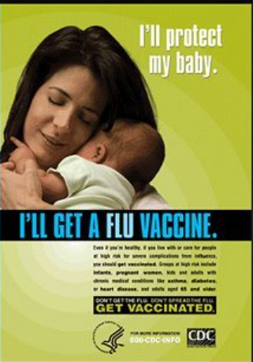
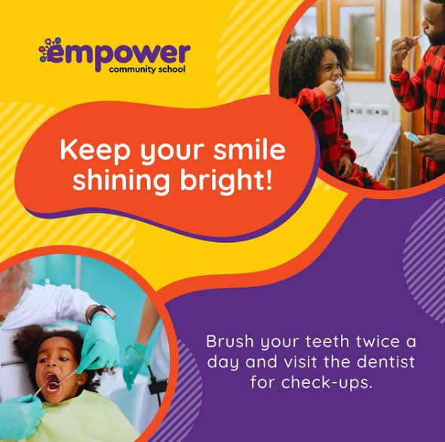
Beyond readability: engagement Strategies
Use Personal Language
Write like you talk—Its okay to use contractions
Minimize the use of abbreviations—Use nicknames instead!
For example, for Environmental Safety Committee, consider the “the committee” instead of ESC.
Use the present tense
Consider your audience—Use language your audience understands and feels comfortable with
What is your audience’s current understanding of the topic?
Is your audience 8th graders or PhD candidates?
Use “must” when something is required (the word “shall” creates confusion)
“must” for an obligation
“must not” when something is prohibited
“may” for discretionary action
“should” for a recommendation
Notes:
Speak in familiar and personally compelling language.
Instead of “one should” say “you should”
When a person reads in first tense, it can personalize the information more naturally.

Slide 49
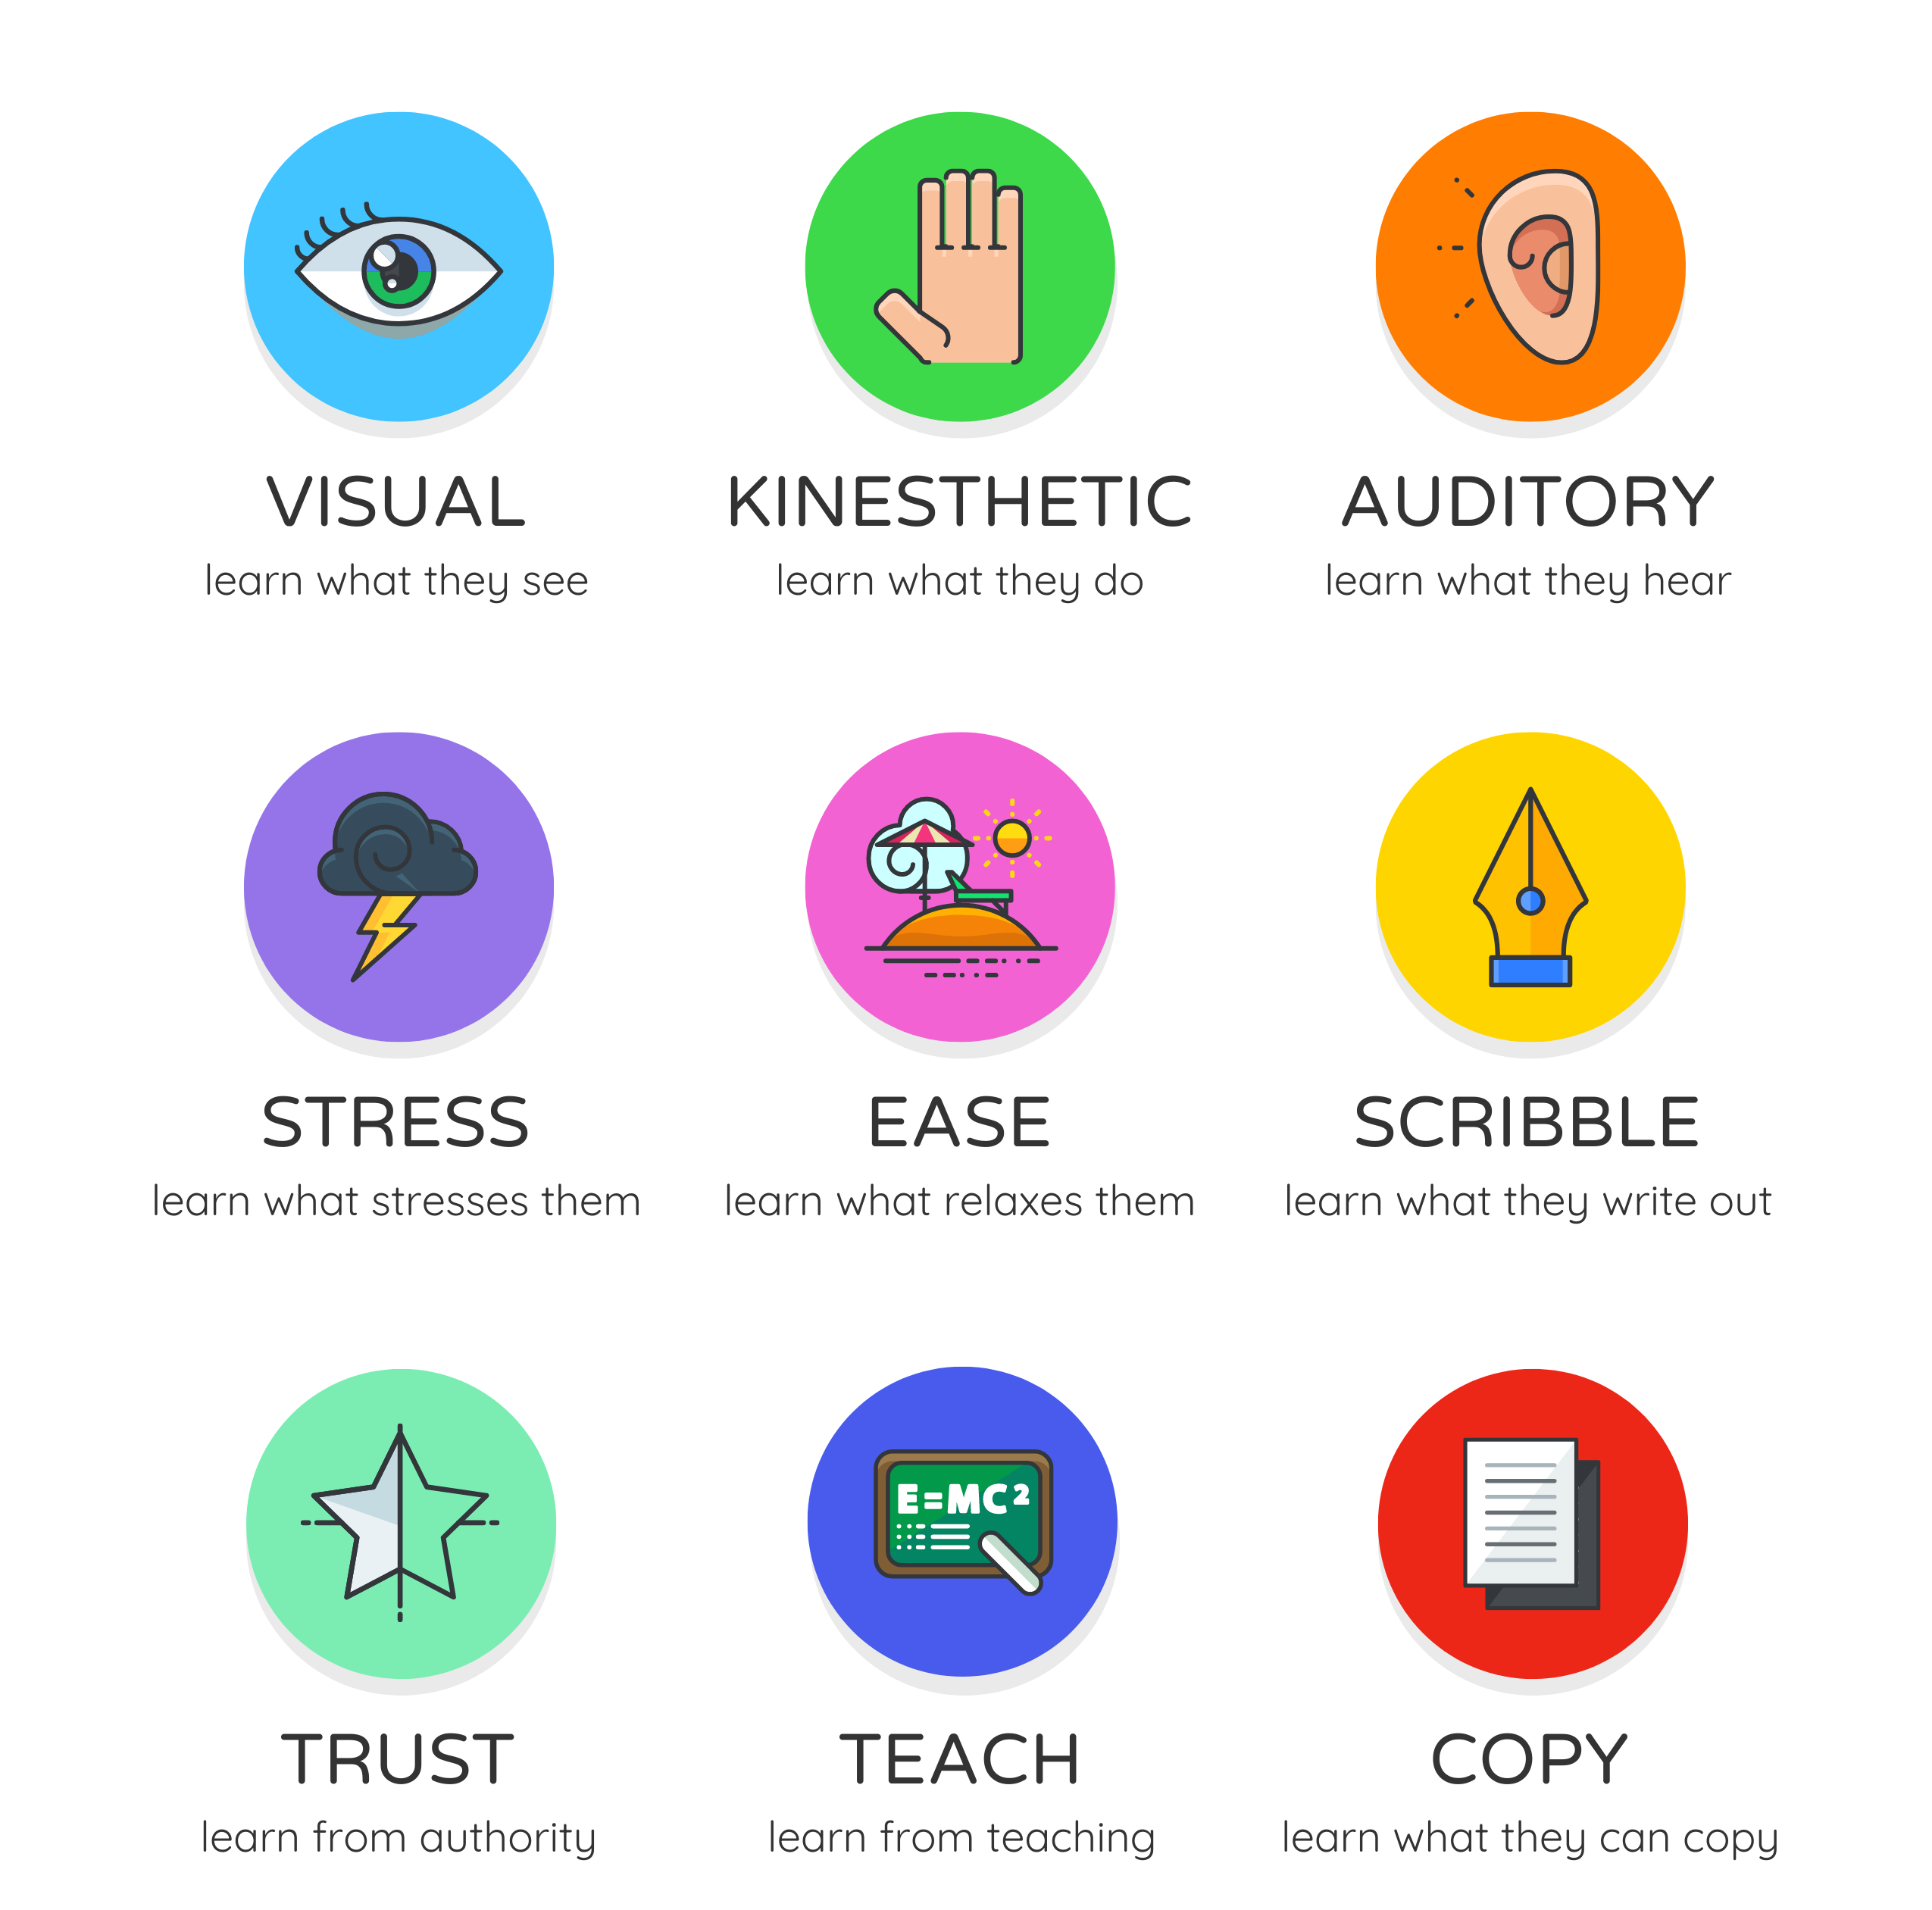
Beyond Readability: Engagement Strategies
Appeal To Different Learning Styles
Notes:
It’s important to convey information to appeal to multiple learning styles; include things not only to read, but to watch, to listen to, or even to interact with.
It’s okay to duplicate the message in text, audio and visual to be inclusive to all learners. Presenting information in multiple ways also reinforces the message through repetition.

Slide 50
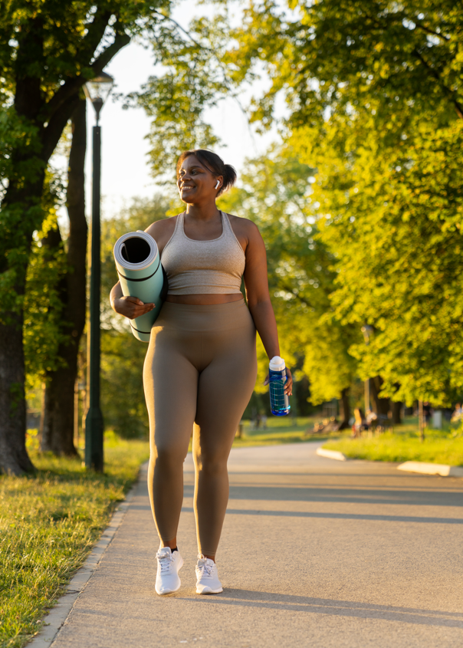


Creating Literacy Friendly Materials: Use Visuals
Choose the Right Images
Images that teach
Images that support your text
Images that are understood by all audiences
Images that are realistic and relatable
Notes:
For example, if you were promoting being physically active, which one of these pictures do you think would be most relatable and realistic to a general audience? Can you think of a situation when other images might be appropriate?
Point out that all of the images show physical activity, but the third one is likely more relatable to most people than the other 2. The first two images show people in extremely good shape, which could be intimidating to someone who is just starting an exercise routine. The third picture shows a walk in the park, a much more ‘doable’ way to start being more active.

Slide 51
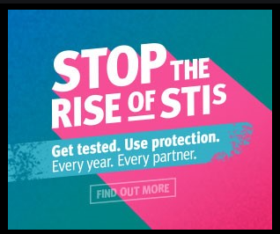
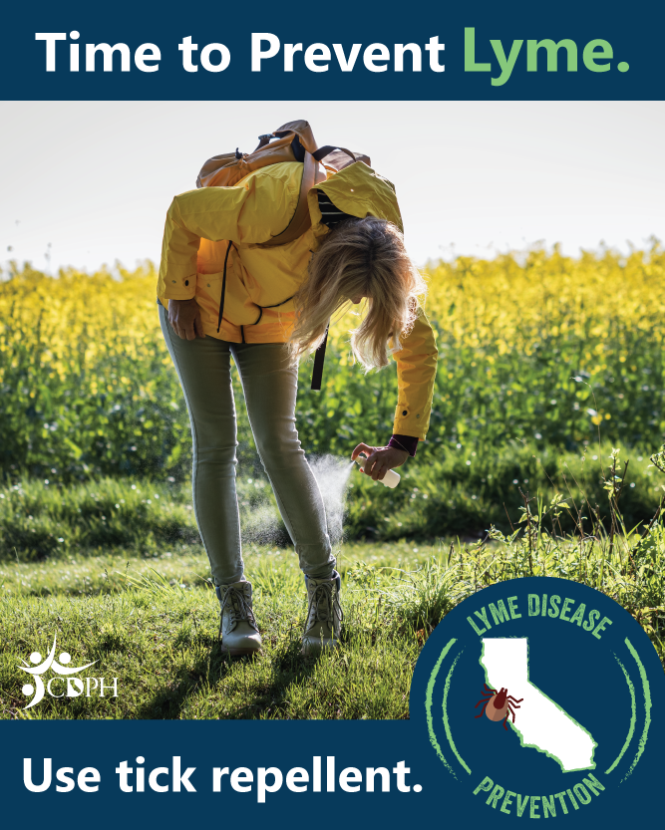


Engagement Strategies
Create Soundbites
Soundbites are catchy phrases that are easy to remember
Notes:
Soundbites are catchy phrases that are easy to remember. Kind of like songs or jingles or songs that get stuck in you head. Give examples of annoying commercials, or songs like “We will rock you” by Queen (scientifically proven to be one of the catchiest songs of all time)
Soundbites often use poetic techniques like contrast, rhyme, repetition, rhythm or metaphors to make them easier to remember. Often they surprise readers to attract attention
YMCA: kids can drown without a sound
Did they work on you???
An apple a day… (keeps the doctor away)
Only you can prevent… (forest fires!)
Cover your… (cough)
Ask not what your country can do for you…. (ask what you can do for your country.”

Slide 52


Engagement Strategies
Organize Information Chronologically or Alphabetically
Chronological order is good to demonstrate timelines or when things follow a fixed order.
Alphabetical lists work well when people are already familiar with the words in the list.
Notes:
We saw sequential information in the handwash ad.
Organizing information by time is useful for finding information in a chronological pattern (like the history of humankind’s most influential inventions) or by the months or years in which events happen. Time is also good for showing how things happen over a fixed duration of time.
Items can also be listed based on priority if things should be done in a certain order.
Organizing information alphabetically works really well when people know specific terms and topics they are looking for. The key is that the reader knows the terms and they have something to look up (like in the index in the back of a textbook or in a dictionary). But if a person wants to learn biology but doesn’t know the names of the parts of a cell, alphabetical won’t work out so well.
Users with limited literacy skills avoid using the search function on websites. Instead, users prefer to browse topics using an alphabetical list (even if the list is long). When they do use the search function, they may have difficulty spelling the search term.

Slide 53


Engagement Strategies
Use Humor and Entertainment
Notes:
It’s appropriate to add humor-create a positive affect for your audience. Everyone likes to laugh, and creating an emotional response makes it more memorable.
Being funny does more than make people laugh. It also makes them begin to think about difficult concepts in a way that feels safe.

Slide 54


Engagement Strategies
Appeal To Emotions
Notes:
These ads appeal to sympathy and protection of others.

Slide 55


Engagement Strategies
Use Images That Stand On Their Own
Notes:
Both of these images convey a clear meaning without words. However, which of these would be more appealing to a general audience? The first image is meant to show the types of food that can lead to unhealthy weight, but could also be interpreted as fat shaming. This could create a negative tone.
The second image clearly aligns health, your heart, and examples of foods that support heart health.

Slide 56


Beyond Readability: Engagement Strategies
Empower Problem-Solving
Notes:
Asking the right questions or providing the right information empowers your priority population to make the right decisions

Slide 57



Engagement Strategies
Meet People Where They Are
COVID-19 vaccines offered at barber shops and salons
Text4Baby: Health messages sent via text during and after pregnancy
Free telephone-based health coaching
Notes:
This can mean meeting people at their education level or physical proximity. Technology also provides creative options to be “there” when you’re not. Promote convenience of information delivery and services.
We see COVID-19 vaccines being offered in barber shops and salons. This is not only convenient, it takes place in a place viewed as safe and with a sense of community.
Text4Baby ensures that a woman can receive timely and helpful guidance for her pregnancy wherever she is.
Another recent example, Sea World hosted a pop-vaccination site. To promote an action we want people to take, we go to a place where they want to be.

Slide 58




Engagement Strategies
What learning styles and
health literacy considerations do you notice?
Swap it, don’t stop it (2 Minute Video)
Healthy Eating (30 Second Video)
Coping Skill: 5, 4, 3, 2, 1 Grounding Technique
(2 Minute Video)
What Should You Do If You Get Flu?
(1 Minute Video)
Notes:
Click on the link to show the video. This is an example of expanding materials past just text to dynamic imagery and sound.
Ask which learning and engagement strategies they see in video? I.E. Plain language, friendly tone, soundbites, different learning styles, humor, chronological information, problem solving…
Swap It
soundbite
Healthy Eating (ad) - YouTube

Slide 59


Practice the Strategies you’ve Learned today
Practice creating a health message for the community with health literacy in mind!
Things to consider:
What is the main message you want to communicate?
What is the action step?
What text will you include?
What imagery you will use?
How will you engage your audience?
Notes:
Practice using the strategies you’ve learned about in this workshop to create a health literate message for the community.
(This is an activity you can do to help you practice the strategies we are learning about.)
You can keep these “tips”/things to consider in mind the next time you are developing materials
Small group workshop activity:
These pictures can use be used to inspire your materials or you can also choose your own.
Send small groups to breakout rooms to put together a social media post with health literacy guidance. Allow 7-10 minutes, time allowing.
Have people share what they developed when back in large group.
Add pictures
Bring people back to share their

Slide 60
Health Literacy: Main Takeaways
Health literacy is an equity issue—Health information is needed, not just nice-to-have.
Health literacy requires accessible and actionable communication
Striving for clear communication requires work on the part of health professionals and patients managing their own care—We must work together!
Low health literacy can affect anyone based on circumstances like fatigue or stress—Treat health literacy principles as universal precautions: every person, every time.
Creating materials to increase health literacy takes practice, don’t be intimidated—You have learned many strategies today that you can begin implementing and refer to.
There is a huge community of people working to improve health literacy: Ask for help if you need it!
Notes:
Everyone has a right to health information
Everyone should receive information they understand
Work tighter, ask questions
Anyone can experience moments of lowered health literacy
After a car accident when someone is still trying to register what just happened
After someone just received a serious or fatal health diagnosis about themselves or a family member
Making materials with lower health literacy in mind is not always easy and may not come naturally but it does get easier with practice

Slide 61

Parting Quote
"We must close the gap between what health professionals know and what the rest of America understands."
—Former U.S. Surgeon General, Richard H. Carmona, M.D.
Notes:
As a public health professional, you are in the business of promoting, protecting, and improving community health and the quality of life through communication, education, disease surveillance, evaluation, and research.
I will leave you with a quote to remind you of the importance that health literacy plays in the work we all do ☺

Slide 62

Thank You!
Jamie.Schroer@sdcounty.ca.gov
Notes:
I hope today was helpful, please feel free to reach out with questions. Any questions or comments now?
I will send a copy of presentation and cubicle checklist for guidance while designing outreach materials.
Health Equity and Climate Change - Health Literacy PPT - All Documents (sharepoint.com)
https://sdcountycagov.sharepoint.com/sites/PHS/healthequity/Shared%20Documents/Forms/AllItems.aspx?id=%2Fsites%2FPHS%2Fhealthequity%2FShared%20Documents%2FTraining%20Champions%2FHealth%20Literacy%20PPT&p=true&ct=1683916220336&or=Teams%2DHL&ga=1

Slide 63
Resources for Ongoing Learning
CDC
https://www.cdc.gov/healthliteracy/pdf/simply_put.pdf
https://www.cdc.gov/healthliteracy/index.html
https://www.cdc.gov/healthliteracy/HealthLiteracyResources/
Health.gov
https://health.gov/healthliteracyonline/display/full/
https://health.gov/our-work/national-health-initiatives/health-literacy
Health Resources and Services Administration
https://www.hrsa.gov/about/organization/bureaus/ohe/health-literacy/index.html
Plain Language Action and Information Network
https://www.plainlanguage.gov/
Hemingway Editor
https://hemingwayapp.com/?via=sign-up-new&gad_source=1
Agency for Healthcare Research and Quality
https://www.ahrq.gov/health-literacy/index.html
TRAIN Learning Network
https://www.train.org/main/search?type=course (Search: “Health Literacy”)
Notes:
I hope today was helpful, please feel free to reach out with questions. Any questions or comments now?
Presentation and cubicle checklist for guidance available

Slide 64
POST-TEST

Slide 65
Post-EST QUESTION 1
“I feel confident in assessing the literacy of internal and external audiences (e.g., reading level; ability to obtain, interpret and use health and other information; social media literacy; numeracy)” (CCPHP Domain 3, 1.4)
Notes:
1. How confident do you feel assessing the literacy of internal and external audiences (e.g., reading level; ability to obtain, interpret, and use health and other information; social media literacy; numeracy) (3.1.4)

Slide 66
Post-test QUESTION 2
“I feel comfortable in developing messaging using health literacy techniques to disseminate public health information and data?” (CCPHP Domain 3, 1.6)
Notes:
2. How comfortable do you feel developing messaging using health literacy techniques to disseminate public health information and data? (3.1.6)

Slide 67
Post-test QUESTION 3
“I feel confident in my understanding of linguistic and culturally proficient communication? (e.g., tailoring messages for different audiences, using age-appropriate materials, incorporating images, using plain language, etc.)” (CCPHP Domain 3, 2.1)
Notes:
3. What is your understanding of linguistic and culturally proficient communication? (e.g., tailoring messages for different audiences, using age-appropriate materials, incorporating images, using plain language, etc.) (3.2.1)

Slide 68
Post-test QUESTION 4
“I feel confident in my ability to communicate information to influence behavior and improve health” (CCPHP Domain 3, 2.6)
Notes:
4. How would you rate your ability to communicate information to influence behavior and improve health? (3.2.6)

Slide 69


Thank you. Any Questions?
We invite you to take a brief post training evaluation survey. You can take the survey by scanning the QR code below or going to this link:
https://www.surveymonkey.com/r/7MZ8G99
Notes:
Anissa

Slide 70
Annex A: CDC Training Evaluation
The pre-test, knowledge check, observation check, and post-test questions were recommended by CDC for training evaluations. For more information, visit Training Effectiveness | Training Development | CDC
The pre-test and post-test were asked based on the Core Competencies for Public Health Professionals. For more information, visit 2021 Core Competencies for Public Health Professionals (phf.org)

Slide 71

Annex B: CDC Post Course Recommendations
Notes:
Training Effectiveness | Training Development | CDC

Slide 72

Annex B: CDC Post Course Recommendations Continued
Notes:
Training Effectiveness | Training Development | CDC

Slide 73

Annex B: CDC Post Course Recommendations Continued
Notes:
Training Effectiveness | Training Development | CDC

