Slide 1

City of San Diego
Planning Commission Hearing
December 6, 2018
County of San Diego
Mt. Etna CPA Request

Slide 2
Affordable Housing Is Important
Regional and local problem
Region lacking more than 170,000 units
Shortfall of 88,000 in San Diego
  54,000 of those are units for very low to moderate income
Notes:
DAVID
Good morning, everyone. My name is David Estrella. I’m the director of Housing and Community Development Services for the County of San Diego Health and Human Services Agency.
We live in a region of over three million people where housing affordability and availability is an ever increasing problem. It is likely that most everyone here today, either knows someone who has or perhaps you your self have, experienced challenges in maintaining safe, decent, affordable housing.
According to the 2018 Regional Housing Needs Allocation or RHNA, our County is lacking more than 170K housing units region wide. The City of San Diego alone accounts for over 88k of the needed units of which 54, 000 represent the affordable housing need for very low to moderate income households. These are units that house our veterans, teachers, seniors, people who have experienced trauma in their lives, nurses, families, in other words, people just like you and me.
In order to address this housing crisis, the County Board of Supervisors, has taken several steps over the last few years, most recently they have directed staff to identify excess county land that can be used for affordable housing. Originally, eleven sites were identified as potential sites for affordable housing development. This is one site, of several throughout the county that have been identified to provide affordable housing. And that is what brings us here today.
Regional Housing needs:
Region- 170K
Unincorporated-22K
City of San Diego-88K

Slide 3
Affordable Housing Is Important
Fulfills basic human needs
Contributes to well being of individuals and families
Reduces stress, toxins and infectious diseases
Frees up funds for healthcare and food
Improves economic vitality of community
Notes:
DAVID - Why is this important?
The County of San Diego’s vision is for A Region that is Building Better Health, Living Safely and Thriving, however, the vision can’t be achieved without housing. Decent, affordable housing is important to individuals and families. It fulfills a basic human need for shelter, but it also contributes to the well-being of individuals and both parents and children. Studies show that children in stable housing do better in school and are less likely to experience disruption in their education due to unwanted moves. Decent, affordable housing reduces stress, toxins, and infectious disease, which leads to improvement in both physical and mental health. Affordable housing also frees up funds within families’ tight budgets to spend on health care and food. Studies have shown that children whose parents receive housing assistance benefit from better nutrition. For parents, living in decent, affordable housing also means reduced stress due to a lessening of concerns that high housing costs will lead to foreclosure and eviction; this in turn leads to fewer physical and mental health problems and reduced absenteeism on the job.
Affordable housing also is important to the economic vitality of communities it can attract and retain employees to the community- a selling point and a competitive advantage for area employers. Affordable homes also support the local workforce so they can live close to their jobs. In revitalizing communities, the construction of affordable housing can help to stimulate economic growth. A healthy mix of housing options, from market- rate and affordable rental housing, single- family homes, duplexes, as well as developments for seniors, ensures opportunities for all individuals to improve their economic situation and contribute to their communities.
Addresses housing affordability so that no neighborhoods are out of reach for our growing population Affordable Housing has a positive impact on individuals and the community. Access to affordable homes improves education outcomes by increasing housing stability for low-income families. It increases health and wellbeing by freeing resources to pay for health expenses and healthy food. It boosts economic activity by generating jobs, taxes, and economic income.
Hip pocket__________________________________________________________________
Common Myths
Property value-There is no conclusive evidence that supportive or affordable housing negatively impact property values. A recent report by the University of North Carolina examined several quantitative studies that revealed that low income housing does not have a negative effect on nearby property values
Crime-There is no conclusive evidence that supportive or affordable housing increases neighborhood crime. A study in the journal-Urban Studies, looks at crime dating back to 1997 and looks at 215 cities and found virtually no relationship between subsidized housing and higher crime rates at the city level or suburbs.

Slide 4

Request CPA Initiation
Change from Commercial to Residential High
  45-73 du/acre
  184 to 448 units with density bonus
Remove Community Core commercial design standards in CPIOZ-B
Add CPIOZ-A design standards
Notes:
DAVID
In light of our goals for affordable housing and the availability of the Mt. Etna site, we are here asking that the Planning Commission allow us to Initiate an amendment to the community plan. With the approval of the initiation, the County will begin the CPA process and prepare an Environmental Impact Report or EIR.
This is the first formal step, and once approved these are the questions that will be answered:
traffic and parking concerns,
availability of services,
safety and
infrastructure improvements.
At this time, I’d like to introduce Yara Fisher Principal Planner with AECOM.
HAND OFF TO YARA
Thank you David. Hello Chair and Commissioners – Today the County is asking if we can start the process of amending the Clairemont Community Plan to allow for Residential High at the Mt. Etna site. This would allow a range of from 184 units to a maximum of 448 units with density bonus on the site
This would also remove the commercial requirements associated with the CPIOZ B
As a result of hearing concerns about compatibility and design, the CPA would also include CPIOZ A design standards to address compatibility, access, and other local improvements
Associated actions that will be analyzed in an EIR include: zone change to RM-3-9 and site demolition.
All of these activities are intended to make affordable housing feasible at this site.

Slide 5
Initiation Criteria
LU-D.10 a) appears consistent with the goals and policies of the General Plan and community plan and any community plan specific amendment criteria
LU-D.10 b) provides additional public benefit to the community as compared to the existing land use designation, density/intensity range, plan policy, or site design
LU-D.10 c) public facilities appear to be available to serve the proposed increase in density/intensity, or their provision will be addressed as a component of the amendment process.
Notes:
The County understands that there are a few items that must be addressed to Initiate a CPA – Consistency with Plans – including the General Plan and Community Plan, Public Benefits of the project, and Availability of Public Facilities. Because Marlon already summarized these, I will walk through each of these fairly quickly.

Slide 6
Affordable Housing Benefits
Consistent with goals
  City of Villages Strategy
  Urban village centers
  Infill and higher density development near commercial and major transportation corridors
  Variety of housing types and affordability levels
Notes:
First we must look at consistency with the General Plan and Community Plan. The General Plan has been in place since 2008 and envisions a City of Villages strategy with urban village centers, infill, and mixed uses near transit. Several goals within the General Plan and Community Plan also encourage a variety of housing types and affordability levels to be provided. The project’s location in the Community Core, within a Transit Priority Area, and the proposal for Residential High density is consistent with all of these objectives.

Slide 7
Affordable Housing Benefits
Provides public benefit
  Additional opportunities for affordable homes near transit, shopping, and employment
  Community services and gathering spaces for seniors open to the public
  Enhanced streetscapes and improvements
  Meet broader City housing and Climate Action Plan goals
Notes:
Criterion LUD 10b asks what public benefits the CPA will bring. The CPA will provide for multiple public benefits.
In light of the severe housing affordability crisis, the CPA removes barriers to providing affordable homes and provides additional rental opportunities near transit, shopping, and employment.
People that may benefit from this include: middle income families, people who are developmentally disabled (autism, Down Syndrome cerebral palsy, and epilepsy), and seniors
Future affordable housing may also include community services and gathering spaces for seniors and the public
If approved the County will work with the community and City staff to identify enhanced streetscapes and improvements around the site.
Finally, the CPA would help the City meet it’s broader affordable housing and climate action plan goals.

Slide 8
Affordable Housing Benefits
Availability of public facilities
  Site developed with a variety of uses since 1961 and is served by public facilities
  EIR will address all public facilities
Notes:
The third criterion is whether public facilities are available or will be addressed as part of the project.
The site has been developed with a variety of uses since 1961 and is served by public facilities. The EIR will analyze the proposal’s impact on all services and facilities and the developer would be required to provide fees and upgraded facilities consistent with City standards.

Slide 9

Process & Community Plan Amendment
2018
2019
2020 - 2023
County RFP & Proposal Review &
CPA Application
Developer begins Community Outreach
County Ground Lease w/ Developer
5 Public Meetings (Scoping, Ad-Hoc, CPG)
Technical Studies and 45-Day Review of Draft EIR
Begin Construction – January 2021
Planning Commission Initiation Hearing
CPG & PC Decisions -
City Council Approval
Project Completion – January 2023
Notes:
With your agreement that the Project meets the Initiation Criteria – we will continue the multi-year CPA and EIR process. The process began in earnest with the City when we submitted the Initiation Application in August. Since that time, we have held five meetings with the community. From these meetings we have heard concerns regarding density, land use compatibility, traffic, parking and availability of public facilities. We have collected these comments and if we are allowed to move forward, the comments will be used to help inform the CPA and the associated EIR.
As the County begins work on the CPA and EIR in 2019, technical studies will commence and community outreach will increase. During this time, we will work with the City and the community to develop the content of both the CPA and the EIR.
The CPA and EIR are targeted for release next Summer - with the City Council and County considering the documents in the Fall. Developer application and construction activities are expected to occur in 2020 through 2023.

Slide 10
Addressing Community Concerns
Traffic and Circulation
Parking
Density, Compatibility, and Height
Infrastructure, Public Services and Facilities (e.g. schools, law enforcement, fire, water, etc.)
Public Input
Notes:
In the process we just outlined, we will be able to address the community concerns voiced at the scoping meetings and in emails, phone calls, and letters.
As we said this is just the start of the process, if we move forward, community concerns will be heard in additional outreach meetings and they will be addressed in the CPA and EIR.
By approving this initiation request, you will provide us with the opportunity to study and respond to the concerns we have heard…. and that you will likely hear today.

Slide 11
City of San Diego
Planning Commission Hearing
December 6, 2018
County of San Diego

Slide 12
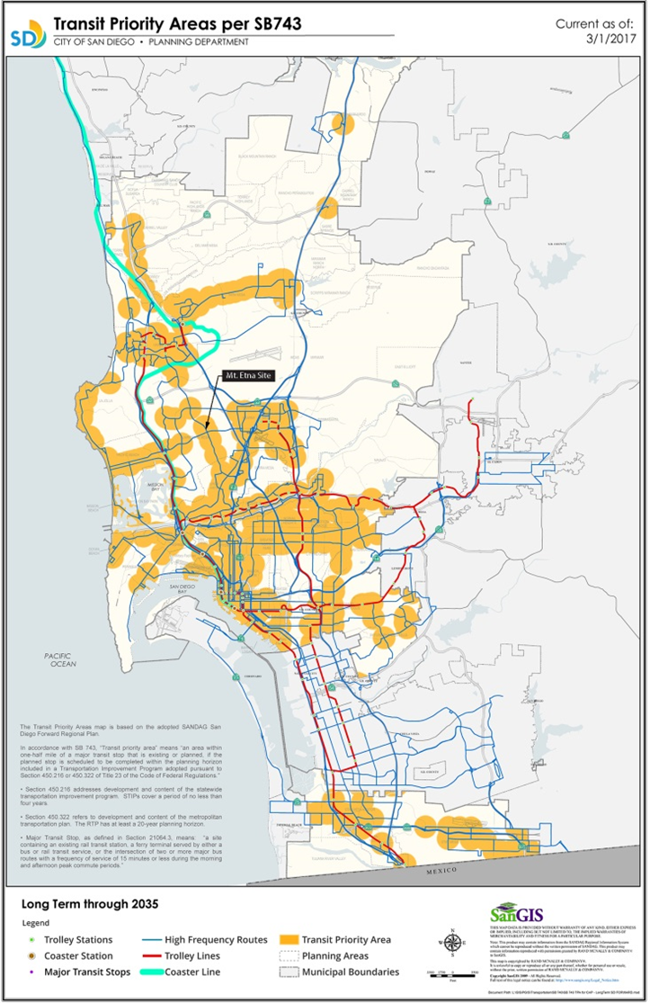
TPA
Notes:
Existing and planned major transit stop - Existing bus route and a planned light rail route 563 on Balboa planned by 2035

Slide 13
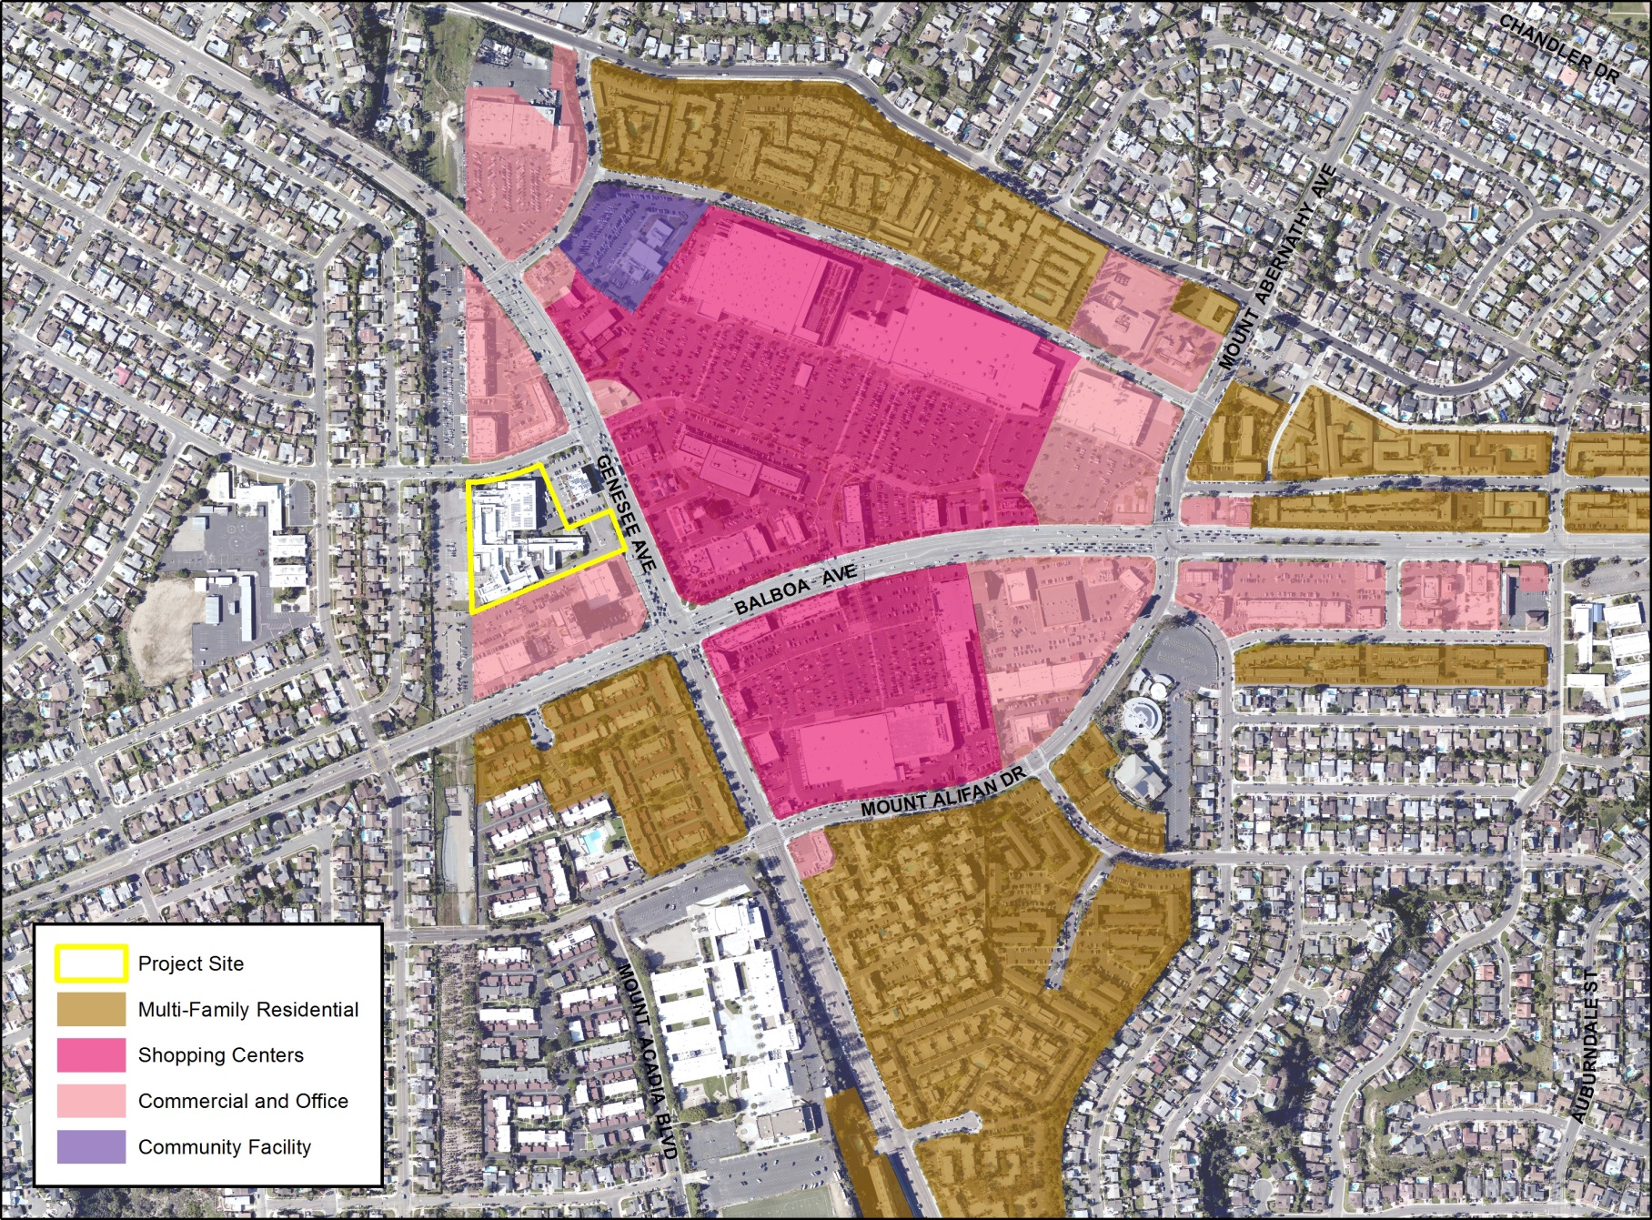
Multifamily Buffer Strategy
Notes:
This image shows the multifamily buffer strategy around the Community Core. Here you see single family residential on the periphery with the community core in pink. Around the community core is existing multifamily residential providing a buffer between the commercial and single family residential uses. The project would continue this strategy.

Slide 14
Residential Objectives
Residential Objectives 1, 3, 4, and 5
  1 - Diversity of housing options - Provides for Residential High and affordable homes
  3 - Development guidelines - CPIOZ A design standards for streetscape and compatibility
  4 - Higher density near commercial and transportation corridors - In Commercial Core, TPA, proximity to Genesee and Balboa
  5 - Adequate off-street parking - Low income, people who are developmentally disabled and seniors use fewer cars; on-site parking garage provided
Notes:
The Community Plan also includes several Residential Objectives. Specifically….
The CPA at this location would contribute to Objective 1 to provide a diversity of housing options
It would also provide higher density homes near commercial and transportation corridors
Adequate parking would be provided on-site as lower income, developmentally disabled, and seniors drive less and parking would be provided on-site
ONLY IF QUESTIONED
The CPA would also include objective design standards through a new CPIOZ-Type A to ensure compatibility and the EIR would analyze public facilities consistent with LUD-10c.
nsit. Any future project would also be required to meet the City’s parking requirements.
Further, the site developer would be required to pay any applicable fees and provide facilities adequate to meet the City’s existing public services requirements.

Slide 15
Commercial Objectives
Commercial Goals and Objectives
  Goal – well designed and appropriately located commercial
  1 – Unique theme, pedestrian, and bicycle amenities
  2 – Adequate commercial facilities for residents
  5 - Maintain commercial uses in neighborhood centers
    Community Core and CO-1-2 zone allow for affordable housing and multifamily development with an NDP
    Site has not been used for commercial development in past
    No transition of existing commercial uses
    Increased customer base for commercial Community Core uses
Notes:
The Commercial goals of the Community Plan seek to provide well designed and adequate commercial uses for its residents.
The Community Core and existing zoning allow for affordable housing and multifamily development.
The site has not been used in the past for commercial development so no loss of existing commercial will occur
And additional residents will provide an increased customer base for the commercial uses

Slide 16
Other goals
Transportation, Open Space, Parks and Recreation, and Community Facilities Goals and Objectives
  Efficient use of land to ensure adequate transportation, services, and facilities
    Infill development located in a TPA
    CPIOZ-A design objectives to address streetscape and pedestrian environment
    Environmental Impact Report (EIR) addresses parks, recreation, and other community facilities consistent with LUD-10c
    All improvements and fees the responsibility of future development
Notes:
Finally, the Community Plan includes relevant goals and objectives related to Transportation, Open Space, Parks and Recreation, and Community Facilities. These goals and objectives focus mostly on the efficient use of land to ensure adequate transportation, services, and facilities are provided with development that is compatible with the community.
The project does this by providing infill development and addressing all services and facilities within a concurrent EIR.

